Slide 1
California Alternative Pathway to a Diploma
Presented to RCOC Service Coordinators by:
Tina Carpenter, Program Specialist / WAI Coordinator
Janis White, Educational Training and Outreach Consultant, TPI, Chapman University
May 2024

Slide 2
What is the California Alternative Pathway to a Diploma?
Effective June 2022, Students with exceptional needs can graduate from high school through a newly defined diploma pathway by meeting criteria as stated in Education Code 51255.31. There have been several amendments since this bill was first passed.
Assembly Bill 181, the 2021-2-22 Education Omnibus Budget Trailer Bill California EC Section 51225.31 Effective June 30, 2022
Amended by SB114 on 7/10/2023
Amended by SB 141 on 9/13/2023
CDE Updated letter 8/25/2023 https://www.cde.ca.gov/sp/se/lr/om082523.asp
Guidance Update: 3/29/2024 https://www.cde.ca.gov/sp/se/lr/om082523.asp
Notes:
Traditional Pathway focused on functional and life skills. Now students will explore more indepth subject matters and fun and exciting new ways. Students with exceptional needs attending a school district, county office of education, charter school, or state special school

Slide 3
Comparison of California Diploma Options
Diploma | Who is Eligible? | Terminates FAPE? | Coursework Requirements | Testing Requirements
Traditional Diploma (A-G) (College Prep) | Students with or without a disability | Yes | Local District A-G Requirements | Eligible to participate in statewide and district assessments
Alternative Pathway to a Diploma | Students with a disability eligible for the California Alternate Assessment | No, students are still eligible for FAPE services until age 22. | Students complete required course credits aligned with California Alternate Standards. | Eligible to participate in the California Alternative Assessment
Certificate of Completion | Students with a disability unable to earn a Standard or Alternative Diploma | No, students are still eligible for FAPE services until age 22. | IEP Goals | Eligible to participate in statewide assessments as indicated in the IEP.

Slide 4
What does California Law vs. Local School Districts Require?
A-G Diploma “College Prep “
220 units of credit
English- 40 credits
Math – 30 credits (including 1 year of Algebra 1)
Social Studies 30 credits (including U.S. History and geography, world history, U.S. gov’t and 1 semester courses in economics and American govt. and civics)
Science - 20 credits (including biology and physical science)
Visual and Performing - Art/Lang/Career Tech 20 credits
PE - 20 credits
60 credits: Other coursework adopted by the local school district
State Diploma Requirements
130 units of credit
English - 30 credits
Math - 20 credits
Social Studies -30 credits
Science - 20 credits
Art/Lang/Career Tech - 10 credits
PE - 20 credits
Electives - 0 credits

Slide 5
Who is Eligible?
Must be a 9th grader by 2022 school year and later.
Must be a student with exceptional needs with a current IEP.
AB 51225.31 Updated August 2023
Eligible to take the California Alternate Assessment (CAA)
Complete state standards aligned courses to meet statewide coursework requirements
Notes:
Currently have 9th and 10th graders who are eligible for this pathway. First graduates 2026.

Slide 6
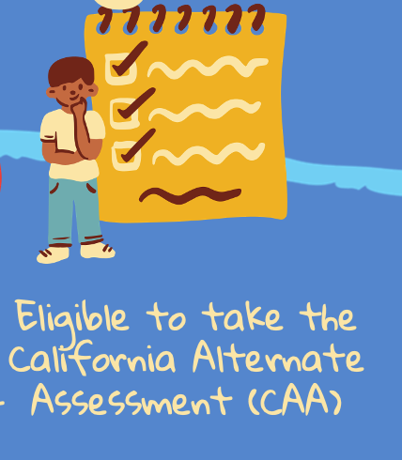

Slide 7
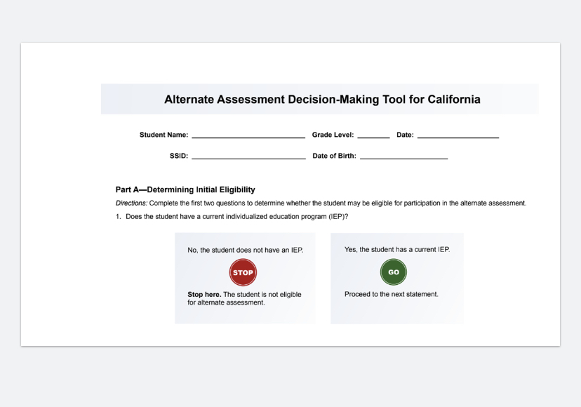
How do you decide if a student is eligible to take the Calif. Alternative Assessment? Use of the Alternate Assessment Decision-Making Tool
https://www.cde.ca.gov/ta/tg/ca/documents/altassessmentdecision.pdf

Slide 8
Does the student have to take the State Alternate Assessments or only be eligible?
Chapter 2, Required Courses of Study, of SB 141 amended Education Code Section 51225.31 to read, with emphasis added in bold:
1) The pupil’s individualized education program team has deemed the pupil eligible to take the state alternate assessments, as described in subdivision (k) of Section 60640.
The student is eligible to take the CAA in grade 11.

Slide 9
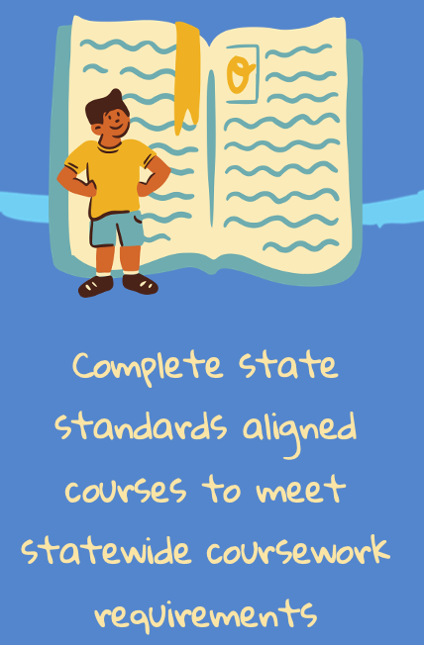
This is the most difficult part of the requirements

Slide 10
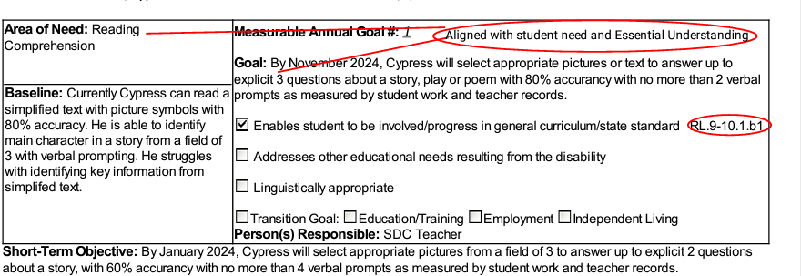
IEP Goals - The pupil is required to complete state standards-aligned coursework to meet the statewide coursework requirements specified in Section 51225.3.
IEP goals is a good way to align with state standards. (Essential Understandings.)
Notes:
Its about checks and balances.

Slide 11
State standards-aligned coursework
Imagine you are climbing a ladder and each step represents your progress from one grade to the next
Common Core State Standards (CCSS)- The entire ladder
Core Content Connectors (CCCs) – special handles/supports attached to the ladder helping students who need extra assistance, making it easier to climb
Essential Understandings – main steps you cannot skip if you want to climb the ladder successfully
Standards–based IEP goals – Personal targets specific for each person.

Slide 12
Notes:
Not new for special education teachers

Slide 13
Example of State Standards Aligned Course Requirements for Algebra
Notes:
The student has to meet the common core state standards (CCSS).
BUT there are Common Core Connectors which take the CCSS and add ‘connectors’ that connect the standards to understandable goals.
The next step in meeting the standards is to add the Essential Understandings of the goal, such as creating 3 rows of 3 with the use of a manipulative if necessary.
The next one is to fill in boxes on a graph. Such as how many red cars are there? How many blue cars?

Slide 14
Graduation
(c) An individual with exceptional needs who meets the criteria for the alternative diploma pathway pursuant to this section shall be eligible to participate in any graduation ceremony and any school activity related to graduation with their grade-level peers with and without disabilities.
Participation in graduation activities shall not be construed as termination of the provision of free appropriate public education, consistent with Section 300.102(a)(3)(ii) of Title 34 of the Code of Federal Regulations, unless the individualized education program team has determined the pupil has completed their high school experience. The student can continue their pursuit of a diploma into the transition program.

Slide 15
Implications for School Districts
Courses / Schedules aligned with 51225.3
Coursework Aligned with CSCC
4 Year Plan
4 year plan
Course Descriptions
Essential Understandings
Special Thank You to Anaheim Union High School District for their Leadership in the implementation of this new alternative.
Notes:
Each district will have their own course of study and schedules.

Slide 16
What to expect on an IEP?
Document in notes:
- Student Disability
- CAA eligibility
- Student’s completing coursework aligned with CSCC
Individual Transition Plan
Indicate student will be receiving a DIPLOMA
Goals
Indicate CSCC standard (Essential Understanding)
Accommodations/ Modifications
-Curriculum is modified to meet state CSCC Essential Understandings acceptable by EC 51225.3
-Document grading expectations and requirements for both general education and special education courses.
- Document Additional Support / Services for successful participation in gen ed core courses.

Slide 17
Page 2 of
Individual Transition Plan

Slide 18
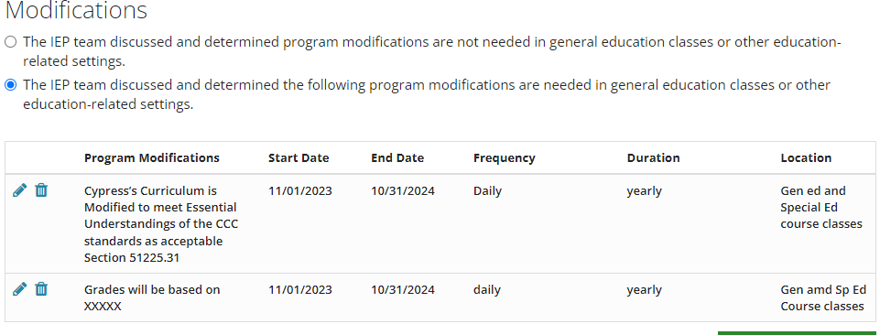
Accommodations / Modifications
The IEP team should document student’s Curriculum is Modified to meet Essential Understandings of the CCC standards are acceptable Section 51225.31
The IEP team should document grading expectations and requirements for both general education and special education courses.

Slide 19
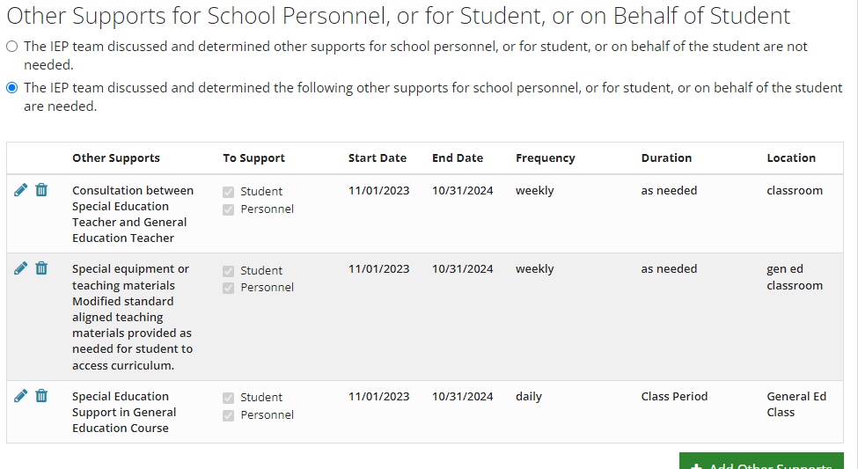
Other Supports for School Personnel or for Student
Document Additional Support / Services for successful participation in gen ed core courses.
Notes:
More opportunities are available now for students, when appropriate to participate in elective courses. This is a good time to talk about reasonable supports needed for your child to be successful.

Slide 20
School Districts Guide to Implementation
Developing A Board Approved Diploma Pathway
Developing and Implementing the Course of Study
Communication to Eligible Students and Families
The IEP
In the IEP meeting, general education teacher and educational specialist partner to describe the proposed student courses, structure, and benefit to the student and family. Define and converse with the IEP team about course by course accommodations and modifications.
Clearly define support on the IEP
Gain agreement on support from all IEP team members
The IEP team may investigate the need for an Algebra 1 waiver from CDE
Post-Secondary placement, options and planning are discussed
Notes:
The IEP team is pivotal in identifying courses to be taken and essential understandings that can be used to meet the course requirements.

Slide 21
Can the classes be part of the functional curriculum of a moderate/severe class?
No. The classes are aligned with the regular education academic curriculum and the students in this academic class have all been determined by their IEP team to be eligible for this alternative pathway to a diploma.

Slide 22
Do School Districts have to do this?
Yes. We now have a diploma option for students who have never had this opportunity before. A diploma will open up more job opportunities allowing a student to check a box when applying for a job on-line and have the chance to finish the application toward a job.

Slide 23
Resources on CDE website useful for implementation of diploma pathway:
California Alternative Assessment
Content Connectors
Guidance for IEP teams
https://www.cde.ca.gov/ta/tg/ca/altassessment.asp.

Slide 24
Questions?

Slide 25
Thank you!
Carpenter_T@AUHSD.US
drjbwhite01@gmail.com

