Slide 1
Welcome
THOMPSON AUTISM AND NEURODEVELOPMENTAL CONFERENCE
Balancing Acts: Co-Occurring Conditions in Autism
2024
Notes:
Welcome slide –
Text: Welcome / Thompson Autism and Neurodevelopmental Center Conference / Working Together to Expand Horizons / 2023
Logos: TANC, Glennwood, TPI

Slide 2
Co-Occurring Disorders in Autism
By: J. Thomas Megerian, M.D., Ph.D.
Thompson Autism and Neurodevelopmental Center @ CHOC
03.20.23

Slide 3
Disclosures: Consultant for Kuzani Pharmaceuticals Chief medical Officer, Yamo Pharmaceuticals Consultant for Cognoa Reviewer for FDA’s Pediatric Medical Device Consortium Grant

Slide 4
Objectives
Understand the unmet needs of children, adolescents and young adults with ASD under current care models
Identify the benefits to collaborative models of care for this population
Understand the successes and challenges to delivering this model of care.

Slide 5
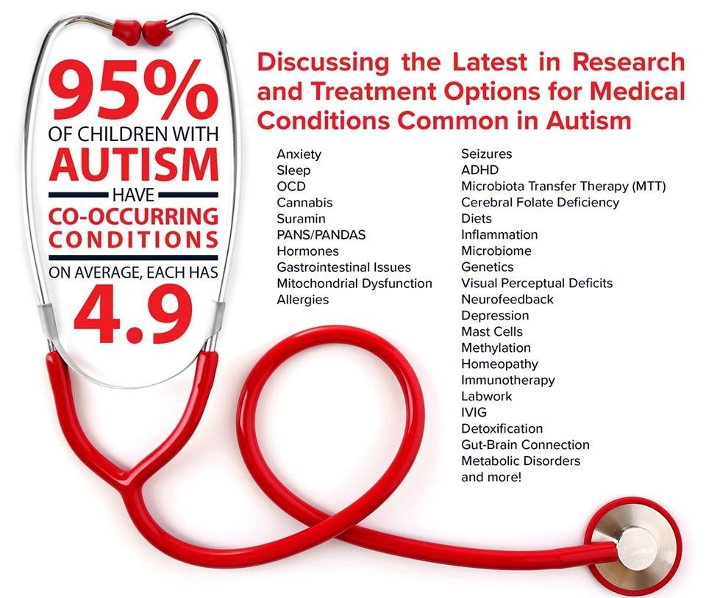
Co-Occurring Disorders in ASD
Anxiety
ADHD
Sleep difficulties
OCD
Seizures
GI disorders
Allergies
Diets- ketogenic, gluten free diet
Genetics- gene therapy
Neurofeedback
Gut-brain connection
Cerebral Folate Deficiency
Immunotherapy
Stem cell therapy
Notes:
Tom

Slide 6
Case Study: Juan
Juan is a 14 year old male with ASD (level 1), presents with symptoms of inattention and hyperactivity, obesity, depression with some hypomania, and epilepsy treated with levetiracetam. He also has begun have headaches over the last 6 months associated with photophobia, nausea and vomiting.
In addition to vomiting, he has history of intermittent diarrhea and abdominal pain. He likes to drink chocolate milk frequently, and eats cheese pizza everyday for lunch.
Has IEP, in mainstream classroom with pull-out services, expresses sadness over not having friends. Mother not sure that is IEP is sufficient.
Co-occurring appt is with psychology, psychiatry, Neurology and GI.

Slide 7
Overview of Co-Occurring Disorders in ASD
Autism Spectrum Disorder (ASD) IS NOT A SINGLE DISORDER
“ASD is a common syndrome that comprises, at least in part, several hundred rare disorders.” – Dan Geschwind and Matthew State
Analogy: Cancer, Anemia, Dementia
A description of symptoms that result from a multitude of different disorders
Over 100 genes have been implicated as a risk factors for ASD
Eg; Shank3 (Phelan-McDermid Syndrome), FMR1 expansion mutation (Fragile X), 21 Duplication (Down’s Syndrome), MECP2 (Rett Syndrome), NGLN3, etc).
Genetic Overlap:
ASD related genes also raise the risk for non-ASD neurological, neurodevelopmental or psychiatric disorders by virtue of shared genetics underpinnings.
Geschwind & State, www.thelancet.com/neurology Vol 14 November 2015
Notes:
Autism Spectrum Disorder (ASD) IS NOT A SINGLE DISORDER
“ASD is a common syndrome that comprises, at least in part, several hundred rare disorders.” – Dan Geschwind and Matthew State
Analogy: Cancer, Anemia, Dementia
A description of symptoms that result from a multitude of different disorders
Over 100 genes have been implicated as a risk factors for ASD
Eg; Shank3 (Phelan-McDermid Syndrome), FMR1 expansion mutation (Fragile X), 21 Duplication (Down’s Syndrome), MECP2 (Rett Syndrome), NGLN3, etc.).
It is important to understand that many of the genes responsible for increasing a person’s risk of ASD, also put them at risk for other medical, developmental and psychiatric disorders. This means that sometimes the same gene that causes ASD in one person, may cause a different disorder in another person, depending on environmental factors and protective genetic factors.
Genetic Overlap:
ASD related genes also raise the risk for non-ASD neurological, neurodevelopmental or psychiatric disorders by virtue of shared genetics underpinnings.

Slide 8
Co-Occurring Disorders: Learnings from Twin Studies
In a twin study in Sweden, Lundstrom et al. found that half of the 272 ASD patients studied had 4 or more coexisting disorders.
ADHD = 79%, LD = 75%, TD = 36.1%, ODD = 36.1%, OCD = 23.8%, Composite = 74.6% [Composite (DCD, ED, visual-spatial)]
Only 4% did not have a comorbid disorder.
Overall prevalence of psychiatric and behavioral disorders are higher than in the general population.
Supports common genetic component for many disorders.
Early studies showed mono-zygotic (identical) twins that were discordant for ASD, still shared cognitive, coordination and language delays and/or hyperactivity.
Conversely, in dizygotic twins, only 1 in 10 shared delayed motor milestone and a learning disability.
Lundstrom, et al, 2015. Journal of Child Psychology and Psychiatry, 56(6), 702–710
Notes:
This indicates that the genetic cause of autism is often involved in causing other disorders, since identical twins have a much higher rate of these other disorders even when they do not share the ASD diagnosis.

Slide 9
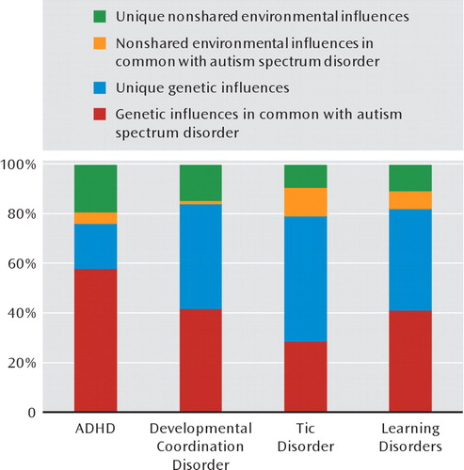
Co-Occurring Disorders in ASD
Studies Comparing Identical to Fraternal Twins Show Common Genetic Overlap With ASD And:
Shared genetic variance for ASDs with Co-Occurring Disorders
Attention deﬁcit hyperactivity disorder (ADHD)
Eg; Probability of having a co-occurring diagnosis of ASD and ADHD was 44% in identical twins, compared to 15% for dizygotic co-twins
Developmental coordination disorder
Tic disorder
Learning Disabilities
Lichtenstein, et a (2010). American Journal of Psychiatry, 167, 1357–1363.
Notes:
Based on twin studies, you can see that genetic overlap with ASD and ASD is nearly 60%, and is 40% for Learning Disabilities and DCD, nearly 30% of Tic disorders

Slide 10
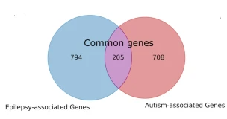
Why So Many Co-occurring Disorders!
Phenotype of Autism Relies Heavily on anatomy of risk gene expression.
Many Genes that increase risk for ASD are involved in the pathogenesis of other disorders:
The interplay of the nature of the genetic insult on neuronal development, along with the location of expression accounts for the wide range of differences between ASD symptoms and syndromes
Intellectual disability,
Epilepsy
ADHD
Language delays
Neuropsychiatric disorders.
Examples:
MET mutations = ASD + GI symptoms
FOXP2 mutations = ASD + Speech and Language Disorders
Manoli & State, Am J Psychiatry 178:1, January 2021; Nisar S, Hashem S, Bhat AA, et al. Association of genes with phenotype in autism spectrum disorder. Aging (Albany NY). 2019;11(22):10742-10770. doi:10.18632/aging.102473
Peng, J., Zhou, Y. & Wang, K. Multiplex gene and phenotype network to characterize shared genetic pathways of epilepsy and autism. Sci Rep 11, 952 (2021). https://doi.org/10.1038/s41598-020-78654-y
Notes:
Phenotype of Autism Relies Heavily on anatomy of risk gene expression.
Many Genes that increase risk for ASD are involved in the pathogenesis of other disorders:

Slide 11
Examples of Co-Occurring Disorders
Intellectual disability (ID)
25 -70% in ASD
Conversely, ASD Prevalence in ID is 6x more likely with increasing severity of ID.
Impairments (verbal, social, behavioral) are greater, with less favorable prognosis
Gastrointestinal (GI)
Constipation, Diarrhea, Abd Pain, Vomiting, GERD, Food Intolerance
9 – 91%
More likely in those with regression presentation (84% vs 61%)
GI disorders in turn lead to Increased rates of co-occurring anxiety, irritability, aggression, agitation.

Slide 12
Gastrointestinal Problems Have Complex Relationship With Other Disorders
B
Poor Sleep
Increasing Anxiety
C
GI Symptoms
Anxiety
Increasing GI Symptoms
Increasing Irritability
A
D
Ofei and Fuchs, in Handbook of Interdisciplinary Treatments of ASD, Rieske ed. 2019.
Notes:
GI symptoms and Anxiety and have a reciprocal relationship. And in turn, together they have networked relationship with sleep and irritability, making co-occurrence of these symptoms highly prevalent and difficult to untangle.

Slide 13
Examples of Co-Occurring Disorders: Sleep
Sleep Disorders in ASD
53- 80%
Insomnia (Difficulty falling asleep)
Night Waking (Staying Asleep)
Sleep Apnea
Genetic Syndrome
Psychological & Medical Dx ***
Melatonin**
Sleep
Sensory Difficulties
IQ
Social Factors*
*Parental approaches, Environmental, Routine
**Sensitivity to and Production of
***Sleep Apnea, GI symptoms, Epilepsy Anxiety.
Notes:
Sleep disorders occur with very high frequency in ASD and other NDDs. It is especially affected by Factors listed.

Slide 14
Neuropsychiatric and Behavioral Diagnosis- Systematic Review 2020
Diagnosis | Point Prevalence Estimate | Range | Key Points
ADHD | 28% | 30-80% | Conversely, ASD present in 20-50% of Children with ADHD.
Depression | 11% | 1.1 – 52% | Increased SIBs are significantly correlated with depression.
Anxiety | Children = 39.6% Adolescents = 34.8% | 13.6-84.1% | Increased Anxiety may be associated with Higher IQ and Lower ASD severity. Social Anxiety Most prevalent subtype (29.2%)
Bipolar and Mood disorders | 18.8% Bipolar 5% | 4.4-37% | May be associated with higher functioning and insight. May also cause regression in lower functioning pts (Loss of language, social withdrawal, etc.)
Hossain, et al, Psychiatry Research 287 (2020) 112922
Shaltout, et al, in; Advances in Neurobiology 24, 2020.
Strang, in in Comorbid conditions among children with ASD, Matson,ed Springer, 2016

Slide 15
Neuropsychiatric and Behavioral Diagnosis- Systematic Review 2020
Diagnosis | Point Prevalence Estimate | Range | Key Points
Sleep | Pooled Prevalence: 13% (Vs 3.7 % in gen pop) 50 – 80% vs 9 – 25% in Gen Pop | Up to 67% | Total Sleep time 32.8 min less Latency 10.9 min longer Sleep efficiency = 1.9% less Some Sleep issues may be confounded by other disorders.
OCD | 17.4 | 2.6-37.2%
Disruptive, impulse control, conduct disorders | 12% | 1.4-70.8%
Tic and Tourette Syndrome | 22% Tic 11% TS | 2.6-36% | Tic = 19-24% Tourette = .4-3% in general population
Eating Disorders | 7.9% | 1.4 – 7.9%
Intellectual Disability | 50% | 25-70% | Often associated with more severe social, behavioral and motor issues.
Hossain, et al, Psychiatry Research 287 (2020) 112922
Shaltout, et al, in; Advances in Neurobiology 24, 2020.
Ueda, K.; Black, K.J.. J. Clin. Med. 2021, 10, 2479
Cortese, S., CNS Drugs 34, 415–423 (2020).
Elrod et al. Journal of Developmental & Behavioral Pediatrics: April 2015 - Volume 36 - Issue 3 - p 166-177

Slide 16
Medical Diagnosis in ASD
Disorder | Prevalence | Range | Features
Gastrointestinal Problems (Constipation, Diarrhea, Abdominal Pain, GERD) | 24.7% (Constipation = 12.1%, Abd Pain = 11.7%) | 9 – 91% | May correlate with Severity of ASD Constipation and Diarrhea most prominent
Epilepsy | 12.1% | 5 – 40% | Vs 2-3 % in the General Population Risk: Co-occurring ID (21% vs 8%) Risk: Female (35% vs 18%)
Cerebral Palsy | 4.8% in ASD Up to 15% of kids with CP have ASD sx. |  | More likely to have RRBs and other medical and developmental conditions
Migraine |  | 28.4-61% | Near 2x more likely than general population with an average of 11%
Ofei and Fuchs, in Handbook of Interdisciplinary Treatments of ASD, Rieske ed. 2019.
Cervantes & Jang, in Comorbid conditions among children with ASD, Matson,ed Springer, 2016
Matson & Burns. in Handbook of Interdisciplinary Treatments of ASD, Rieske ed. Springer 2019
Strang, in in Comorbid conditions among children with ASD, Matson,ed Springer, 2016

Slide 17
Medical Diagnosis in ASD: Immunologic
Disorder | Prevalence/Range | Features
Urticaria | 8.4% in ASD vs 6.3% in Controls. 9 – 91% | May correlate with Severity of ASD Constipation and Diarrhea most prominent
Asthma and Allergic Disorders | Asthma = 21% 15.6% Eczema/Skin Allergy Food Allergies = 9.6% | 66% and 69% higher likelihood of asthma and Allergy vs. Gen Pop. (Some studies find no increased rates) Others find Atopy in early childhood associates with higher likelihood of ASD Dx
Hearing Impairments | 1.6% = Co-occurring HL and ASD 5.8% = Co-occurring HL with ASD+ | 9% of Children with Hearing Impairment had dx of ASD
Vision Impairment | 23% Strabismus: 18 – 51% | 7.2% - 19% of Children w/ Vision Impairments had DX of ASD
Do, et al. Ophthalmic & Physiological Optics 37 (2017) 212–224
Cervantes & Jang, in Comorbid conditions among children with ASD, Matson,ed Springer, 2016
Matson & Burns. in Handbook of Interdisciplinary Treatments of ASD, Rieske ed. Springer 2019
Strang, in in Comorbid conditions among children with ASD, Matson,ed Springer, 2016

Slide 18
Gastrointestinal Problems in ASD
Both functional and organic conditions are elevated in ASD:
Chronic constipation, Chronic diarrhea
Abdominal pain
Gastroesophageal Reflux
GI disorders worsen behaviors (sobbing, screaming, irritability, agitation, aggression)
GI symptoms often disrupt sleep
Ofei and Fuchs, in Handbook of Interdisciplinary Treatments of ASD, Rieske ed. 2019.

Slide 19
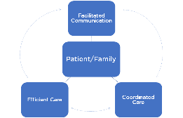
Co-Occurring Care at TANC: Juan
Juan is a 14 year old male with ASD (level 1), presents with symptoms of inattention and hyperactivity, obesity, depression with some hypomania, and epilepsy treated with levetiracetam. He also has begun have headaches over the last 6 months associated with photophobia, nausea and vomiting.
In addition to vomiting, he has history of intermittent diarrhea and abdominal pain. He likes to drink chocolate mile frequently, and eats cheese pizza everyday for lunch.
Has IEP, in mainstream classroom with pull-out services, expresses sadness over not having friends. Mother not sure that is IEP is sufficient.
Co-occurring appt is with psychology, psychiatry, Neurology and GI.

Slide 20
Co-Occurring Care at TANC: Juan
After Conferring during appointment, team decides on following treatment course:
GI, Psychiatry and neurology confer and agree that levetiracetam may be contributing to some hyperactivity symptoms and that valproic would be a better choice for seizure control, since it can also address mood issues and headaches which appear to be migraines. GI is also concerned that stomach pain with vomiting could be a sign of abdominal migraine and is eager to see if this course helps with GI symptoms.
Psychiatry and GI confer and decide that a stimulant may worsen diarrhea so patient is started on atomoxetine which may help with ADHD as well as depressive symptoms.
GI requests stool sample and blood work to rule out celiac disease and recommends diet alteration to see if excess dairy intake is contributing to diarrhea.
Psychology will meet weekly to work with teen on depression, anxiety, and executive skills coaching, and offers to have parent and child join PEERs group starting next month.
FAST (Families, Agencies and Schools Together) team is called to meet with family and to review IEP and contact school to see what other services might be available to address mother’s concerns.
Nurse goes over instructions on how to taper levetiracetam and titrate valproic acid. Follow-up with entire team will be in 12 weeks to evaluate outcome of intervention plan.
Patient will come back to see NP for medication eval in 4 weeks to see if atomoxetine and valproic acid doses are effective or need to be adjusted.

Slide 21
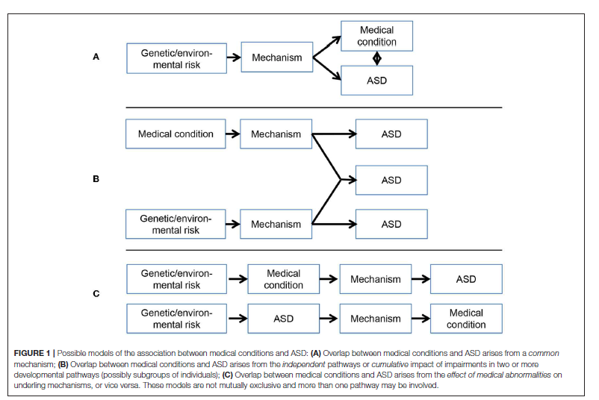
Co-Occurring Disorders and Autism Phenotypes
Phenotype A
Phenotype B
Phenotype C
Phenotype D
Phenotype E
Tye, et al. Front. Psychiatry, 23 January 2019
Notes:
EG; Phenotype A is an example of Tuberous Sclerosis syndrome.
Neonatal meningitis is an example of phenotype B.
Premature birth is an example of phenotype c
Phenotype D is an example of Fragile X
Phenotype E is exemplified by ASD with anxiety or ASD with concussion/injury

Slide 22
Co-Occurring Care at TANC: Tamara
Tamara is a 5 year old female with ASD, who presents with feeding difficulties, fine motor delay, constipation, poor weight gain, irritability, self injury, oppositionality, and prolonged latency to sleep onset.
Family uses diphenhydramine to help with sleep.
ABA in place
Sees GI, NDD, sleep specialist, Psychology in Co-Occurring Clinic

Slide 23
Change in Recognition of Co-Occurring Diagnoses Over 8 Years In 8 Year Olds
Mean count and 95% confidence intervals of co-occurring conditions in 8-year-old children with autism spectrum disorder in Autism and Developmental Disability Monitoring Network
Rubinstein, et al. Res Dev Disabil. 2018 December ; 83: 168–178

Slide 24
Autism and Co-occurring Conditions: OC
New Cases= 450/Yr.
Existing Cases= 10.5K
86% of patients under the age of 12
Patients typically have comorbidities and will require services from pediatric medicine, neurology and other sub-specialists
OC Ped Autism Population: 11K
Top Treating Specialties
(based on E&M CPT codes/FY2021)
Pediatric Medicine= 37%
Neurology= 21%
Psychiatry/Behavioral Health= 17%
All Other= 25%
Attention-deficit hyperactivity disorder, combined type
Developmental disorder of speech and language, unspecified
Unspecified urinary incontinence
Attention-deficit hyperactivity disorder, unspecified type
Epilepsy, unspecified, not intractable, without status epilepticus
Rett’s syndrome
Other specified disorders of the brain
Attention-deficit hyperactivity disorder, predominantly inattentive type
Constipation, unspecified
Top Diagnoses/Conditions with Peds Autism Patients
Source(s): ESRI forecasts for 2021. Kidsdata.org. US Census. CA Regional Center Reports. UCI Autism Center Stats. : Blueprint Networx Custom Report – 12.15.2021. FY 2021. Only Patients under 18. Report ran on Autism DX patients and the Procedure Grouping and Behavioral Health service line. Includes claims from referring providers in CA Share and volume differences to facility report due to counting patients that are treated by more than one service line at a facility.

Slide 25
Co-Occurring Disorders in ASD at TANC
Our goal was to provide a home for kids with ASD (and other NDDs) who had co-occurring disorders cared for by CHOC
Target:
High incidence Co-Occurring Disorders in ASD
High Frequency ‘Typical’ Disorders that are especially challenging to treat in kids with ASD
Routine Eye care
Routine Dental Care
Routine ENT Care

Slide 26
Current Co-Occurring Service Lines
Neuropsychiatric-Behavioral Disorders
Psychiatry, Psychology, Developmental and Behavioral Peds, Neurodevelopmental Neurology
ADHD, Depression, Mood, Disruptive, ODD, Anxiety, OCD, Agitation/Aggression
GI disorders
Neurological Disorders
Epilepsy, Sleep, Neurometabolic disorders, Down’s Syndrome, Migraine, Tics
Dental
Other Services
F.A.S.T Program with Chapman
Transition Services
Resource Assistance
Social Work

Slide 27
Co-Occurring Service Model at TANC
Expedited Communication
Between Clinical Specialists at Time of Patients Visit
Efficient Care
Patient/Family access specialists, MSW, Resource Providers in a single visit.
Decreases missed work, therapy, school
Coordinated Care
Alignment on care plan, between specialists, family, Social Work, Resource Specialists
Expedited Communication
Patient/Family
Efficient Care
Coordinated Care

Slide 28
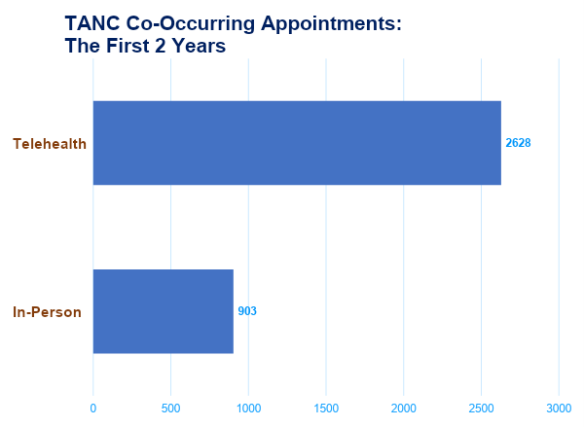
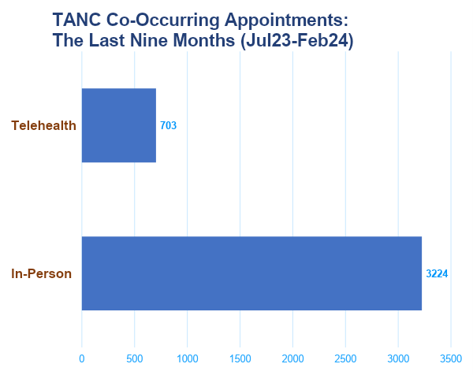
Growth of Co-Occurring Care at TANC
First two years: 3531 Total visits Last 8 Months: 3927 Total Visits

Slide 29
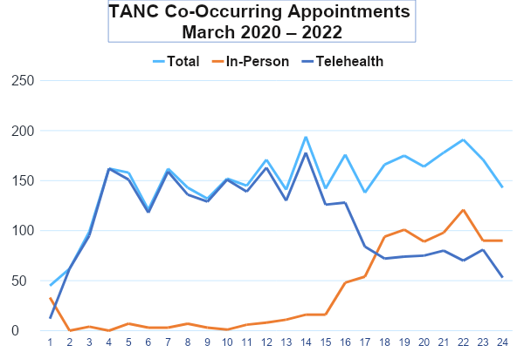
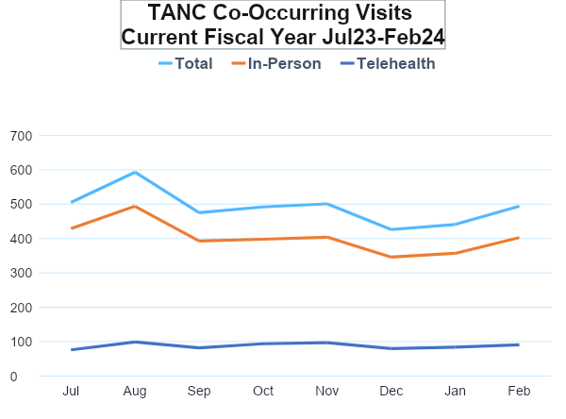
Growth of Co-Occurring Care at TANC
150 Average visits per month
491 Average visits per month

Slide 30
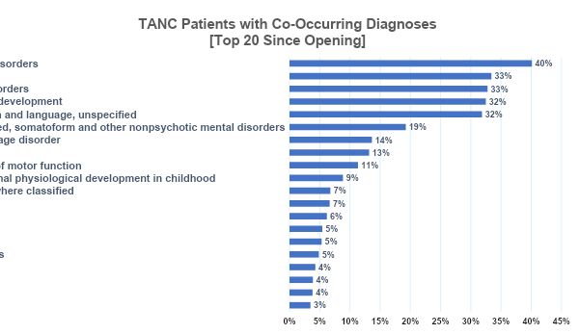
Co-Occurring Care at TANC
Top 20 Co-Occurring Clinic Diagnoses
Based on Unique Patients Seen with ASD
Since March 2020
Top Diagnoses:
Emotional Dysregulation, Sleep, ADHD, Anxiety, Language delays, Epilepsy, Behavioral Disorders, Mood, Constipation

Slide 32
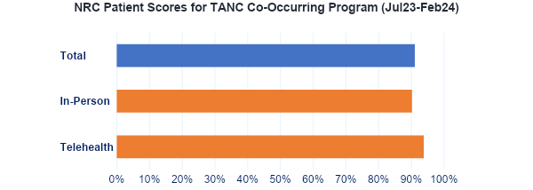
How are We Doing?

Slide 33
Co-Occurring Services – Family Satisfaction
We are so grateful that our son has been accepted and to CHOC Behavioral Health Thompson, autism clinic. The clinic has been a lifesaver, the staff and doctors are spectacular. They helped us so much in understanding how to help our child. Thank you.
I really liked the fact of having the appointment with the 2 doctors. It is very important because they are coordinated with my son’s health.
Providers and staff were patient, kind, understanding, nonjudgmental. Took their time and did not rush through providing information and explanation.
Great facility. Very caring nurses, provider and staff. Very great atmosphere. I'm happy my son gets to go to this great facility.
I love the Thompson center!! I love the team my son has!! Thank you everyone that's part of my sons well being!!!

Slide 34
Panel Discussion

Slide 35
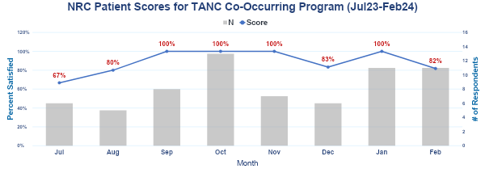
How are We Doing?

Slide 36
Co-Occurring Care at TANC: Tamara
Tamara is a 5 year old female with ASD, who presents with feeding difficulties, fine motor delay, constipation, poor weight gain, irritability, self injury, oppositionality, and prolonged latency to sleep onset.
Family uses diphenhydramine to help with sleep.
ABA in place
Sees GI, NDD, sleep specialist, Psychology in Co-Occurring Clinic

Slide 37
Co-Occurring Care at TANC: Tamara
After Conferring during appointment, team decides on following treatment course:
NDD will start trial of risperidone for irritability, SIBs, oppositional behaviors which will also address GI concern over weight gain and obviate need to start cyproheptadine.
GI will start MiraLAX and recommends supplemental Pediasure, refers to OT provider that works on both feeding AND fine motor issues
Sleep specialist advises trial of melatonin 5 mg at night to help with sleep onset.
Psychology will work on sleep hygiene, parent training for on how to handle irritability/oppositional behaviors/SIBs.
Follow-up with team will be in 8 weeks to evaluate outcome of intervention plan

Slide 38
Questions?

Slide 39
Morning Break
Notes:
Welcome slide –
Text: Welcome / Thompson Autism and Neurodevelopmental Center Conference / Working Together to Expand Horizons / 2023
Logos: TANC, Glennwood, TPI

Slide 40
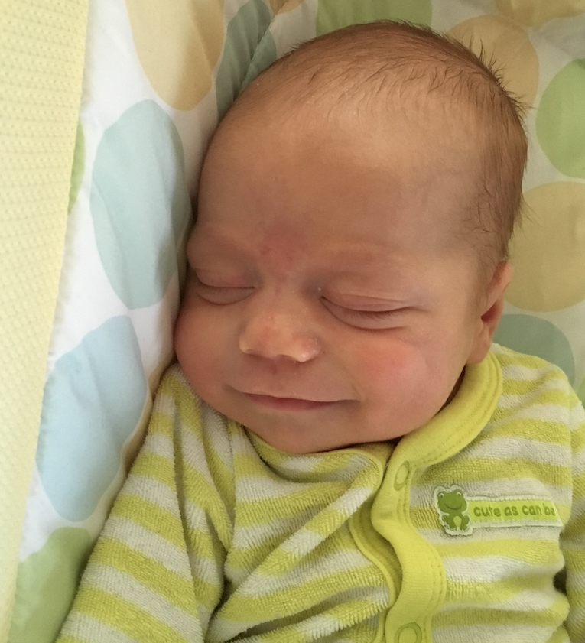
Sleep in Children and Adolescents with Neurodevelopmental Conditions
Melisa Moore, PhD
Thompson Autism and Neurodevelopment Center Conference
March 20, 2024

Slide 41
Disclosure
I do not have relevant financial relationship(s) to disclose with ineligible companies whose primary business is producing, marketing, selling, re-selling, or distributing healthcare products used by or on patients.
I do not intend to discuss an unapproved/investigative use of a commercial product/device.
Sleep in Children with Autism and Other Developmental Conditions

Slide 42
Objectives
Identify common insomnia symptoms in children with neurodevelopmental conditions
Discuss variations in behavioral treatments for sleep problems in children with neurodevelopmental conditions
Recognize empirically supported treatments for insomnia in children with neurodevelopmental conditions

Slide 43
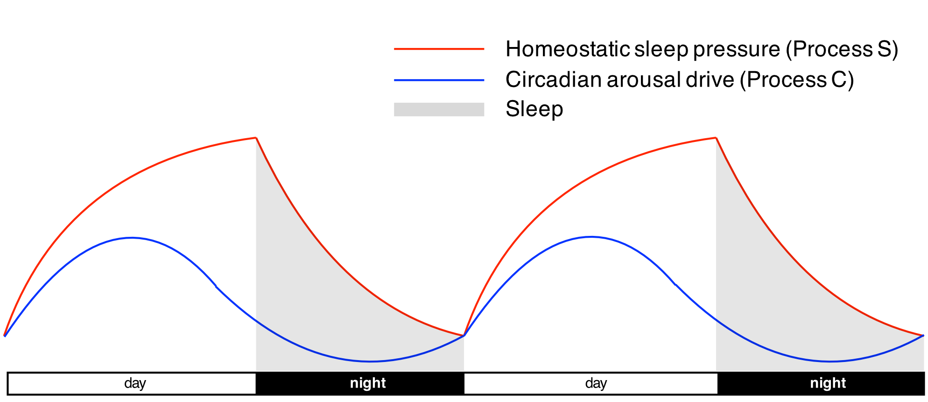
How Sleep Works
Image Oikonomou & Prober Current Opinion in Neurobiology 44, 80-88 (2017)

Slide 44
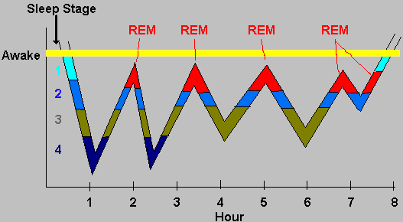
Stages of Sleep
Light sleep, Deep Sleep, REM Sleep, Wake
Each cycle avg 45-90 minutes
Image: http://faculty.washington.edu/chudler/sleep.html
Notes:
Image: http://faculty.washington.edu/chudler/sleep.html

Slide 45
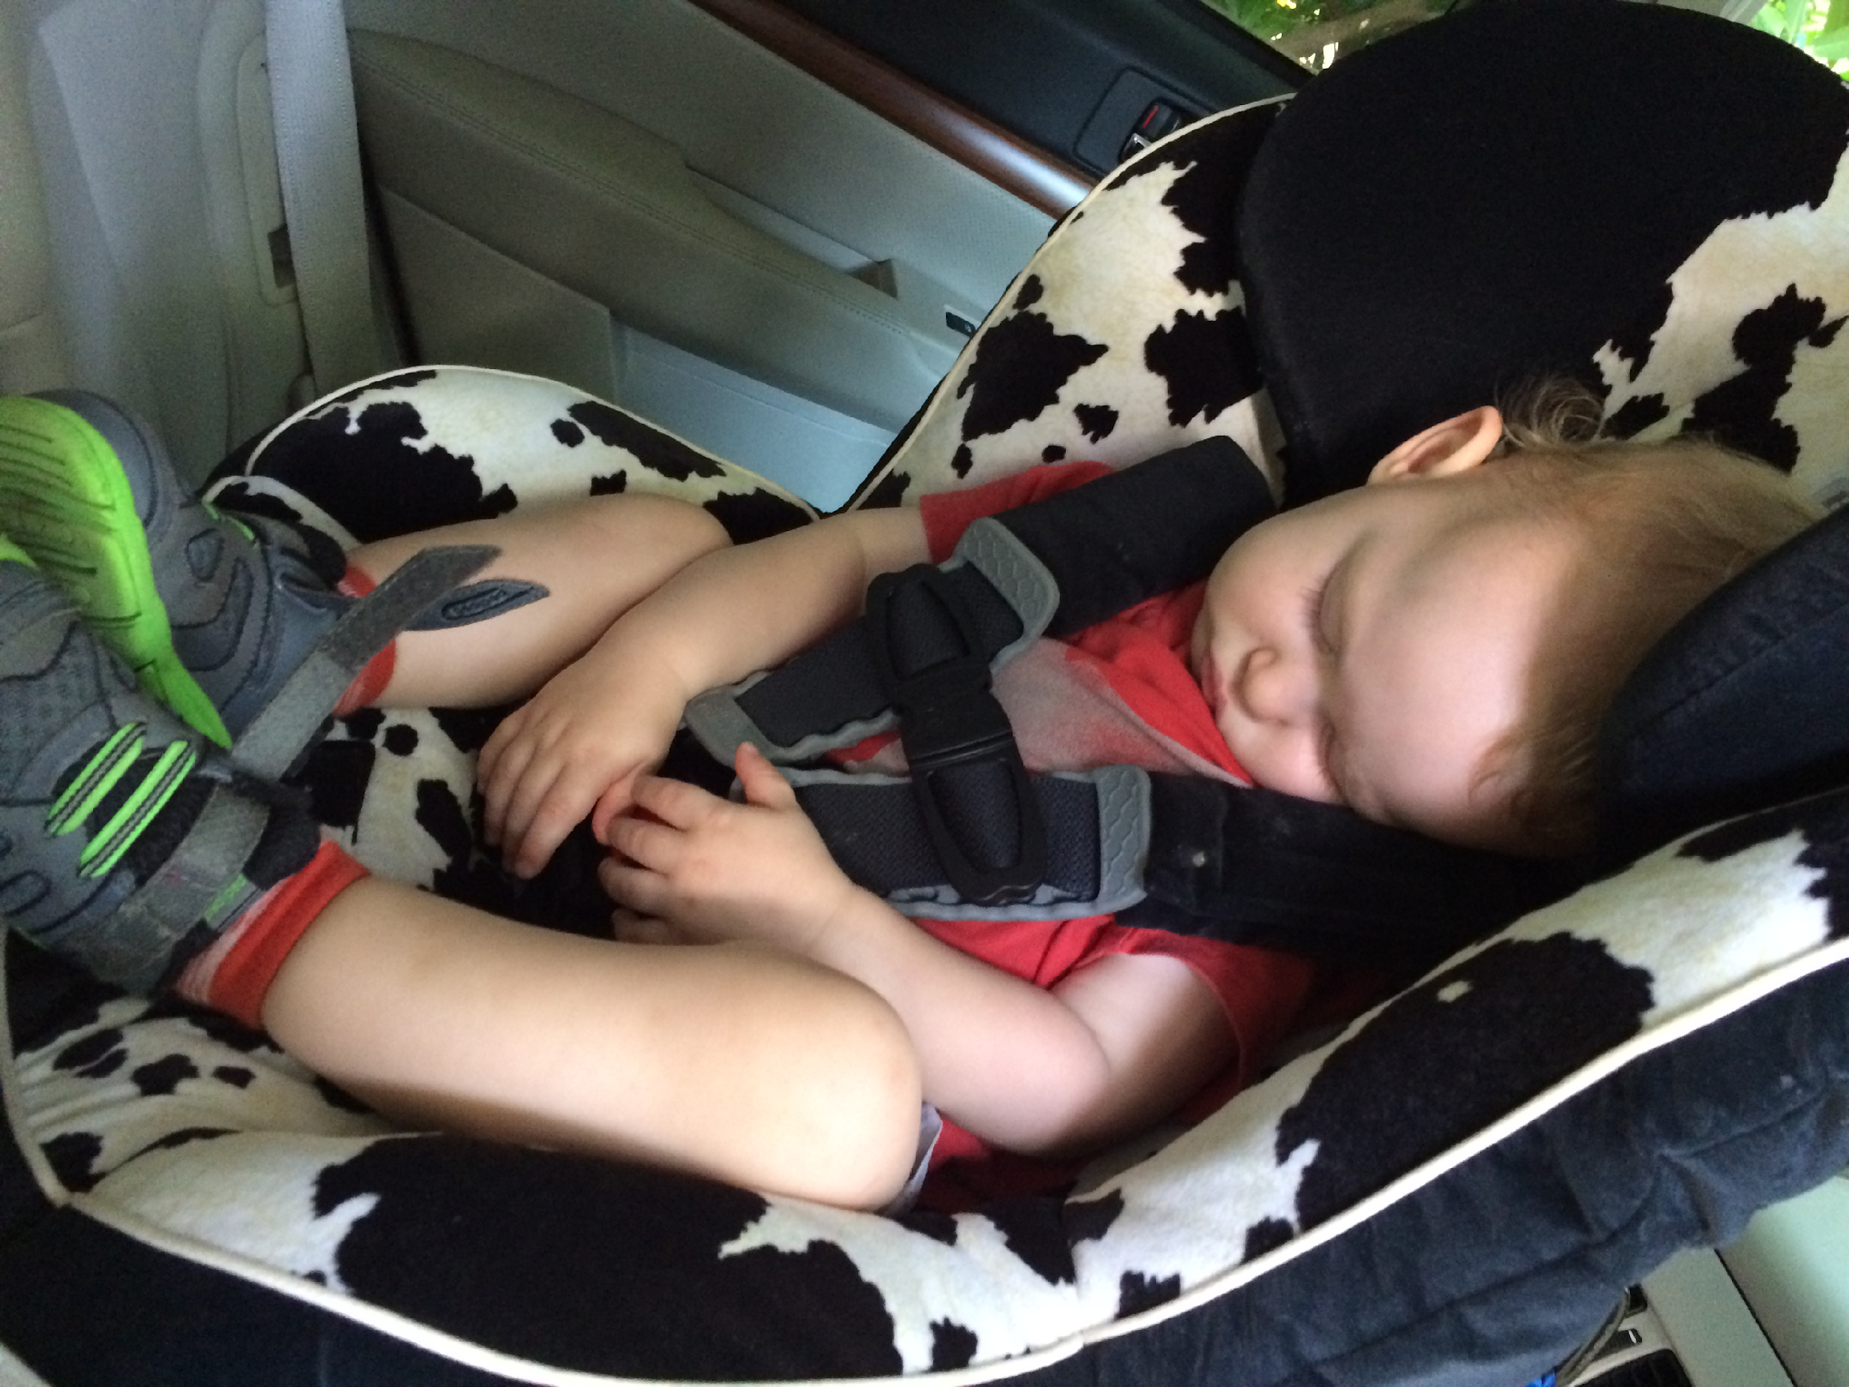
Why Is This Important?
Night wakings are normal!
Whatever you have to fall asleep, you need to get back to sleep during those normal night wakings

Slide 46
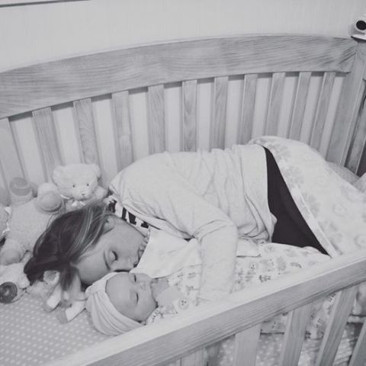
Sleep in Children with Neurodevelopmental Conditions

Slide 47
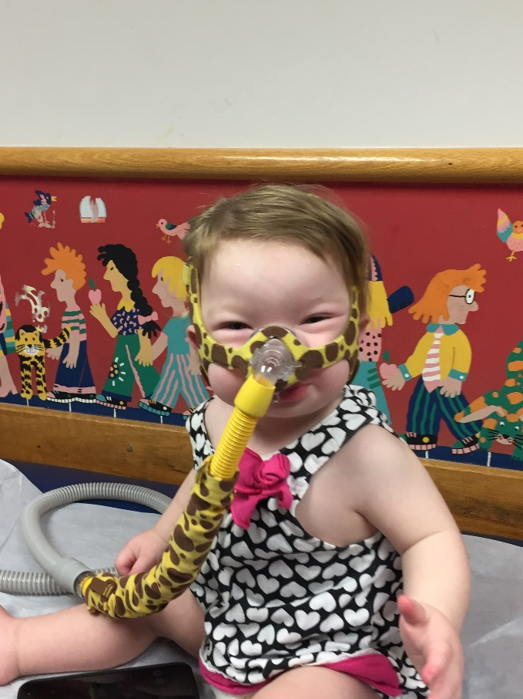
Sleep in NDC
50-96% report sleep problems
Disorder specific:
ADHD/ Periodic Limb Movement Disorder
Trisomy 21/ Obstructed Sleep Apnea
Smith Magennis/ Inverted melatonin rhythm
Insomnia prevalent across diagnoses (up to 96%)
Griggs-Damberger & Ralls 2013; Humphreys 2014, Reynolds and Malow 2011

Slide 48
Insomnia Persists in ASD
Changes in sleep emerge 18-42 months
Prolonged sleep onset
Wakings
TST
Insomnia complaints in adolescents with ASD 53% -80%
Adults complain of insomnia despite adequate sleep hygiene
Griggs-Damberger & Ralls 2013; Humphreys 2014; Reynolds and Malow 2011

Slide 49
Impact of Sleep Problems
Child:
Social skills
Attention
Hyperactivity
Repetitive behaviors
Parent:
Auto accidents
Job loss
Even small-medium effect sizes associated with daytime behaviors and parent stress
Elrod 2015; Sikora, Johnson, Clemons, Katz 2012; Mazurek & Sohl 2016

Slide 50
Etiology

Slide 51
Potential Causes of Insomnia in NDC
Changes in sleep pressure
Melatonin differences
Organic sleep problems
OSA
PLMD
Medical co-morbidities
Seizures, GERD, constipation, excessive secretions
Medications: SSRIs, stimulants
Holloway, Aman & Butler 2013; Kerns, Kendall, Berry et al. 2014; Kerns, Maddox, Kendall et al. 2015; Mazurek & Petroski 2015; Reynolds, Lane, Thacker 2012
Notes:
Medical comorbidities include seizures, GERD, constipation, excessive secretions

Slide 52
Potential Causes of Insomnia in NDC
Anxiety
30-70% ASD
Reductions in anxiety associated with reduced sleep problems
Sensory over-responsivity
Behavioral
Sleep hygiene
Behavioral insomnia
Fletcher et al. 2017; Holloway, Aman & Butler 2013; Kerns, Kendall, Berry et al. 2014; Kerns, Maddox, Kendall et al. 2015; Mazurek & Petroski 2015; Reynolds, Lane, Thacker 2012; Richdale et al. 2014; Souders et al .2009
Notes:
Physiological (activation of sympathetic nervous system)

Slide 53
Treatment

Slide 54
24 Hour Sleep History
Medical Sleep
Behavioral Sleep
Other Conditions
OSA
RLS
Narcolepsy
Parasomnias
Sleep Hygiene
Circadian Disorders
Insomnia
BIC
Anxiety
Depression
ADHD
ASD
Reflux
Eczema
Pain

Slide 55
Gold Standard: Start Behavioral
For children AND adults with insomnia, behavioral treatment is recommended
With or without medications
Both efficacious and effective
Short term and long term benefits

Slide 56
What Is a Behavioral Approach?

Slide 57
Step 1: Set Up the Right Conditions (Sleep Hygiene)
Consistent schedule: weekdays and weekends
Have a nightly bedtime routine
Sleep promoting conditions
Dark, cool, quiet
Avoid electronics 30-60 minutes before bed
Avoid caffeine
Naps only if age appropriate

Slide 58
Bedtime Routine
Same every night
3-4 activities (e.g., bath, stories)
-Start with feeding
-One direction
-30-45 minutes
-Nothing upsetting
Short and sweet
Effective – reduces bedtime problems, night wakings
Mindell, Telofski, Wiegand, & Kurtz (2009). Sleep.

Slide 59
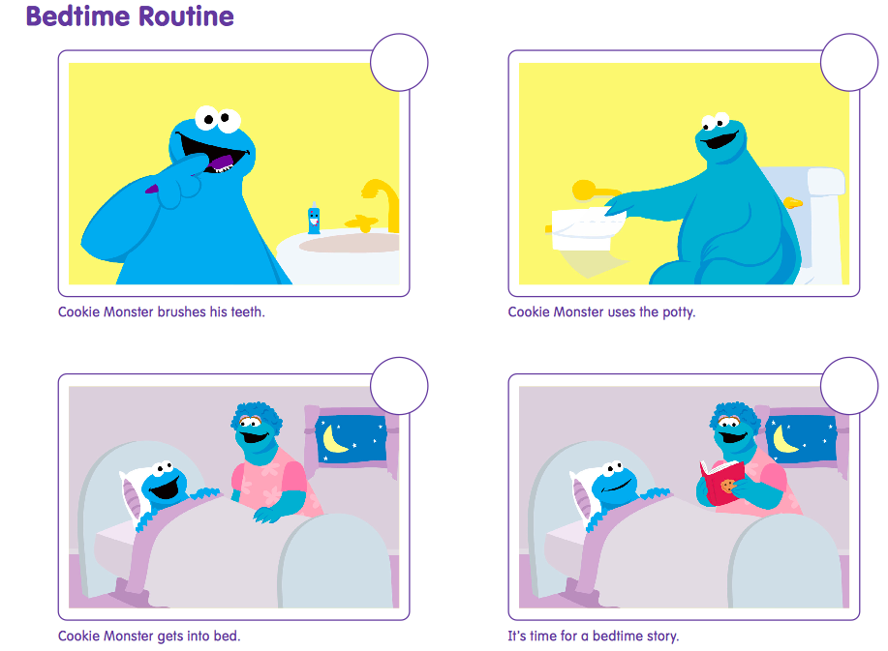

Slide 62
Step 2: Sleep Associations

Slide 63
Switch Associations
Night wakings are normal!
Whatever you have to fall asleep, you need to get back to sleep during those normal night wakings
Start with bedtime
Feeding first
Increase independence
All at once or slowly = same results
Collaboration is critical

Slide 64
Step 3: Reinforcement
Reinforce any/ all positives
Behavior chart
“Good morning light”
Change focus from sleep problems to good sleep behaviors

Slide 65
Insomnia Treatment in NDCs
Behavioral Intervention still standard
Melatonin & other medications possibly indicated
Behavioral targets more specific
Different Treatment Goals
Continuous sleep vs. maintaining safety
Expected Outcomes
Collaborators
OT, ABA, Speech, Developmental Peds

Slide 66
Targets of Behavior Therapy
Transition to sleep
Changing activities
Settling/ calming down
Establish routine
Anxiety
Sensory issues
Understanding expectations around sleep
Visual schedule
Social story

Slide 67
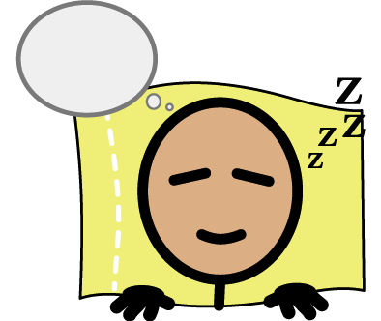
Sometimes I will wake up during the night. Lots of people wake up in the night. I should stay in bed.

Slide 68
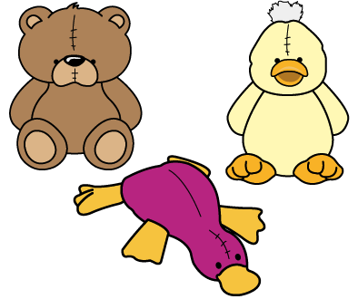
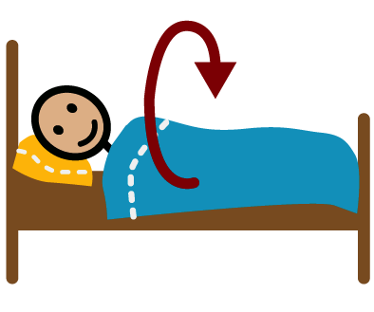
When I wake up at night I can find a stuffed animal, snuggle with my blanket, listen to music or just roll over and close my eyes.

Slide 69
Sometimes falling back to sleep will take awhile. That’s okay! I can think about happy things, like my favorite movie or my favorite place to visit.

Slide 70
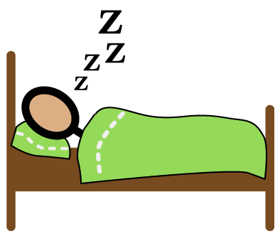
Now that I am 10 I can fall asleep and stay in my own bed all night long!

Slide 71
Other Interventions
Evidence does not support:
Handouts alone
Aromatherapy
Evidence does support:
Behavioral interventions
Melatonin
Medications (clonidine)
Some support for:
Weighted blankets
Seep restriction
Meditative movement (e.g. yoga, tai chi)
Sensory strategies
Adkins et al. 2012, Escalona et al. 2001; Frasier; Griggs-Damberger & Ralls 2013; Malow et al. 2012, Piravej et al. 2009; Souders et al. 2017; Wang et al. 2016

Slide 72
OT and Behavior Therapists
Visual supports
Social stories
Visual schedule
Motivation (If/ Then)
Transitions
Multiple warnings
Visual timers
Sensory strategies
Assess sensory profile
Create specific calming environment and routine
Toys/ aids

Slide 73
Flexibility is KEY
Sometimes:
Electronics
Parent involvement

Slide 74
Melatonin

Slide 75
Social Media
Twitter study
Mixed group, NDC
Melatonin most commonly referenced, increased after pandemic, only 7% referenced NDC
Other aids: lavender/ essential oils, weighted blanket, CBD
Most info from industry, bots
Regional group for families of children with special needs
1612 members, 106 responses
2.5 year-old with developmental delay and sensory issues. “Looking for advice beyond that for the typical child”
Carson, M., Moore, M., Cicalese, O., Dunnewald, M., Varker, A., Mindell, J., and Williamson, A. Variations in Twitter posts referencing pediatric sleep aids. Sleep Health 9(4):451-459, 2023.

Slide 76
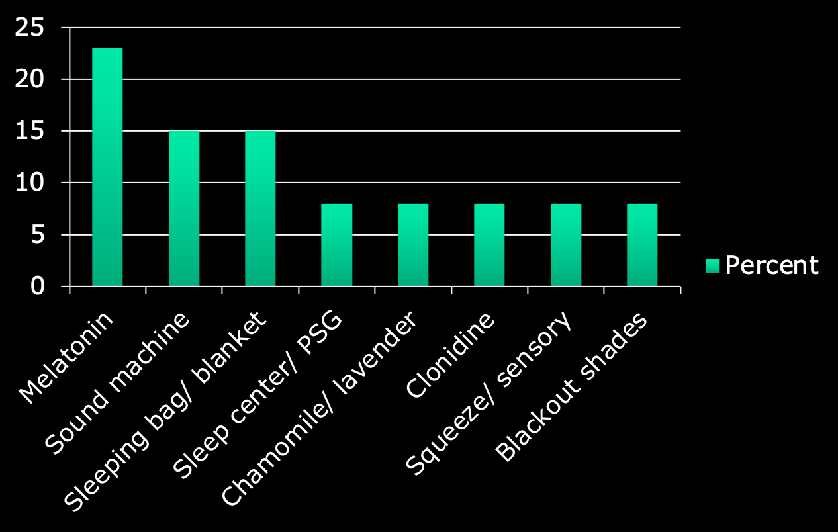
Community Recommendations

Slide 77
Melatonin
16 treatment studies support short term effectiveness in NDC
SOL
WASO
TST
Most studies 3-5 mg (range 0.5-15mg)
Titrate weekly
30 minutes before bedtime (range 30-45 minutes)
No differences in pharmacokinetics between TD and ASD
Bruni; Goldman 2014; Gringas 2014; Souders 2017
Notes:
Theoretically could have impact on puberty, no studies identified related adverse events

Slide 78
Melatonin
Randomized, double blind, placebo controlled trial
N=110
Ages 3- 15.75 years
45 min. before bed
Dose escalation 0.5mg, 2mg, 6mg, 12mg
At 12 weeks by actigraphy:
SOL decreased by 45.3 minutes
Longest SOL at baseline improved most
TST increased by 13.3 minutes
Wake time 29.9 minutes EARLIER
Gringas et al., 2012

Slide 79
Combination Therapy in ASD
RCT- 4 groups
N=134
Ages 4-10
4 session CBT
Sleep education
Sleep schedule, sleep hygiene, graduated extinction
Review and discuss problems
Review and relapse prevention
3mg CR Melatonin at 9pm
12 week follow up
Cortesi, et al. 2012

Slide 80
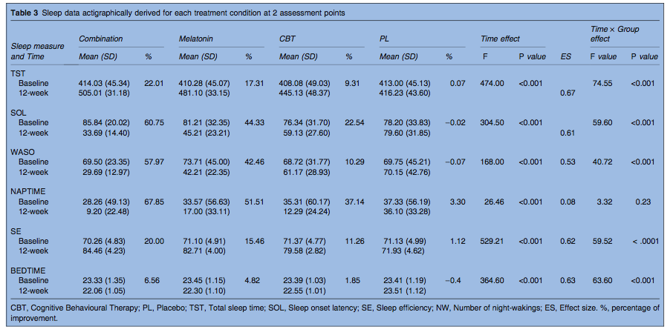
Combination Therapy in ASD

Slide 81
Expectations: Rough Comparison
 | Behavioral | Melatonin | Combined
SOL (minutes) | 2.0- 18.6 | 15.7- 45.3 | 52.2
TST (minutes) | 1.0- 37.1 | 13.3- 70.8 | 91.0
WASO (minutes) | 3.5- 7.6 | 11.0- 31.5 | 39.8
Sleep Efficiency (%) | 2.9- 8.2 | 4.7- 11.6 | 14.2
All actigraphic data
Parent reported improvements much greater than actigraphy
Ayash 2015; Blackmer 2016; Cortesi 2012; Gringas, 2012; Johnson 2013; Malow 2012; Malow 2014;Wirojanan 2009

Slide 82
Summary
Insomnia impacts most children with NDCs
Whatever is needed to fall asleep at bedtime is what you need to get back to sleep
Behavioral treatment is gold standard, with or without medications
Visuals can be helpful
Flexibility and collaboration are key

Slide 83
When to refer
Snoring, gasping, difficulty breathing during sleep
Need help making a change
At limits of sleep deprivation (Caregiver or Child)
Response to behavioral approach not as expected

Slide 84
Resources
Books:
Sleep Better: A Guide to Improving Sleep for Children with Special Needs (Durand, 2014)
Pediatric Sleep Problems (Meltzer & Crabtree, 2015)
A Clinical Guide to Pediatric Sleep (Mindell & Owens, 2015)
What To Do When You Dread Your Bed (Huebner, 2008)
Journals:
Sleep; Sleep Medicine; Journal of Clinical Sleep Medicine; Sleep Medicine Reviews; Behavioral Sleep Medicine, Journal of Developmental and Behavioral Pediatrics
Practical Websites:
Pediatric Sleep Council, https://www.babysleep.com/
National Sleep Foundation, https://sleepfoundation.org/
Autism Speaks Sleep Toolkit, https://www.autismspeaks.org/site-wide/sleep-tool-kit

Slide 85
Thank you and questions
www.drmelisamoore.com
melisa@drmelisamoore.com

Slide 86
Comparison of 2 Cases

Slide 87
Case Example #1: Background
3 ½ year-old with frequent night wakings
Medical history: reflux as infant
No medications
No significant recent life events
Not receiving early intervention
In typical preschool
Daytime difficulties
Tantrums
Potty training

Slide 88
Case Example #1: Sleep History
Bedtime
Routine starts 8pm: bath, snack, books, song, TV, lotion, prayers, more books, patted to sleep
Negotiating
Time-outs
Typically falls asleep with mom in his bed 9-9:30pm
Woke about every 60-90 minutes
Getting out of bed about 35 times per night
Running around
Irritable, arguing with mom
“I’m scared”

Slide 89
Case Example #2: Background
2 ½ year-old with long night wakings
Medical history: Constipation treated with miralax
No significant recent life events
Not receiving early intervention
At home with mom during the day
Daytime difficulties
Tantrums
Not following directions

Slide 90
Case Example #2: Sleep History
Bedtime
Routine starts 7:30pm: bath, pjs, good night to parents, special jump
Milk in special cup, keeps cup in bed
Takes 30-90 minutes to fall asleep regardless of parental presence, asleep 9:30pm
Woke after 4-5 hours
Seems wide awake
Awake 2-3 hours, sometimes falls back to sleep 4-5am
Wants milk again in special cup
After milk, does not need a parent to return to sleep, singing and talking to himself

Slide 91
Case Example #1: Sleep History
Bedtime
Routine starts 8pm: bath, snack, books, song, TV, lotion, prayers, more books, patted to sleep
Negotiating
Time-outs
Typically falls asleep with mom in his bed 9-9:30pm
Woke about every 60-90 minutes
Getting out of bed about 35 times per night
Running around
Irritable, arguing with mom
“I’m scared”

Slide 92
Behavioral Targets #1
Insufficient sleep
Long, unorganized bedtime routine
Bedtime problems
Frequent wakings
Limit setting

Slide 93
Behavioral Treatment Plan #1
Insufficient sleep | Earlier, consistent bedtime
Long, unorganized bedtime routine | Short Bedtime chart
Bedtime problems | Graduated extinction Start where they are
Frequent wakings | Address after bedtime
Limit setting | Referral

Slide 94
Follow up 1: 4 weeks
Progress at bedtime
Mom gradually out of room
Starting to address night wakings
Walk back to bed every time (85, 35, 12)
Seeing mental health professional for daytime limit setting
Notes:
This was after twice weekly phone follow up and faxed reports of details

Slide 95
Follow up 1: 4 weeks
Progress at bedtime
Mom gradually out of room
Starting to address night wakings
Walk back to bed every time (85, 35, 12)
Seeing mental health professional for daytime limit setting
Notes:
This was after twice weekly phone follow up and faxed reports of details

Slide 96
Follow up 2: 4 weeks, 2 days
Standard extinction
2 nights with baby gate
Notes:
This follow up was by phone

Slide 97
Case Example #2: Sleep History
Bedtime
Routine starts 7:30pm: bath, pjs, good night to parents, special jump
Milk in special cup, keeps cup in bed
Takes 60-90 minutes to fall asleep regardless of parental presence
Woke after 4-5 hours
Wide awake
Awake 2-3 hours
Wants milk again in special cup
After milk, does not need a parent to return to sleep, singing and talking to himself

Slide 98
Behavioral Targets #2
Long time to fall asleep
Middle of the night milk
Long night waking

Slide 99
Behavioral Treatment Plan #2
Long time to fall asleep | Later bedtime
Middle of the night milk | Move milk to beginning of routine; eliminate cup
Long night waking | Mom cue “still night time”, Good morning light

Slide 100
Follow up 4 weeks:
Moved milk to beginning of routine in open cup
No longer has special cup in bed
No longer needing milk in the night
SOL still 60-90 minutes
Still waking 2-3 hours during middle of the night, regardless of parental presence
Notes:
This follow up was by phone

Slide 101
Recommendations:
Refer for Developmental Evaluation
Social story for getting up at night
Visuals on wall, door
Continue with good sleep hygiene and good morning light
Notes:
This follow up was by phone

Slide 102
Follow up 6 months:
Diagnosed with ASD
Started melatonin
Shorter time to fall asleep (10-30 minutes)
Persistent night waking
Change expectations and treatment target (safety)
Basket of toys in parents’ room
Notes:
This follow up was by phone

Slide 103
Epilepsy and Autism: How they influence each other
03/20/24

Slide 104
Disclosures
I do not have relevant financial relationship(s) to disclose with ineligible companies whose primary business is producing, marketing, selling, re-selling, or distributing healthcare products used by or on patients.​
I do not intend to discuss an unapproved/investigative use of a commercial product/device.

Slide 105
Objectives
Define Autism and Epilepsy​
Review common risk factors and associations of both conditions ​
Discuss common circumstances where both autism and epilepsy exist in the same patient​
Review realistic circumstances potential areas of treatment overlap between these two conditions​

Slide 106
What is Autism?
How we define Autism Changed with the DSM 5
Autistic disorder, pervasive developmental disorder, Asperger’s, etc.
Persistent deficits in social communication and social interaction across multiple contexts
Restricted, repetitive patterns of behavior, interests, or activities
Notes:
Diagnostic and statistical manual
Moved away from things like IQ and putting in a specific box, and focusing more on the amount support or therapy needed to help function

Slide 107
What is Autism?
Persistent deficits in social communication and social interaction across multiple contexts, as manifested by the following, currently or by history
Deficits in social-emotional reciprocity
Deficits in nonverbal communicative behaviors used for social interaction
Deficits in developing, maintaining, and understanding relationships
Notes:
1. ranging, for example, from abnormal social approach and failure of normal back-and-forth conversation; to reduced sharing of interests, emotions, or affect; to failure to initiate or respond to social interactions.
2. ranging, for example, from poorly integrated verbal and nonverbal communication; to abnormalities in eye contact and body language or deficits in understanding and use of gestures; to a total lack of facial expressions and nonverbal communication.
3. Deficits in developing, maintaining, and understanding relationships, ranging, for example, from difficulties adjusting behavior to suit various social contexts; to difficulties in sharing imaginative play or in making friends; to absence of interest in peers.

Slide 108
What is Autism?
Restricted, repetitive patterns of behavior, interests, or activities, as manifested by at least two of the following, currently or by history (examples are illustrative, not exhaustive; see text):
Stereotyped or repetitive motor movements, use of objects, or speech
Insistence on sameness, inflexible adherence to routines, or ritualized patterns of verbal or nonverbal behavior
Highly restricted, fixated interests that are abnormal in intensity or focus
yper- or hyporeactivity to sensory input or unusual interest in sensory aspects of the environment
Notes:
1. e.g., simple motor stereotypes, lining up toys or flipping objects, echolalia, idiosyncratic phrases).
2. (e.g., extreme distress at small changes, difficulties with transitions, rigid thinking patterns, greeting rituals, need to take same route or eat same food every day).
3. e.g., strong attachment to or preoccupation with unusual objects, excessively circumscribed or perseverative interests)
4. (e.g. apparent indifference to pain/temperature, adverse response to specific sounds or textures, excessive smelling or touching of objects, visual fascination with lights or movement).

Slide 109
What is Epilepsy
Epilepsy is a disease of the brain defined by any of the following conditions:
1. At least two unprovoked (or reflex) seizures occurring >24 h apart
2. One unprovoked (or reflex) seizure and a probability of further seizures similar to the general recurrence risk (at least 60%) after two unprovoked seizures, occurring over the next 10 years
3. Diagnosis of an epilepsy syndrome
RS Fisher 2014, ILAE task force

Slide 110
What is Epilepsy
Should be able to subcategorize to focal vs. generalized vs. unknown onset. (ILAE 2017 Classification, “new”)
Fighting to call them focal when possible🡪 more common & more options
Etiology:
Structural—abnormalities of the brain seen on MRI (or CT)
Genetic, metabolic, post infectious/autoimmune causes
RS Fisher 2014, ILAE task force

Slide 111
Notes:
I’m pretty laid back about most things, but using things like “grandma” seizures is a bit of pet peeve
This is the “new” terminology
Guides options for treatment and workup

Slide 112
Risk Factors (not causes)
Family history of epilepsy
Traumatic brain injury
More significant than we dropped them and they cried immediately
Brain infections (history of meningitis, encephalitis)
Autism and developmental delay
History of febrile seizures

Slide 114
Risk of Epilepsy in patients with Autism
Reported frequency of epilepsy in patients with autism is 5-40%
Depending on the study and the definition of either which has changed over time
Based on Swedish Patient Registry individuals with epilepsy were 10.49 x more likely to have a future diagnosis of autism
Hazards ratio of 9.27 for males, 13.1 for females (p<0.001).
More boys have autism, but the rate of epilepsy in girls with autism is higher
Recent long-term follow up studies (El Achkar and Spence) have showed 22% out of 150 individuals with autism later developed epilepsy

Slide 115
Other Co-occurring Risks
Rate of autism was 16% in those with epilepsy compared to 1% of the general population
ADHD
Poor or disrupted sleep
Anxiety

Slide 116
Genetic Disorders
Tuberous Sclerosis
Genetic diagnosis which causes generally benign tumors throughout the body with high prevalence of both autism and epilepsy.
Dravet Syndrome
GLUT1 deficiency
Hundreds of other causes with literature expanding on a regular basis

Slide 117
Epilepsies that Cause Features of Autism
Developmental or Epileptic encephalopathies
Infantile spasms
Lennox Gastaut
Myoclonic-atonic or Doose Syndrome
Landau-Kleffner, Electrographic Status Epilepticus in Sleep (ESES), Developmental and/or epileptic encephalopathy with spike-and-wave activation in sleep (DEE-SWAS)
Population of children with EEG abnormalities in sleep thought to be directly related to developmental outcomes.
Classically have speech regression and autistic features. But can be improved with medication
Notes:
These are all associated with developmental regression or stagnation

Slide 118
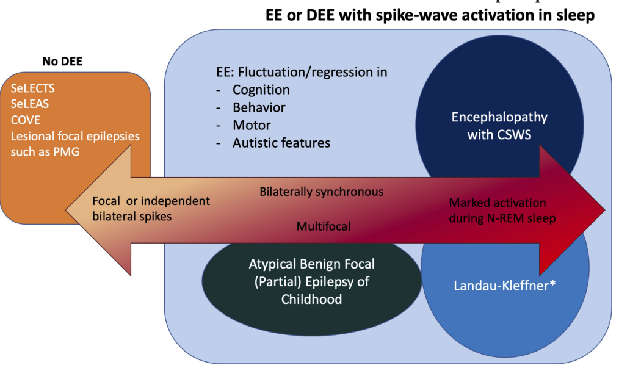

Slide 119
How and when do we look for causes?
Genetic screening for all children with autism
Often indications to look for genetic causes if there is both a diagnosis of autism and epilepsy
EEG need and duration
Highly variable and dependent on access and availability
Repetitive and stereotyped events🡪 epilepsy is a “clinical diagnosis”
Showing features of an epilepsy syndrome, multiple risk factors for epilepsy, developmental regression, or other atypical features

Slide 120
Notes:
I’m pretty laid back about most things, but using things like “grandma” seizures is a bit of pet peeve
This is the “new” terminology
Guides options for treatment and workup

Slide 121
Notes:
More detailed

Slide 122
Notes:
More detailed

Slide 123
Staring Spells
Not all episodes of staring are seizures
Not all seizures that involve staring are absence seizures
“petit mal”—older terminology for small seizures often associated with absence but does not differentiate from focal seizures that involve behavioral arrest
Focal epilepsy vs generalized
Different treatments in regards to epilepsy medications
Different etiologies/reasons
Genetic vs structural
Notes:
Anecdotally the most common reason for new EEG referrals at my institution
A square is a rectangle but a rectangle is not a square

Slide 124
Treatment
Therapies and developmental monitoring
“Kill 2 birds with 1 stone”
Seizure medications that help with sleep, mood, or other comorbid issues
Shared information between medical providers or institutions
Avoids repeating tests and questionnaires
Combined and/or comprehensive appointments
Education and preparation
Notes:
Example of patient with autism-> self grat w/ abnormal EEG🡪 then later epilepsy w/ ESES

Slide 125
American Psychiatric Association. Diagnostic and statistical manual of mental disorders. 5th ed. Arlington, VA: American Psychiatric Association; 2013.
Roberto Tuchman, Michael Cuccaro, Michael Alessandri, Autism and epilepsy: Historical perspective, Brain and Development, Volume 32, Issue 9, 2010, Pages 709-718, ISSN 0387-7604, https://doi.org/10.1016/j.braindev.2010.04.008. (https://www.sciencedirect.com/science/article/pii/S0387760410001178
RS Fisher et al 2014. “A practical clinical definition of epilepsy.” Epilepsia, 55(4):475-482,2014 doi: 10.1111/epi12550
Frank MC Besag (2018) Epilepsy in patients with autism: links, risks and treatment challenges, Neuropsychiatric Disease and Treatment, , 1-10, DOI: 10.2147/NDT.S120509
Specchio N, Wirrell EC, Scheffer IE, Nabbout R, Riney K, Samia P, et al. International League Against Epilepsy classification and definition of epilepsy syndromes with onset in childhood: Position paper by the ILAE Task Force on Nosology and Definitions. Epilepsia. 2022;63:1398– 1442. https://doi.org/10.1111/epi.17241
References:

Slide 126
Contact: Dr. David / david.adams@choc.org

Slide 127
Lunch Break
Notes:
Welcome slide –
Text: Welcome / Thompson Autism and Neurodevelopmental Center Conference / Working Together to Expand Horizons / 2023
Logos: TANC, Glennwood, TPI

Slide 128
Co-Occurring Anxiety Disorders in Youth with Autism Spectrum Disorder (ASD) Considerations for Assessment and Treatment Esther Hong, Ph.D. March 20, 2024

Slide 129
Disclosure
I do not have relevant financial relationship(s) to disclose with ineligible companies whose primary business is producing, marketing, selling, re-selling, or distributing healthcare products used by or on patients.
I do not intend to discuss an unapproved/investigative use of a commercial product/device.

Slide 130
Objectives
1
2
3
Risk factors
Assessment
Intervention
Notes:
Discuss the early risk factors for co-occurring anxiety disorders in youth with ASD.
Review existing best practices for the diagnosis of anxiety disorders in individuals with ASD.
Review evidence-based interventions, with focus on treatment modifications/considerations, to treat co-occurring anxiety disorders in children and adolescents with ASD.

Slide 131
ASD Diagnostic Criteria
Social Communication
Social-emotional reciprocity
Nonverbal communication for social interactions
Developing and maintaining relationships
Restricted, Repetitive Behaviors
Repetitive, stereotyped speech, motor movements, use of objects
Adherence to routines, ritualized behavior, rigid thinking
Restricted, fixated interests
Sensory interests/aversions

Slide 132
Anxiety Disorders
Separation anxiety disorder
Selective mutism
Specific phobia
Social anxiety disorder
Panic disorder
Agoraphobia
Generalized anxiety disorder

Slide 133
ASD and Anxiety
Approximately 40% of children with ASD have an anxiety disorder
Sampling bias?
Wide range of prevalence
1.6% - 62% overall
2.6% - 62% (clinical samples)
1.6% - 23.3% (community-based samples)
22.3% - 38% (epidemiological sample)
Overall, anxiety levels higher in children with ASD in comparison to:
Neurotypical (NT) children
Children with other neurodevelopmental disabilities (NDDs)
Notes:
(Gotham et al., 2017) (Vasa et al. 2020)

Slide 134
ASD and Anxiety
Overall, most common anxiety disorders in ASD:
Specific phobia, social anxiety, GAD
Longitudinal study
Mean age T1 = 26.6 months old, Mean age T2 = 164.8 months
55.7% of adolescents with ASD had anxiety disorders
Separation (39.3%), Social (27.9%), GAD (18.0%), Panic (6.6%), School (3.3%)
Anxiety symptoms increase from early childhood to adolescence
Notes:
(Ben-Itzchak et al., 2020) (Dellapiazza et al., 2022) (Vasa et al., 2020)

Slide 135
Objectives
1
2
3
Risk factors
Assessment
Intervention

Slide 136
Risk Factors for Anxiety
Early childhood risk factors have been evaluated in NT children
Limited research on early childhood risk factors in ASD population
Gender
Cognitive and adaptive functioning
ASD severity
Can we identify early risk factors to mitigate or prevent anxiety symptoms in children with ASD?

Slide 137
Risk Factors
Cognitive functioning
Sensory behaviors
Restricted, repetitive behaviors (RRBs)
Social communication

Slide 138
Cognitive Functioning
Higher IQ in children with ASD increases risk for anxiety
Cognitive level may predict type of anxiety disorder
Lower cognitive abilities at toddlerhood → higher separation anxiety in adolescence
Higher cognitive abilities at toddlerhood → higher GAD in adolescence
Mixed findings overall
Methodological limitations
Sampling bias
Notes:
(Dellapiazza et al., 2022) (Gotham et al., 2015) (van Steensel et al., 2017) (Ben-Itzchak et al., 2020)

Slide 139
Sensory Behaviors
Sensory over-responsivity (SOR) in early childhood associated with anxiety
Longitudinal study
T1 age = 18-33 months, T2 age = 30-45 months
Higher SOR in toddlerhood predicted increased anxiety at 1-year follow-up
SOR emerged earlier than anxiety symptoms
SOR remained stable, while anxiety increased
Better predictor of anxiety than ASD severity
Notes:
(Mazurek et al., 2019) (Green et al., 2020) (Gara et al., 2020) (Dellapiazza et al., 2022)

Slide 140
Sensory Behaviors
Psychophysiological studies in youth with ASD
Brain activation positively correlated with parent-reported anxiety and SOR
Heightened brain activation when multiple sensory modalities present
Notes:
Green et al. (2013, 2015)

Slide 141
RRBs
RRB severity found to be an early predictor of anxiety
58% of children with severe RRBs in early childhood (2-5 years) had elevated anxiety symptoms by age 11
RRB severity associated with specific anxiety disorders
Separation anxiety, GAD, panic/agoraphobia, obsessive-compulsive subscales
Not associated with social phobia and physical injury fears

Slide 142
RRBs
Intolerance of uncertainty (IU)
Reduced tolerance and increased discomfort with ambiguity
Negative reactions to uncertain situations and events
Distinct from excessive worrying
Significantly higher IU in children with ASD
IU mediated the relationship between ASD diagnosis and anxiety scores
IU
ASD
Anxiety
Notes:
(South & Rodgers, 2017) (Keefer et al. 2016)

Slide 143
Social Communication
Early social communication difficulties associated with higher rates of social anxiety at 7, 10, and 13 years of age
Bidirectional relationship between social communication and social anxiety
Social anxiety during adolescence is not associated with social communication deficits
Social communication and social anxiety are distinct domains
Mixed findings, other studies have found no significant relationship with anxiety
Notes:
(Pickard et al., 2017) (Teh et al., 2017)

Slide 144
Other Factors
Sleep disturbance
Aggression
Defiant behavior
Other co-occurring conditions (e.g., ADHD)
Notes:
Vasa et al., 2020

Slide 145
Objectives
1
2
3
Risk factors
Assessment
Intervention

Slide 146
Anxiety Measures
Child Behavior Checklist (CBCL)
Behavioral Assessment System for Children (BASC)
Screen for Child Anxiety Related Emotional Disorders (SCARED)
Spence Children’s Anxiety Scale (SCAS)
Multidimensional Anxiety Scale for Children (MASC)
Beck Anxiety Inventory (BAI)
Child Symptom Inventory (CSI)
Social Worries Questionnaire (SWQ)
Revised Child Anxiety and Depression Scale (RCADS)
Beck Youth Inventories (BYI)
Early Childhood Interview (ECI)
Pediatric Anxiety Rating Scale (PARS)
Anxiety Diagnostic Interview Schedule (ADIS)

Slide 147
Anxiety Measures
Parent-reported rating scales (most commonly used)
Teacher-reported rating scales
Self-reported rating scales
Semi-structured diagnostic interviews
Customized checklists*

Slide 148
Assessment Measures
Issues with measurement
Incompatible factor structure (e.g., SCAS)
Measurement invariance
Biased normative samples
Poor parent-child inter-rater reliability (e.g., RCADS, MASC)
Measures not designed for/validated in youth with ASD
12 of 48 studies included questions that were designed to assess anxiety in ASD population
Dearth of ASD-specific anxiety measures
Notes:
(Jitlana et al., 2017) (Vasa et al. 2020) (Dellapiazza et al., 2022)

Slide 149
Assessment Measures
Anxiety is mis- or under-diagnosed in children with ASD
Anxiety is mis- or under-diagnosed in children with ASD with lower IQ, lower language abilities, higher ASD symptom severity, etc.
Notes:
(Jitlana et al., 2017) (Vasa et al. 2020) (Dellapiazza et al., 2022)

Slide 150
Anxiety Scale for Children with Autism Spectrum Disorder (ASC-ASD) (Rodgers et al., 2016)
Adapted the RCADS
Additional items:
Sensory anxiety
Intolerance of uncertainty
Phobias
Total 24 items
Parent and Child versions (8-16 years old)
Multiple languages
Resulted in 4 Subscales:
Performance Anxiety
Uncertainty
Anxious Arousal
Separation Anxiety
Psychometrics:
Good internal consistency
Good validity
Good test-retest reliability

Slide 151
Parent-Rated Anxiety Scale for Youth with Autism Spectrum Disorder (PRAS-ASD) (Scahill et al., 2019)
Developed using a focus group of parents of youth with ASD
Children and adolescents aged 5-17 years (N=990), 80.8% male
Started with 72 items
Resulted in 25 items, with a single factor
Psychometrics:
Good divergent validity
Good convergent validity
Good test-retest reliability

Slide 152
Objectives
1
2
3
Risk factors
Assessment
Intervention

Slide 153
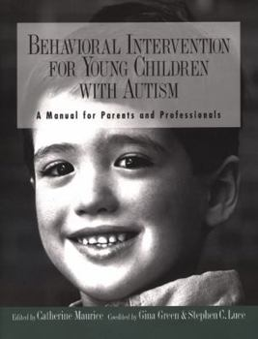
Cognitive Behavior Therapy
Psychoeducation, cognitive restructuring, self-talk, relaxation strategies, coping skills, exposure
Focuses on cognitive processes
Manualized, evidence-based CBT interventions
Facing Your Fears
Being Brave
Cool Kids/Chilled Teens
Behavioral Interventions for Anxiety in Children with Autism (BIACA)
Multimodal Anxiety and Social Skills Intervention (MASSI)
Notes:
(Gara et al., 2020) (Keefer et al., 2016) (Wood et al., 2015) (Lang et al., 2010) (Storch et al., 2015) (White et al., 2013)

Slide 154
Adaptations to CBT
Modular approach (e.g., BIACA, MASSI)
Psychoeducation
Coping skills/problem solving
Motivation
Adaptive skills
Social skills training (group)
Generalization
Modifications to treatment
Visual aids
ASD symptoms
Parent involvement
Target IU
Manage SOR

Slide 155
CBT Limitations
Existing CBT interventions may focus on anxiety symptoms that are not as relevant for children with ASD
E.g., focus on cognitive process rather than cognitive content
Higher IU → poorer treatment response
Targeted interventions may be needed
SOR
IU

Slide 156
Coping with Uncertainty in Everyday Situations (CUES) Programme (Rodgers et al., 2016)
Parent group-based manualized program
Designed for people with ASD, with IU
N=11 parents
Mean child age = 11 years, 8 months
8-session program, 2 hours per session
Psychoeducation on IU
Program goals
Tolerate uncertainty
Promote flexibility
Identify unhelpful strategies
Parent training to support their child
Findings
Good retention
97% attendance
High satisfaction
Increased confidence and knowledge of IU
Treatment gains

Slide 157
Implications
Given high prevalence of co-occurring anxiety in ASD, clinicians should be assessing for anxiety during diagnostic evaluation process
Differential diagnosis
We need to rethink how we assess for anxiety in children with ASD
Particularly children with limited cognitive/language abilities and more significant RRBs
Ongoing research on specific risk factors is needed to improve assessment and targeted treatment of anxiety
Use of ASD-specific anxiety measures

Slide 158
Implications
Early detection and intervention may prevent or mitigate effects of anxiety
Several risk factors can be detected in toddlerhood/early childhood
Modifications to evidence-based interventions are necessary for optimal outcomes
Encouraging research on targeted anxiety interventions for children with ASD

Slide 159
THANK YOU! Questions?

Slide 160
References
•Dellapiazza, F., Michelon, C., Picot, MC. et al. Early risk factors for anxiety disorders in children with autism spectrum disorders: results from the ELENA Cohort. Sci Rep 12, 10914 (2022). https://doi.org/10.1038/s41598-022-15165-y
•Gara, S. K., Chhetri, A. G., Alrjoob, M., Abbasi, S. A. A. & Rutkofsky, I. H. The sensory abnormalities and neuropsychopathology of autism and anxiety. Cureus 12, e8071 (2020).
•Gotham, K., Brunwasser, S. M. & Lord, C. Depressive and anxiety symptom trajectories from school age through young adulthood in samples with autism spectrum disorder and developmental delay. J. Am. Acad. Child Adolesc. Psychiatry 54, 369-376.e3 (2015).
•Green, S.A., Ben-Sasson, A., Soto, T.W. et al. Anxiety and Sensory Over-Responsivity in Toddlers with Autism Spectrum Disorders: Bidirectional Effects Across Time. J Autism Dev Disord 42, 1112–1119 (2012). https://doi.org/10.1007/s10803-011-1361-3
•Keefer, A., Kreiser, N. L., Singh, V., Blakeley-Smith, A., Duncan, A., Johnson, C., et al. (2016). Intolerance of uncertainty predicts anxiety outcomes following CBT in youth with ASD. J. Autism Dev. Disord. 1–10. doi: 10.1007/s10803-016-2852-z [Epub ahead of print].
•Jitlina K, Zumbo B, Mirenda P, Ford L, Bennett T, Georgiades S, Waddell C, Smith IM, Volden J, Duku E, Zwaigenbaum L, Szatmari P, Vaillancourt T, Elsabbagh M. Psychometric Prope rties of the Spence Children's Anxiety Scale: Parent Report in Children with Autism Spectrum Disorder. J Autism Dev Disord. 2017 Dec;47(12):3847-3856. doi: 10.1007/s10803-017-3110-8. PMID: 28409361.
•Johnco C, Storch EA. Anxiety in youth with autism spectrum disorders: implications for treatment. Expert Rev Neurother. 2015;15(11):1343-52. doi: 10.1586/14737175.2015.1111762. Epub 2015 Nov 7. PMID: 26548429; PMCID: PMC4886863.
•Lang, R., Regester, A., Lauderdale, S., Ashbaugh, K., & Haring, A. (2010). Treatment of anxiety in autism spectrum disorders using cognitive behaviour therapy: A systematic review. Developmental neurorehabilitation, 13(1), 53-63.

Slide 161
References
Pickard, H., Rijsdijk, F., Happe, F., & Mandy, W. (2017). Are Social and Communication Difficulties a Risk Factor for the Development of Social Anxiety? Journal of the American Academy of Child and Adolescent Psychiatry, 56(4), 344-351.
Rodgers, J., Hodgson, A., Wright, C., Honey, E., & Freeston, M. (2016). Towards a treatment for intolerance of uncertainty in young people with autism spectrum disorder: Development of the Coping with Uncertainty in Everyday Situations (CUES) Programme. J Autism Dev. Disord. Doi: 10.1007/s10803-016-2924-0
Rodgers J, Wigham S, McConachie H, Freeston M, Honey E, Parr JR. Development of the anxiety scale for children with autism spectrum disorder (ASC-ASD). Autism Res. 2016 Nov;9(11):1205-1215. doi: 10.1002/aur.1603. Epub 2016 Feb 17. PMID: 26887910.
Scahill L, Lecavalier L, Schultz RT, Evans AN, Maddox B, Pritchett J, Herrington J, Gillespie S, Miller J, Amoss RT, Aman MG, Bearss K, Gadow K, Edwards MC. Development of the Parent-Rated Anxiety Scale for Youth With Autism Spectrum Disorder. J Am Acad Child Adolesc Psychiatry. 2019 Sep;58(9):887-896.e2. doi: 10.1016/j.jaac.2018.10.016. Epub 2019 Feb 21. PMID: 30797036.
Storch EA, Lewin AB, Collier AB, Arnold E, De Nadai AS, Dane BF, Nadeau JM, Mutch PJ, Murphy TK. A randomized controlled trial of cognitive-behavioral therapy versus treatment as usual for adolescents with autism spectrum disorders and comorbid anxiety. Depress Anxiety. 2015 Mar;32(3):174-81. doi: 10.1002/da.22332. Epub 2014 Nov 25. PMID: 25424398; PMCID: PMC4346416.
Teh, E. J., Chan, D.M.-E., Tan, G. K. J. & Magiati, I. Continuity and change in, and child predictors of, caregiver reported anxiety symptoms in young people with autism spectrum disorder: A follow-up study. J. Autism Dev. Disord. 47, 3857–3871 (2017).
Vasa, R. A. & Mazurek, M. O. An update on anxiety in youth with autism spectrum disorders. Curr. Opin. Psychiatry 28, 83–90 (2015).
Wood JJ, Ehrenreich May J, Alessandri M, et al. Cognitive behavioral therapy for early adolescents with autism spectrum disorders and clinical anxiety: a randomized, controlled trial. Behavior Therapy, 46(1), 7-19.
White SW, Ollendick T, Albano AM, et al. Randomized con-trolled trial: multimodal anxiety and social skill intervention for adolescents with autism spectrum disorder. J Autism Dev Disord2013;43(2):382–394.

Slide 162
HITHA AMIN, MD
March 20th, 2024

Slide 163
Attention deficit hyperactivity disorder co-occurring in Autism

Slide 164
Disclosure
I do not have relevant financial relationship(s) to disclose with ineligible companies whose primary business is producing, marketing, selling, re-selling, or distributing healthcare products used by or on patients.
I do not intend to discuss an unapproved/investigative use of a commercial product/device.

Slide 165
Definition
Brief history of ADHD
Risk factors for ADHD
Brain mechanisms
Approaches in management
Resources

Slide 166
ADHD
ADHD is a persistent pattern of inattention and/or hyperactivity-impulsivity that interferes with functioning or development.
Inattention – failing to follow-through on instructions or chores, wandering off task, difficulty sustaining focus, being disorganized.
Hyperactivity – excessive motor activity, excess fidgeting, tapping, talkativeness.
Impulsivity – hasty actions occurring without forethought, may have the potential for harm. May include social intrusiveness (interrupting others excessively).
Notes:
ADHD - one of the most researched disorders

Slide 167
ADHD - types
Inattentive Type | Displays poor listening skills Loses and/or misplaces items needed to complete activities Sidetracked by external or unimportant stimuli Forgets daily activities Diminished attention span Lacks ability to complete schoolwork and other assignments or to follow instructions. Avoids homework or activities requiring concentrations. Fails to focus on details and/or makes thoughtless mistakes.

Slide 168
ADHD - types
Hyperactive/Impulsive Type | Hyperactive symptoms: Squirms when seated or fidgets with feet/hands. Marked restlessness that is difficult to control. Appears to be driven by ‘a motor’ or is often ‘on the go’. Lacks ability to plays and engage in leisure activities in a quiet manner. Incapable of staying seated in class. Overly talkative
 | Impulsive symptoms: Difficulty waiting turn Interrupts or intrudes into conversations and activities of others Impulsively blurts out answers before questions are completed

Slide 169
ADHD - types
Combined Type | Patient meets both inattentive and hyperactive/impulsive criteria for the past 6 months

Slide 170
ADHD
Symptoms should have persisted 6 months in ≥ 2 setting.
Symptoms have negatively impacted academic, social and/or occupational functioning.
For persons younger than 17 years, ≥ 6 symptoms are necessary.
In 17 years and older, ≥ 5 symptoms are necessary.
Symptoms should be present before the age of 12 years.
Notes:
Adults with ADHD

Slide 171
ADHD
Prevalence in the US:
In 9.8 % of children ages 3-17 yr (6 million)
3–5 years: 265,000 (2%)
6–11 years 2.4 million (10%)
12–17 years: 3.3 million (13%)
Boys (13%) are more likely to be diagnosed with ADHD than girls (6%).
Black, non-Hispanic children and White, non-Hispanic children are more often diagnosed with ADHD (12% and 10%, respectively), than Hispanic children (8%) or Asian, non-Hispanic children (3%).
CDC Data 2016-2019

Slide 172
ADHD - History
Year
1902 | George Still lectures to Royal College of Surgeons about aggressive children
1920 | Epidemic of Von Economo’s encephalitis.
1923 | Ebaugh studied neuropsychiatric syndrome marked by hyperactivity and attention deficits.
1935 | Childer describes the “restless” syndrome.
1940 | Psychostimulants used for hyperactivity (Bradley and Bowen)
1947 | “Brain-injured child” term used; later changed to MBD “minimal brain damage”
1960 | “Hyperactivity disorder of childhood” described by Chess
1971 | “Minimal brain damage” changed to “Minimal brain dysfunction”. Wender described 6 categories
1980 | APA defines ADD and ADHD
1990s | Church of Scientology speaks out against ADHD as a diagnosis
2000s | Neuroimaging for ADHD (Castellanos)
Introduction to ADHD, Thomas Blondis. Capute and Accardo’s Neurodevelopmental Disabilities in Infancy and Childhood, 3rd Edition, 2008

Slide 173
ADHD – Risk Factors
Heritability of ADHD: 74%
Genome Wide Association Studies (GWAS) – multiple loci found.
Candidate genes are the genes known to be involved in synaptic transmission and plasticity.
Examples: DRD4, DRD5, DAT, BDNF, HTR1B, SCL6A2, SLC6A4, SNAP25
Faraone and Khan, 2006. J Clin Psych
Forero et al, 2009, J Psychiatry Neurosci

Slide 174
ADHD – Risk Factors
Increased incidence of ADHD with certain syndromes:
Fragile X
22q11 deletion syndrome

Slide 175
ADHD – Risk Factors
Prenatal, perinatal:
IUGR
Preterm birth
Intrauterine drug exposure: nicotine, amphetamines, alcohol

Slide 176
ADHD – Risk Factors
Postnatal:
Traumatic Brain Injury
- Exposures: lead
Infections: Encephalitis

Slide 177
ADHD Mimics
Seizures: Absence seizures or focal seizures – staring spells
Learning disabilities
Thyroid disorders
Iron deficiency
Lead toxicity (causes ADHD)
Phenylketonuria (PKU)

Slide 178
ADHD – Co-occurring conditions
Speech delay
Learning disabilities
Tics
OCD
Anxiety
Sleep disturbance

Slide 179
ADHD – Co-occurring with Autism
Prior to the Diagnostic and Statistical Manual for Mental Disorders – 5th edition (DSM-5) in 2013, clinicians were unable to make an ADHD diagnosis in the context of ASD.
Notes:
It was presumed that any symptoms of inattention and/or hyperactivity–impulsivity were secondary to ASD and not due to an additional ADHD diagnosis

Slide 180
ADHD – Co-occurring with Autism
Children with ASD constitute 8%, children with ADHD represent 13% of all youth receiving school-based services under the Individuals with Disabilities Education Act.
These two conditions alone account for nearly one-fourth of all children receiving school-based services.
Kena et al, National Center for Education Statistics 2016

Slide 181
ADHD – Co-occurring with Autism
Survey conducted in Australia.
505 children (2–18 years) with ADHD (n = 239), autism (n = 117), and co-occurring ADHD + autism (n = 149)
Mellahn et al, 2022. Frontiers Psych

Slide 182
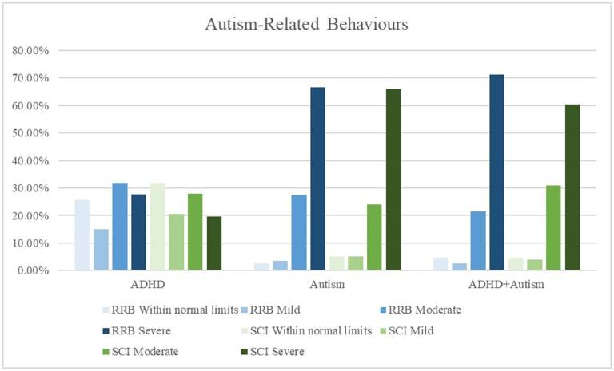
ADHD – Co-occurring with Autism
Mellahn et al, 2022. Frontiers Psych

Slide 183
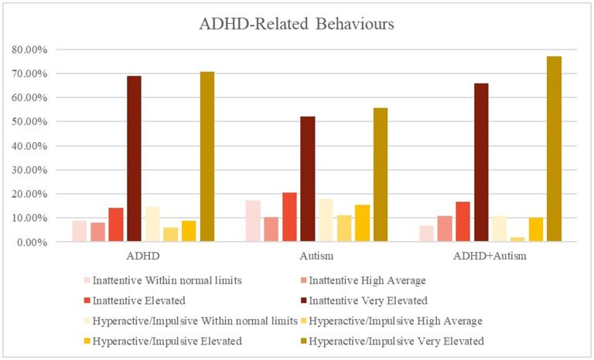
ADHD – Co-occurring with Autism
Mellahn et al, 2022. Frontiers Psych

Slide 184
ADHD – Co-occurring with Autism
The children with ADHD alone had a higher proportion of speech delay (5%) and learning disorders (17%).
The ADHD + Autism group reported higher rates of ID (5%), ODD (20%), anxiety (39%), depression (7%) and genetic conditions (3%).
Mellahn et al, 2022. Frontiers Psych

Slide 185
ADHD – Co-occurring with Autism
The children with ADHD alone were more likely to be on medication (90%), than the children in the ADHD + Autism group (86%) and in autism alone (39%).
The children with ADHD alone with likely to be on stimulants (81%).
Methylphenidate was the most common. The most frequently reported stimulant medications in the ADHD + autism group were lisdexamfetamine (19%) and methylphenidate extended release (19%).
The children with ADHD + autism had a higher proportion of non-stimulant ADHD medication (25%), antipsychotic (19%), antidepressant (22%) and melatonin (32%) use.
Mellahn et al, 2022. Frontiers Psych
Notes:
Discuss again later

Slide 186
ADHD – Neuroimaging

Slide 187
Neural networks
Using statistical analysis of the fMRI BOLD signal, widespread brain regions that showed functional connectivity, were defined as brain networks.
Some of these networks include:
Default Mode Network (Medial frontoparietal)
Salience (Mid cingulo-insular)
Attention (Dorsal frontoparietal)
Control (Lateral frontoparietal)
Sensorimotor (Pericentral)
Visual (Occipital)
Large Scale Brain Networks in Cognition: Emerging Principles, Menon 2011

Slide 188
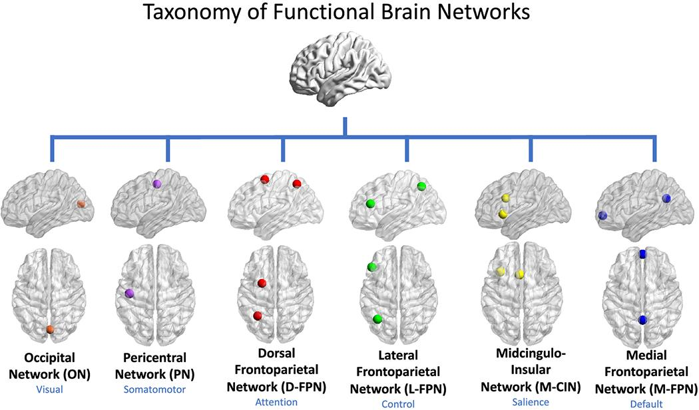
Neural networks
Uddin et al, 2019 Nov Brain Topography. Towards a universal taxonomy of macro-scale functional human brain networks

Slide 189
Brain mechanisms of attention
Role of attention: Prioritize incoming sensory processing to enable optimized behavioral responses given the task at hand.
The main neural mechanisms associated with attentional modulation of sensory inputs are:
target amplification and distractor suppression.
Bottom-up vs Top-down processes
i

Slide 190
Brain mechanisms of attention
Two distinct attention systems:
Dorsal frontoparietal: mediates top-down voluntary allocation of attention to location or features
Ventral frontoparietal system: detecting unattended or unexpected stimuli; triggers a switch in attention.
Corbetta and Shulman, 2002

Slide 191
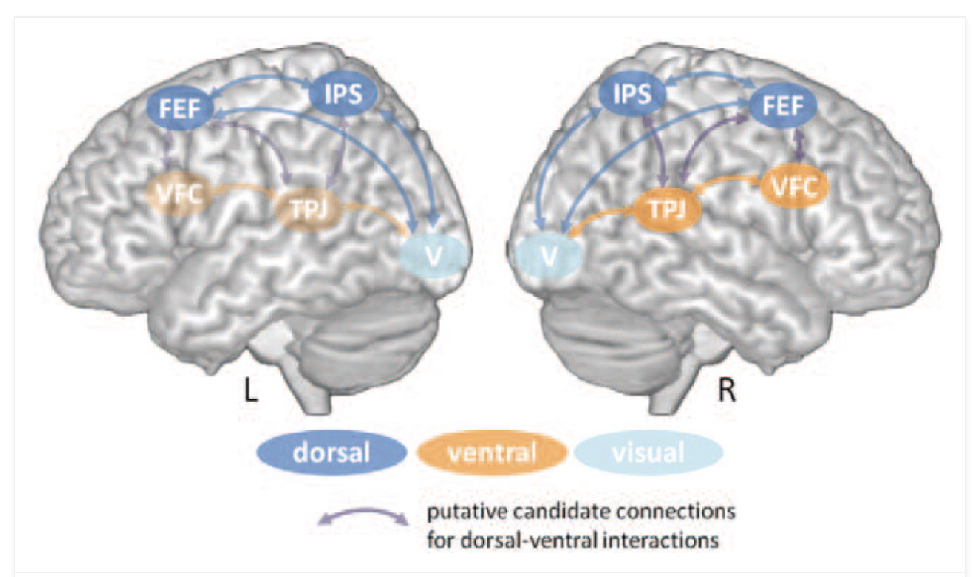
Brain mechanisms of attention
Vossel et al, 2013

Slide 192
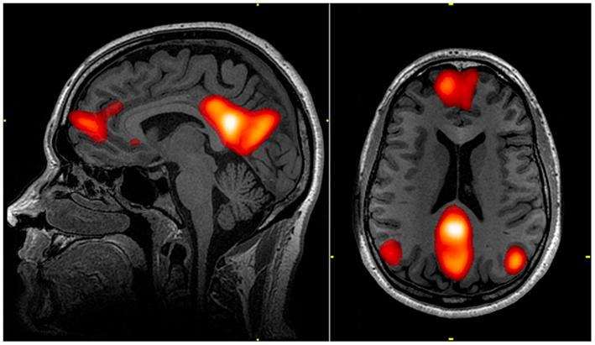
Default Mode Network (DMN)
The brain’s DMN is formed by a set of regions that are spontaneously active during passive moments.
It is also active during directed tasks that require participants to remember past events or imagine upcoming events.
Buckner, 2013 Dialogues Clinl Neurosci

Slide 193
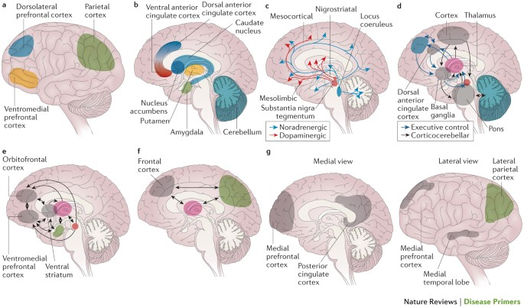
ADHD – brain mechanisms
Faraone el al. Nature Reviews Disease Primers 2015

Slide 194
ADHD – brain mechanisms
DLPFC – linked to WM
VMPFC – linked to complex decision making, strategic planning
Parietal cortex – linked to attention
Negative correlation between DMN and frontoparietal control network is weaker in persons with ADHD
Faraone el al. Nature Reviews Disease Primers 2015

Slide 195
ADHD – brain mechanisms
Stronger MPFC-DLPFC anticorrelations = superior cognitive control and cognitive performance in adults.
In typically developing children, with increase with age, there is increase in the magnitude of anti-correlations between the MPFC and DLPFC.
Top-down control mechanisms improve markedly over childhood and adolescence.
Resting-state fMRI studies have also shown an association between diminished MPFC-DLPFC anticorrelations and cognitive impairment in ADHD.
Kelly et al, 2008

Slide 196
Functional Imaging in ADHD vs ASD
45 children : 18 with ADHD (combined-type), 13 with ASD and 14 TD.
Age: 8-12 years
Saenz et al 2020. Translational Psychiatry

Slide 197
Functional Imaging in ADHD vs ASD
Saenz et al 2020. Translational Psychiatry

Slide 198
Autonomic nervous system activity in ADHD vs ASD
Hypoarousal in ADHD ?
Hyperarousal in autism?

Slide 199
Autonomic nervous system activity in ADHD vs ASD
106 children (mean age 10.81 years)
31 TD
18 autism
24 ADHD
33 Autism + ADHD
Bellato et al 2022. J Autism Dev Disorders

Slide 200
Autonomic nervous system activity in ADHD vs ASD
Hyper-arousal in children with autism, hypo-arousal in children with ADHD.
Children with autism: indices of hyper-arousal were found during both passive and active tasks (but not during resting-state) and were associated with reduced activity of the parasympathetic nervous system
Children with ADHD: indices of hypo-arousal (including reduced HR in those with ADHD-only) were found during the resting-state period and the passive auditory oddball task; and were more associated with reduced activity of the sympathetic nervous system.
Children with co-occurring autism and ADHD: did not display a unique profile distinct from autism- and ADHD-only but showed the same atypicalities found in children with ‘pure’ conditions, namely reduced CVI during the POP task and some sections of the passive oddball task (like children with autism-only) and reduced CSI during the initial resting-state period and the oddball task (like children with ADHD-only).
These findings, at least in the domain of arousal dysregulation, support the additive model of autism/ADHD comorbidity.
Bellato et al 2022. J Autism Dev Disorders

Slide 201
ADHD – Social factors
It is estimated that by the age of 12 years, children with ADHD get about 20,000 more negative messages about themselves than other children their age.

Slide 202
ADHD – Social factors
“messy…” clumsy” “…too flaky”
“… lazy…” “unfocused”
“careless” “forgetful” “disorganized”
“…why can’t you be like everyone else…”
Beaton et al 2022, Experience of criticism in adults with ADHD: A qualitative study. PLOS One

Slide 203
ADHD – Social factors
“I am met with very little understanding from my family. I am doing what needs to be done and working hard”
“I am often criticized for being late”
“Frequent comments, jokes and sarcasm about my level of forgetfulness which are unintentionally hurtful”
”feel like a lot of my family and acquaintances think I’m pitiful or stupid/lazy.”
Beaton et al 2022, Experience of criticism in adults with ADHD: A qualitative study. PLOS One

Slide 204
ADHD – Social factors
“Any suggestion, critique or something similar from anyone cuts like a knife and leaves me unable to feel anything but devastated for days.”
“I think that some of my friends don’t understand to the extent I am unable to do things without being medicated, and that I can’t simply force myself into a schedule and magically fix everything, even getting out of bed and getting dressed requires focus I am sometimes unable to summon.”
“I don’t have many friends and feel a burden to the ones I have which makes me think they are not really my friend.”
I am often forgetful and spacey. Sometimes, I don’t think things through. These criticisms are fair and I always keep it in mind, however it still causes me to have anxiety sometimes.”
Beaton et al 2022, Experience of criticism in adults with ADHD: A qualitative study. PLOS One

Slide 205
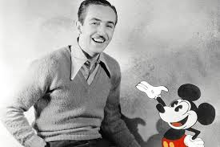
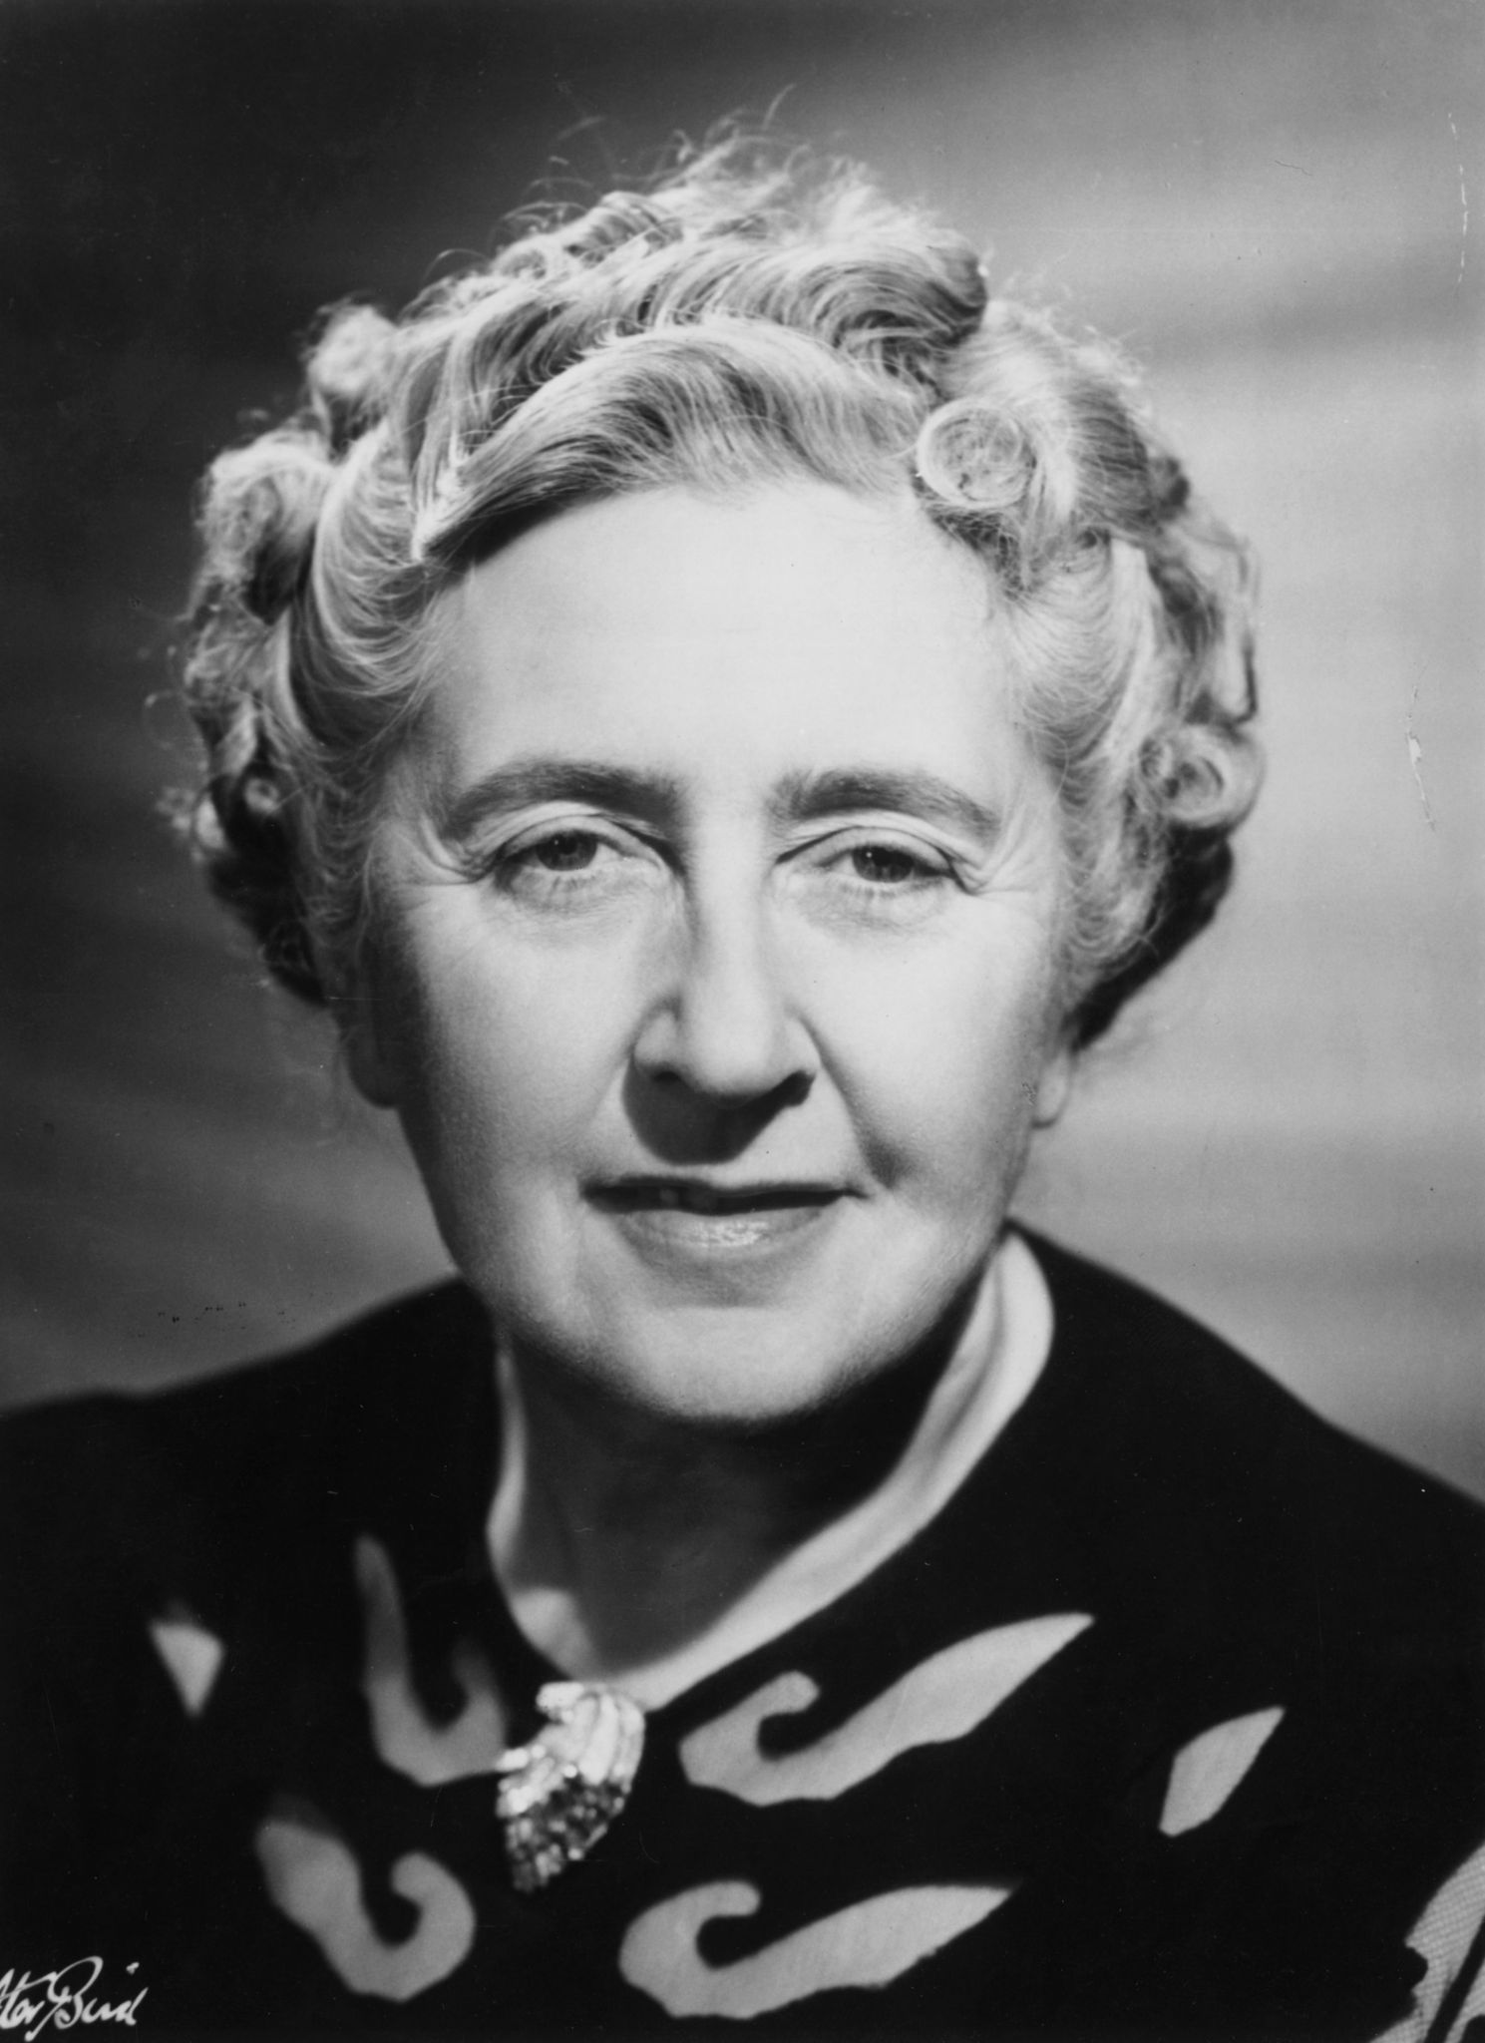
Famous personalities with ADHD

Slide 206
ADHD Management

Slide 207
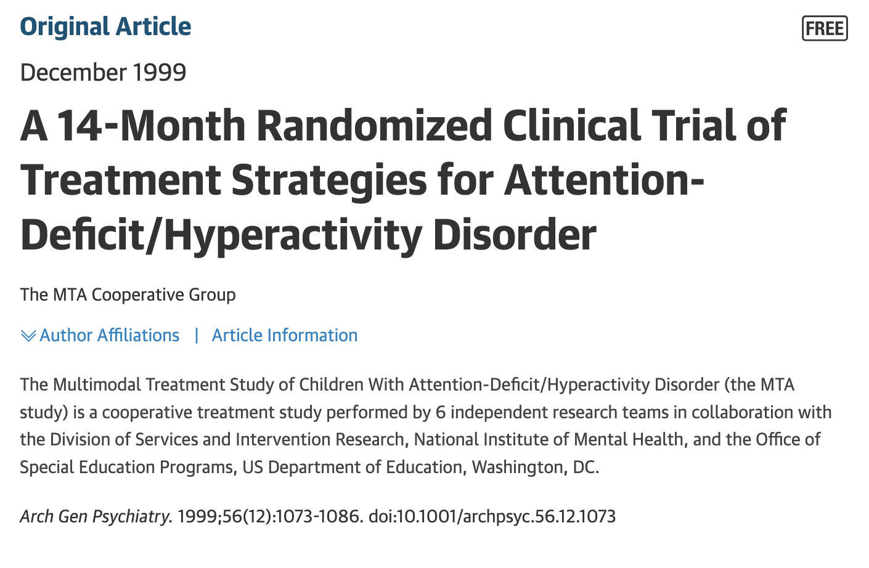
ADHD management: MTA study

Slide 208
ADHD management: MTA study
579 children with ADHD Combined Type,
Ages: 7 to 9.9 years
Assigned to 14 months of:
a. Medication management (titration followed by monthly visits)
B. Intensive behavioral treatment (parent, school, and child components, with therapist involvement gradually reduced over time)
C. The two combined;
D. Standard community care (treatments by community providers)
- Outcomes were assessed in multiple domains before, during treatment and at treatment end point (with the combined treatment and medication management groups continuing medication at all assessment points).
MTA study group, Arch Gen Psych, 1999

Slide 209
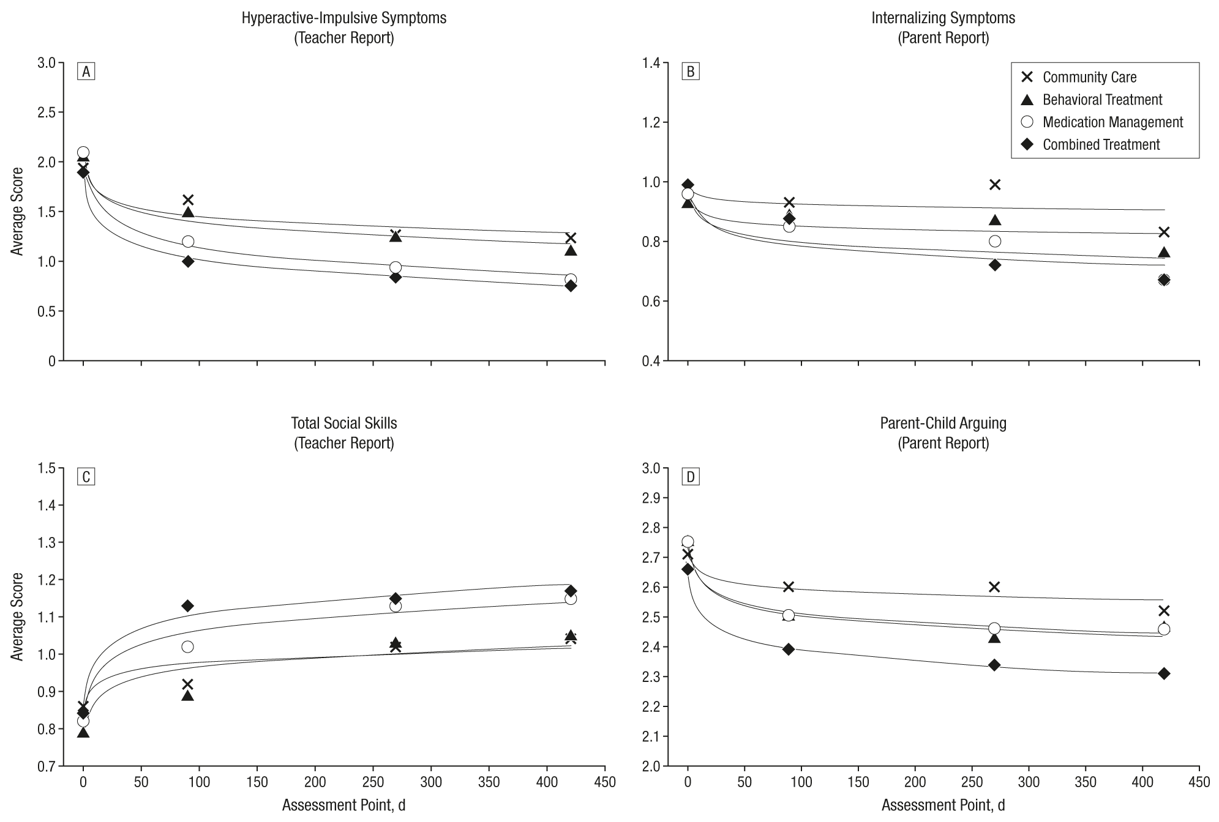
ADHD management: MTA study outcomes
MTA study group, Arch Gen Psych, 1999

Slide 210
ADHD management: MTA study
All 4 groups showed sizable reductions in symptoms over time.
Children in the combined treatment and medication management groups showed significantly greater improvement than those given intensive behavioral treatment and community care.
Combined and medication management treatments did not differ significantly on any direct comparisons; but in several instances (oppositional/aggressive symptoms, internalizing symptoms, teacher-rated social skills, parent-child relations, and reading achievement) combined treatment proved superior to intensive behavioral treatment and/or community care while medication management did not.
Study medication strategies were superior to community care treatments, despite two thirds of community-treated subjects receiving medication during the study period.
MTA study group, Arch Gen Psych, 1999

Slide 211
ADHD – medication management
Stimulants
Methylphenidate : Ritalin, Focalin, Concerta
Amphetamines: Adderall, Vyvanse
Non-stimulants
Alpha-2 adrenergic agonists: clonidine, guanfacine
Strattera

Slide 212
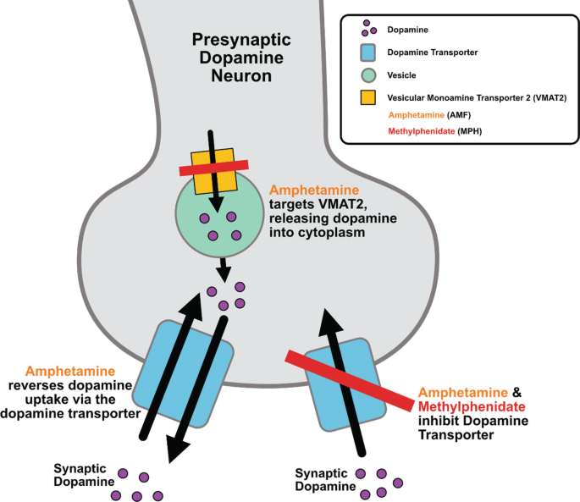
ADHD – medication management
Stimulants – mechanism of action

Slide 213
ADHD – medication management
Stimulants
Duration of action:
Short acting: 3-4 hours
Medium acting: 6-8 hours
Long acting: 10-12 hours
Delivery mechanisms:
Tablets
Microbead technology
Prodrugs
Liquids
Transdermal

Slide 214
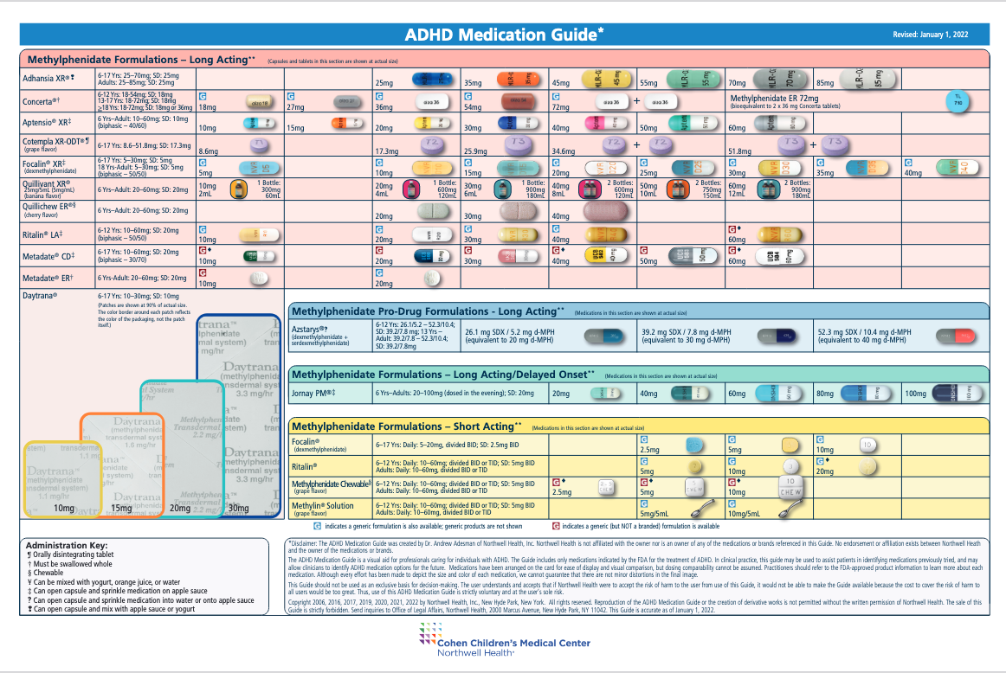
ADHD – Stimulants: Methylphenidate

Slide 215
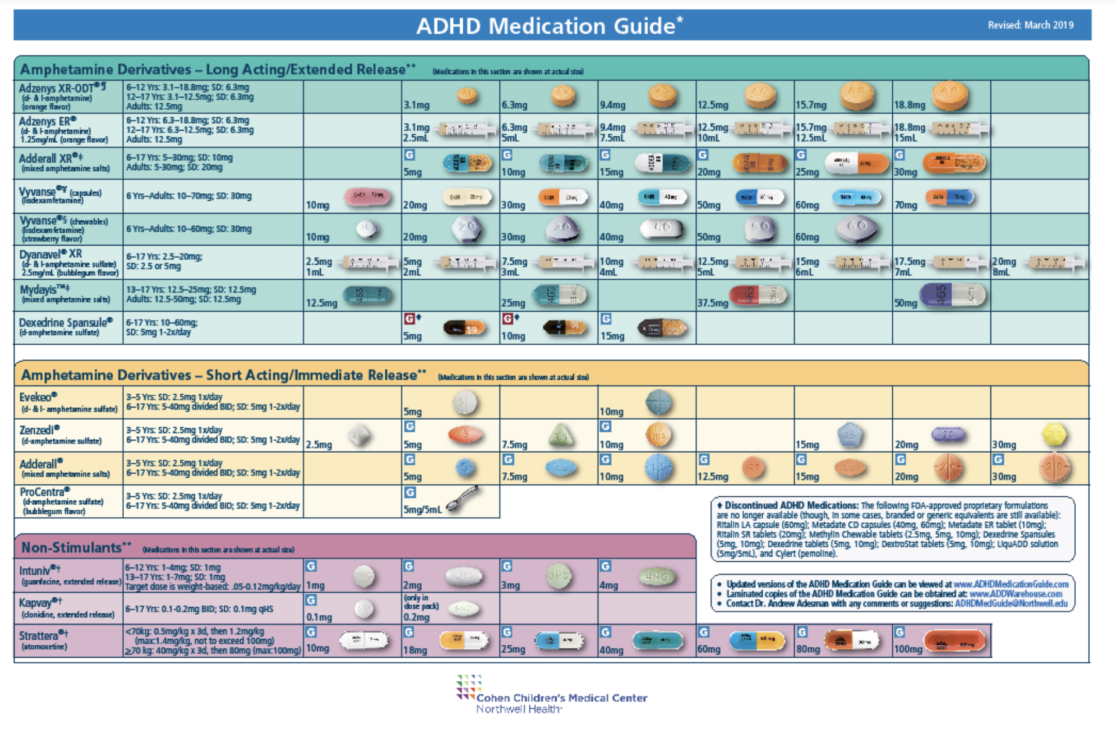
ADHD – Stimulants: Amphetamines

Slide 216
ADHD – Co-occurring with Autism
Stimulants are very effective in ADHD (without ASD) (ES = 1.03).
While effective for managing ADHD symptoms in ASD, effect sizes are lower in ADHD + ASD (ES = .67)
Methylphenidate is associated with higher rates of side effects such as social withdrawal, depression, and irritability when used in ASD.
Reichow et al, 2013. J Autism Dev Disord

Slide 217
ADHD – medication management
Second-generation Antipsychotics:
risperidone, aripiprazole
Effect on D2 receptor antagonism + 5HT2A antagonism.
Aripiprazole acts as a partial dopamine agonist.
“Goldilocks zone”
Notes:
the alterations in dopaminergic transmission could be the cause of reduced motivation to pursue social interactions, since the brain of autistic individuals could register these activities as “not rewarding.” The reduced motivation also leads to reduced social experience and consequently to deficits in the development of social cognition.

Slide 218
ADHD – Co-occurring with Autism
The children with ADHD alone were more likely to be on medication (90%), than the children in the ADHD + Autism group (86%) and in autism alone (39%).
The children with ADHD alone with likely to be on stimulants (81%).
Methylphenidate was the most common. The most frequently reported stimulant medications in the ADHD + autism group were lisdexamfetamine (19%) and methylphenidate extended release (19%).
The children with ADHD + autism had a higher proportion of non-stimulant ADHD medication (25%), antipsychotic (19%), antidepressant (22%) and melatonin (32%) use.
Mellahn et al, 2022. Frontiers Psych

Slide 219
ADHD –behavioral management
Parent Training in Behavioral Management (PTBM)
Social Skills Training
Cognitive Behavioral Therapy

Slide 220
ADHD –behavioral management
School Support
504 plan
vs
IEP: Individualized Education Plan

Slide 221
ADHD –management of co-occurring conditions
Sleep disorders:
Use of melatonin for sleep initiation
Sleep study for evaluation, r/o sleep apnea
Tic disorder
Anxiety
CBT
SSRIs
OCD

Slide 222
Resources for ADHD Management

Slide 223
Resources for ADHD Management
AAP Toolkit

Slide 224
Resources for ADHD Management
AAP Toolkit
ADHD: What Every Parent Needs to know

Slide 225
Resources for ADHD Management
AAP Toolkit
ADHD: What Every Parent Needs to know
ADD Magazine:
www.additudemag.com

Slide 226
Resources for ADHD Management
www.chadd.org

Slide 227
Resources for ADHD Management
www.greaterocchadd.org

Slide 228
Complementary and Alternative Therapies
Vitamins, including Zinc, Magnesium, Omega-3- Fatty Acids
Mindfulness techniques
Trigeminal nerve stimulator
Neurofeedback, Biofeedback therapies
Video-game based therapy for increasing attention: EndeavorRx.
Further research is needed to study long-term outcomes with these therapies.

Slide 229
eTNS
.

Slide 230
EndeavorRX
.

Slide 231
Take home points
ADHD is the most treatable disorder in psychiatry.
Management using combined medication and behavioral approach has shown best outcomes.
Stimulants are among the most effective treatments in medicine with effect sizes of 1, though the effect size may be smaller in ASD+ ADHD (0.67). Non-stimulants may also be efficacious in ASD +ADHD.
Useful tools for management are available through the AAP, CHADD.

Slide 232
References
MTA study
AACAP Practice Parameters
ADHD toolkit
Capute and Accardo’s Neurodevelopmental Disabilities in Infancy and Childhood, 3rd edition.
Faraone et al. Attention deficit Hyperactivity Disorder, 2015. Nature Review Disease Primers
Bellato et al. Heart Rate Variability in Children and Adolescents with Autism, ADHD and Co-occuring Autism and ADHD, during Passive and Active Experimental Conditions, 2022 J Autism Dev Disorder
Mellahn et al. 2022.Understanding the Diversity of Pharmacotherapeutic Management of ADHD With Co-occurring Autism: An Australian Cross-Sectional Survey, 2022. Front Psych
Beaton et al. Experience of criticism in adults with ADHD: A qualitative study, 2022. PLOS One

Slide 233
QUESTIONS?

Slide 234
THANK YOU!
CONTACT: hitha.amin@choc.org

Slide 235
Afternoon Break
Notes:
Welcome slide –
Text: Welcome / Thompson Autism and Neurodevelopmental Center Conference / Working Together to Expand Horizons / 2023
Logos: TANC, Glennwood, TPI

Slide 236
THOMPSON
Autism and
Neurodevelopmental Center
Integrative Approaches to Managing Comorbid Conditions in Autism Spectrum Disorder: An Interdisciplinary Perspective
Michael J. Cameron, Ph.D., BCBA-D, LBA
Director, Severe Behavior Program

Slide 237
Disclosure
I do not have relevant financial relationship(s) to disclose with ineligible companies whose primary business is producing, marketing, selling, re-selling, or distributing healthcare products used by or on patients.
I do not intend to discuss an unapproved/investigative use of a commercial product/device.

Slide 238
Capability
Comfort
Calm

Slide 239
Capability measures a patient’s
functional status.

Slide 240
Comfort measures
relief from physical and emotional
pain.

Slide 241
Calm measures the extent to
which patients maintain a high quality
of life during services

Slide 242
The common medical comorbidities among the ASD population include epilepsy, sleep disorders, gastrointestinal disorders, metabolic disorders, hormonal dysfunction, osteoporosis, obesity, otitis media, hearing impairment, bladder and renal disorders, hypertension, diabetes, recurrent headaches and migraines, oral diseases (e.g., dental caries), immune disorders, and bacterial and viral illnesses (Bauman, 2010).

Slide 243
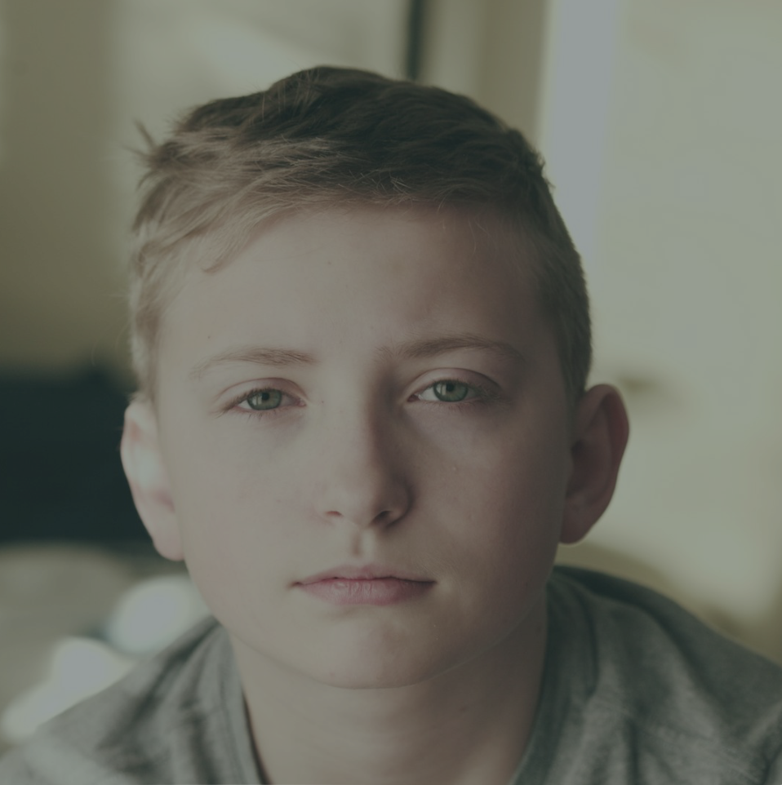
Psychiatric disorders are also prevalent among children with ASD. Rosen et al. (2018) have reported that 70–72% of children with ASD have at least one co-occurring psychiatric condition.
The most common being anxiety and mood disorders, obsessive-compulsive disorder, attention deficit hyperactivity disorder, and oppositional defiant disorder.

Slide 244
These comorbid conditions are correlated with increased use of pharmacology (Mandell et al., 2008), increased healthcare utilization (Gurney et al., 2006), and the termination of ASD therapeutic services (Croen et al., 2017). The principal cause of treatment discontinuation (e.g., applied behavior analysis services) is familial stress (Kerns et al., 2015b).

Slide 245
Interdisciplinary Collaboration
Primary Care
Developmental Pediatrician
Psychiatrist
Psychologist
Speech and Language Pathologist
Occupational Therapist
Physical Therapist
Orientation and Mobility Specialist

Slide 246
Anticipatory Guidance:
A critical component of
pediatric care

Slide 247
Sleep

Slide 248
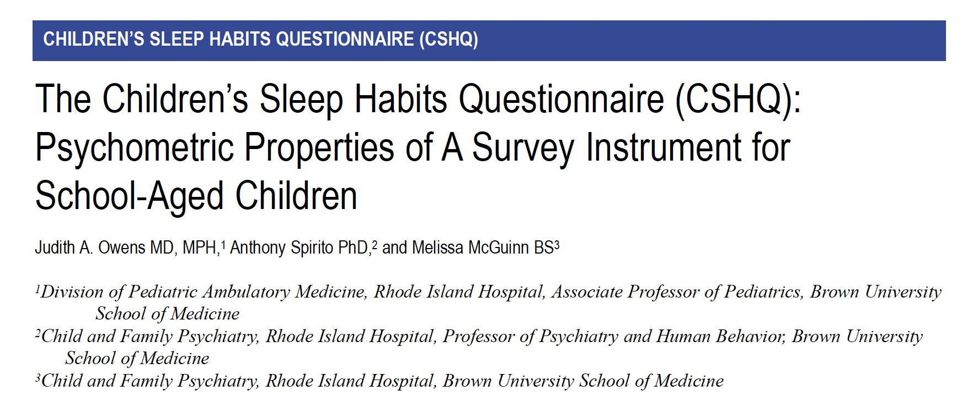

Slide 249
Medication

Slide 250
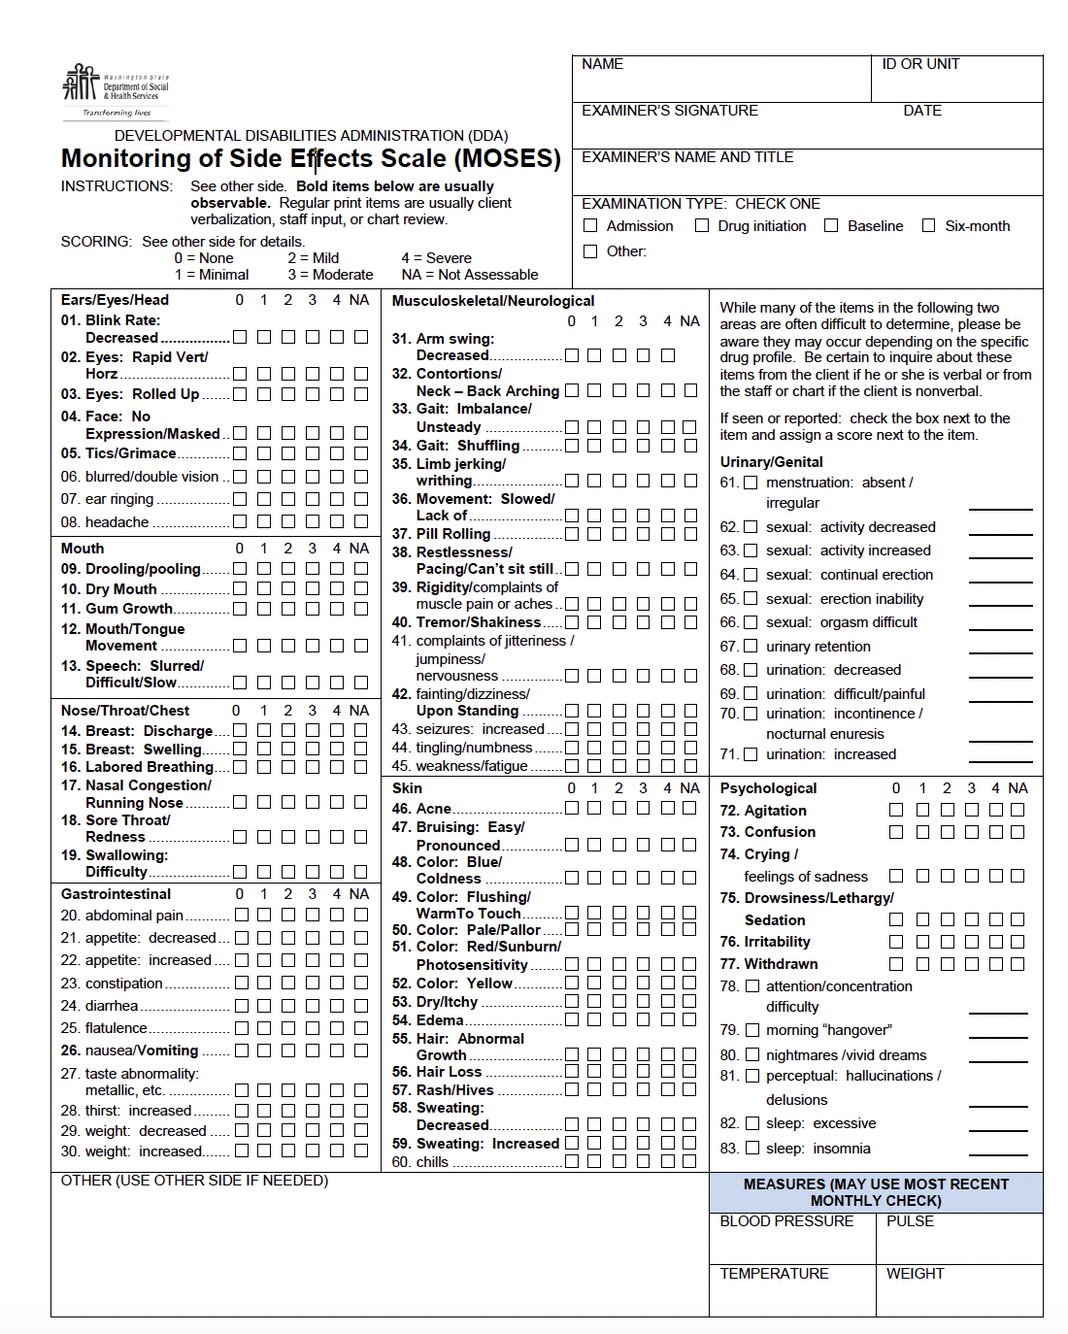

Slide 251
Gastrointestinal
Problems

Slide 252
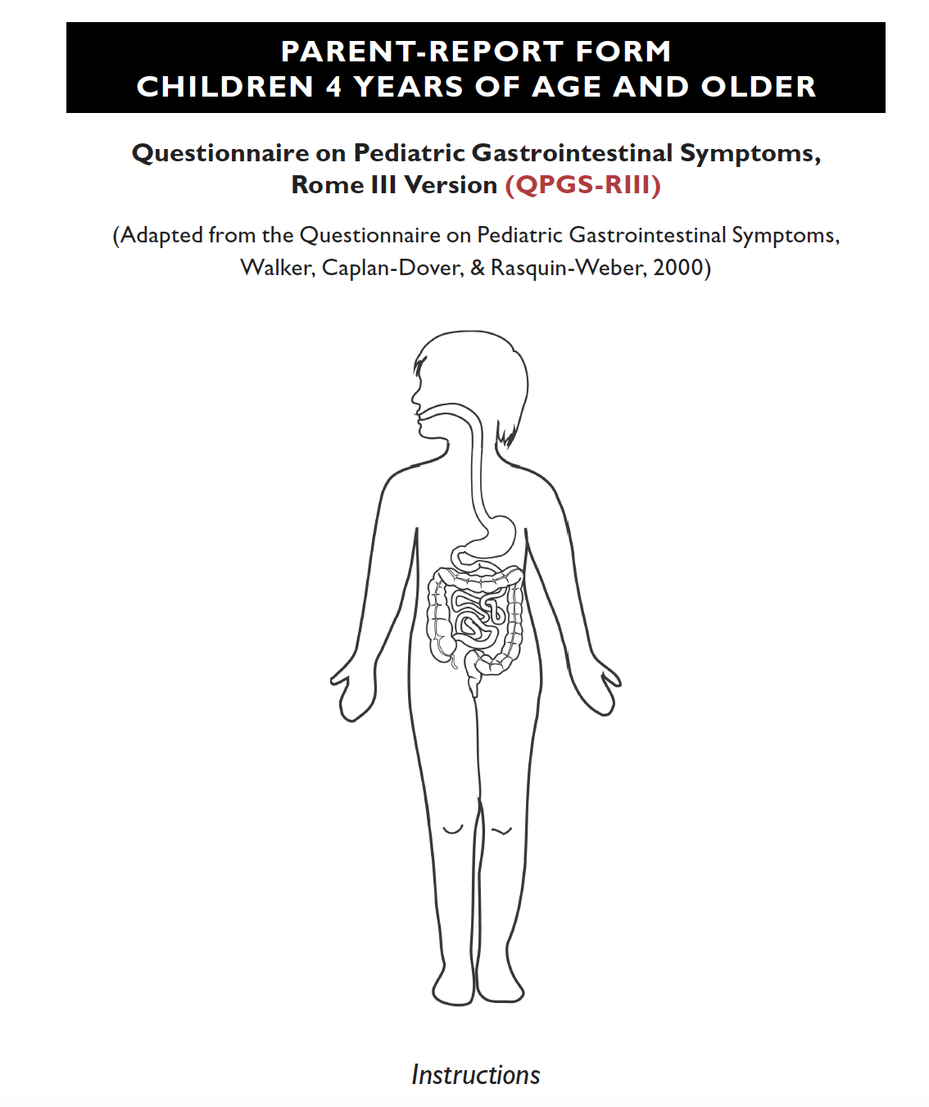

Slide 253
Case Study

Slide 254
