Slide 1
SOCIAL SECURITY AND WORKING

Slide 2
WHAT IS TICKET TO WORK
Social Security’s Ticket to Work program supports career development for individuals ages 18 through 64 who receive Socials Security disability benefits (SSI or SSDI) and want to work. The Ticket Program is free and voluntary. It helps people with disabilities move toward financial independence and connect them with the services and support they need to succeed in the workplace

Slide 3
Why Should You Partner With a Ticket to Work Employment Network
No Medical Review for five (5) years if making timely progress
Help manage your SSA Cash Benefits
Help monitor proper reporting requirements when working
Direct access to Social Security
Explain any letters that you get from SSA
Long term support for success while working

Slide 4
Services Offered
Free Career & Benefits counseling for SSI & SSDI beneficiaries
We assist individuals that have a Ticket to Work to secure employment
All services free of charge including
Career Counseling
Benefits Counseling and Management with our CPWICs (Community Partner Work Incentive Coordinators)
Vocational Evaluation
Individualized Work Plan (IWP)
Resume Development
ADA Job Accommodations
Labor Market Research
Ongoing Employment Support
Practice Interviewing

Slide 5
KNOW THE NAME OF YOUR BENEFIT
THE “S” BENEFITS

Slide 6
CASH BENEFITS MAY BE AFFECTED IF INDIVIDUAL RETURNS TO WORK – SSA PROVIDES WORK INCENTIVES TO TRY WORKING. EACH BENEFIT HAS ITS OWN RULES AND INCOME LIMITS. IT IS IMPORTANT THAT BENEFICIARY GETS CORRECT INFORMATION
IT IS VERY IMPORTANT TO KNOW THE CORRECT NAME OF THE BENEFIT AN INDIVIDUAL IS RECEIVING OR APPLYING FOR. Each benefit has its own application process, reporting requirements and cash benefit amounts.
***Social Security Disability Insurance (SSDI) (Federal) – individual has worked and paid FICA taxes - cash benefit will vary
***Supplemental Security Income (SSI) (Federal) - individual has no work history
and cash benefit is based upon living arrangement
State Disability Insurance (SDI)
Short Term Benefit from State of California – Individual can apply online and cash benefit determined by amount paid into the system from payroll taxes.

Slide 7
WHY WORKING IS IMPORTANT WHILE RECEIVING BENEFITS
Accumulate SSA Work Credits (quarters of coverage)
An individual under the age of 24 needs 6 credits to be eligible for SSDI (Title 2)
In 2023, $1,640.00 equals one quarter of coverage – total $6,560.00 year
If receiving SSI cash benefits will eventually transition to SSDI and be eligible for Medicare
Quality of Life
Independence

Slide 8
MYTHS DEBUNKED
If I go to work I will lose my cash benefits
I will lose my Medi-Cal
I will be in overpayment
Too much trouble

Slide 9
FALSE

Slide 10
Social Security Work Incentives
Student Earned Income Exclusion (SEIE)
Impairment Related Work Expenses (IRWE)
1619b – Medi-Cal coverage if earnings zero out SSI cash benefit
Subsidies
Expedited Reinstatement (EXR)
Only 1619b is automatic – the other Work Incentives have to be requested

Slide 11
STUDENT EARNED INCOME EXCLUSION
Full time student up to the age of 22 will have $8,950.00 of gross earnings in 2023 EXCLUDED before SSI cash benefit is affected
Must request – it is not automatic
Notify when student graduates – otherwise will be subject to overpayment

Slide 12
IMPAIRMENT RELATED WORK EXPENSES
SSA allows an individual to deduct from gross earnings any out of pocket expenses that they need to go to work
Transportation – driver
Job Coaches if not Regional Center

Slide 13
AN INDIVIDUAL WILL ALWAYS MAKE MORE WHEN WORKING AND COLLECTING SSI BENEFITS

Slide 14
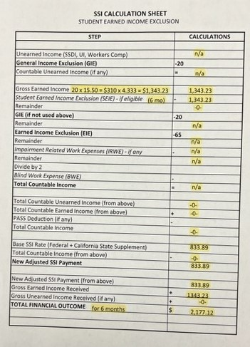

Slide 15
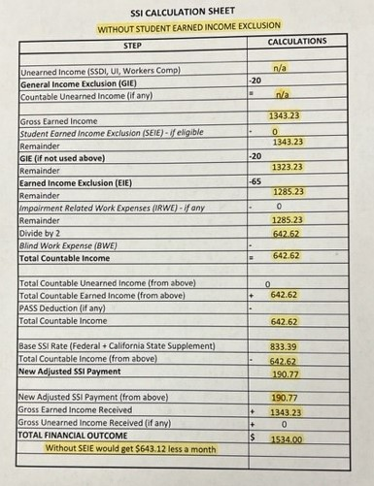

Slide 16
TICKET TO WORK AND HOW WE CAN HELP
If you sign up with an Employment Network you will have support as long as it takes to get a job and work successfully as long as all the terms of the Ticket to Work program are met
The application process is simple and it is a non-binding contract that can be cancelled by the beneficiary or Employment Network anytime

Slide 17
IMPORTANT THINGS TO REMEMBER
REPORT ANY CHANGES TO SSA
REPORT WAGES – START AND STOP WORKING
WHEN GRADUATING AT THE AGE OF 22

Slide 18
WE ARE HERE TO HELP Contact: Renee Melton, SSA Benefits Specialist

