Slide 1
ORANGE COUNTY LOCAL PARTNERSHIP AGREEMENT The Power of Collaboration & Partnerships Alameda & Contra Costa LPA
August 22, 2023

Slide 2
OCLPA PRESENTERS
Anita Kwon Regional Center of Orange County Employment & Day Services Manager akwon@rcocdd.com (714) 796-5102 | Adam Gottdank, Ph.D. North Orange Continuing Education Associate Dean Disability Support Services agottdank@NOCE.edu (714) 808-4716
Kathi Millett Goodwill of Orange County Program Director kathi@ocgoodwill.org (714) 240-7328 | Linda O’Neal, M.A. Chapman University, Thompson Policy Institute, SDSU II and RCOC Transition Specialist linda_oneal@cox.net (949) 374-0270

Slide 3
CU THOMPSON POLICY TRANSITION INITIATIVE OCLPA GOOGLE DRIVE
Materials from today’s presentation are available in the TPI OCLPA Google Shared files as follows:
https://drive.google.com/drive/folders/1pobyTxWMasNUZYZJ-7BSqfucZeupF9Br?u
Tiny URL:
https://tinyurl.com/mr3u87js

Slide 4
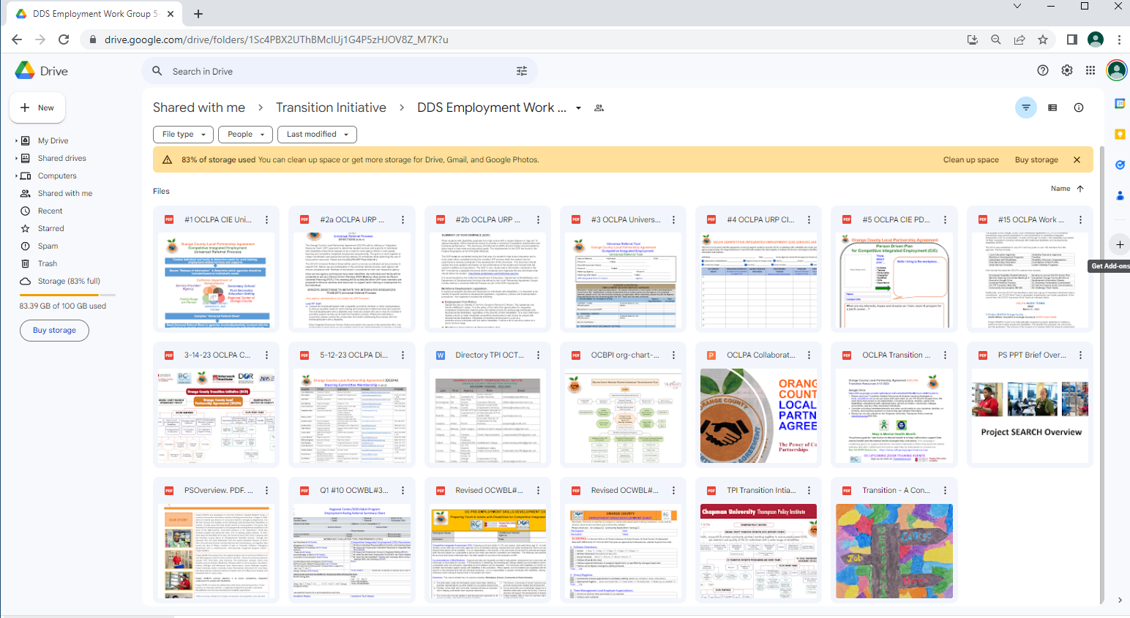

Slide 5
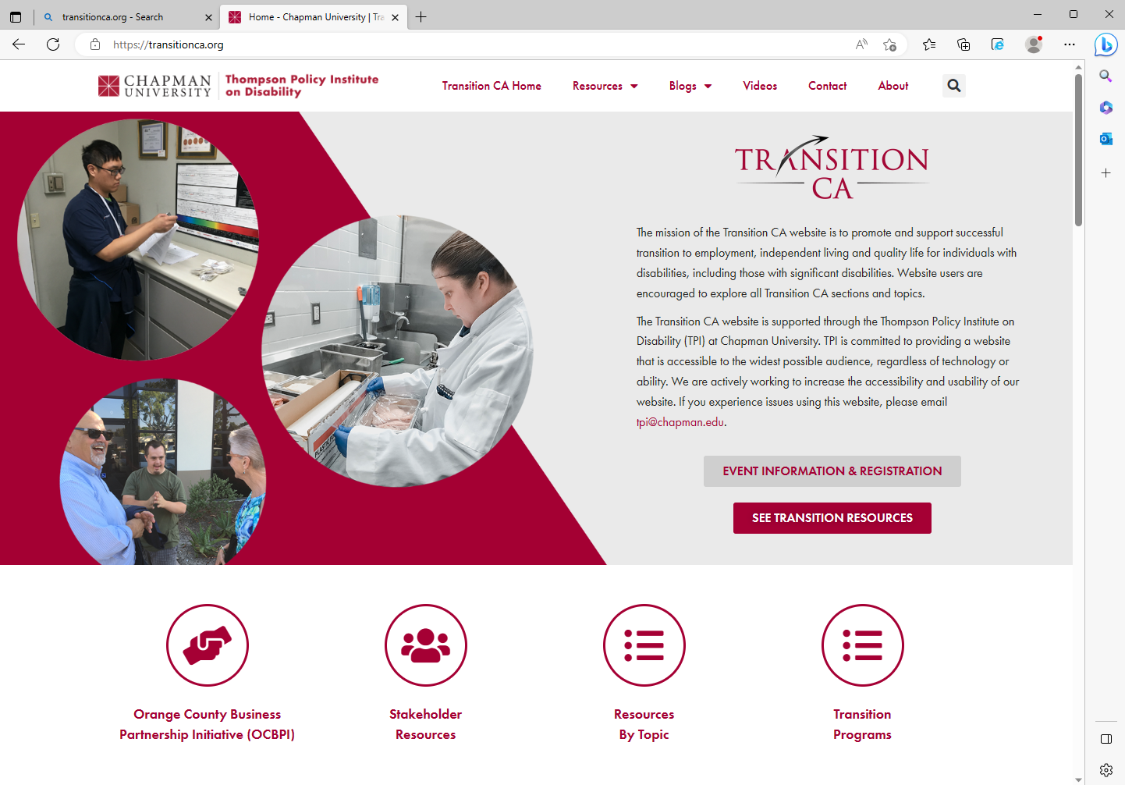
Transitionca.org

Slide 6
ORANGE COUNTY LOCAL PARTNERSHIP AGREEMENT
Logo developed by
Dane Cangro, Tustin USD

Slide 7
ORANGE COUNTY LPA PURPOSE
The purpose of the Orange County Local Partnership Agreement (OCLPA) is to enhance partnerships that promote preparation for and achievement of competitive integrated employment (CIE) for
youth/adults, 14 years old through 30 years+, with disabilities
& related “At Risk” populations including individuals with intellectual disabilities and developmental disabilities (ID/DD).

Slide 9
OCLPA Work Teams
Project SEARCH | CIE Data Collection
Post Secondary Education DEI Services & Supports | Benefits Planning & Mangement
Agriculture Work Team | Family Work Team
OC Work Based Learning CIE Documents | Business Site Accommodations

Slide 10
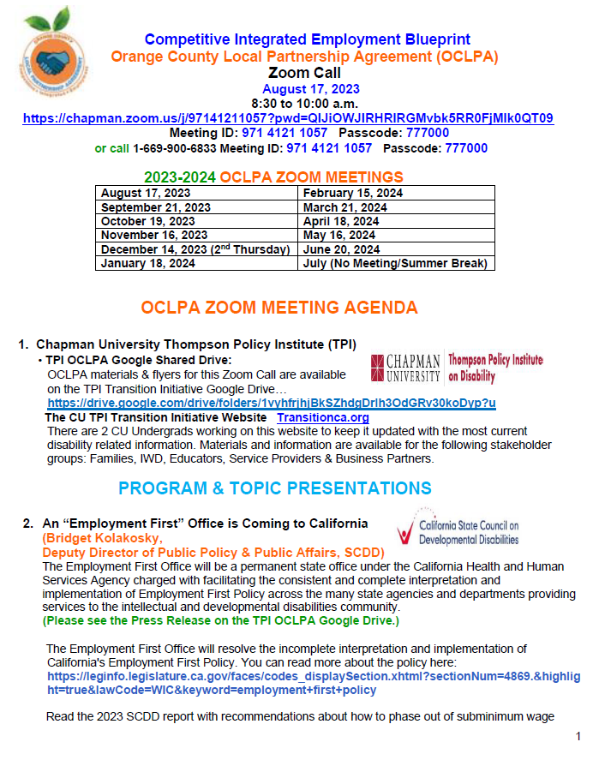
MONTHLY OCLPA STEERING COMMITTEE MEETING
AGENDA SECTIONS:
Program & Topic Presentations
Discussion Topics
OCLPA Work Team Updates
Planning & Ongoing Talks
PSE Opportunities
Resources & Services
Webinars, Zooms, Podcasts & Community Events
For Your Information

Slide 11
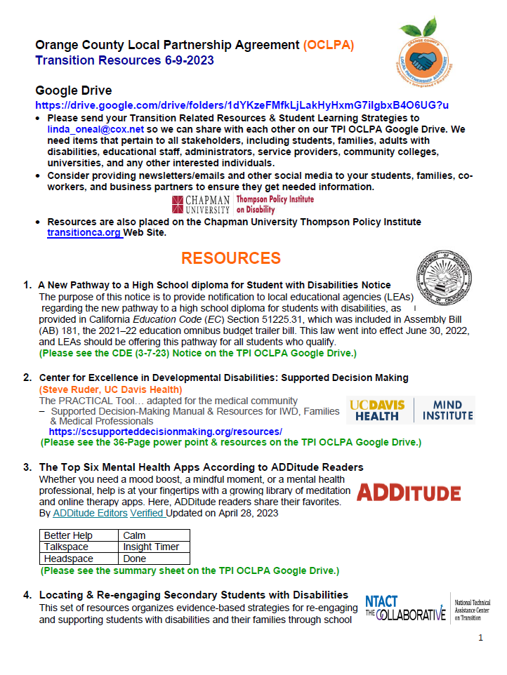
MONTHLY OCLPA TRANSITION RESOURCES LIST
SECTIONS:
Resources
PSE Opportunities
Webinars, Zooms & Community Activities
For Your Information

Slide 12
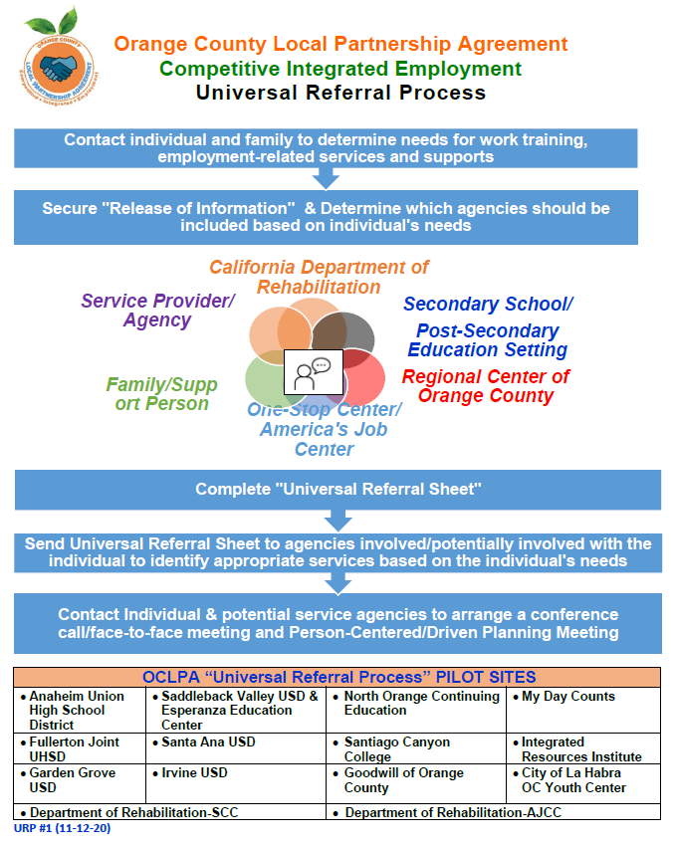
OCLPA Universal Referral Process

Slide 14
Preparing for CIE…START EARLY
Preparation begins at a young age
Dress/Hygiene
Following Directions
Time Management
Work Tasks
Communication and Socialization
http://www.rcocdd.com/wp-content/uploads/2017/05/OCWBL1-OC-Pre-Employment-Skills-Development-Chart-7-18-16.pdf

Slide 15
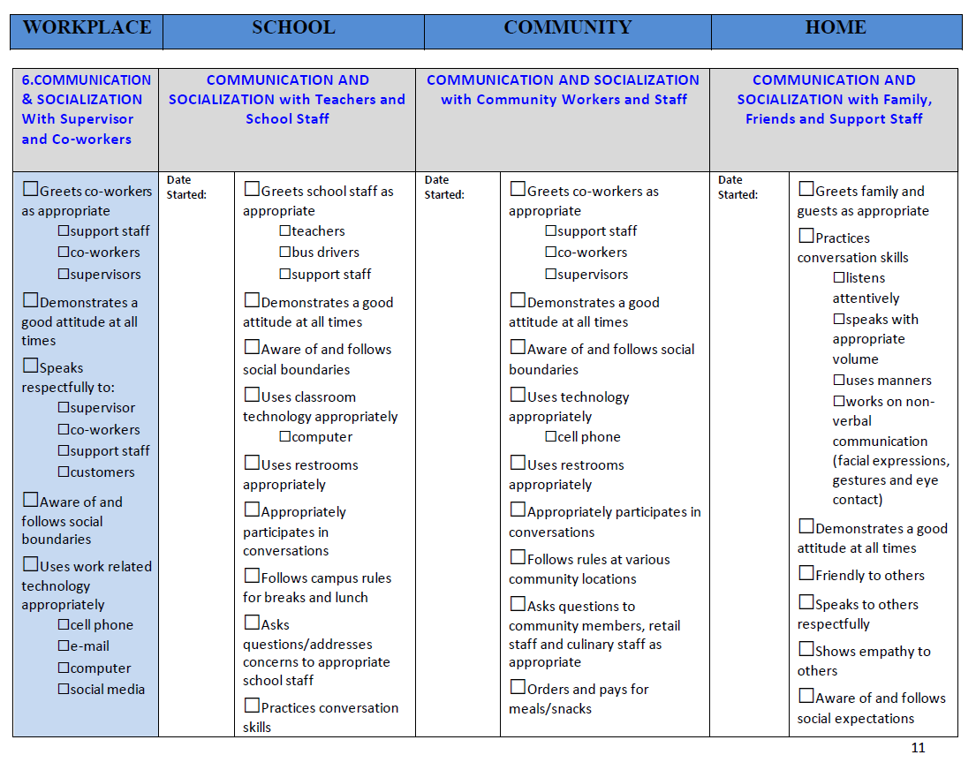

Slide 16
North Orange Continuing Education Adam S. U. Gottdank, Ph.D. Associate Dean, Disability Support Services (DSS)
Inclusion in Higher Education & Employment

Slide 17
sub- committee on postsecondary & employment inclusion

Slide 18
Identification of
student needs
services that currently exist
services that are needed
program models
Research that promotes transition, inclusion, persistence, and success of students with disabilities
postsecondary education & employment
intersectionality factors
provide recommendations to the OCLPA Steering Committee
for best practices
implementation
Purpose of sub-committee

Slide 19
Promising Practices
Person-Centered Planning/Interactive Process
Specialized Counseling
Intrusive case management
Coordination of inclusive services
Educational Coaching
Specialized instructional labs and tutoring
Universal Design for Learning
Use of Emerging Technologies
Governance Policies

Slide 20
Promising Practices
Ally Programs
Technology training
Peer Mentors
Teaching students to navigate campus
Labs that support neuro-diversity
Co-enrollment in DSS classes
Specialized AA degree or certification
Transportation / mobility training
Partner with independent living programs

Slide 21
Inclusion: 2 Broad Pathways
Transition To:
Higher Education
Programs and services that support inclusion
Workforce
Programs and services that support employment

Slide 23
Community Partners Working for CIE Success

Slide 24
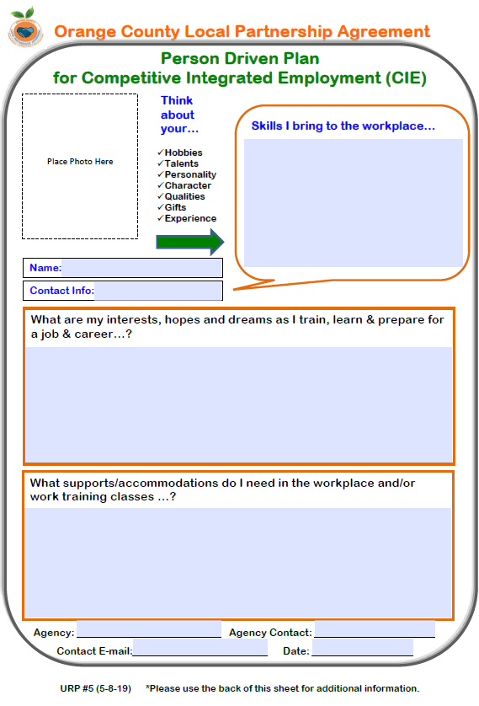
OCLPA
Person Driven Planning Document

Slide 25
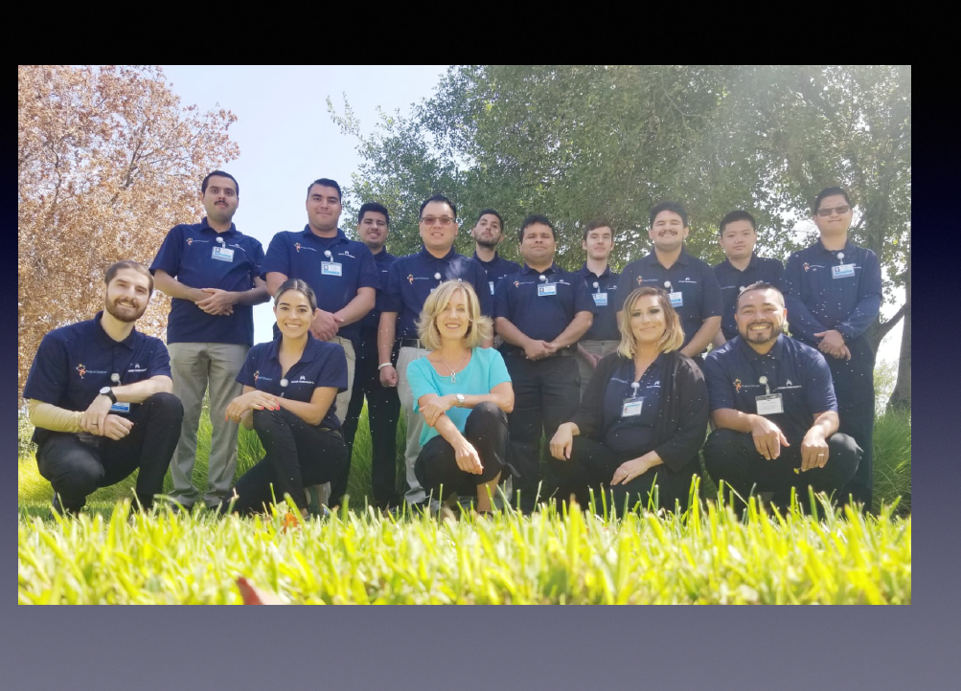
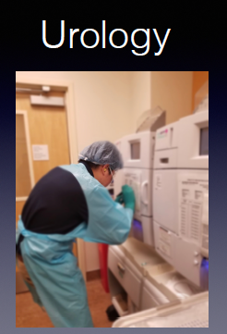

Slide 26
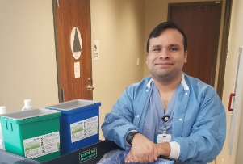
OCLPA SUCCESS STORY: ALEX
RCOC: Tailored Day Services
Disabled Student Services and WorkAbility III
North Orange Continuing Education
Cypress College
Alex: Employed at Kaiser Permanente Irvine Medical Center (40 hrs./wk. at $18/hr.)
GOAL!
Competitive Integrated Employment (CIE)
Regional Center of Orange County (RCOC)
GOC: Supported Employment
RCOC:
Transportation provided by OC Cab. Co.
Families
DOR
NOCE
Department of Rehabilitation
(DOR)
Goodwill of Orange County
Project SEARCH
RCOC
Kaiser Permanente
Anaheim Medical Center
CU Thompson Policy Institute

Slide 27
ORANGE COUNTY COMPANIES WHO HAVE HIRED PROJECT SEARCH GRADUATES
UCI Medical Center
CHOC Children’s Hospital
Kaiser Permanente Irvine
Manhattan Data LLC
Brackens Kitchen
White Bottle
Irvine Regional Outdoor Education Center
Goodwill of Orange County
St. Jude Medical Center
Los Alamitos Armed Forces Training Base
Micro-Center
Ruff House Pet Care
Capstone Financial
St. Joseph’s Hospital
Volcom
Alta-Med
Kaiser Anaheim Medical Center
Village Green Foods
Macy’s
Chic Party Rentals
Goodwill OC Leadership:
Rick Adams
Kathi Millett
Diana Nevarez
Al Rivera

Slide 28
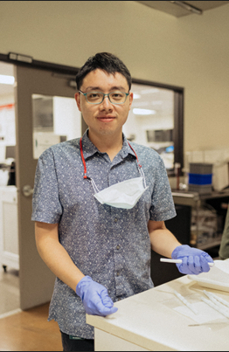
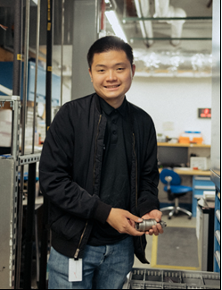
PIP to CIE
Aaron Nguyen
Warehouse Assistant, MRO Warehouse (Maintenance/Repairs/
Operations)
Pei Hsein Lin
Lab Assistant Star Lab

Slide 29
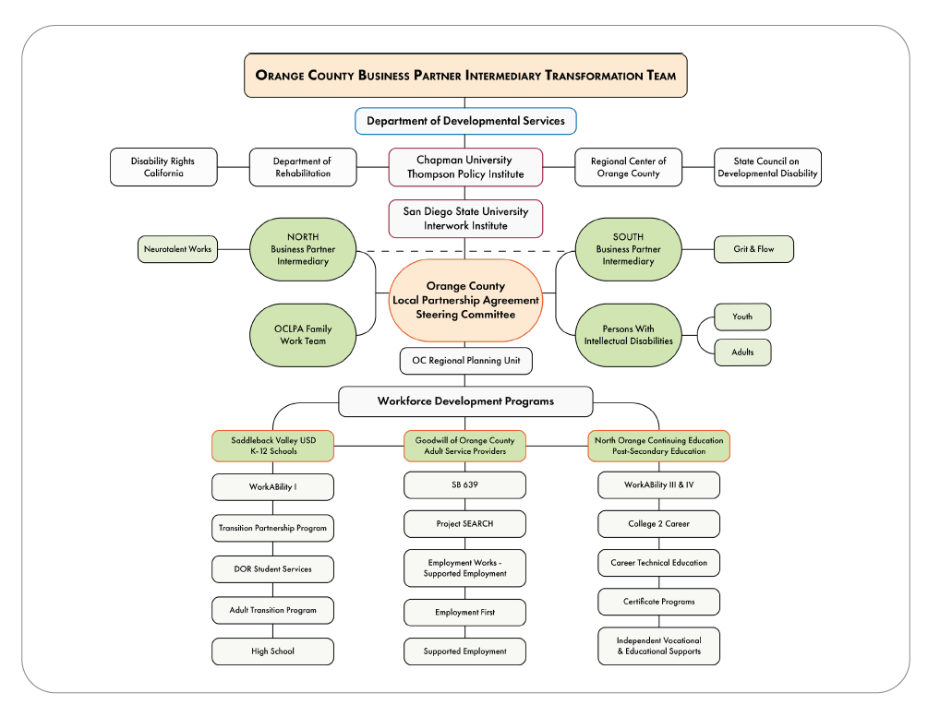

Slide 30
Thanks for the opportunity to meet with you...

