Slide 1
MICROENTERPRISE HITS THE BIG SCREEN Carla’s Movie Restaurant: A Directorial Debut in Business
By Carla & Hilda Sramek and Leslie A.M. Smith

Slide 2
It’s all about the dream
I’m Carla. I started thinking about my movie restaurant in high school.
I got a job at Hollywood Video and started the Movie Club at Los Alamitos High School.
I always wanted the movies and a restaurant together:
A Movie Restaurant!

Slide 3
Keeping track of my dream
What product or service do I want to provide? Why?
The people I like to work with are …
My hope is that from working with me, they will feel ….

Slide 4
It’s a collaborative effort
Everyone needs help creating something new.
Who are the people I know and trust?
What strengths do I bring to my microenterprise?

Slide 5
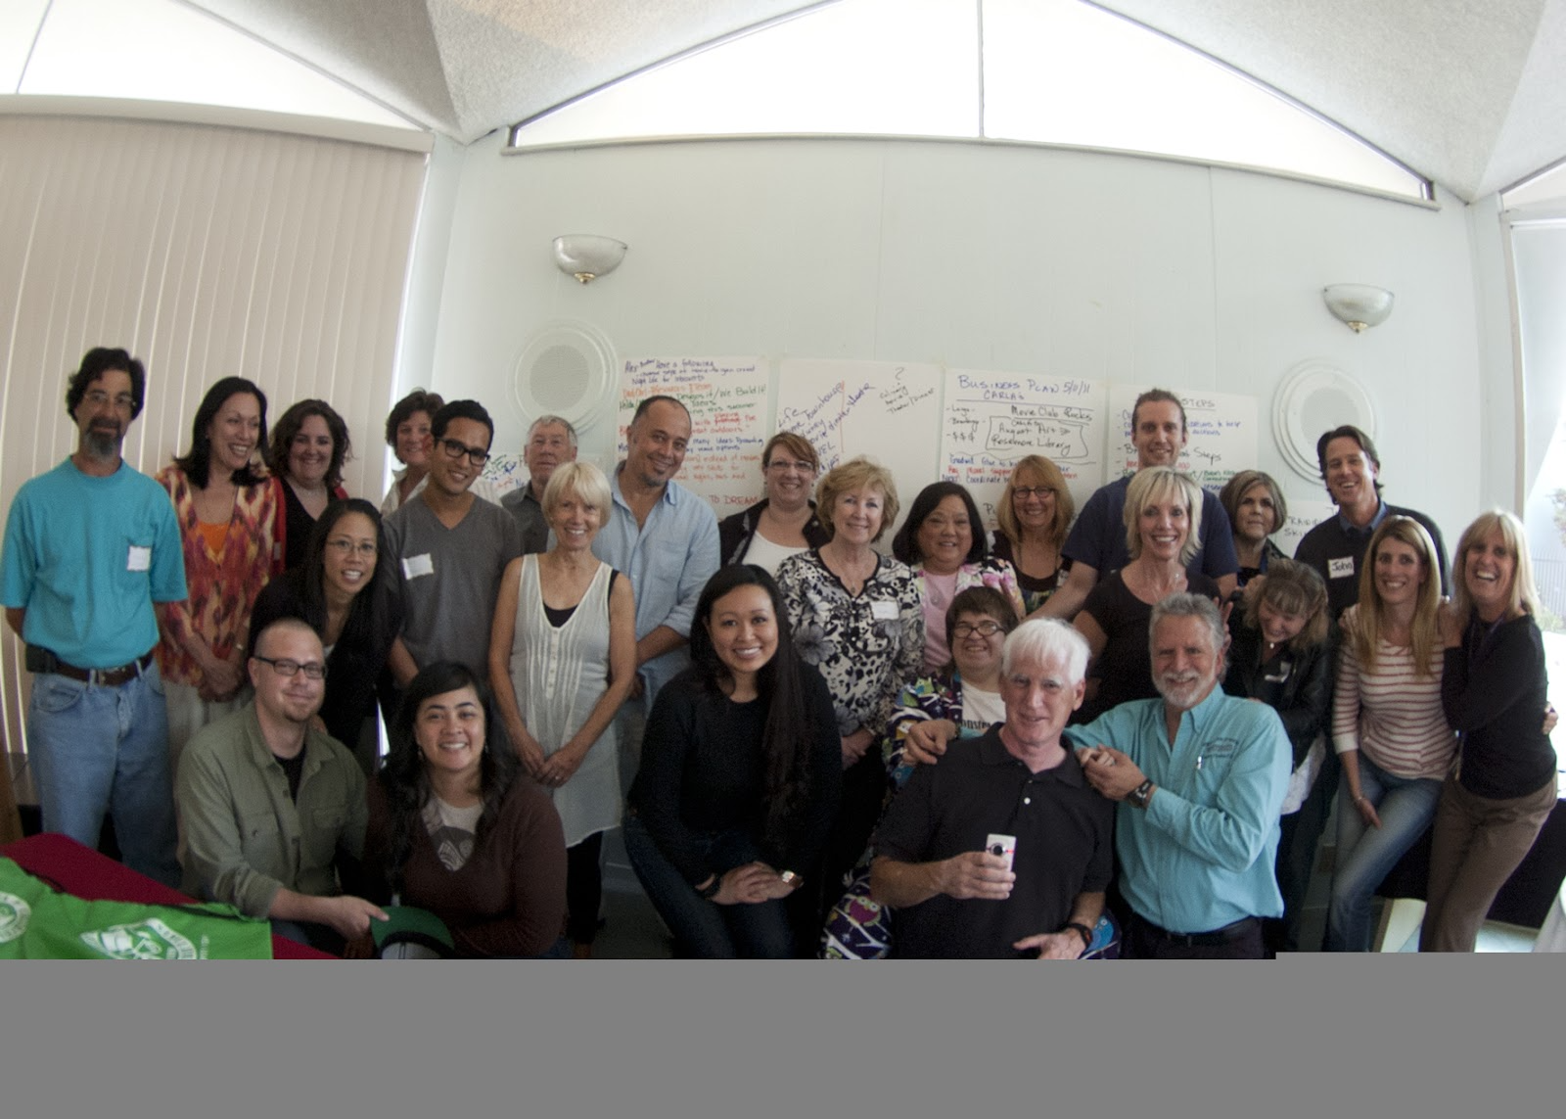
Who do I know and trust?

Slide 6
The facilitator & plan of action
The Facilitator knows how to focus on your dream with people you know and trust
He helps you tell your story, your dreams and nightmares
He brings out your strengths and talents
He makes a list of things necessary to make your dreams come true: the PLAN OF ACTION!

Slide 7
SEEKING ADVICE FROM THE EXPERTS
Many people with experience want to offer support.
What are the areas I need help with?
Who are the experts in this area?
Who am I serving?
Allow businesses to volunteer their resources
Others than just your users will benefit from your microenterprise

Slide 8
A brand identity
Local resources like colleges’ graphic arts/design and marketing/business departments, online services, TED Talks can all be helpful.
It can be very simple:
Carla’s Movie Restaurant

Slide 9
Lights, camera, action!
From the beginning, some people stick with you with their time, their loyalty, their expertise, their friendship.
Considering the people needed to run the microenterprise:
How many volunteers do I need?
What roles do I need to fill?
What qualities do I need on my team: good listener? management skills? promotional experience? fundraiser? etc.
Who is around?

Slide 10
Paying attention
TRENDS CONVERSATIONS UNSOLICITED ADVICE
NEWS IDEAS FROM OTHERS
GET-TOGETHERS WITH PEOPLE FROM DIFFERENT AREAS
If three people say it’s good, go with it! Try it!

Slide 11
CMR-CARLA’S MOVIE RESTAURANT

Slide 12
Ready on the set
Nonprofit or For Profit?
Resources for both
Components of A Business Plan
What parts seem difficult?
What resources do I need to help me?
Marketing
Found through a free Webinar
Other Examples of Microenterprises
Of persons with disabilities

Slide 13
Adapt, be resilient, be creative
CMR:
Ten Years of CMR Pop-ups
Pandemic, Restaurants close
Online Pop-ups
Returning Outdoors
Looking for a Partner in a Permanent Location

Slide 14
Moving forward with confidence
Keeping Up with Business Practices
Chamber of Commerce
Old Friends, New Friends
Keeping the Dream in the Forefront
Revisiting Person-Centered Planning Goals
Considering Partnering with Other Businesses

Slide 15
Like a ratings board
Getting Feedback on Outcomes and Accomplishments
Quantitative
Qualitative: Experiences of people you are serving and people who are observing
*Perceptions *Reactions *Messages * Cards * Online
Are you meeting your objectives?
Are you happy with what is happening?

Slide 17
With thanks to my angel team
Carlasmovierestaurant.org

