Slide 1

Social Security, IDD and Employment Meeting
October 2, 2023
Notes:
Judi

Slide 2
Agenda
Progress Report
Discussions
  Dennis Campos Discussion
  KFF Health News Investigation Article Discussion
  Next Steps

Slide 3
Problem Statement
The Social Security Administration (SSA) provides essential income for some individuals with intellectual and developmental disabilities (IDD) either through Supplemental Security Income (SSI) and/or Title II benefits (Social Security Disability Insurance or Childhood Disability Benefits). The overall intent of SSA is to support individuals to navigate rehabilitation or training so that they may become gainfully employed and reduce their dependence on SSA benefits.
Although significant effort is being focused on helping those with IDD to become self-sufficient and employed to their full capacity, the current implementation of SSI/Title II Benefits and the associated SSA Work Incentive System are ineffective for many, complicated, and can disincentivize those with IDD who wish to work to their maximum capacity.
Whether applying for benefits or while receiving benefits and wanting to work, people with disabilities are often being "misinformed" that they should work fewer hours to keep their benefits or simply not work at all. (An indicator that the system is broken from the self-advocate, agency, families, individuals, and supporting counselors/service staff perspective.)

Slide 4
Background
OCLPA Created the Benefits Planning Work Team in late 2021 (35+ Meetings since established)
  Build Back Better Community Workshops – Feedback
  Family “On-Going” War Stories
  Change.org Petition
  Interest Expressed by Michael Bernick and Lou Vismara
Initial Meeting Q1 2022
Workgroup formed
Analysis throughout 2022
Extended Team has met on 3/17/23, 5/22/23 and 7/24/23
Other California Initiatives - CA Committee on Employment of People with Disabilities Established
Notes:
Linda

Slide 5
Extended Team
Judi Uttal - Chair (OCLPA+, OCASG)
Lindal O’Neal – Core (Transition Specialist, OCLPA+)
Richard Rosenberg – Core (Transition Consultant, OCLPA+)
Scarlett vonThenen – Core (State Council on Developmental Disabilities)
Melissa Cory – Core (Parent, OCLPA)
Jim Huyck (Benefits Advocate)
Lou Vismara (State Assembly, Ret.)
Connie Chu (Disability Rights Calif.)*
Beck Levin (Dale McIntosh Center)
Trinh VanErp (DOR)
Maria Aliferis-Gjerde (DOR)
Jessica Popjevalo (DoR)
Brian Connors (DOR)
Arturo Cazares (RCOC)
Paula Tobler (Disability Rights CA)
Brian Hoang (State Council of Developmental Disability)
Susan Katzen (Special Needs Attorney)
Amy Wesling (ARCA)*
Notes:
Judi

Slide 6

Accomplishments

Slide 7
Publications White Paper and Executive Summary
Employment
Work Incentives
Continuing Disability Review
Medical Insurance
Problem Resolution and the Appeals Process
Expedited Reinstatement
Notes:
Scarlett

Slide 8
Focus Areas
Enhance MySocialSecurity Application to allow for reporting of Work Incentives / Employment Supports with wage reporting. – This will ensure that SSA has all the correct information prior to starting any type of CDR or Overpayment proceedings. This is a cost savings reducing workload, improving turn-around, lowering unnecessary hearings. (Chosen escalate to LPPC + Engage other Nonprofits and States to push this initiative) (add ability to access BPQY on this site- benefits planning query – highlights accountable income, gross wages, when a case worker touched your file)
Limit overpayment to one year of benefits if the delay is not due to IDD and/or Representative Payee failure to report. Minor cost increase to SSA – but reduces financial burden on individuals with IDD who lack financial means. (Federal / Law)
Reset timeframes for Continuing Disability Review to ten years using Blue Book classifications to identify those with more severe/significant disabilities that are unlikely to substantially improve. This will reduce the burden on SSA to implement CDRs and will reduce stress on families. (Federal / Law)
Fix people’s ability to resume SSI / SSDI based on need, guaranteeing immediate reinstatement upon loss of employment. Short run higher costs to SSA. But in the long run a cost savings. The theory is that persons with IDD will work more hours and generate tax revenue. They will likely attempt to achieve independence from SSA. (Federal)
Provide additional assistance when going through an appeals process, expanding the role of the benefits planner, WIPA, or CWIC o include representation for helping persons with IDD/families navigate the appeals process. Slightly higher cost but will help individuals who lack means but need to navigate the appeals process. (Help in California)
Stop confusing ability to work with still being disabled; Do not link disability designation with ability to earn a living. Will increase costs to SSA.
Modify Title II Trial Period by making the nine-month trial work period consecutive versus nonconsecutive earnings. Prevent triggering success that has not be achieved.(Federal / Law)
Implement Case Management Tracking System, that tracks open issues and timelines (case number) with guaranteed response time. Improve beneficiary satisfaction. Lower costs by streamlining problem resolution. Provide better data for managing escalations. (Might be addressed – with getting help with appeals)
Establish Hot Line for help with IDD. Improve beneficiary satisfaction. Reduce problems by having more timely responses to questions.
IDD and/or Representative Payee Expanding the role of the benefits planner, WIPA, or CWI. (Help in California)
California Disability Determination Services
Notes:
Judi

Slide 9
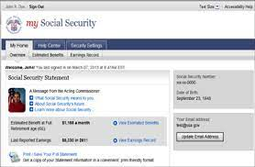
(1) Fix My Social Security Application
SCDD has submitted an Advisory Request form to the Legislative and Public Policy Committee (LPPC) Regarding fixing the Mysocial Security Application
Status: Referred to LPPC. Next LPPC 10/26/23.
LPPC MEMBERSHIP
Harold Ashe, Chairperson
Bridget Kolakosky, Deputy Direcor
Alex Reyes
Andy Imparato
Connie Lapin
Julie Neward
Nicole Adler
Rosie Ryan
Viviana Barnwell
Wesley Witherspoon

Slide 10

(2) SCDD is applying for Interventional Cooperative Agreement Program (ICAP)
State Council on Developmental Disabilities
will apply to create a position responsible for driving our continued work and assisting individuals impacted by SSI processes. Decision by end of September.

Slide 11
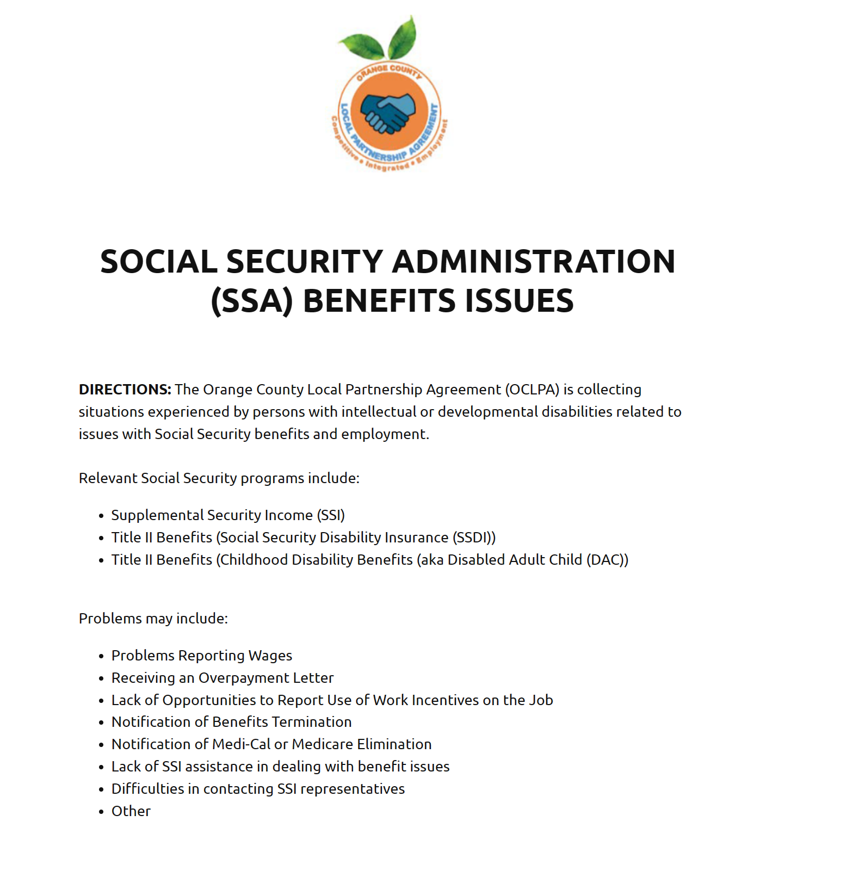
(3) Story Collection Survey
Topics:
  About the Beneficiary and Survey Respondent
  Summary of Benefits
  Employment Status
  Social Security Related Problem
  SSA Escalation Process
  Current Status
598 Eng / 31 Sp Responses To Date
Notes:
Linda

Slide 12
“…You say you want people with disabilities to work but penalize them…”
“I wanted to work so i did social security did not help me in the least. did not answer the phone cut off medical , sent me letters and now an overpayment issue that was there fault how am i supposed to work and take care of this. You say you want people with disabilities to work but penalize them when they do what the point in working if you lose everything or are misinform why not just sit down and live off ssi or ssdi. Well i wanted to work and i do. i assist people with disabilities and have a son that's disabled too. the ssi /ssdi people that don't want to lose there benefits are right to fear losing them because there is no real help if you decide to work just overpayments awaiting you.“

Slide 13



For 67% of the Respondent
Fear of Losing Benefits is a Factor in Working

Slide 14




28% of the 598 Respondents Experienced
Social Security Problems including:
Overpayment Notifications
72% were told that
that they needed to
refund prior benefit
payments
Termination of Benefits
37%
had Benefits
Terminated
Modified Disability Status
10% were told
they no longer
had a disability
Loss of Medical Insurance
14% had their
Medical Insurance
terminated

Slide 15

Problem Resolution is still an Issue for many
138 of 165 People contact SSA
36 people indicated that they were never responded to by SSA
44 people escalated to a judicial hearing.
Out of the 64 reporting problems many still need assistance resolving the matter with 59 providing email addresses requesting assistance.

Slide 16
(4) Helping Survey Respondents
60+ People Requested Assistance
Linda & Scarlett Drafted the SSA Benefits Planning & Management Support in California Document
Scarlett and Linda have emailed it out
Meeting with Paula Tobler on 11/15/23.

Slide 17
(5) Recent Meetings
Met with Amy Wesling, Association of Regional Center Agencies (ARCA). Sent the survey to the 21 Regional Center Directors for Distribution
Met with Brian Connors, Social Security Programs Unit Manager, Department of Rehabilitation
Notes:
Judi

Slide 18
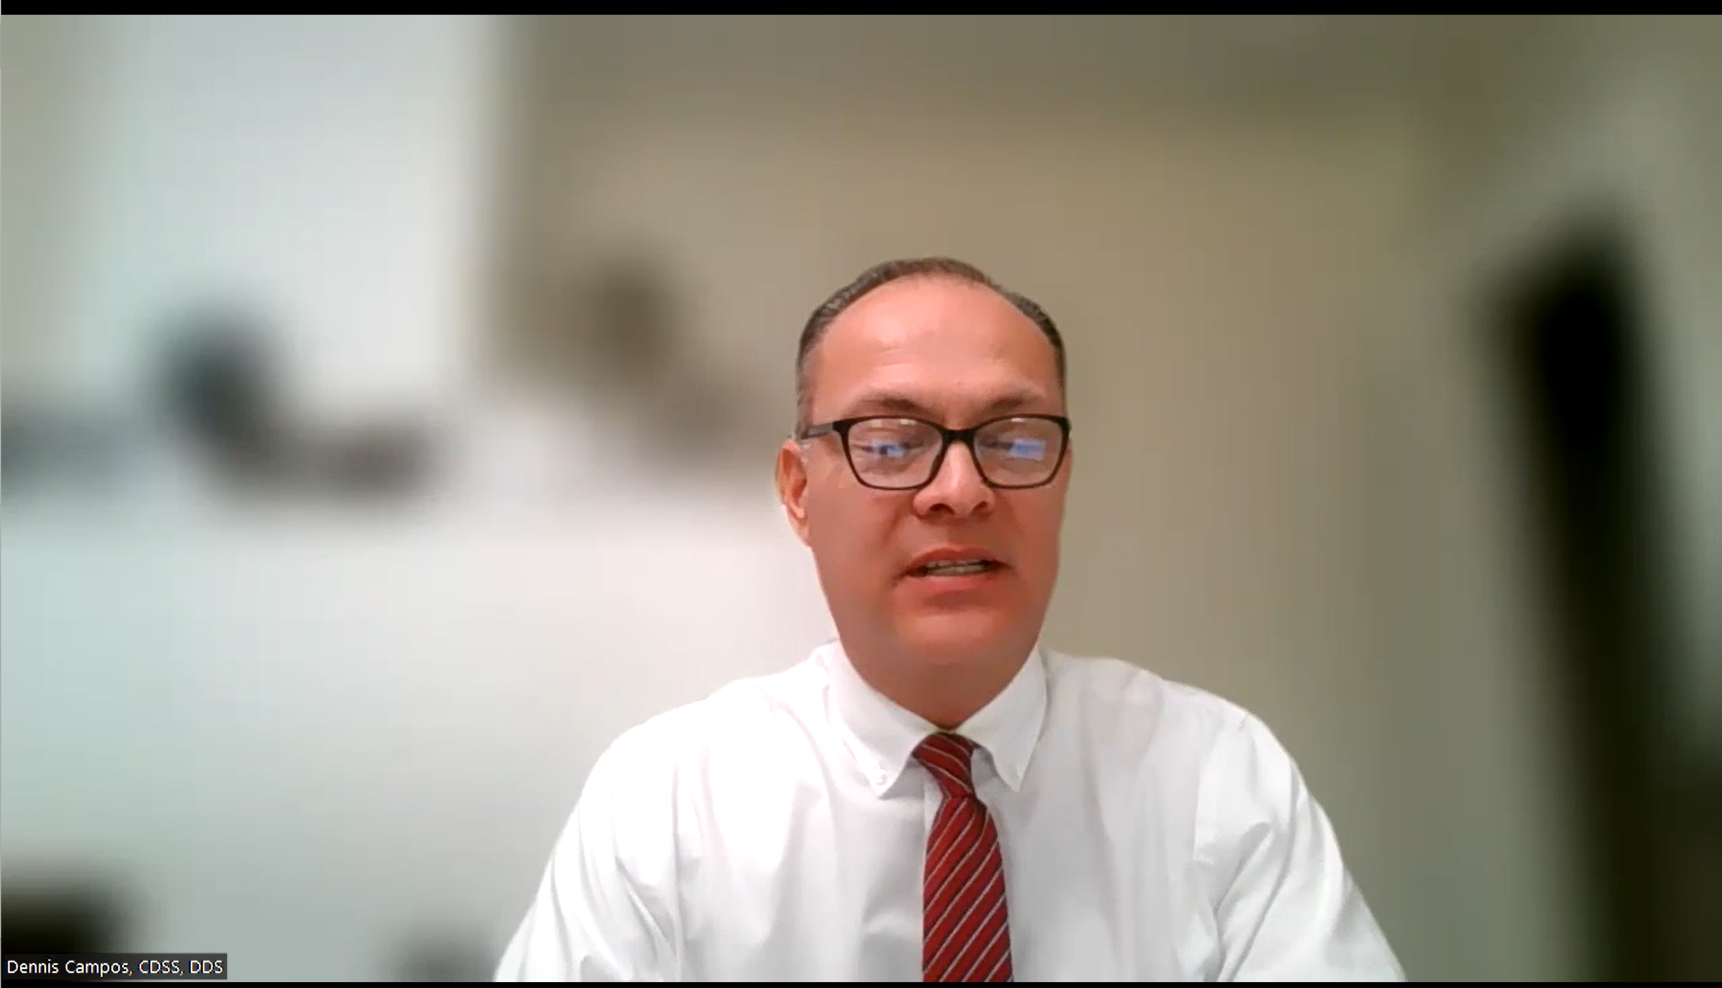
(6) Disability Determination Services Discussion
Disability Determination Services (DDS) is responsible for determining claimants’ disabilities and ensuring adequate evidence is available to support its determinations in California. DDS renders decisions on disability claims, which are received by DDS field offices via telephone, mail, online, or in person1. The California Department of Social Services is the parent agency of CA-DDS, which is reimbursed for 100 percent of allowable expenditures, including direct and indirect costs by the Social Security Administration.
Dennis Campos
Case Adjudication Bureau Chief
Covina Branch
Disability Determination Service Division California Department of Social Services
Notes:
Judi

Slide 19
(7) News Coverage
Contributions from Georgia, Ohio, Florida, Pennsylvania, Washington, North Carolina

Slide 20
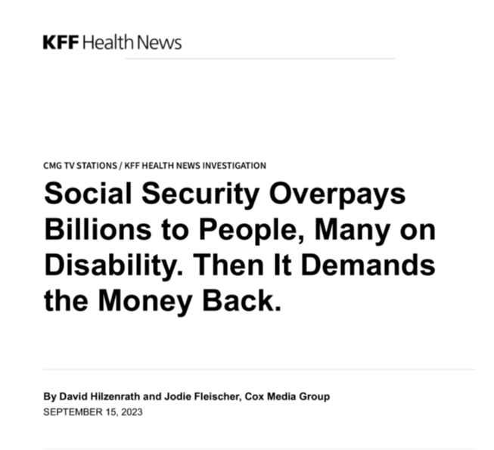
Discussion: Key Takeaways
Articles news items – videos are very good
Reinforced what we are hearing and seeing

Slide 21
Key Points
Modernize Information Technology
Improve Administration of the Disability Programs
Improve the Prevention, Detection, and Recovery of Improper Payments

Slide 22
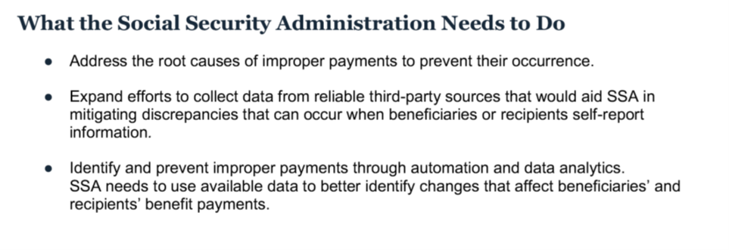
Improve the Prevention, Detection, and Recovery of Improper Payments

Slide 23
Next Steps
How do we move things forward?
State Next Steps
Federal Next Steps
What do we need?
  Survey Complete (reach out to a couple of other groups), Find someone to create final report
  Presentation
  Identify Who We Need to Reach Out to / and When
  PR
Who do we reach out to?
  Legislative People (Beck help)
  Disability Determination Service (DC)
What do we need?
  Survey Complete
  Presentation
  Identify Who We Need to Reach Out to / and When
  PR
Who do we reach out to?
  Social Security Administration
  Federal Legislative People
  Public Policy Organizations (DRC, State Council DD), Univ. Centers of Excellence on Dev. Disabilities) and Partners, Other States (reporter – Judi) and Group focused on this issue

Slide 24
Goals
Push out Survey to other Groups (Scarlett, Amy W.)
Found to Finalize Survey Results – with a Draft (Linda/Richard, UCSF)
Create list of legislative individuals we should speak with (Beck)
Create list of the other states/individuals/organization/researchers working on this issue (Judi)
Next Meeting: 1/29 8:30 AM – 10:00 AM

