Slide 1
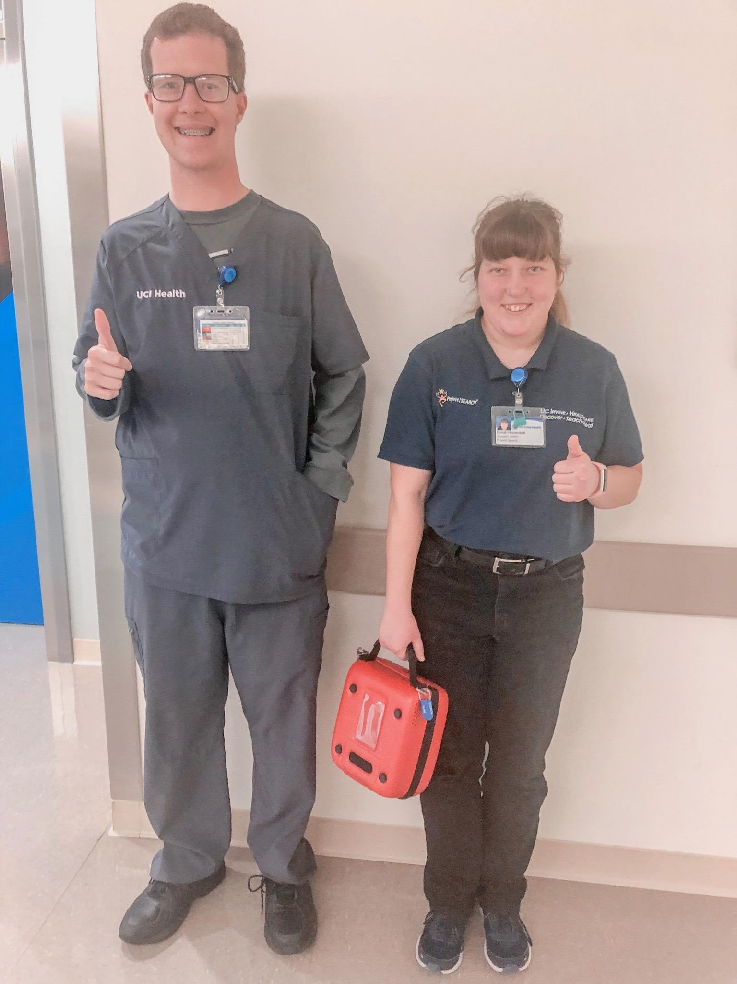
Project SEARCH Success Stories
Goodwill of Orange County

Slide 2
THANK YOU TO ALL
COMMUNITY PARTNERS!

Slide 3
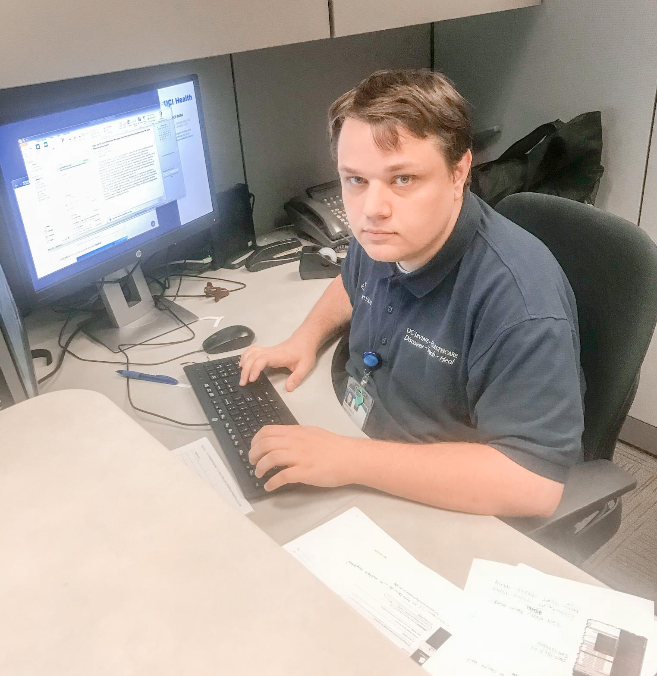
Austin
Austin was extremely motivated to find a career path and enrolled himself in Project SEARCH at UCI Medical Center. He showcased his ability to analyze tasks and make improvements!
Austin suggested ways to streamline UCI’s excel spreadsheets during his rotations and his strategies were adopted and implemented soon after by the Financial Services department.
Austin was hired directly by the host site as a biller in Health and Patient Financial Services department! He has received a promotion, as well! He now takes contracts UCI has with insurance companies & he programs language that allows the EPIC system to automatically calculate profits UCI can expect to receive based on patient services provided.
Notes:
Noelle
Austin is an extremely motivated young man who independently applied for Project SEARCH
He is an extremely intelligent young man, and on the second day of one of his internship rotations he was able to suggest ways to streamline and improve the spreadsheets in the Financial Services department to make them more “logical”
The manager of the department loved his suggestion, and the department soon adopted it/
After graduation he was hired on directly by the host site as a biller in the Health and Patient Financial services dept.
He was actually the first intern to have an internship in there and was hired.
He also received a promotion an now takes contracts UCI has with insurance companies & he programs language that allows the EPIC system to automatically calculate profits UCI can expect to receive based on patient services provided.

Slide 4
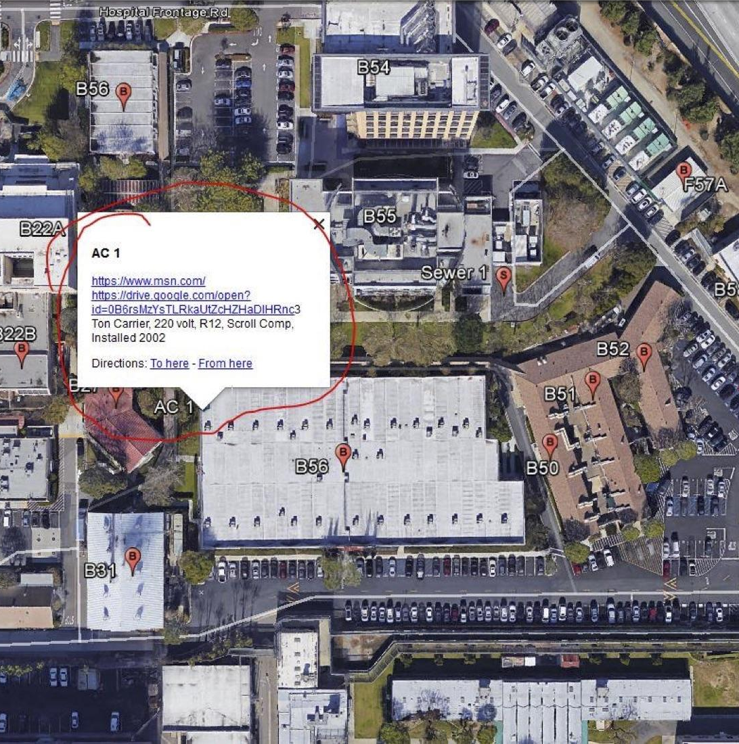
Bryce
He joined our program as a business owner who started a printing business at 16 years old.
During his internship, he created a digital system to map out all of the sewer and water lines and manhole covers throughout the hospital. The facilities department can now use Google Earth and Google maps to track the location of these systems with pictures so they can look up which tools and equipment to use for repairs.
Since graduating, Bryce was hired at UCI Medical Center in the Patient Transport department. He was also named Employee of the Month in 2020.
**Picture will be added here later**
Notes:
Noelle
Bryce joined our program as a business owner who started a printing business at 16 years old.
In his interview he slid his business card that said CEO/Owner across the table and really impressed a couple of the department managers at UCI
During his internship, he created a digital system to map out all of the sewer and water lines and manhole covers throughout the hospital. The facilities department can now use Google Earth and Google maps to track the location of these systems with pictures so they can look up which tools and equipment to use for repairs.
Since graduating, Bryce was hired at UCI Medical Center in the Patient Transport department.
He also served as a mentor to the other PS interns -you might have noticed him on the title slide in his scrubs training a current intern
He was also named Employee of the Month in 2020.

Slide 5
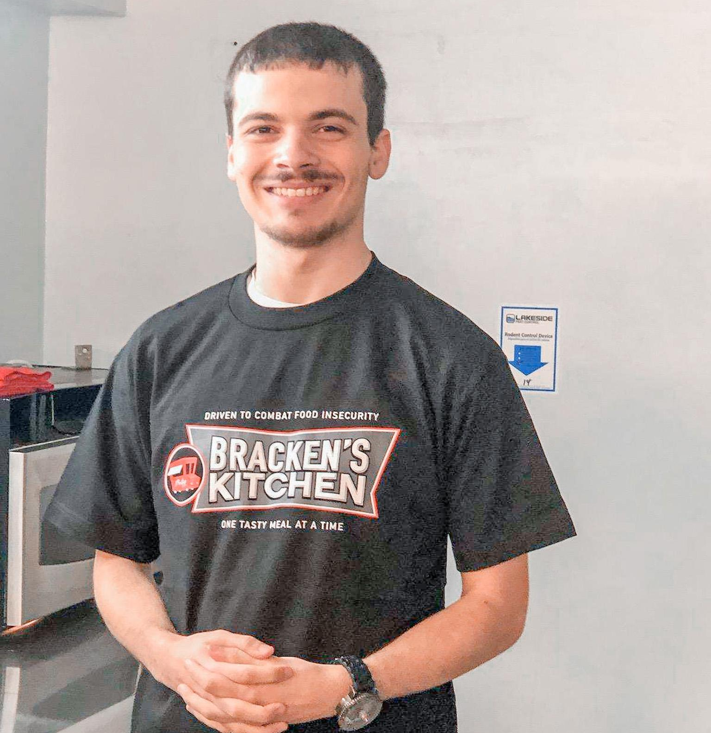
Ethan
**Picture will be added here later**
Ethan was a very quiet, and timid intern when he joined Project SEARCH. He was very polite and nice to those around him, but told us he was uncomfortable interacting with people.
With support Ethan was able to improve his social and communication skills. During his internships he learned how to answer phone calls in the call center, create and dispatch work orders to employees, take customer orders in the deli station, deliver meals to patients throughout the hospital, and work in several rotations where he interacted with staff and visitors all day. He gained the confidence needed to succeed!
Since graduating , Ethan has held a great job opportunity prepping food for those in need with a company called Bracken’s Kitchen. He has kept up those communication skills! He was able to be a part of a local news story..check it out!
Notes:
Noelle

Slide 6
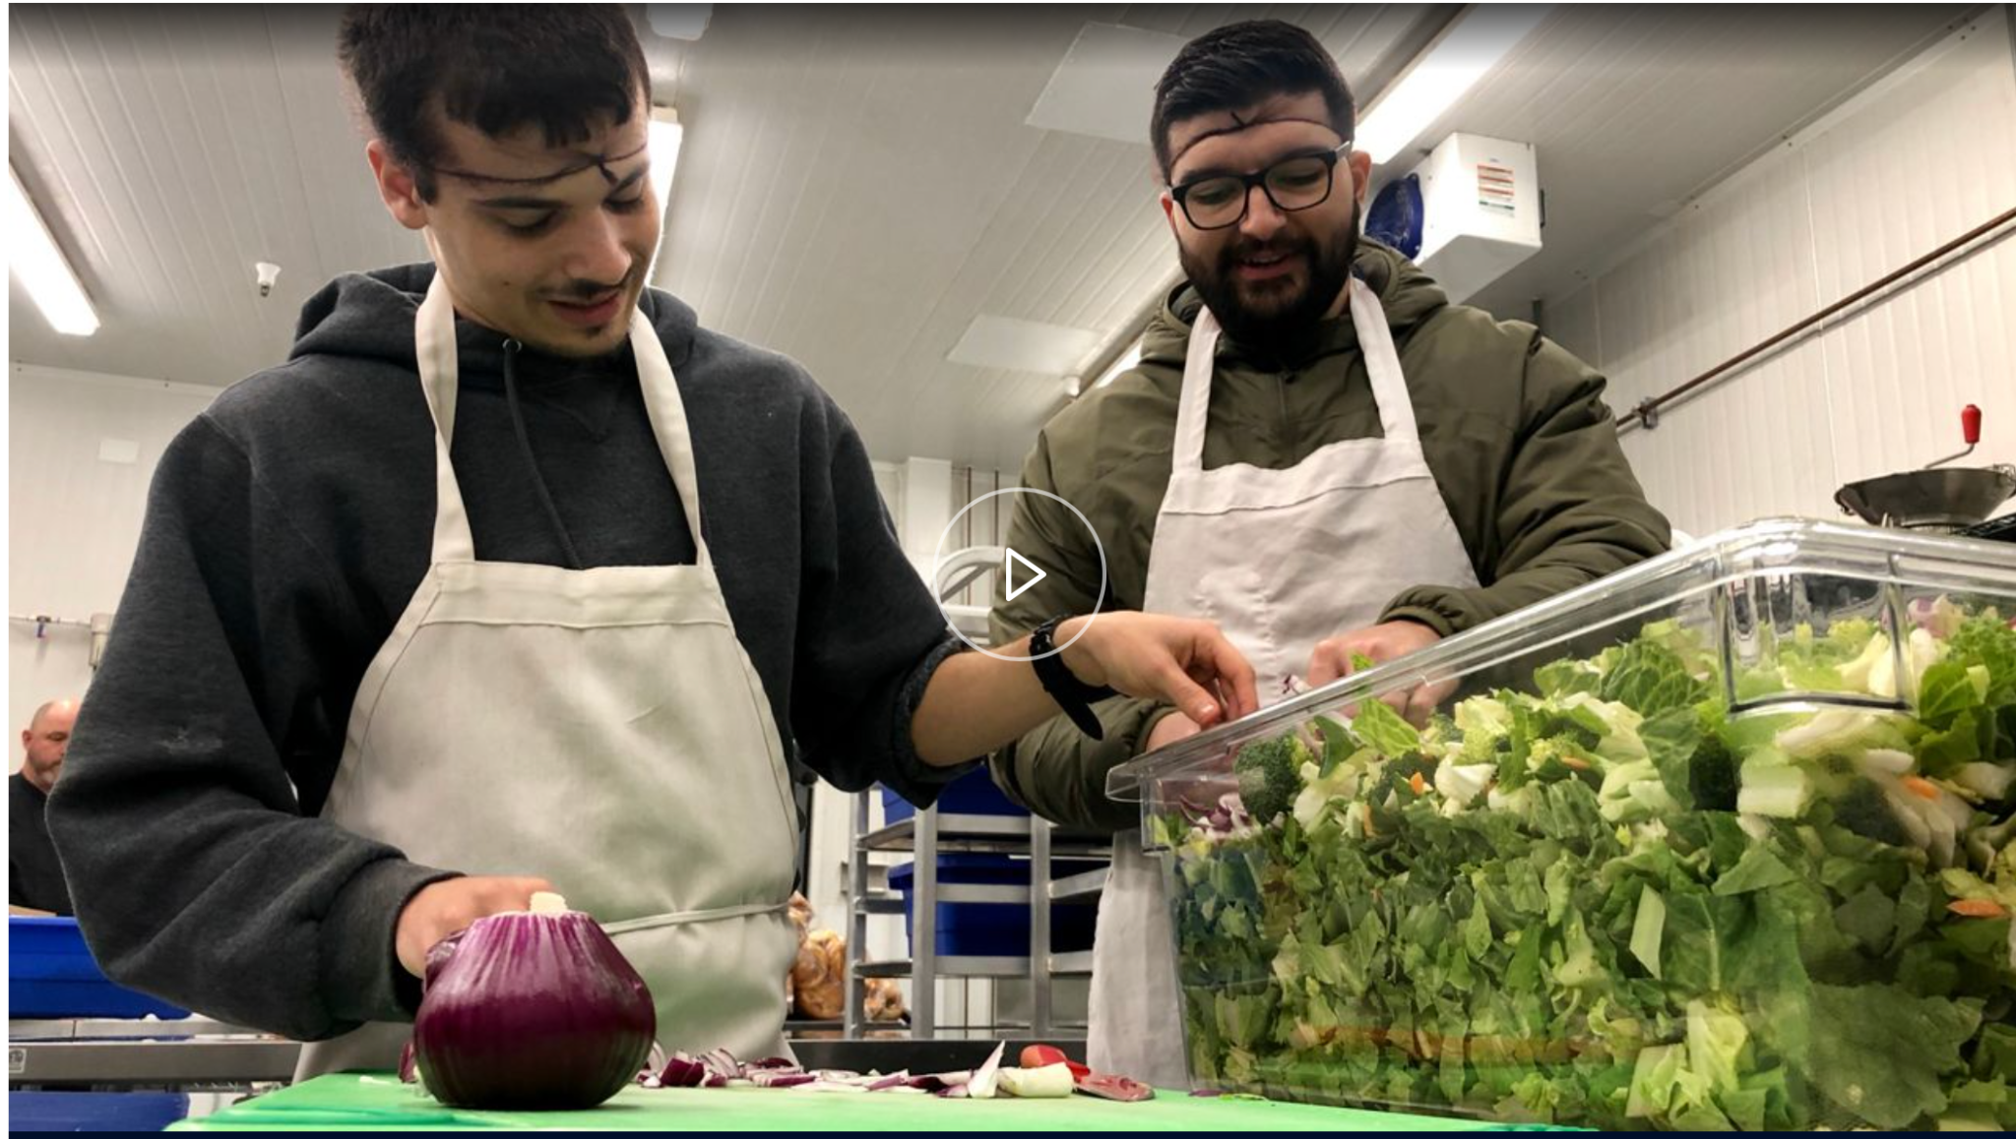
Media Feature
Here is a Spectrum newsclip of one of our success stories, Ethan!
Notes:
Click the photo on the screen to open up the link to the news article and video

Slide 7
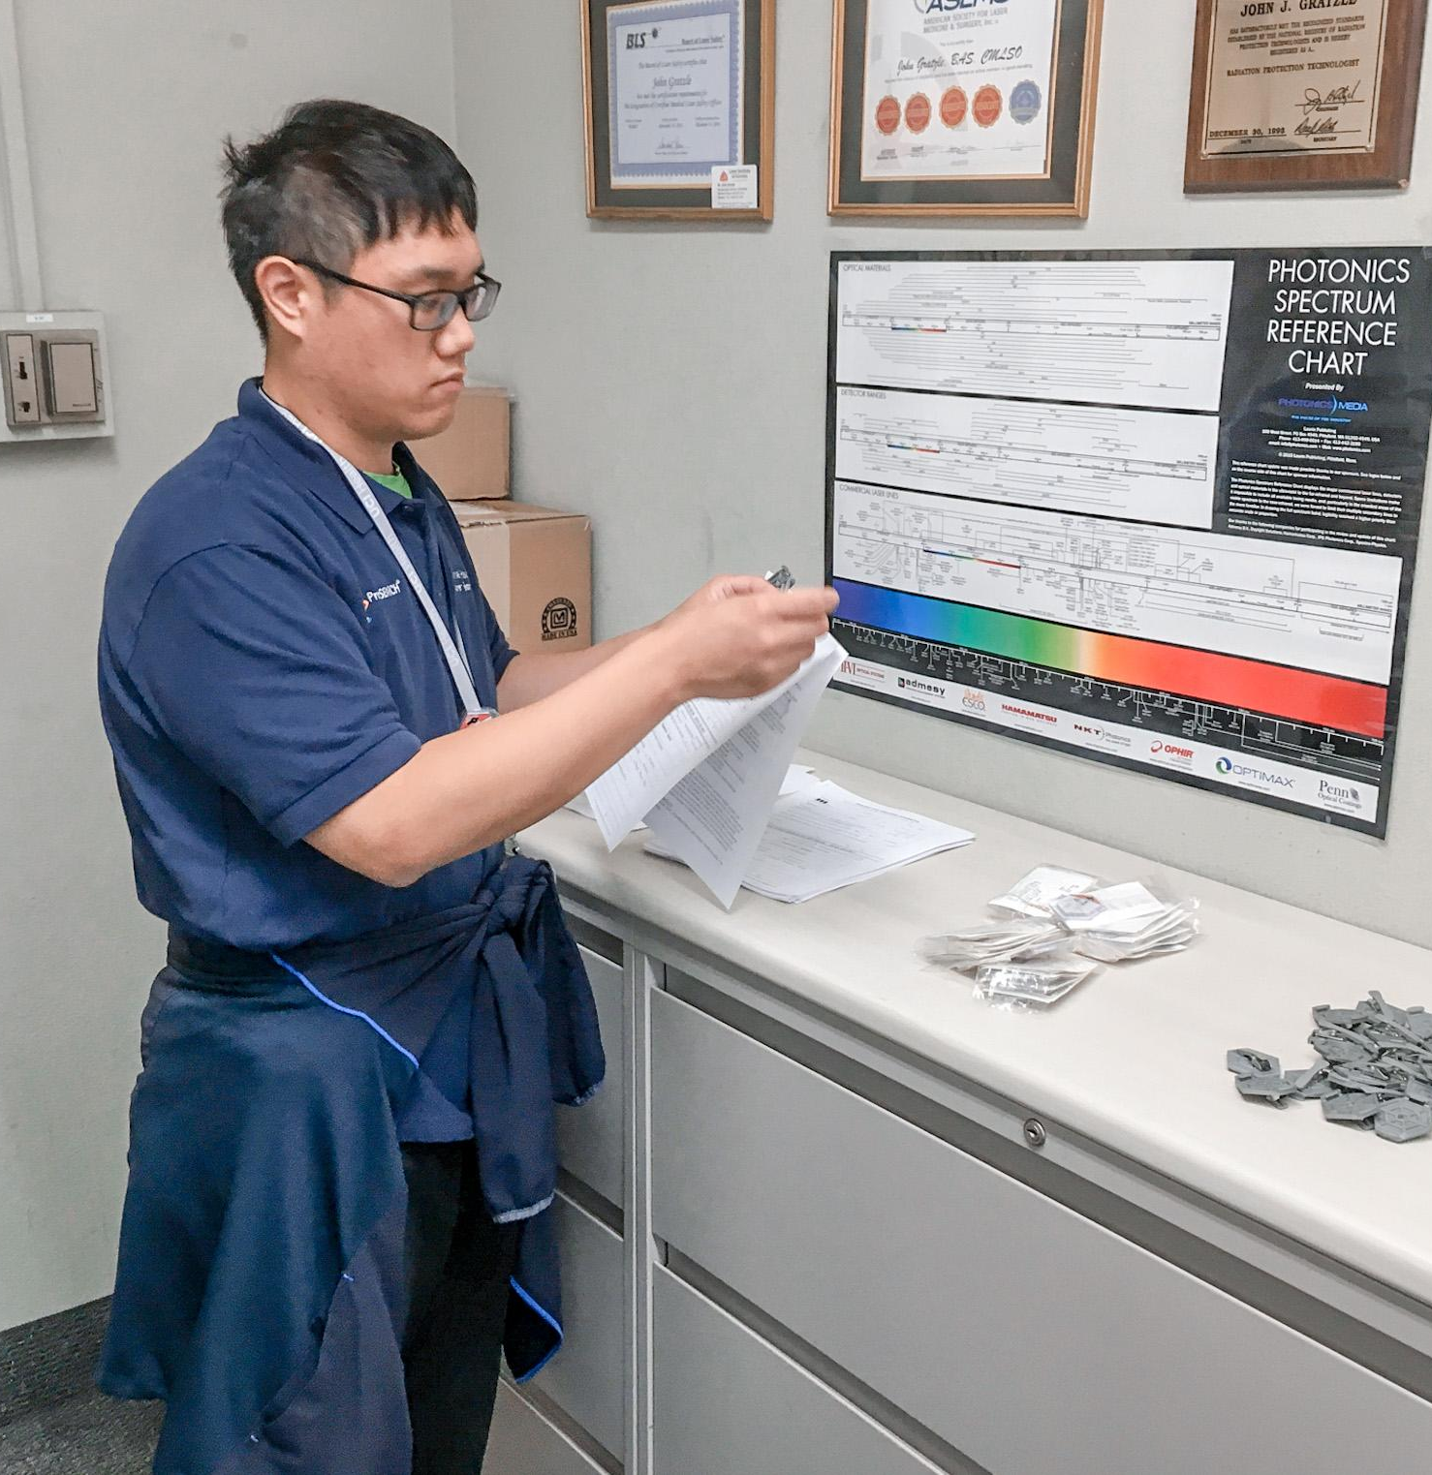
Jason
When Jason started Project SEARCH, he was an introverted person and preferred to be by himself. Jason was at home for about 11 years looking for jobs before joining the program.
Jason interned at the Environmental Health & Safety Department where he filed documents and did data entry. Jason took his work at UCI Medical Center very seriously. He processed 13 years worth of files in one week! He even caught several important errors on documents! He became well respected in his department and learned to work with a team.
Jason Park was hired at File Depot where he prepares files for storage. Jason has maintained employment for over two years!
**Picture will be added here later**
Notes:
Noelle
When Jason started Project SEARCH, he was an introverted person and preferred to be by himself. Jason was at home for about 11 years looking for jobs before joining the program.
Jason interned at the Environmental Health & Safety Department where he filed documents and did data entry. Jason took his work at UCI Medical Center very seriously. He processed 13 years worth of files in one week! He even caught several important errors on documents! He became well respected in his department and learned to work with a team.
Jason Park was hired at File Depot where he prepares files for storage. Jason has maintained employment for over two years!

Slide 8
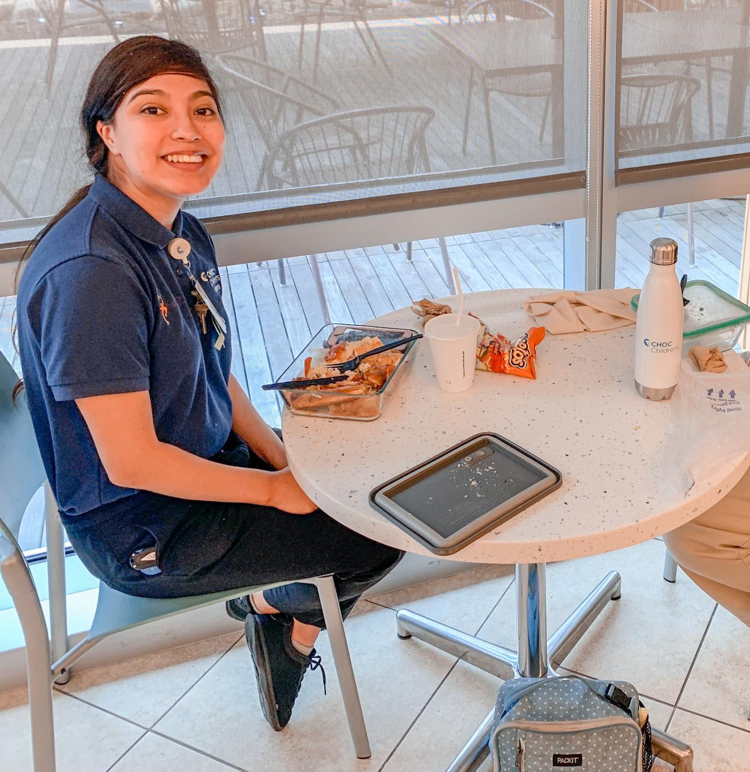
Liliana
Liliana joined Project SEARCH at CHOC Children’s hospital. Liliana needed support with asking for help from staff but she was very open to feedback. She was always on time and prepared to work.
Liliana was motivated to grow and learn. She began to show more confidence and was enjoyed working with a team. She was very helpful around other interns and would offer support to peers. She gained strong self-advocacy skills throughout her internship.
Liliana started working at Foothill Regional Medical Center in the EVS department. She worked full time and even received an Employee of the Month award! Liliana chose to move to CHOC Children’s hospital and currently works in Food Services.
**Picture will be added here later**
Notes:
D

Slide 9
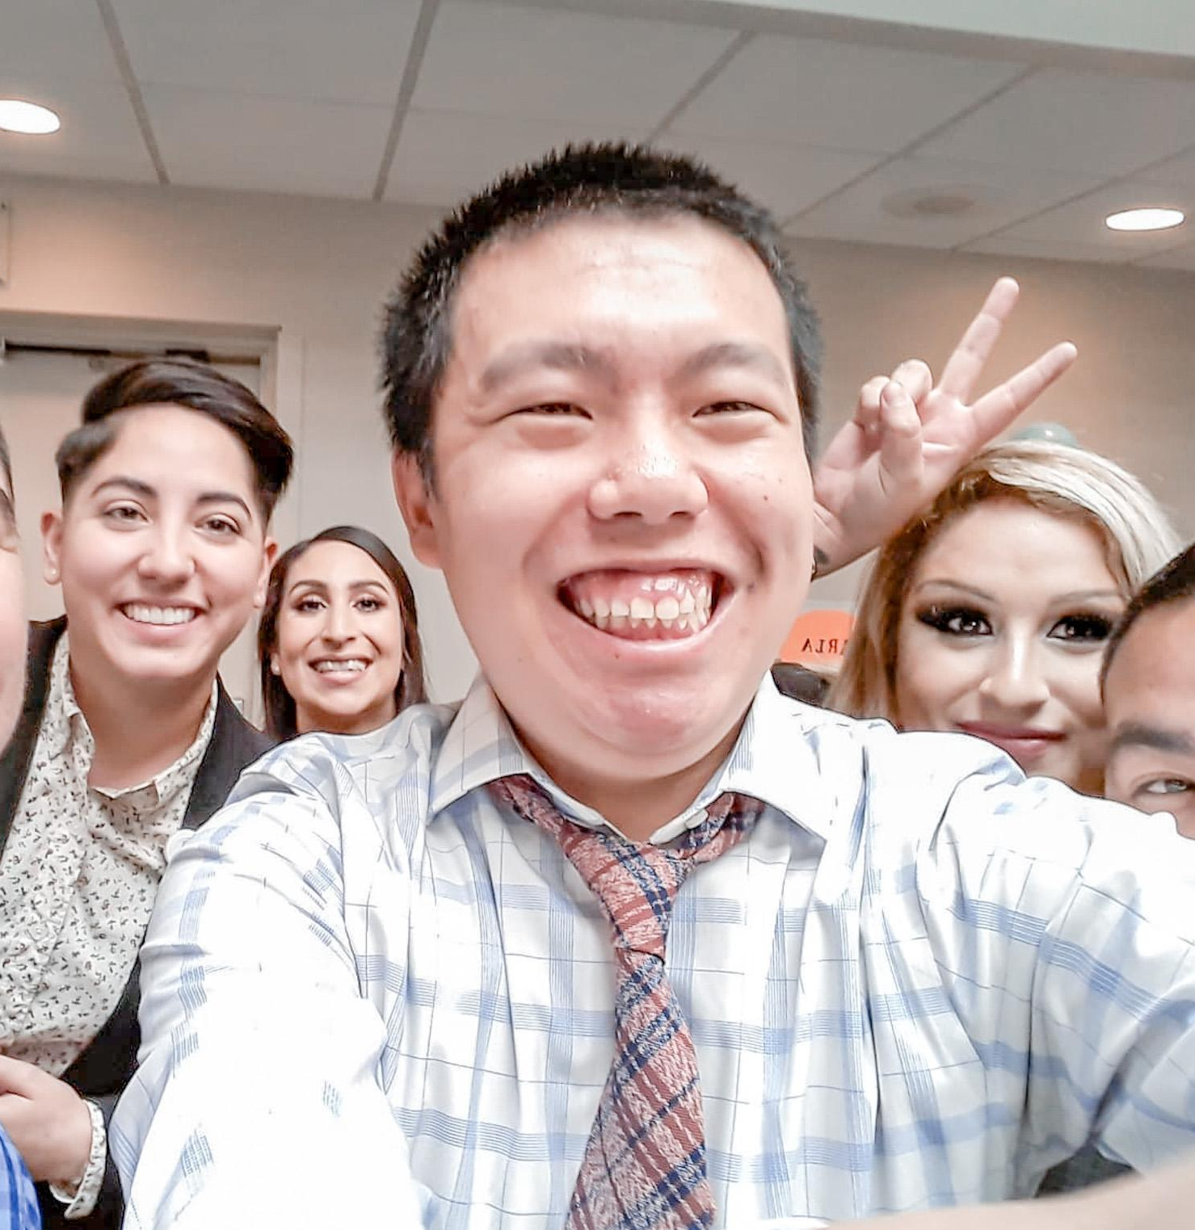
Charles
When Charles first arrived to Project SEARCH, he was reserved but committed to success. During his internship, Charles learned to communicate his needs, learn professional habits and important soft skills.
Charles was known for his charisma and upbeat attitude and that caught the eye of everyone he worked with! Charles has bloomed into a confident and successful young man.
After completing Project SEARCH, Charles accepted a full-time position as a kitchen assistant with LOVARC; an Army Force Base in Los Alamitos. He has maintained employment since 2019!
**Picture will be added here later**
Notes:
D

Slide 10
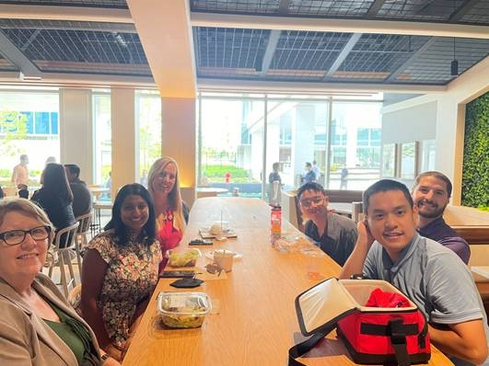
Tan
Tan kept to himself in the beginning of the internship. He didn’t want to socialize with others and would need support with initiating conversations and working as part of a team.
He began to grow more confident in socializing with others. He always showed that he was eager to improve his social skills and learned to work as a team. He loved working in the IT dept at CHOC, he gained a lot of confidence with speaking to employees throughout CHOC hospital.
Tan is currently participating in a paid internship at Edwards LifeSciences as a Laboratory Assistant. His job duties include preparing and sewing pig hearts used for testing heart valves, making saline solutions for the engineers, and completing inventory on returned heart valves.
Notes:
Steph

Slide 11
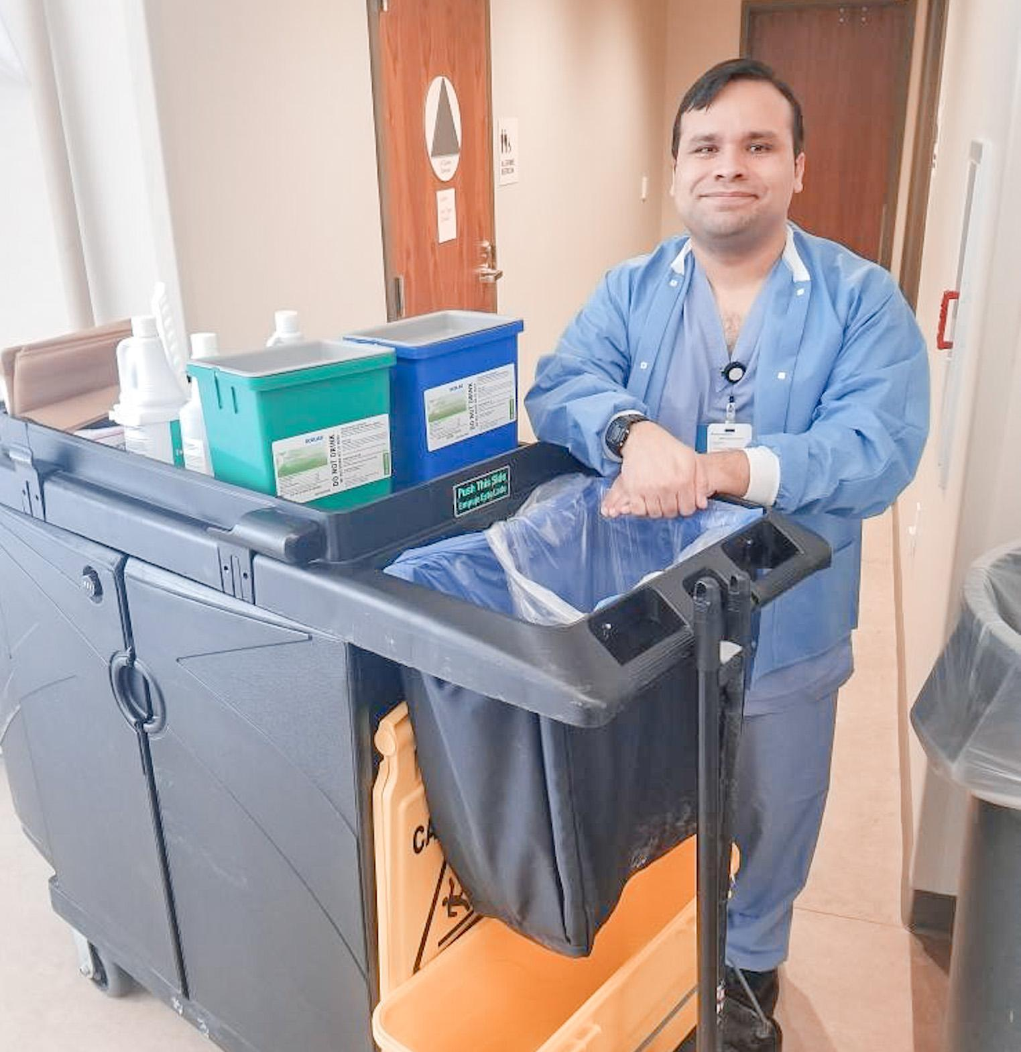
Alex
Before Project SEARCH, Alex worked at Chucky Cheese for over a decade. He was very polite and very successful in his classwork. His ability to receive feedback really made him shine!
Alex was often praised by Kaiser Permanente staff about how polite and kind he was and his excellent work in his departments. With support, Alex learned many new tasks and skills in his departments. He showed a very strong work ethic!
After graduation, Alex was hired as a Housekeeping Aide at Kaiser Permanente, Irvine.
**Picture will be added here later**
Notes:
Steph

Slide 12
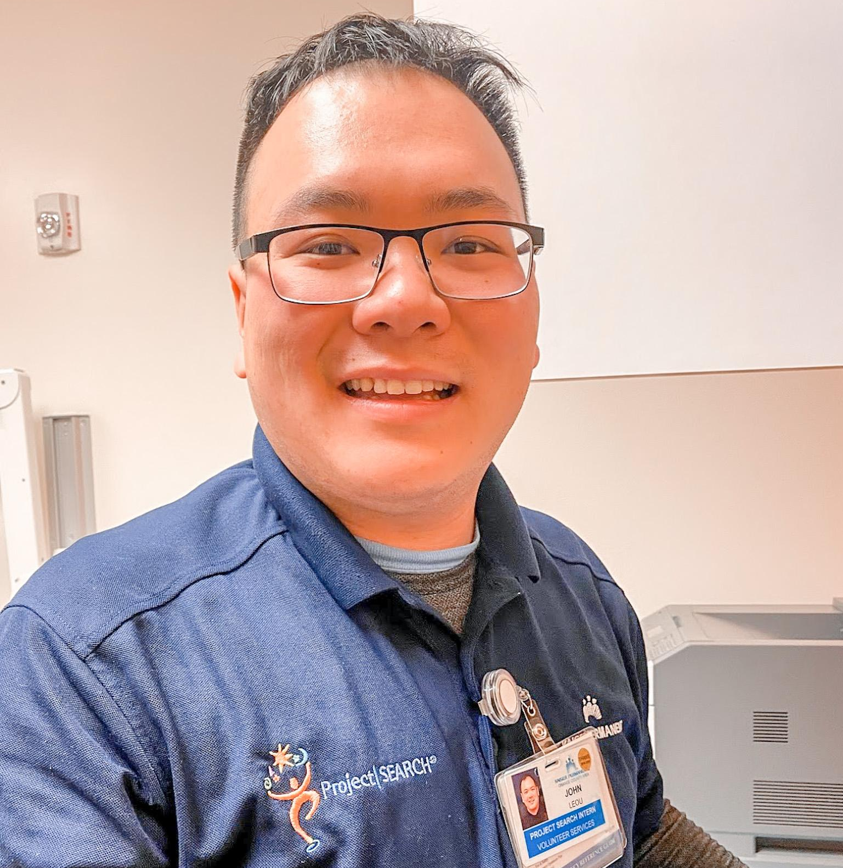
John
When John first joined Project SEARCH, he was punctual, communicative, and enthusiastic. He accepted suggestions on initiating appropriate conversations and asking for help.
John did great in his first department but worried his skills were not high enough for the program. His confidence didn’t match his ability, and John placed a lot of pressure on himself, causing anxiety.
Given support and specific praise, John gained confidence. He began to offer help to his classmates and department co-workers. He showed pride in the positive feedback he was receiving.
After graduation, John was hired at Amazon in Irvine, CA, as an outbound packer. He prepares grocery orders in an integrated environment and averages 32-40 hours per week!
Notes:
Steph

Slide 13
Thank you for your time!
Is there any questions?

