Slide 1
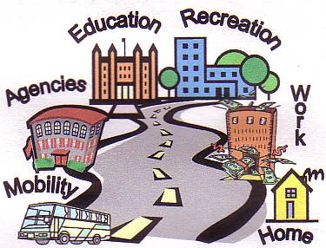
Transition Planning

Slide 2
Work-Based Learning
WBL
Work Experience
Community Experiences
Employment
Paid Work
Competitive Integrated Employment (CIE)

Slide 3
PAID EMPLOYMENT
Work Experience
Internships
On-the Job Training (OJT)
Jobs
Apprenticeships
NON-PAID WBL OPPORTUNITIES
Internships
Job Shadows
Community Based Learning
Volunteer Work
Work Experience
Virtual Job Shadows
Work-based learning should be an integral part of a more comprehensive program that integrates academic courses and career technical education.
There is an array of work-based learning experiences for career awareness, career exploration, career preparation and career training. Resources and information regarding work -based learning can be found at:
http://www.connectedcalifornia.org/curriculum/work_based_learning

Slide 4
Competitive Integrated
Employment
CIE
Definition of Competitive Integrated Employment in WIOA:
The term "competitive integrated employment" means work that is performed on a full-time or part-time basis (including self-employment) –
Paid minimum wage or above, depending on the job

Slide 5
Definition of Competitive Integrated Employment in WIOA... continued:
With non-disabled peers
In an integrated Setting
If self-employed, yields an income that is comparable to the income received by other individuals
As appropriate, present opportunities for advancement that are similar to those for other employees who are not individuals with disabilities and who have similar positions.

Slide 6
ORANGE COUNTY
WORKFORCE DEVELOPMENT PROGRAMS
WorkAbility I (School Programs)
Transition Partnership Program (School Programs)
WorkAbility III & IV (NOCE & UCI)
Career Pathway Programs
Career Technical Education Programs
WIOA Youth Employment Programs (One Stop Centers)
Summer Youth Employment Programs (Goodwill & One Stop)
College 2 Career Program (NOCE)
Supported Employment (RCOC & DOR)
Students Services (DOR)
RCOC Paid Internship Program (PIP)
Project SEARCH (Goodwill & OC Partners)
California Adult Education Programs
OC United Way
Adult Service Providers
Oasis (Saddleback College & Vocational Visions)

Slide 7
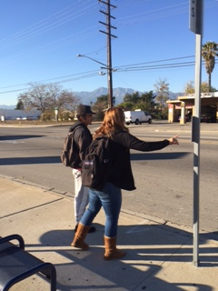
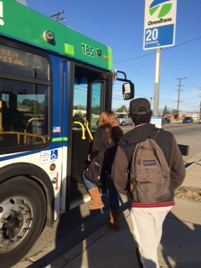
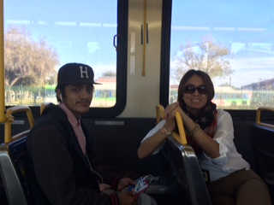
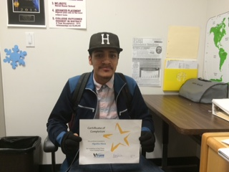

Travel Training Program

Slide 8
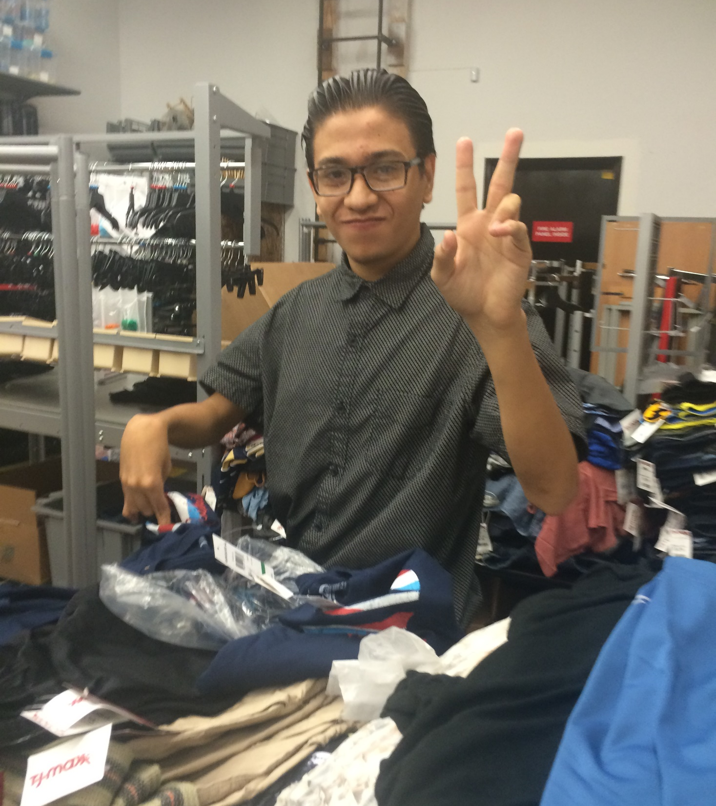

Paid Work Experience

Slide 9

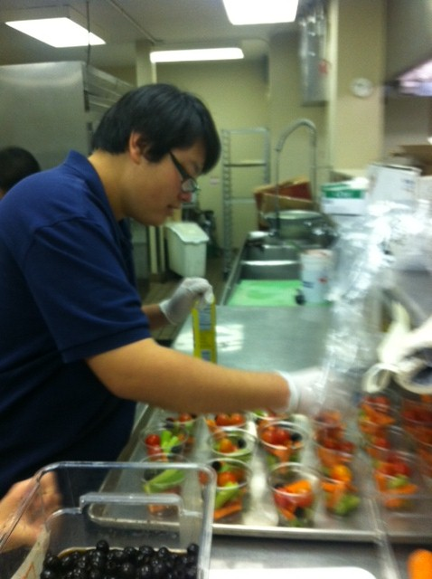
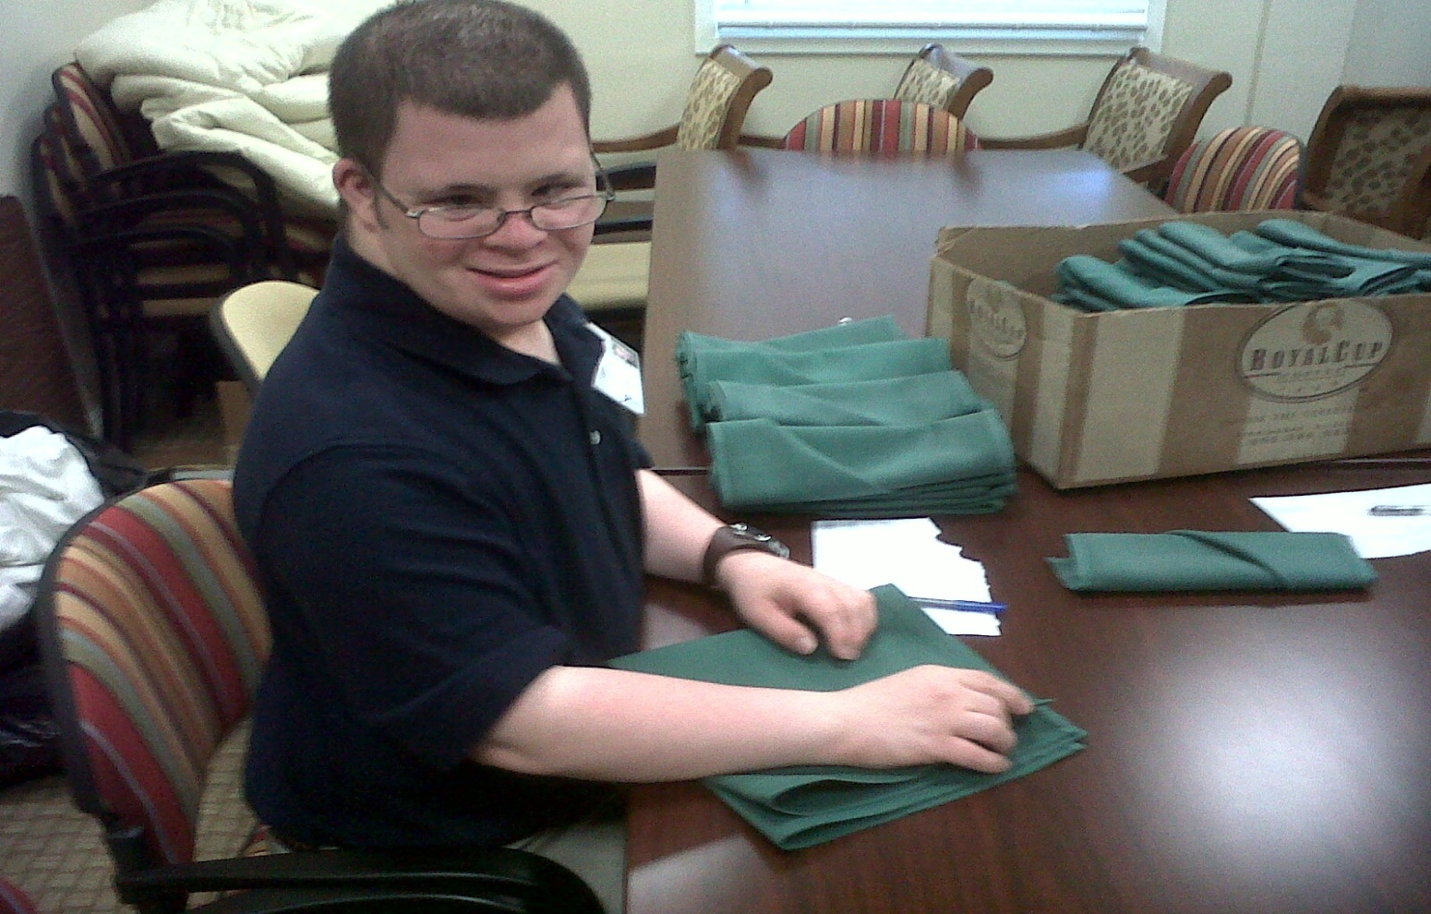
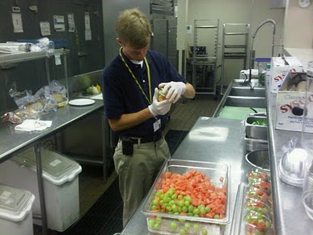
ATRIA Golden Creek Senior Living

Slide 10

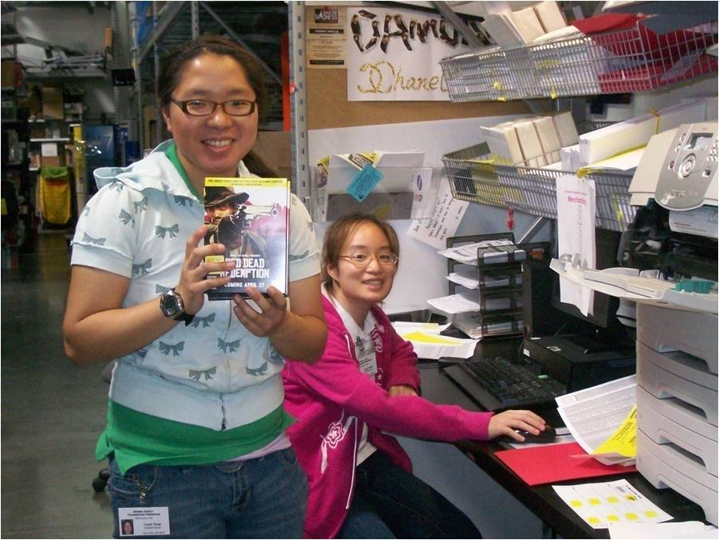
Cassie and Sandy work in the warehouse printing new price labels for DVD’s, CD’s and Video Games.

Slide 11
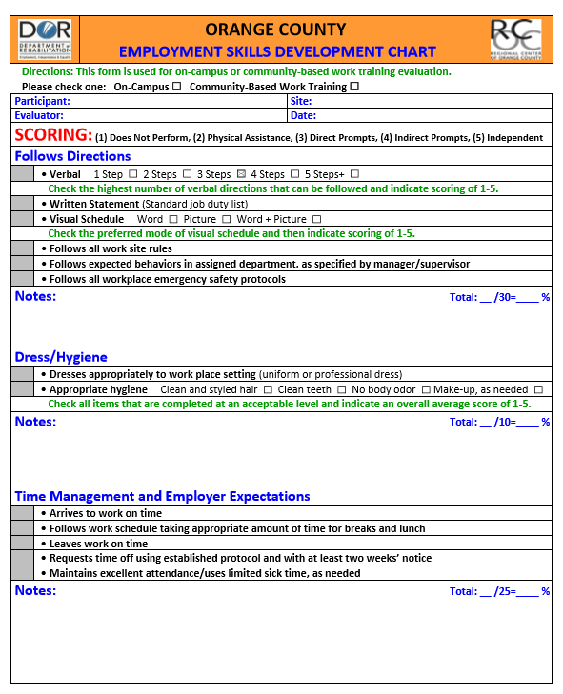

Slide 12
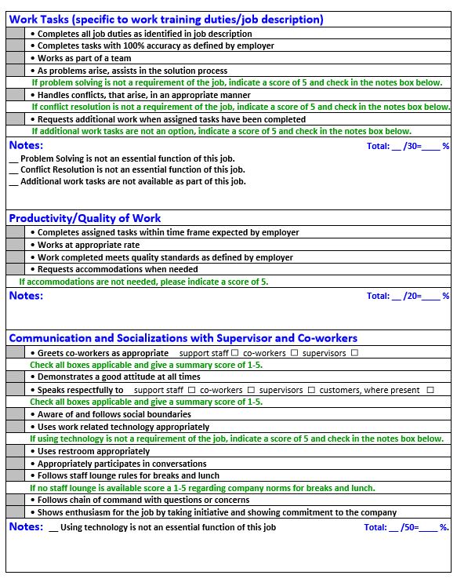

Slide 13
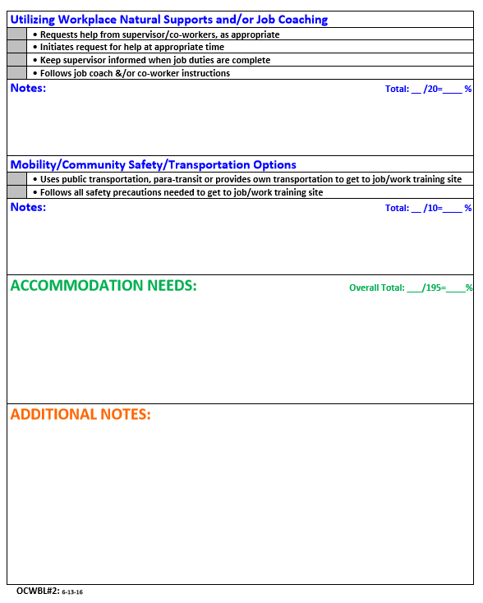

Slide 14

Virtual Job Shadows
VirtualJobShadow.com includes:
4 career interest assessments
Hundreds of engaging job shadowing videos
Rèsumè Builder
College & job searches
Integrated lesson builder
Financial literacy & soft skills curriculum
Admin tools and more!

Slide 15
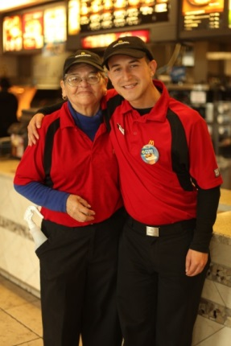

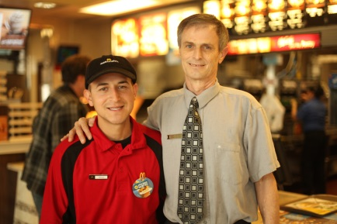


Slide 16

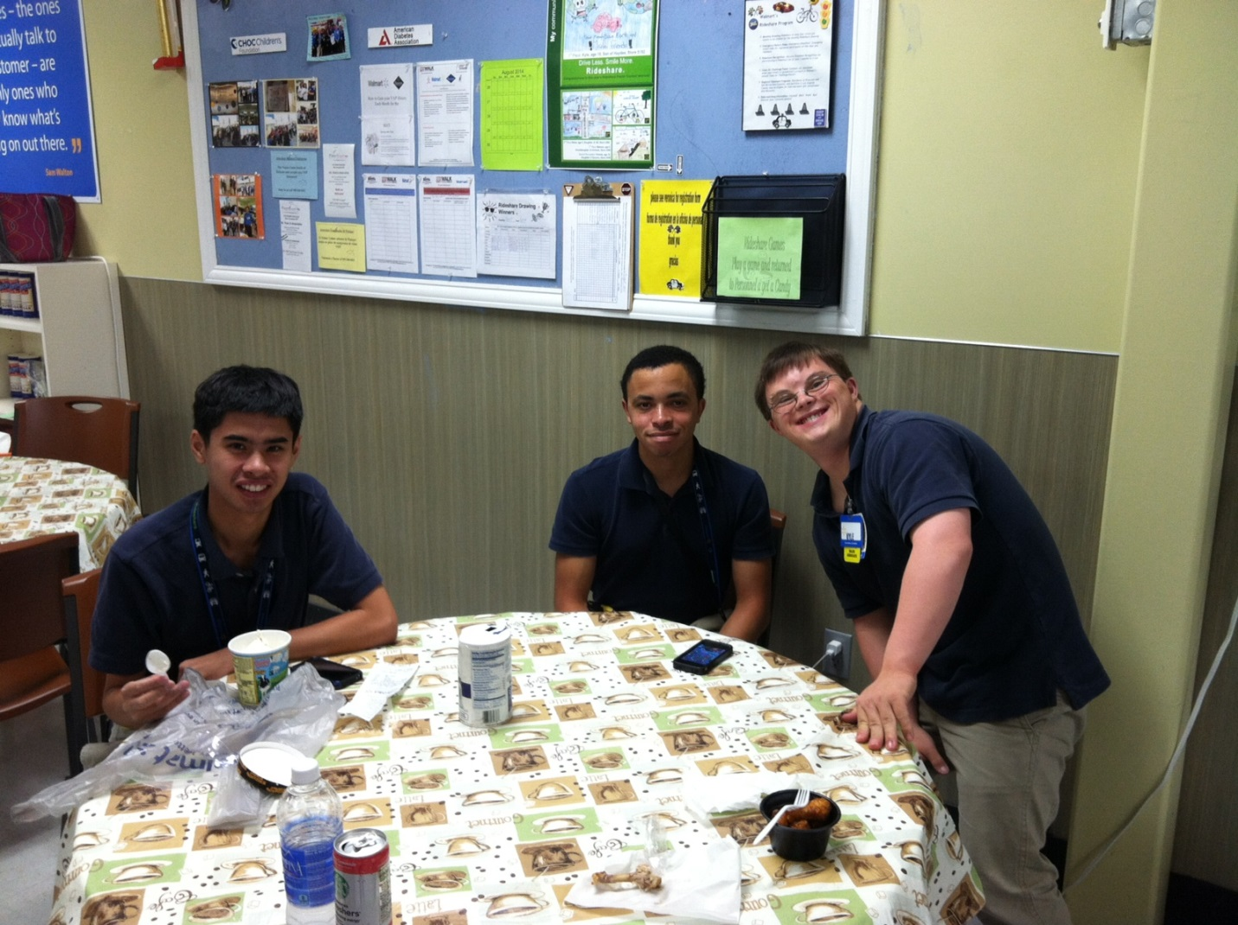

Slide 17

Paid Internship Program
  Developed through the Person-Centered Planning Process- goals, interests, preferences, skills, and strengths
  Purpose: Increase vocational skills and abilities
  Goals:
    acquisition of experience and skills for employment;
    internship leads to Competitive Integrated Employment
  Wages will be at least minimum wage
  Maximum funding for payment of an internship is $10,400 per year
  Support during internship hours based on individual’s needs (may be a part of ATP services)

Slide 18




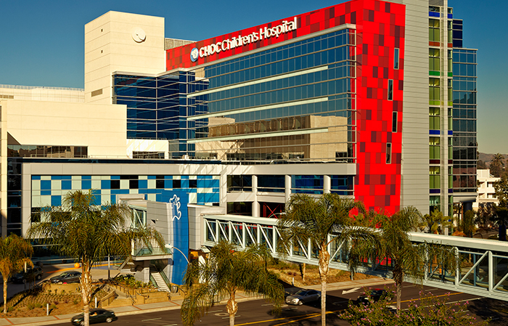

Slide 19







Partners in Success

Slide 20
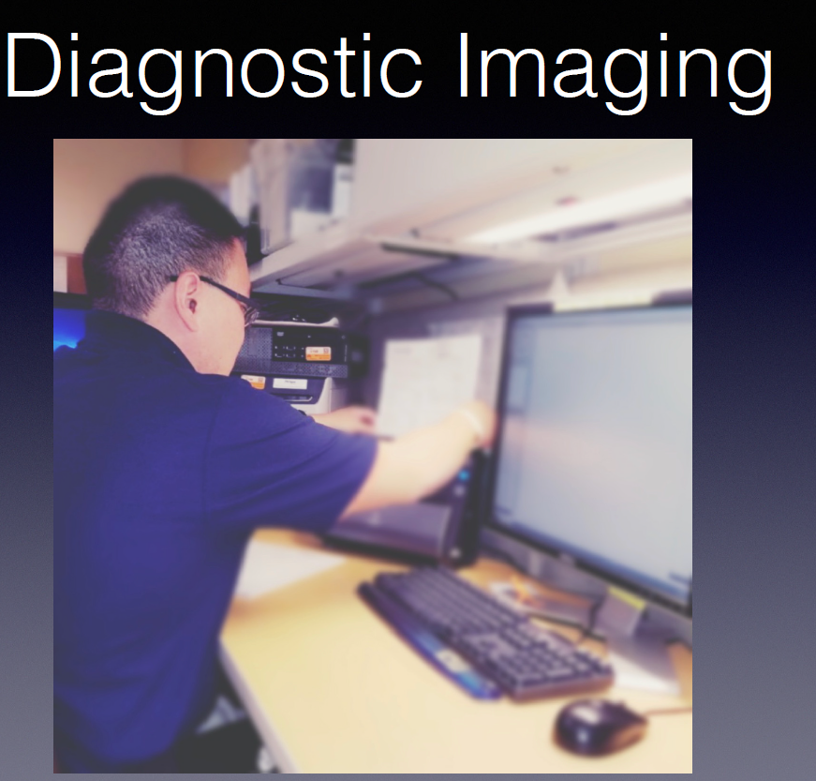
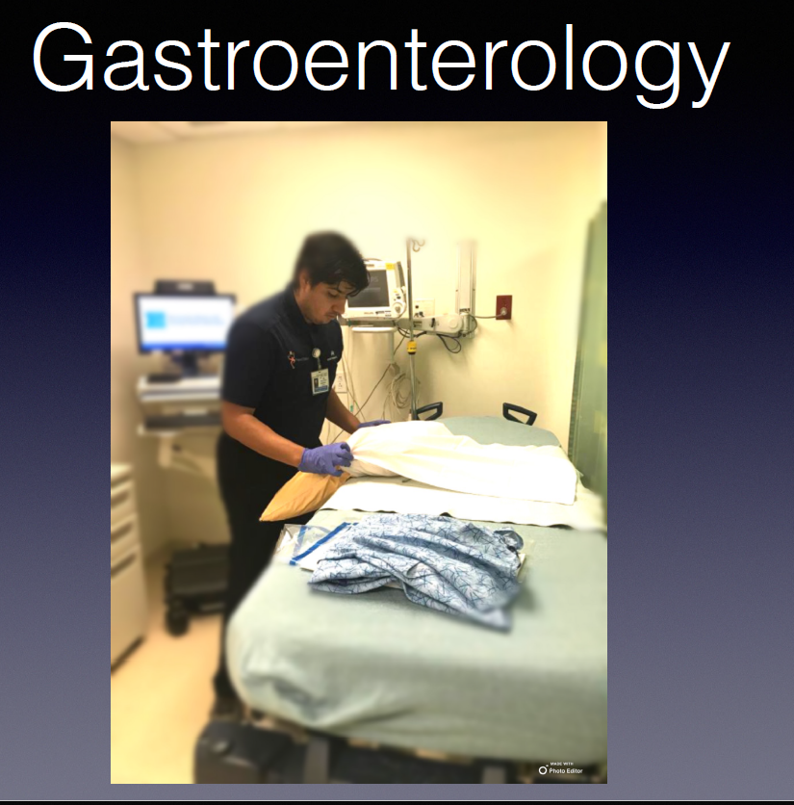



Slide 21
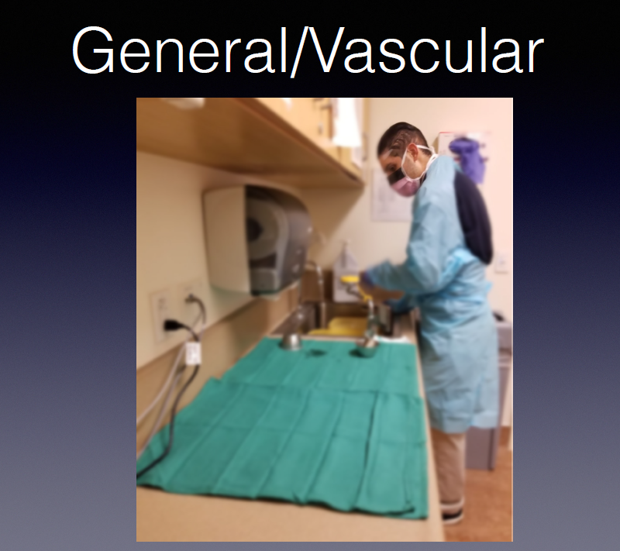
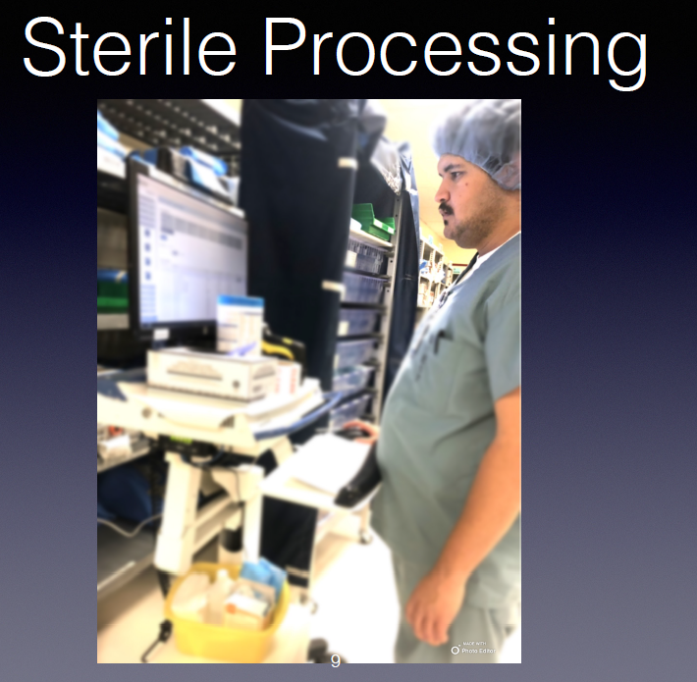
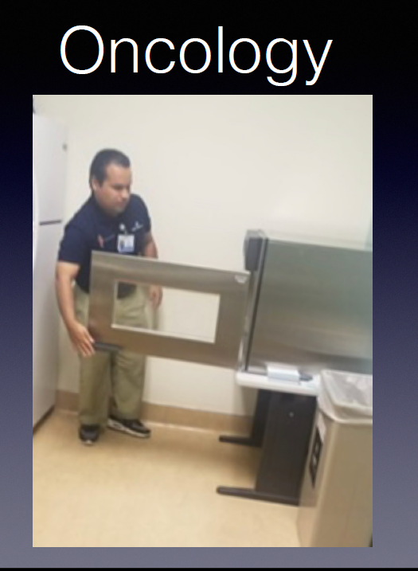
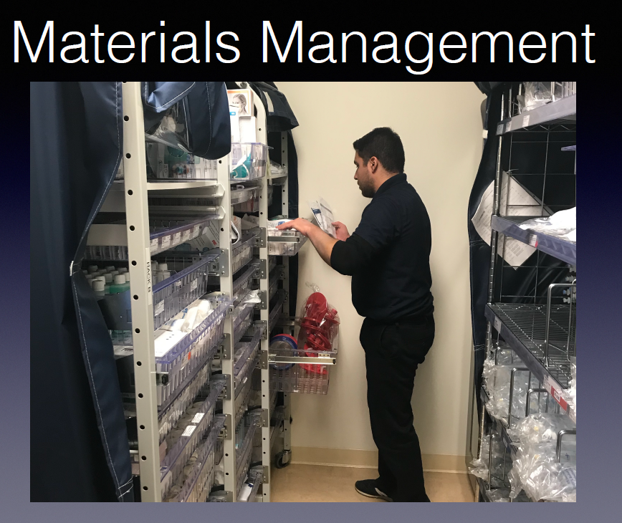
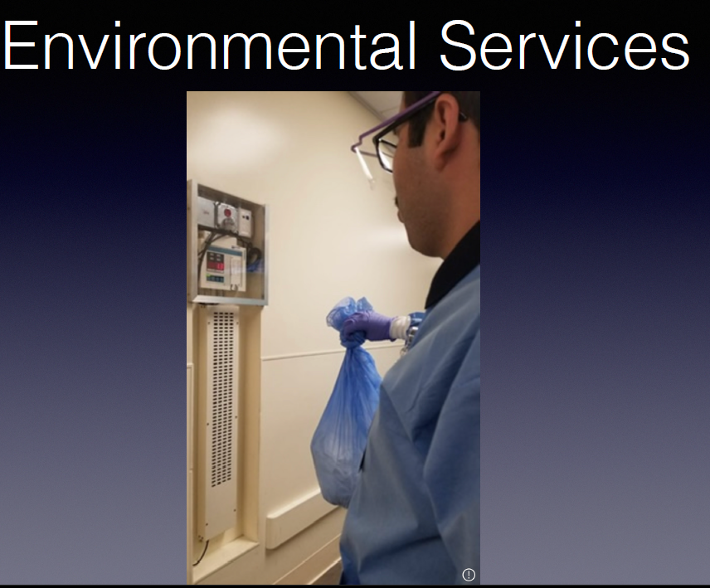

Slide 22

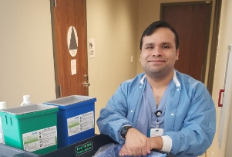
OCLPA SUCCESS STORY: ALEX
RCOC: Tailored Day Services
Disabled Student Services and WorkAbility III
North Orange Continuing Education
Cypress College
Alex: Employed at Kaiser Permanente Irvine Medical Center (40 hrs./wk. at $18/hr.)
GOAL!
Competitive Integrated Employment (CIE)
Regional Center of Orange County (RCOC)
GOC: Supported Employment
RCOC:
Transportation provided by OC Cab. Co.
Families
DOR
NOCE
Department of Rehabilitation
(DOR)
Goodwill of Orange County
Project SEARCH
RCOC
Kaiser Permanente
Anaheim Medical Center
CU Thompson Policy Institute

Slide 23
orange county companies who have hired project search graduates
UCI Medical Center
CHOC Children’s Hospital
File Depot
Manhattan Data LLC
Brackens Kitchen
White Bottle
Irvine Regional Outdoor Education Center
Goodwill of Orange County
St. Jude Medical Center
Los Alamitos Armed Forces Training Base
Ruff House Pet Care
Capstone Financial
St. Joseph’s Hospital
Volcom
Alta-Med
Pavilions
Village Green Foods
Artisan Bakery
Chic Party Rentals

Slide 24
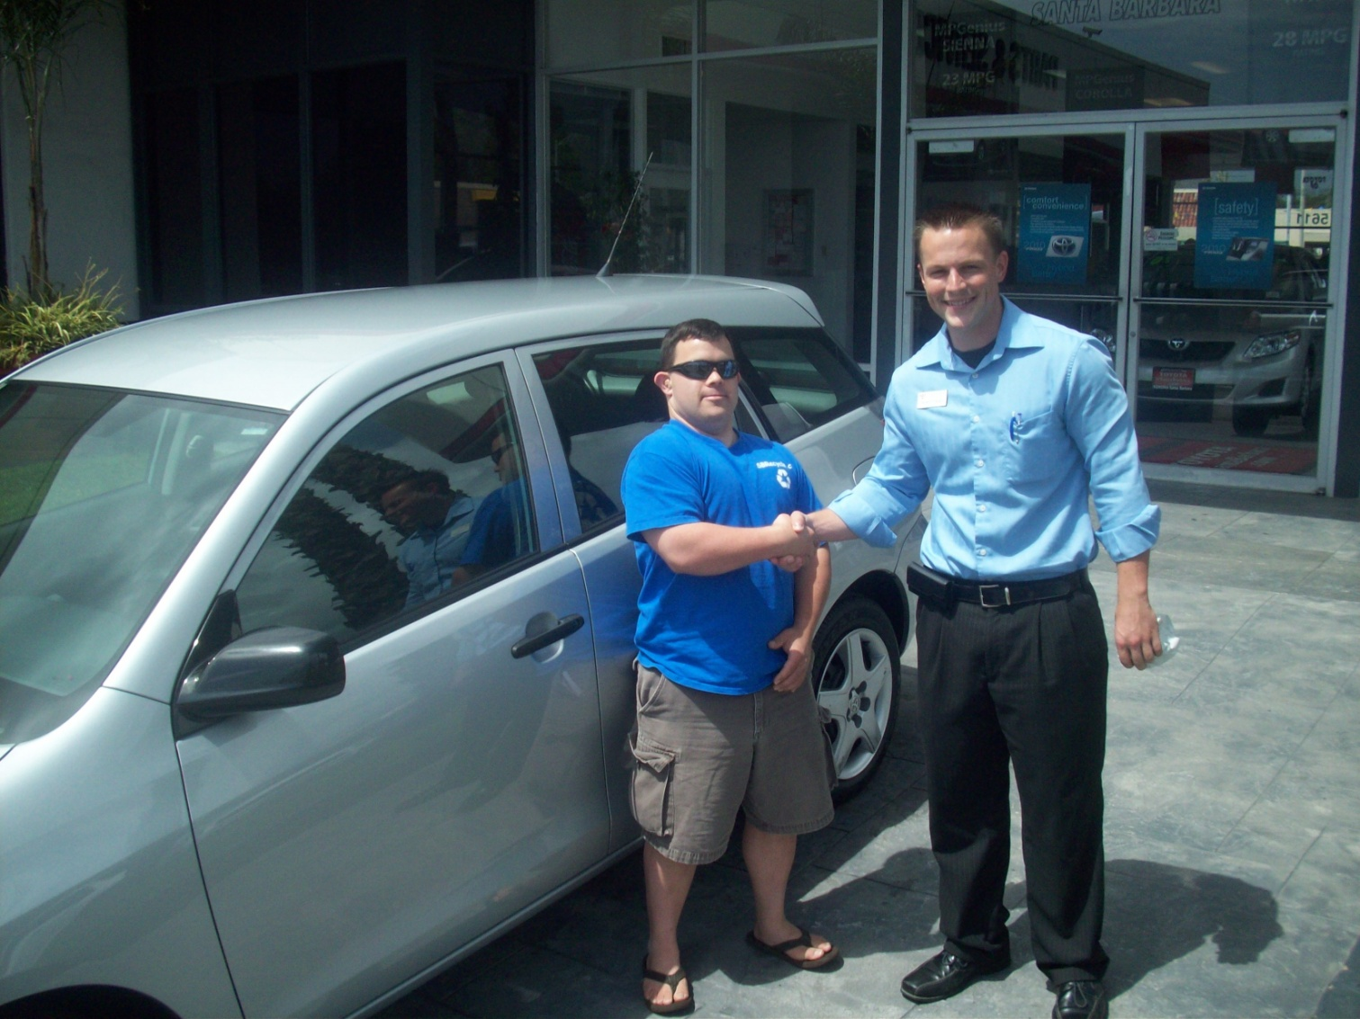
Matthew
Car Owner

Slide 25
Willie

Slide 26
QUESTIONS
COMPETITIVE INTEGRATED EMPLOYMENT
WORK-BASED LEARNING

