Slide 1
North Orange Continuing Education Options for Postsecndary Education 2021

Slide 2
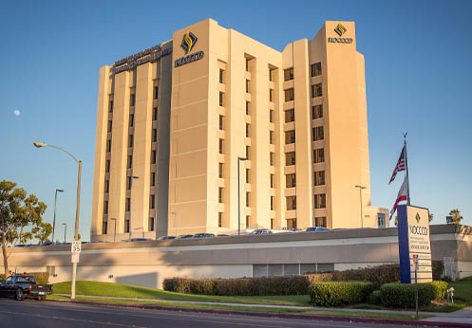
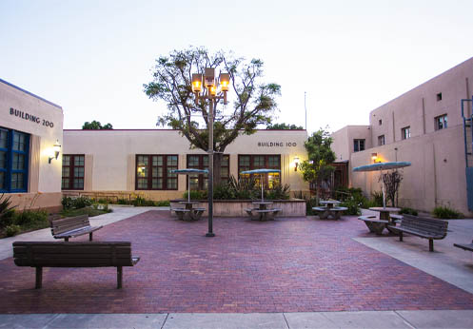
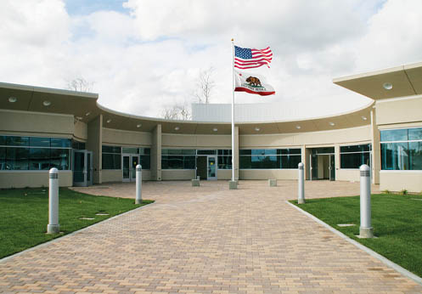
Wilshire Center
*next to Fullerton College
Anaheim Campus
Cypress Center
*located on
Cypress College’s Campus

Slide 3
Transition
Transition to Postsecondary
Programs and services that support inclusion
Transition to Workforce
Programs and services that support employment

Slide 4
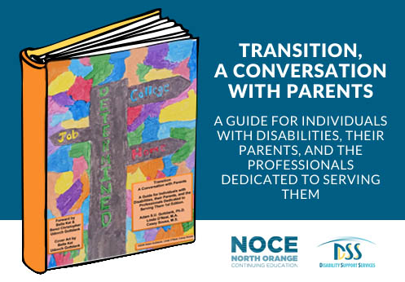
Transition
Shameless Plug:
Transition, A Conversation with Parents; or click here.
Adam S.U. Gottdank, Ph.D.
Linda O’Neal, M.A.
Casey Sousa, M.S.

Slide 5
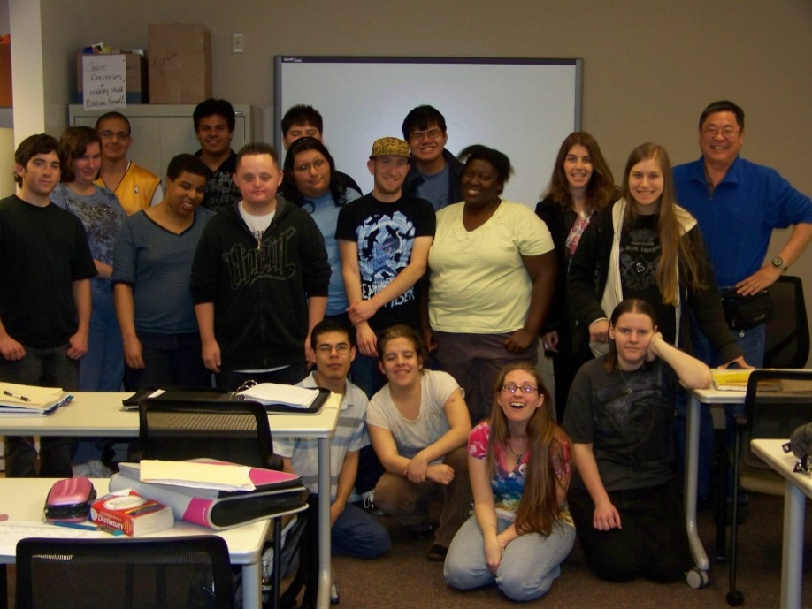
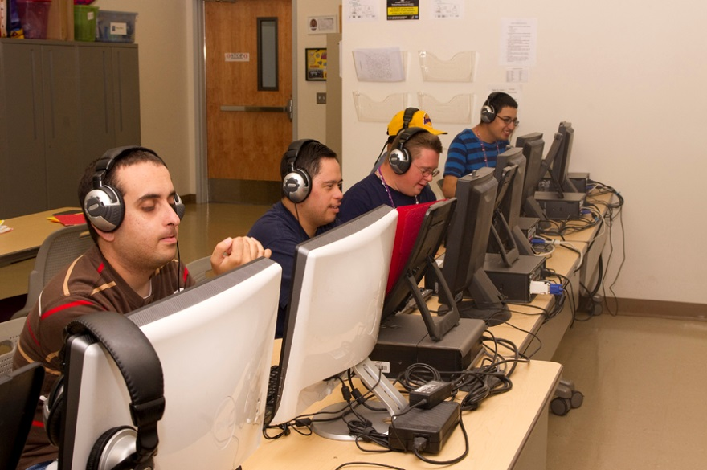
DSS Classes

Slide 6
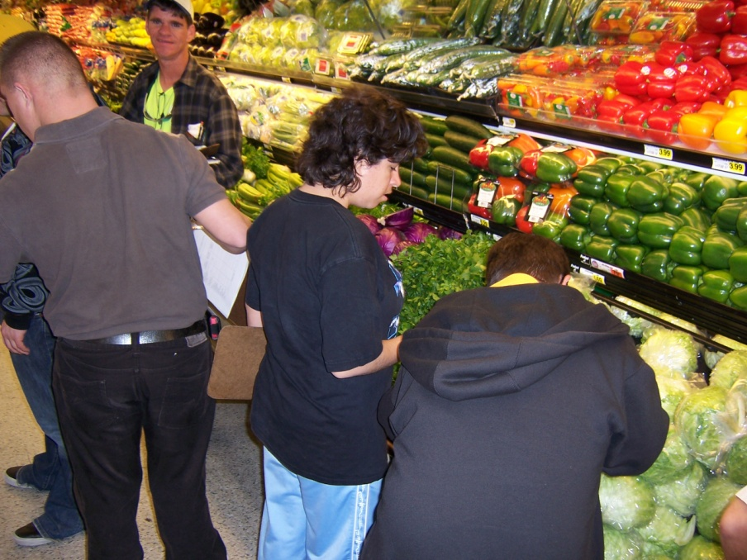
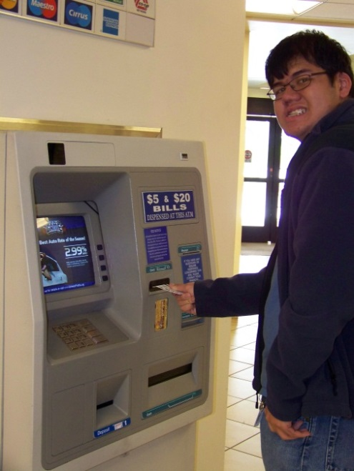
Core
Social Skills
Self-Advocacy
Life Skills
Basic Cooking
Personal Finance/Banking
Living More Independently

Slide 7
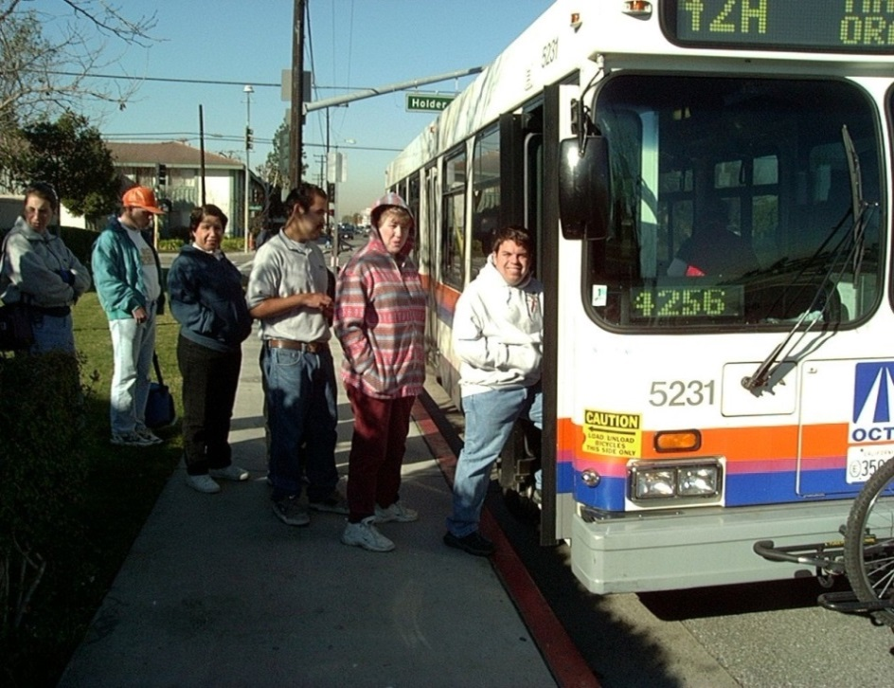
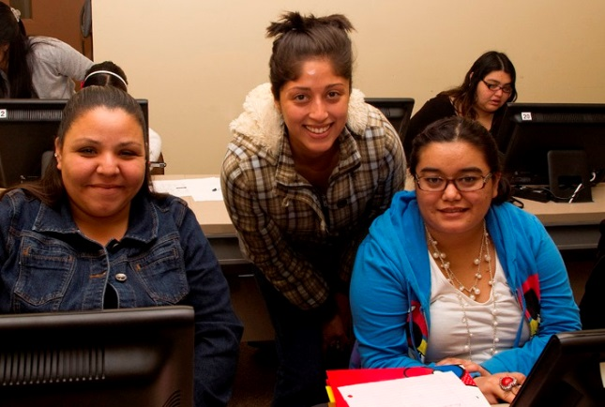
Academic Skills
Reading
Consumer Skills
Community Resources
Computer Skills
Intro
Intermediate
Photoshop

Slide 8
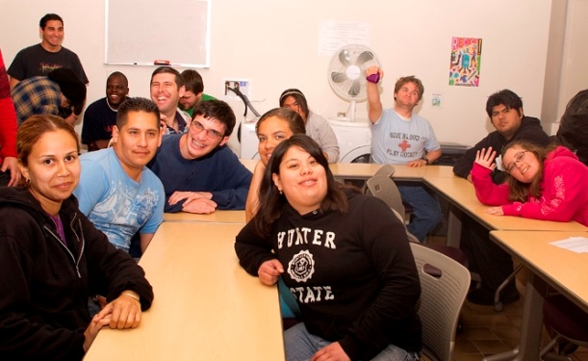
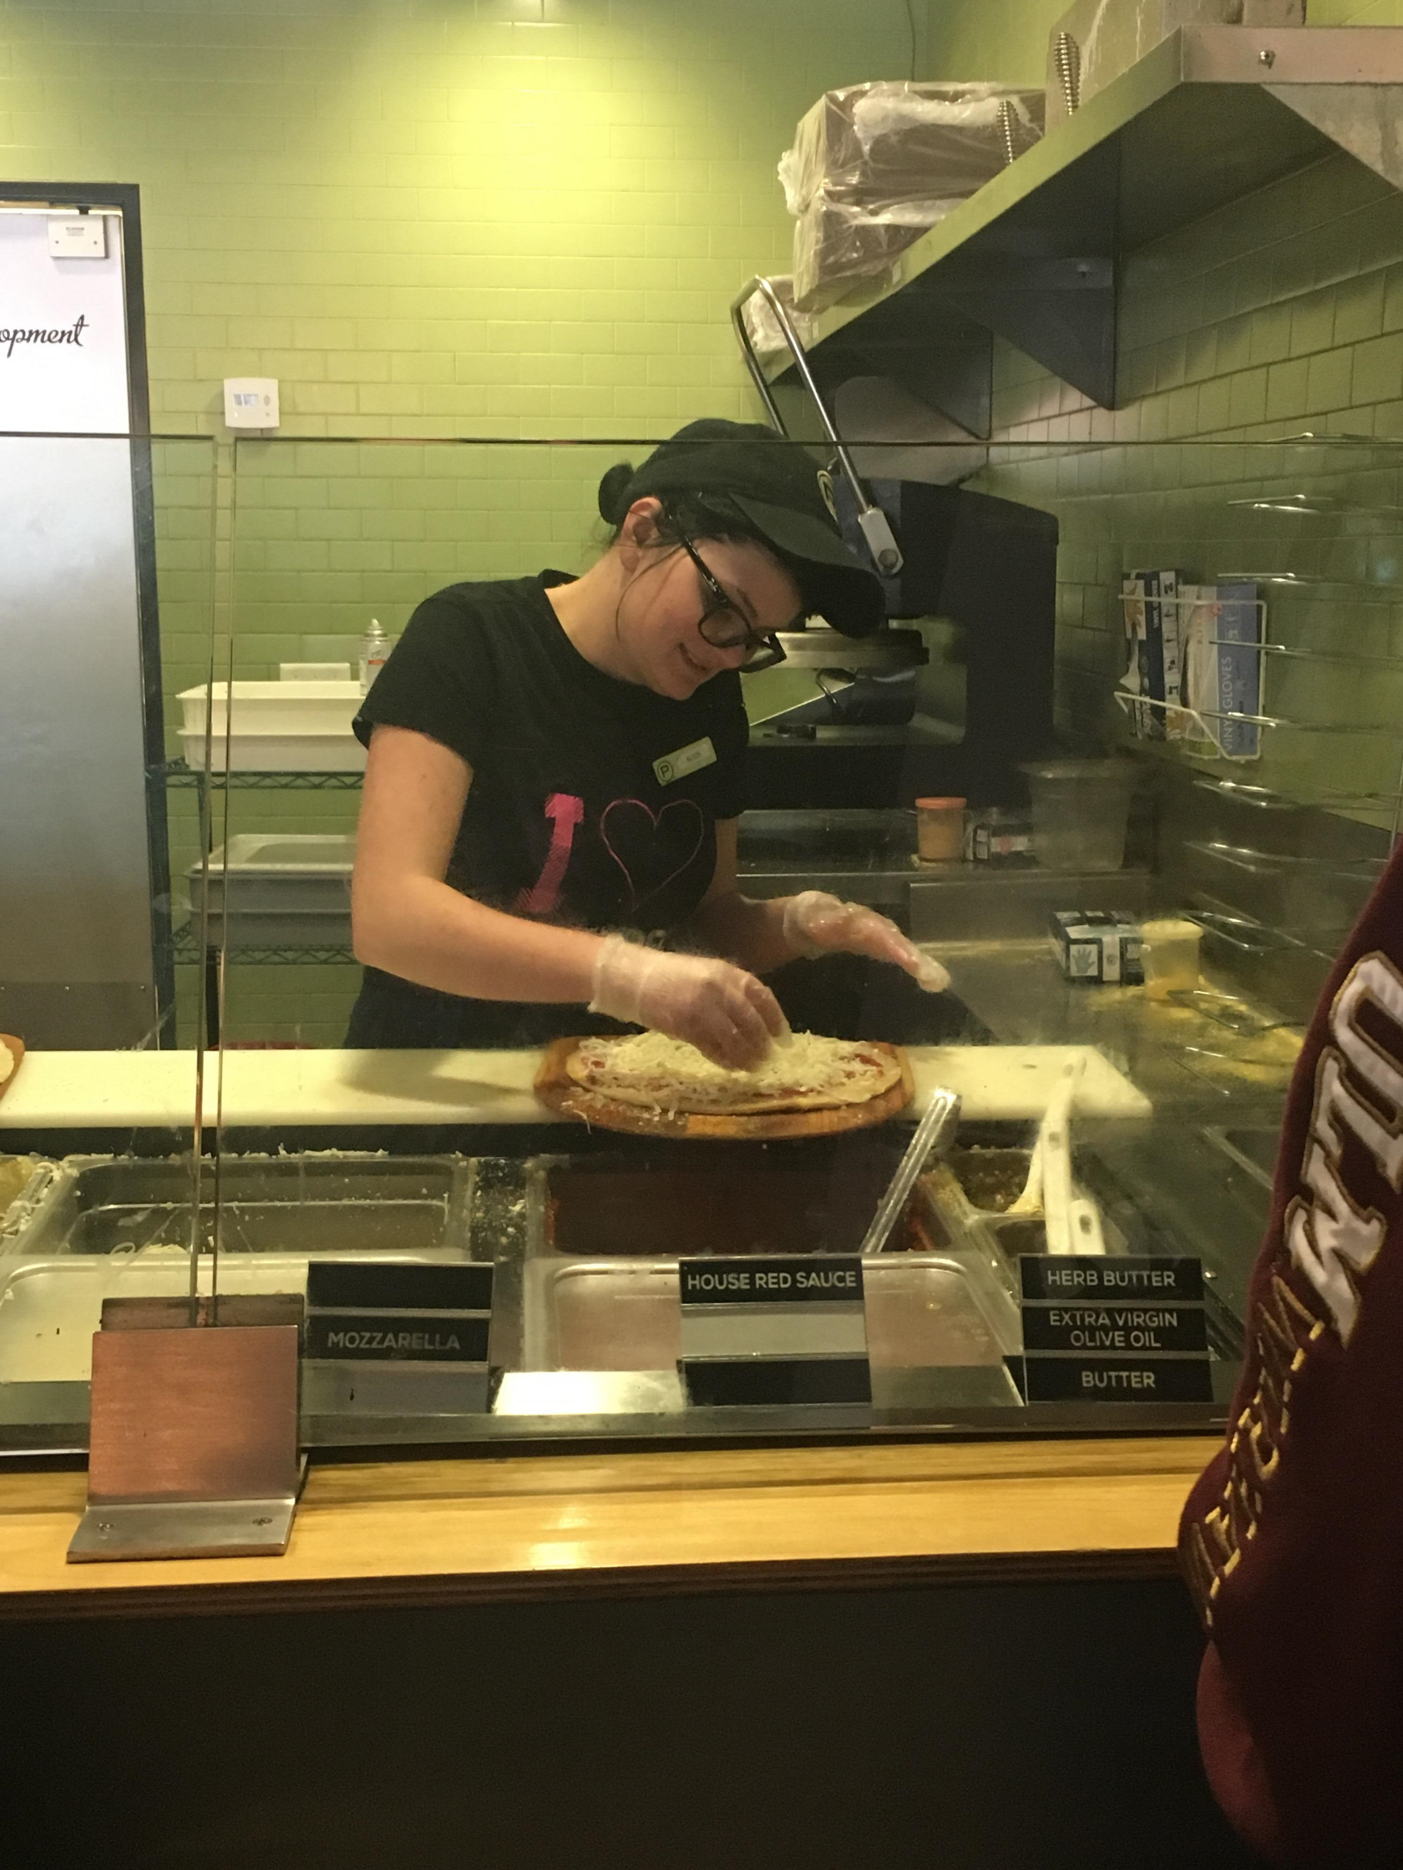
Interpersonal Skills
Relationships
Human Sexuality
Employment Skills
Occupational Skills
Workplace Skills
Communication on the Job

Slide 9
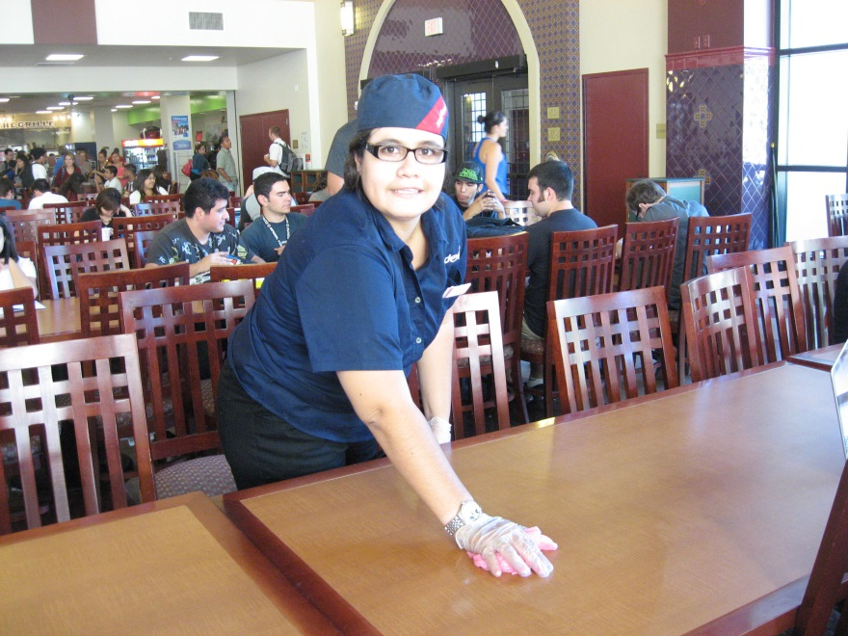
Updating Curriculum
Career Exploration
Retail
Customer Service
Technology
Guest Services
Food Service
Child Care
Animal Care
Digital Marketing

Slide 10
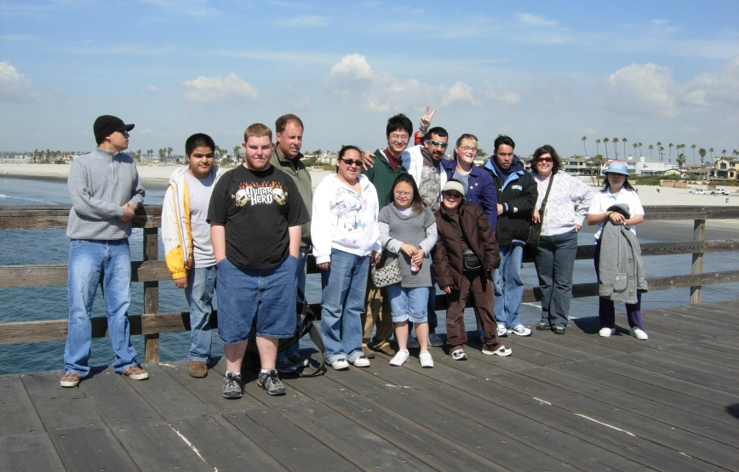
Work Skills
Relationship Safety
Self-Advocacy
Literacy
Social and Communication Skills
Skills for Professionals
Academic & Vocational Success
Personal Health & Wellness
Personal Finance
Living Independently
Updating Curriculum

Slide 11
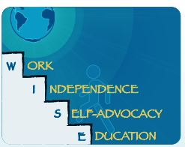
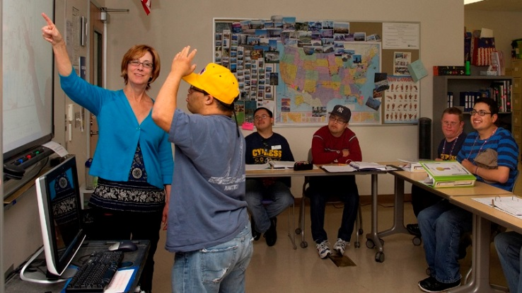
WISE Program
Higher level of instructional support
Regional Center Vendor
Lecture and class discussion
Small group work (1:4 ratio)
Monday through Friday
9:00 a.m. – 2:30 p.m.
Five-year program

Slide 12
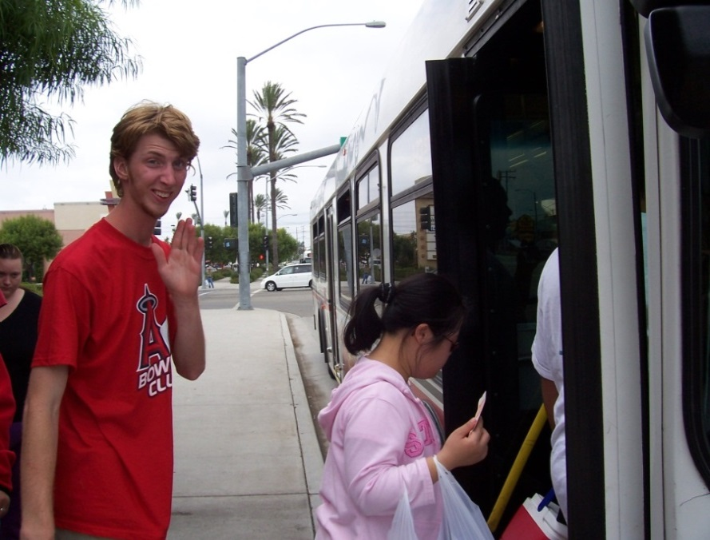
Services Supporting Inclusion
Bus Mobility Skills Training
1:1, small groups
Partnership w/ OCTA
College
Employment

Slide 13
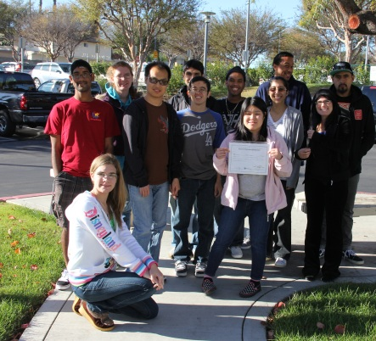
Services Supporting Inclusion
Counseling, Registration Assistance
Test-taking Accommodations
Sign Language Interpreters
Assistive Technology
Note-taking Assistance
Materials in Alternate Formats
Assessment & Evaluation

Slide 14
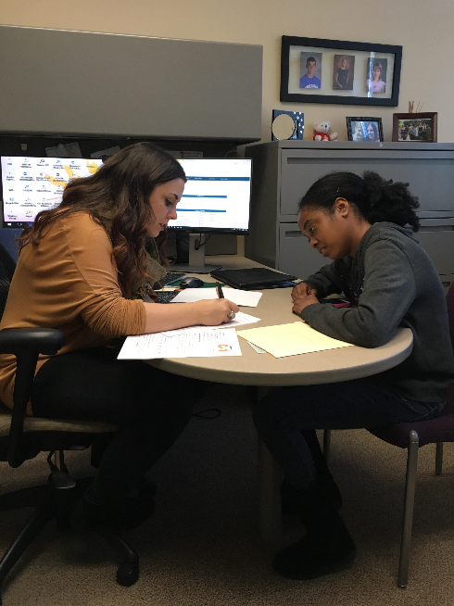
Services Supporting Inclusion
C2C, IVES (RCOC), Equity
1:1 Educational Coaching
Up To 7 Hours Per Week
Not Supervision
Specialized Counseling
Specialized Instructional Lab

Slide 15
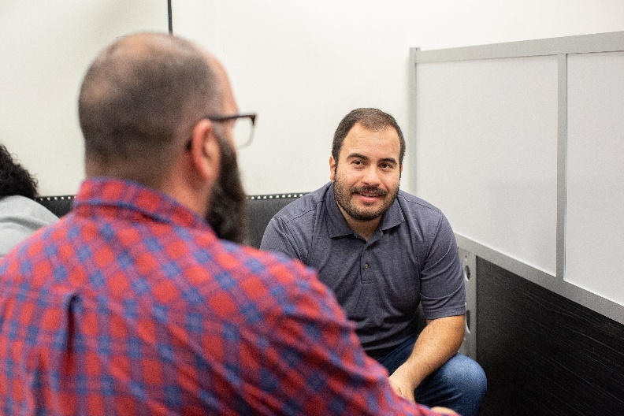
Services Supporting Inclusion
Academics, Relationships, Independence, Self-Advocacy, Emotional Health (ARISE) Lab
Mindfulness & wellness workshops
Social groups and student led activities
Supporting Neurodiversity
Sensory Friendly
Safe Space
1:1 & Small Groups

Slide 16
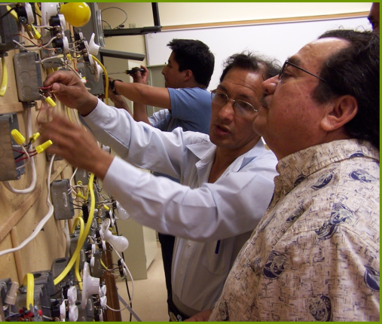
Vocational Certificates
Administrative Professional
Braille Transcribing
Business Information Worker I
Early Childhood Education
Electrical Technology
Funeral Service Assistant
Management
Medical Assistant
Pharmacy Technician
Introductory Computer
Classes
High School Diploma Program
Self-Paced Lab

Slide 17
Many Options
Individual Classes
Certificates
Degrees

Slide 18
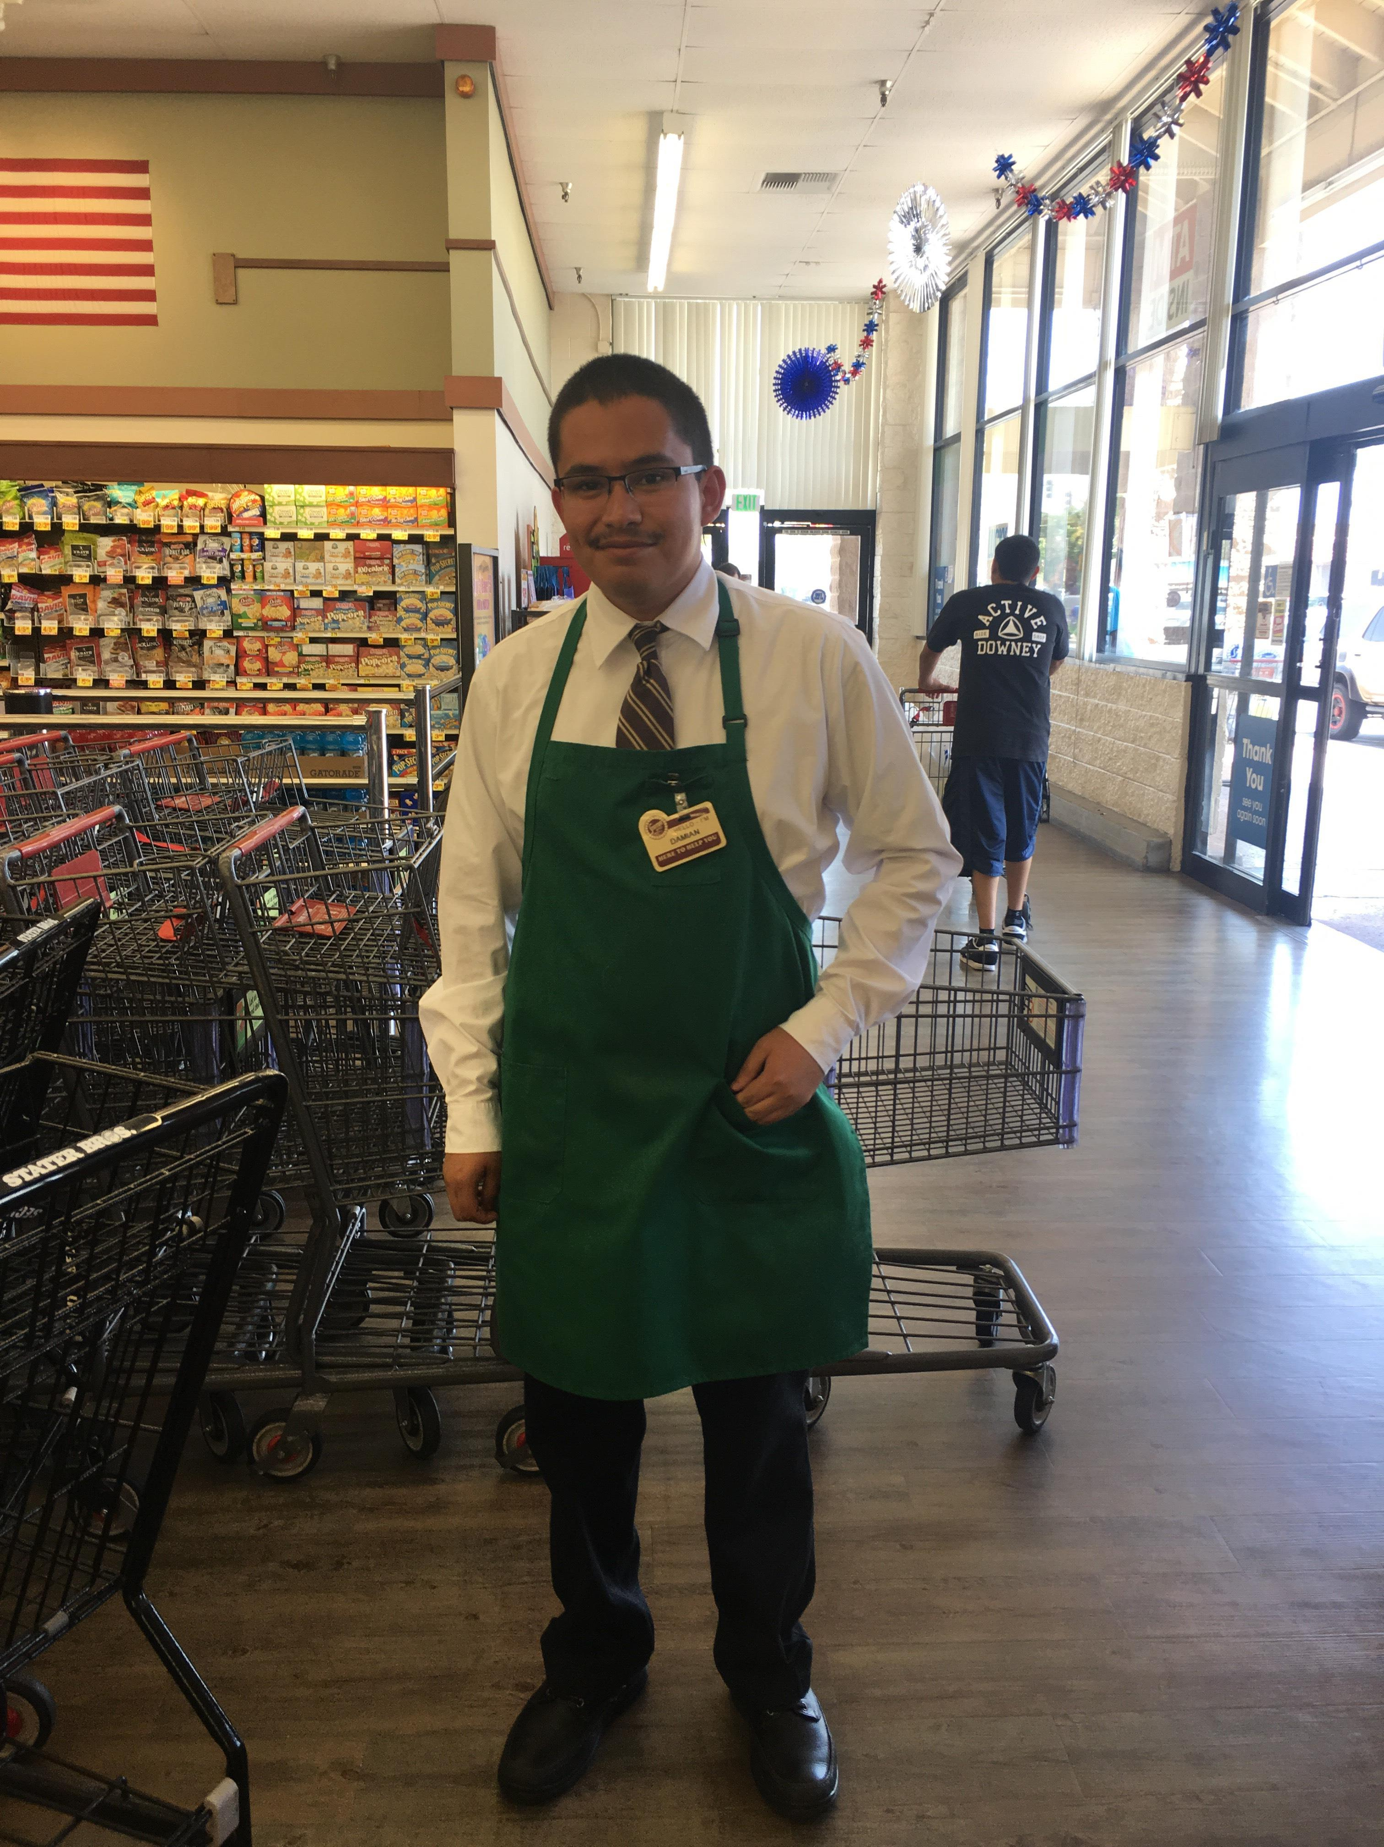
Workforce Programs
Workability III
College to Career
North OC Regional Consortium
Project Search
Workforce Case Management

Slide 19
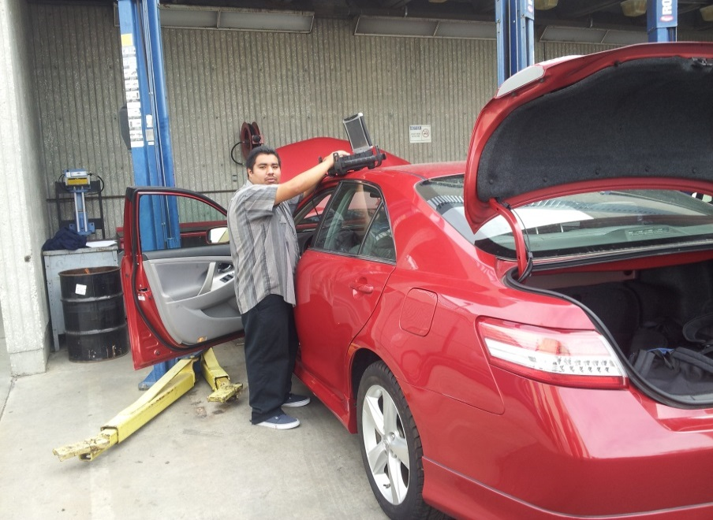
Workforce (generally)
Employment Prep
Resumes, job applications
Interview Skills
Job Development
18 years old, ready to start
Department of Rehabilitation (DOR)
Work independently after services fade
Job coaching (eligible for Regional Center)

Slide 20
Workforce
Many Partners

Slide 21
Contact Us
714.484.7057
Adam Gottdank, DSS Director
agottdank@noce.edu
April Fante, DSS Manager
afante@noce.edu
Lorri Guy, DSS Coordinator
lguy@noce.edu

