Slide 1
OCLPA Universal Referral Process
Linda O’Neal, M.A.
San Diego State University, Interwork Institute
Chapman University, Thompson Policy Institute
Regional Center of Orange County

Slide 2
Orange County Local Partnership Agreement

Slide 3
Orange County LPA Purpose
The purpose of the Orange County Local Partnership Agreement (OCLPA) is to enhance partnerships that promote preparation for and achievement of competitive integrated employment (CIE) for youth/adults, 14 years old through 30 years+, with disabilities and related “At Risk” populations including individuals with intellectual disabilities and developmental disabilities (ID/DD).

Slide 4
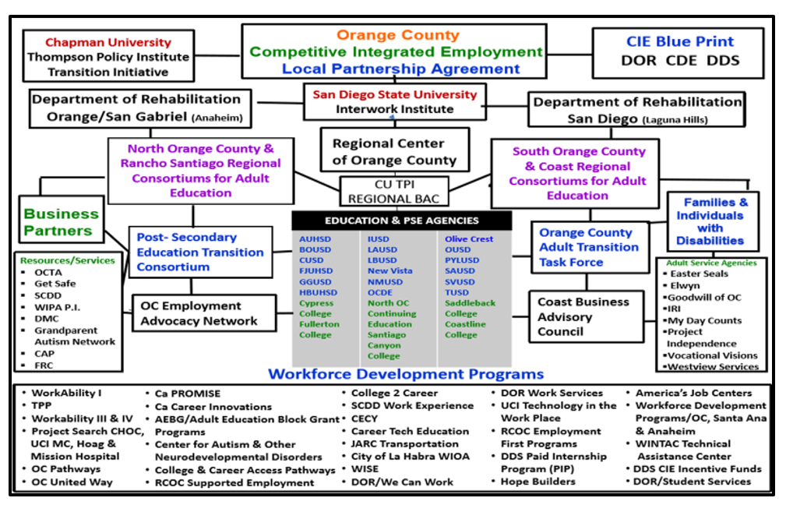

Slide 5
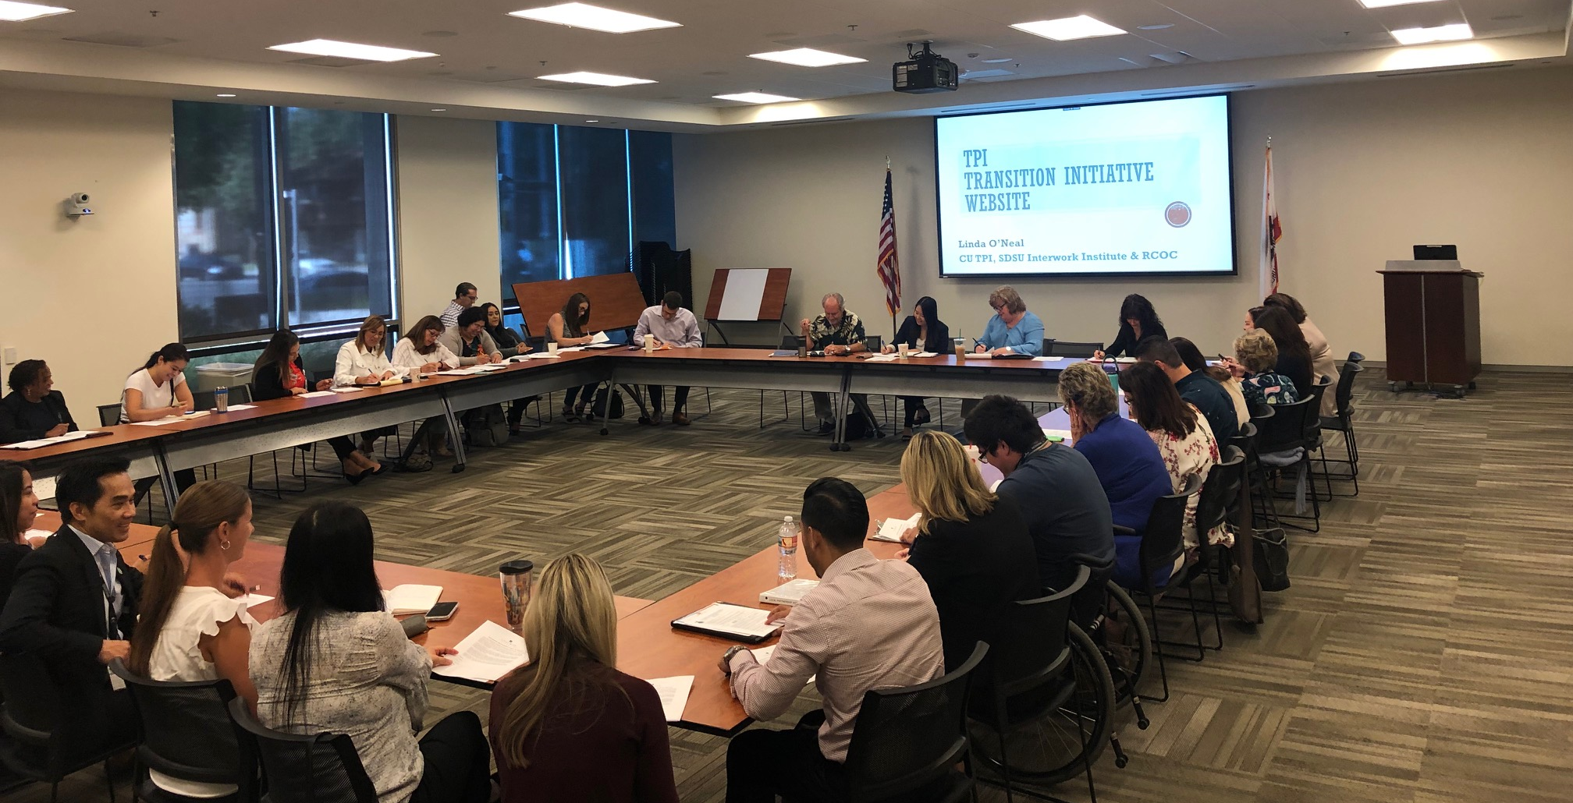

Slide 6
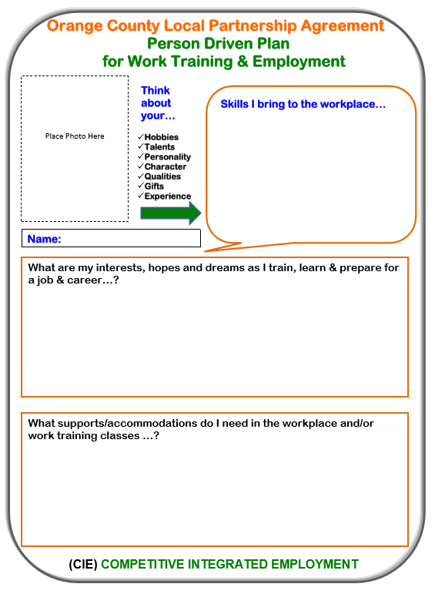
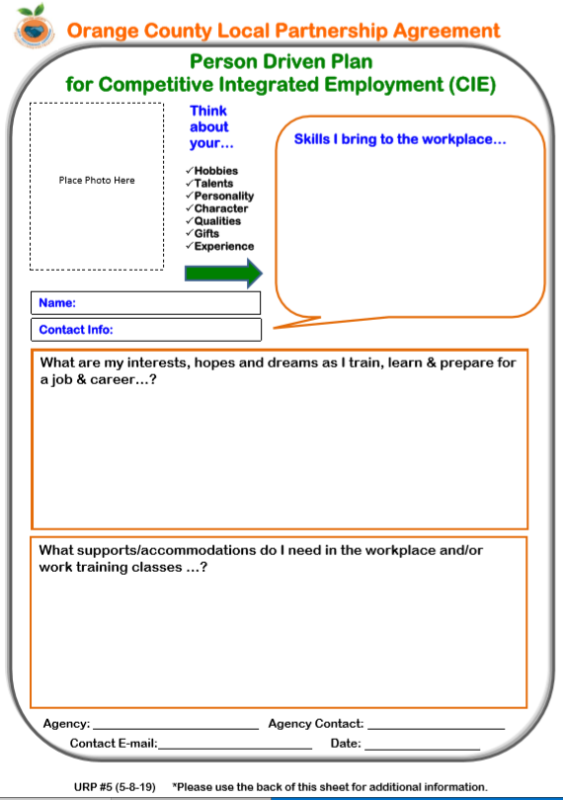

Slide 7
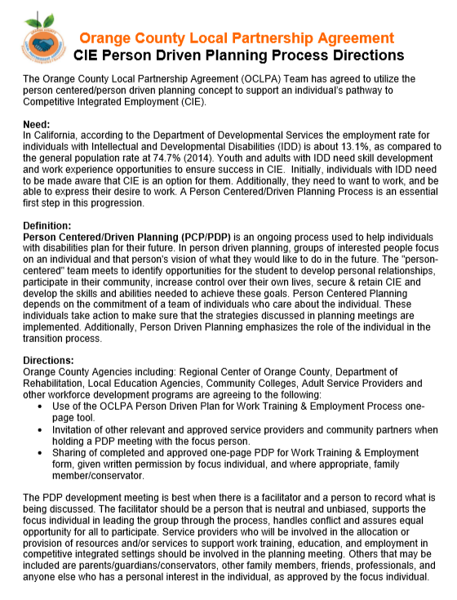
OCLPA
Person Driven Planning
Directions

Slide 8
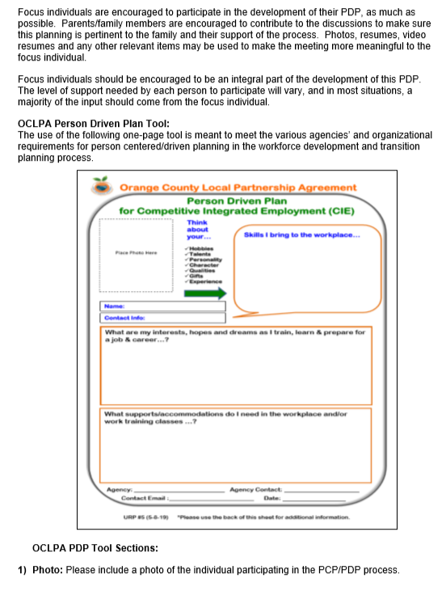
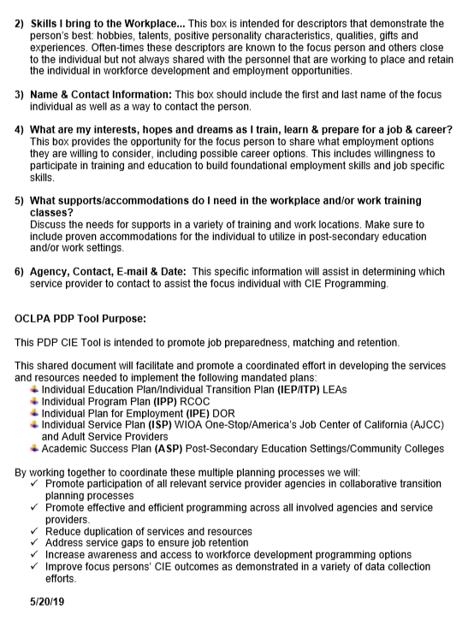

Slide 9
OCLPA Universal Referral Process (URP)

Slide 10
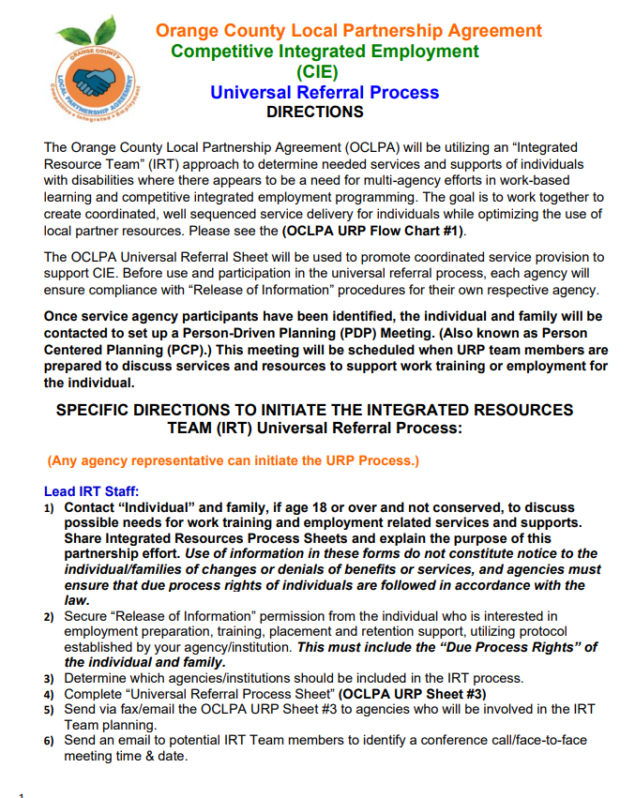
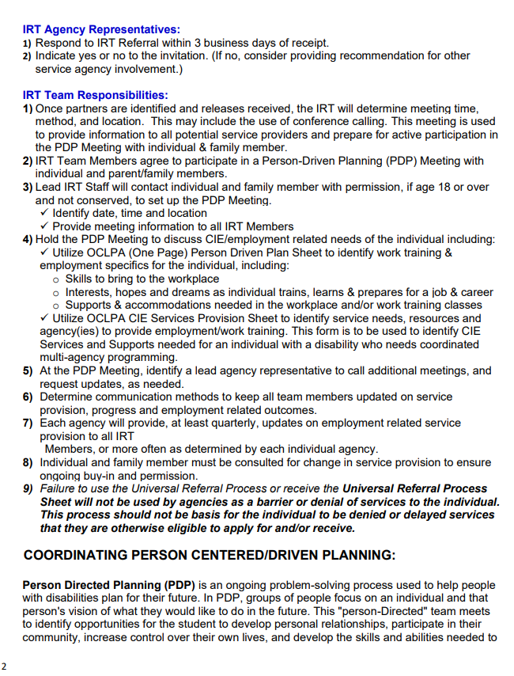

Slide 11
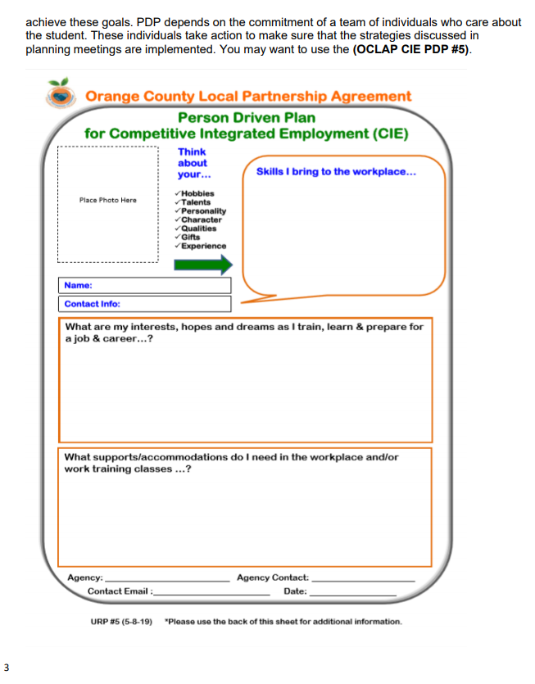
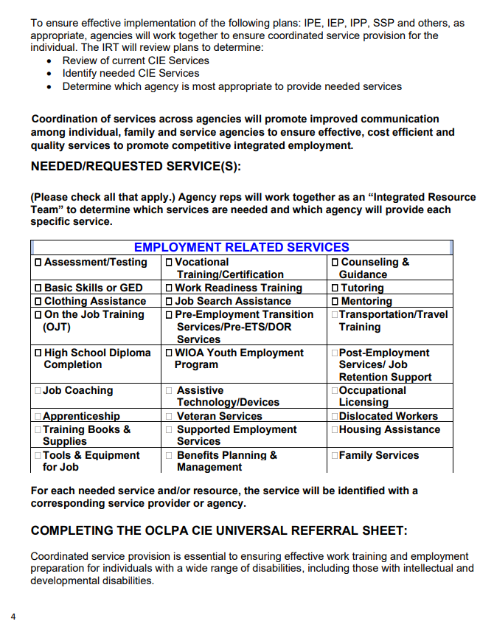

Slide 12
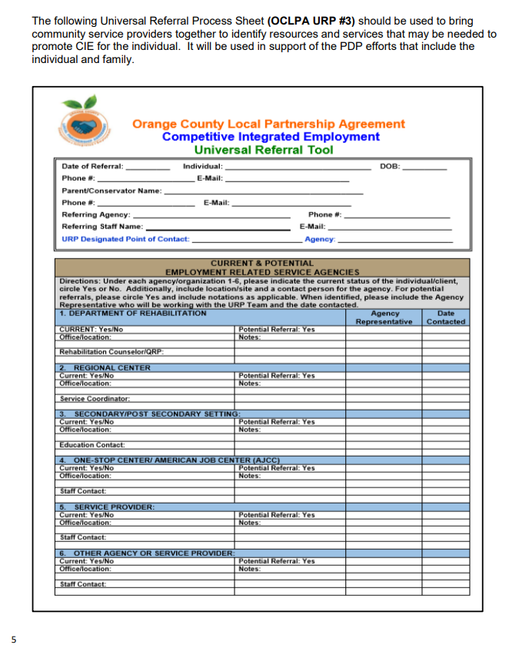
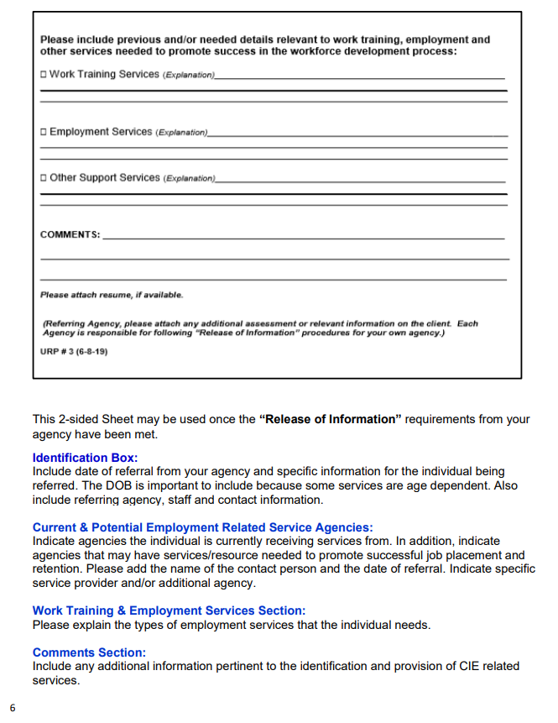

Slide 13
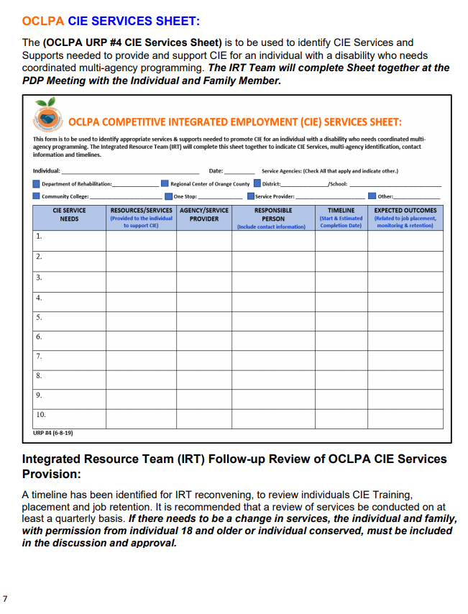
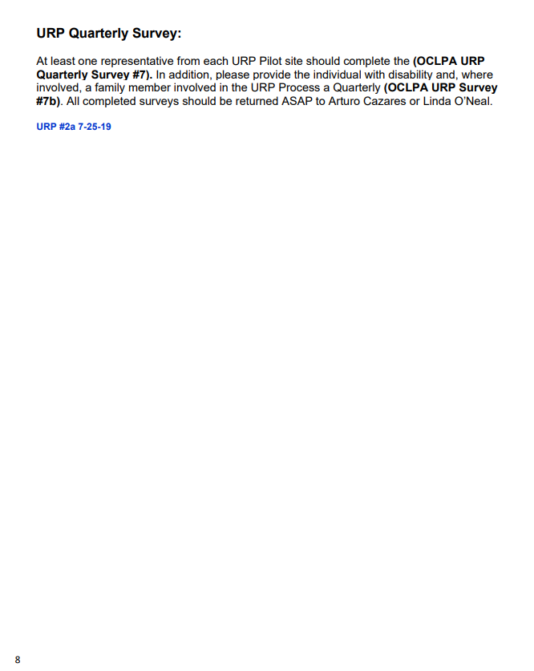

Slide 14
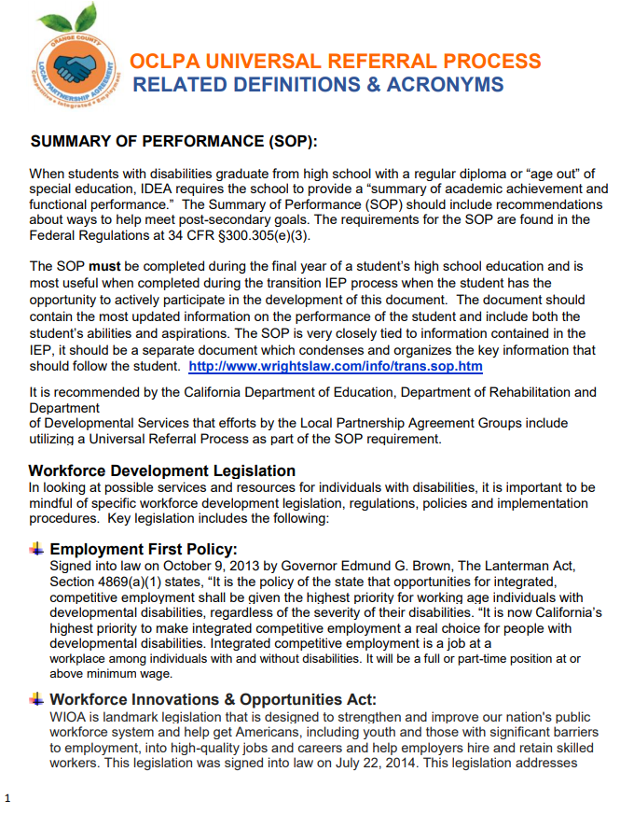
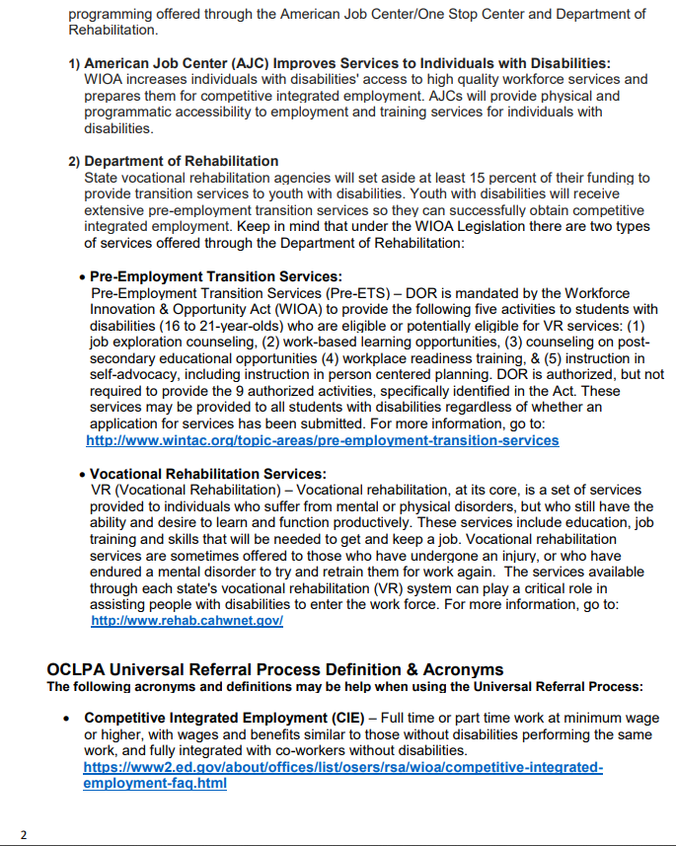

Slide 15
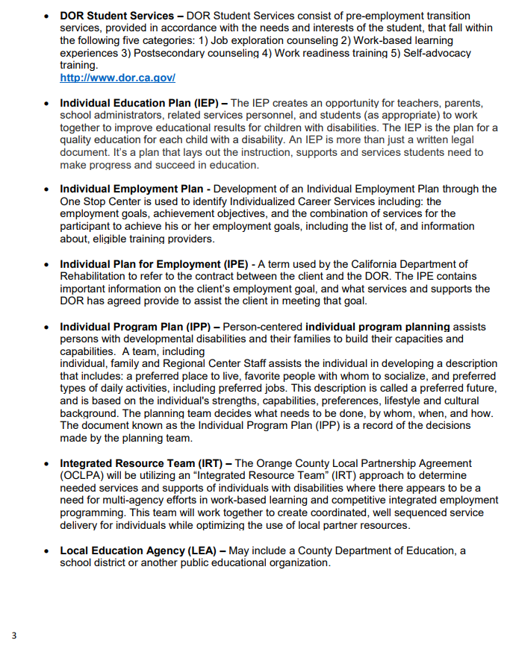
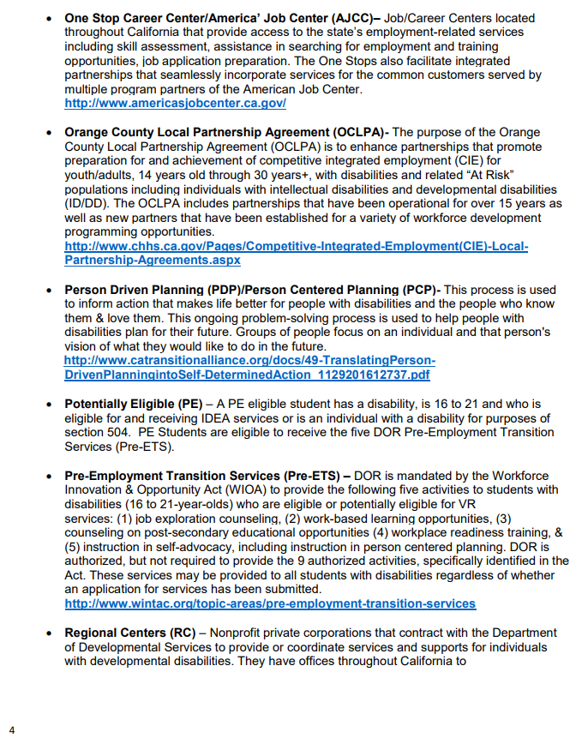

Slide 16
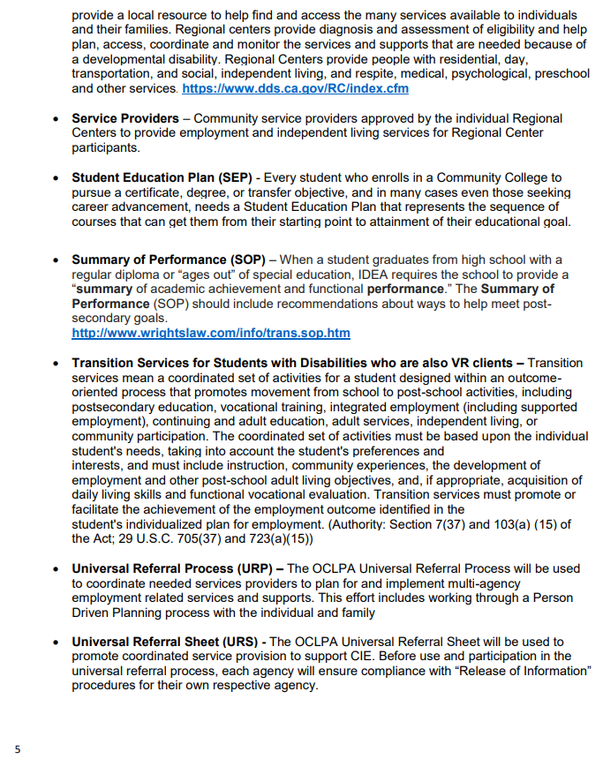
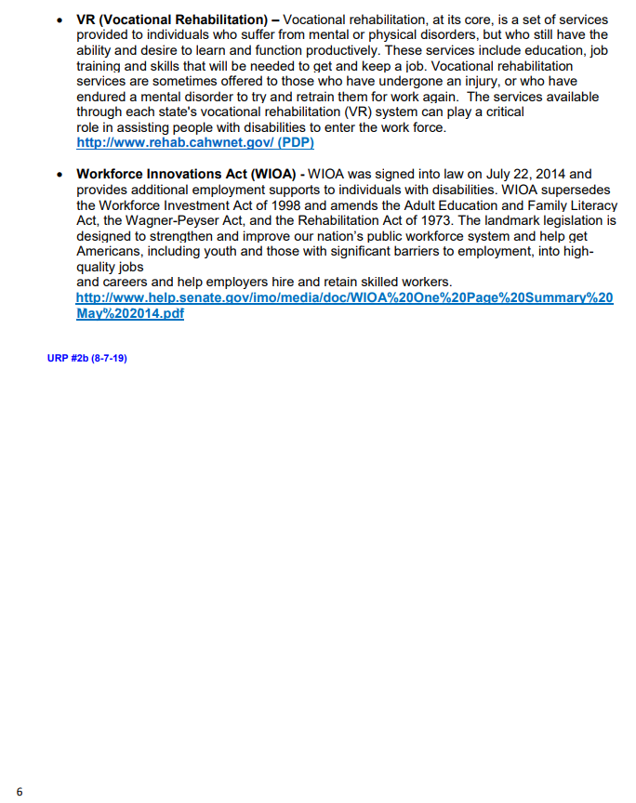

Slide 17
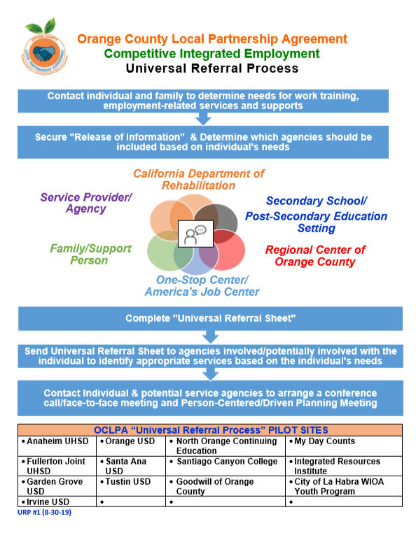
OCLPA Universal Referral Process

Slide 18
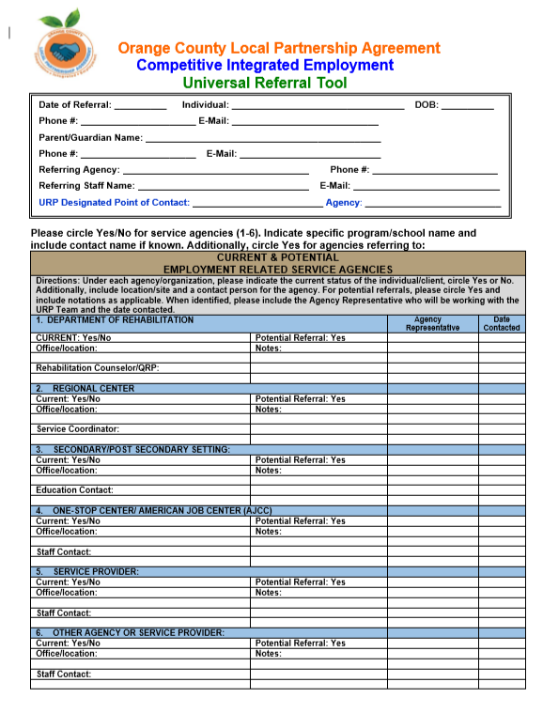
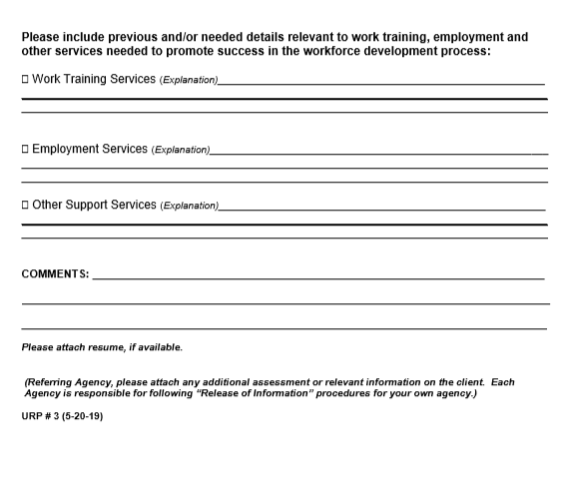
OCLPA URP
Referral Tool

Slide 19
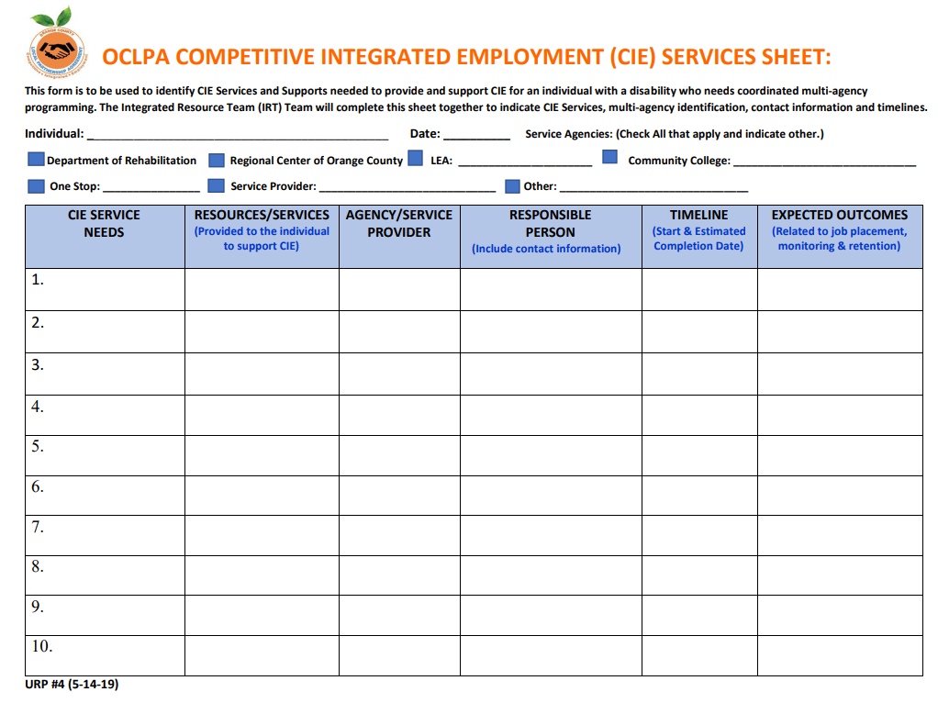

Slide 20
Qualtrics Surveys
IWD &
FAMILY MEMBERS
EDUCATORS &
SERVICE PROVIDERS

Slide 21
QUESTions

Slide 22
Thank you for the opportunity to speak with you today…
Linda O’Neal, M.A.
San Diego State University, Interwork Institute
Chapman University, Thompson Policy Institute
Orange County Regional Center
linda_oneal@interwork.sdsu.edu
(949) 374-0270

