Slide 1
Racial Inequity for People with Disabilities Seeking Services, Education & Employment: Yes we know, now what are we going to do about it?
Candis Bowles
Sr. Managing Attorney
Notes:
Representing kids with disabilities for 17 years.
Worked at DRC for 13 years
Youth PG
Sr Managing Attorney
I am here today NOT because I am an expert on the subject. I am more like you, I serve people with disabilities. Most of my clients are African American ot Latinx . I am excited for this time with your because you are actuakly in a position to discuss this burning question: SKIP NEXT SLIDE TO QUESTION

Slide 2
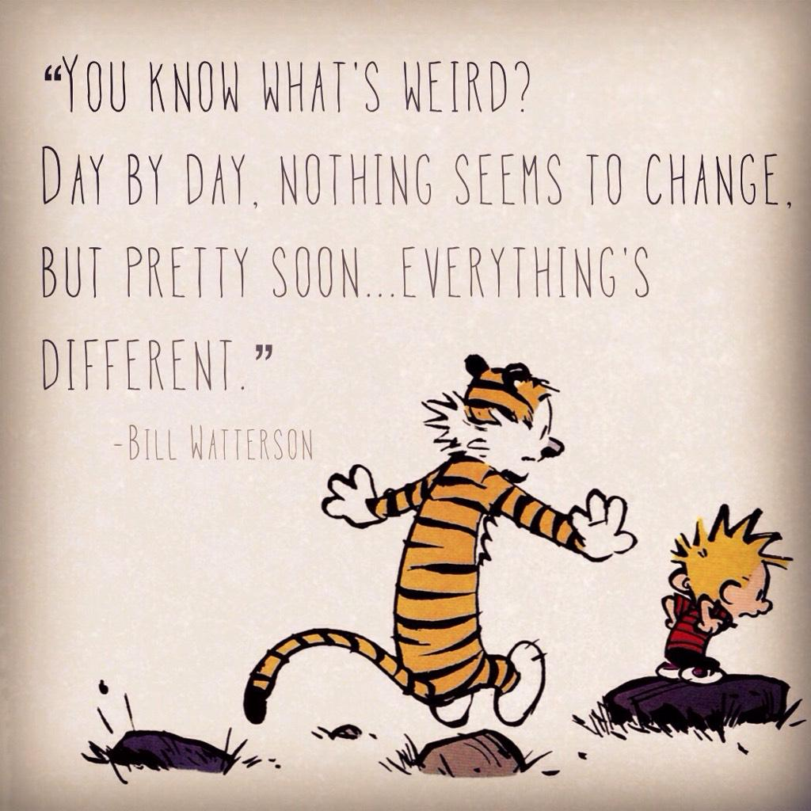
Notes:
This time when we are all working from home and one day runs into the next, it is striking how monotonous this time feels WHILE extraordinary change is taking place. Our discussion today is about how do we build on the momentum of the moment? How do we examine how we have served and underserved AA and Latinx students. We all have individual success but the reality is the numbers are bleak and they have been for many years. So today I want to discuss what works, and how we can focus our attention on : (1) Assessment of services and outcomes; (2) identification of systemic barriers and (3) Equity – so that we can aspire to NOT be in the same place we are now in 10 years.

Slide 3
Question?
Despite all of our efforts, why do we continue to see lower employment and educational outcomes for African American and Latinx students with disabilities?
Notes:
READ QUESTION
GO TO CALVIN & HOBBES

Slide 4
Root Cause of Lower Employment Outcomes
Low expectations
Student’s expressed interest is to earn money now – not more school
Disagreement with types of employment suggests by VR professional
Perception of student as not academically inclined
Lower participation in associate’s degree or college graduate degree
No access to job placement resources available at higher educational institutions
Notes:
In preparation for this meeting I found the study that I sent for you in the materials, it is called the Education and Employment Outcomes from Rehabilitation Services Agency Data Files for Transition Age African American, White and Hispanic Youth with Disabilities.
Question 1: Are AA, W and Hisp students 15-18 statistically different in employment rates and mean income? YES
Question 2: Are AA, W, Hisp student 15-18 statistically different on mean earnings per week YES
Question 3: Are individual demorgraphics and case service variables for statitica;tically significantly related to successful employment AA, W, and Hisp students 15-18 statistically different
STATS like these are not particular helpful to me as a practical matter. As an African American woman – parent of an African American young man – stats are downright scary and demoralizing. So I ignore them. I much rather focus on stats that tell me what I need to do to NOT fall into one of these depressing stats.
What I found valuable in the student are the anaylsis of SOME of the causes for these stats.
# 1 LOW EXPECTATION - We have had schools, who sevre students with behaviors tell us, we are not here to educate these children. We are focused on behavior. The truth is more often than not. behavior is the result of frustration with learning challenges.
#2 CLIENT DOES NOT WANT MORE SCHOOL - Many students have NEVER experienced school success. SO dropping out or graduating and employment is a reasonable reaction to negative school expriences. We have counselors when our clients say, I want to go to law school they respond you should go to paralegal first. TELL MY TYRA BANKS STOry
Lower participation in college or junior college means less access to job placement.

Slide 5
What Works in VR Services?
Empowerment philosophy
VR professionals who are honest, clear and knowledgeable
VR and family have a relationship built on trust, respect
Cultural competence and literacy
Notes:
Empowerment philosophy. – no one wants to hear all of the reasons why you CANNOT do the thing you want. I new I foud thr right contractor because when I told hmom what I wanted he told me how to get – even with the challenges. And more importantly, he convinced me to do things in a manner that resolved the problem but also met my needs.
Since we know that these are the elements for success, have we identified ways to measure them? DO we provide surveys to clients about to which VR counselors about how VRs are supporting them? Do we have training for counseliors that teach them curltral competence? DO we know what that means? Are VR staff trained at engaging family members so that they can serve as a support to the student as they transition? Have VR staff been trained onto understand how to build trust in a relationship with the youth and their family.

Slide 6
What Works in VR Services?
68.2% Employment success rate when job placement services received.
68.23% Employment success rate when occupational training received.
60% Employment success rate when college training received.
Notes:
READ results
If we know these things have such a high employment success rate, then what are we doing to ensure that African American students are not only OFFERED such services but actually receiving them. Does it work to use an intake model as the sole means for identifying students of color. If we want to have more students who are benfiting from job placement, occupational training an d college training are we seeking out students who are a good match for these. Are we educating students who do not appear to be a good match either because of lack of interest or lack of qualification, about the benefits pf college training. Are we offering supports so that a student who feel discouraged by high school and unprepared can gather skills to be junior college ready or have the confidence to start junior college. Are we reaching into schools early so that by the time the student has gis graduating they are aware of VR services they will use for post-secondary work. If students have financial needs that are more urgent, do we have a path for doing both, earning money while pursuing an education .

Slide 7
Root Causes of Achievement Gap
Disproportionate suspension and expulsion
Loss of educational opportunity
Disengagement
Negative school experiences causes lack of interest in post-secondary studies
Uninspiring curriculum, school environment
Notes:
We have all served students who were born into circumstances where the odds were stacked against them and they were on atrajectory that would likely end up on the negative side of the statsitoics. When I started at DRC I was so excited to be fudned by a grant to do systemic advocacy to stipp school to prison pipleline. I represent many students who are in struggling school districts and are foster youth. We prioristze intake calls that invlive students who are being suspende dor expelled because eof the impact of lost educational opportunity on a child’s devleopmemt.The profile for our clients is consistent: childhood trauma, learning challenges, behavior challenges, placement disruption or home instability, frequent suspension for behavior; multiple changes in enrolled schools, placement in segregated schools. Creidt deficient, placed on classes that are challenging because of inconsistent educational acess.; completely checked out of school

Slide 9
What Works in Education
Subject matter specialists assigned to any school where students of color are failing to meet proficiency standards.
Connect lessons to real world practice and application.
Universal design for learning.
Provide parents with strategies that empower them to assist their child in subject matter proficiency.
Notes:
I have also seen these same kids – completely turn things around when the home is stable and the support from a trusted adult at the school and resources.
Robust transition planning is exciting; starts young and is child –led. This is where we have seen the most enagement.
Conenctions to real employment; work programas that put students in real life work experiences
Explaining why junio college is not the same experience as high school and it is a LOT more fun; tak them to the college for a day. Sooner not later.
Employment is critical to self-esteem, it just feels good to have your own miney and to know how to show up everyday. Understand that some kids are managing beigninhousehlo;lds whre access to food is sparce and regular employment is non-existant. The liberation that goes along with a paycheck should not be assumed.

Slide 10
WHAT DO WE DO?
Keep EQUITY at the center of all planning.
Track data – who is getting services, what has been offered, outcomes.
Asset-oriented planning – focus on assets not deficits.
Identify barriers to access.
Communication - engage the family or support system.
Notes:
How do we build on this moment when we are all frustrated by the statis quo and ready and willing to do the work to get meaningful change. EVERYTHING is already completely different. Now is the time to disrupt our usuall approaches because _) THEY HAVE NOT WORKED and embrace and TRY new approached – READ powerpoint.
Number one although it is here last – talk to the kids and the families. This builds trust and they know what they need.
Number two track data and hold staff accountable for connecting to kids in ways that work
Three – Learn to reallocate resources instead of assuming you need more money for more resources. Stop doing things that do not work and cost money (Shift money for 1:1 aides and segragted schools to more special ed teachers, training for genral ed teachers and co-teaching models that meet kids needs through UDL.)
BE CREATIVE!

Slide 11
Notes:
Try something new to get a different result. We have decided to try (1) Meeting with parents first; let them tell us what they need; (2) Working with CDE and districts to communicate what we know about students experience.

