Slide 1
CalABLE
Providing greater financial security to Californians living with a disability

Slide 2
Table of Contents
ABLE Background
ABLE Basics
How Do ABLE Accounts Work?
Investment Options
Opening an Account
Resources and Contacts
Q & A

Slide 3
Achieving Better Life Experiences Act (ABLE)
Background
2014 - The ABLE Act was established to empower people with disabilities and help them save to cover the additional costs of living and working with a disability.
Added Section 529A Qualified ABLE Program to the Internal Revenue Code
Allowed states to create tax-advantaged savings and investment programs for people with disabilities.

Slide 4
ABLE Background
An ABLE account will not affect eligibility for means-tested benefits like SSI or Medi-Cal.
Allows individuals with disabilities to maintain public benefit status even while saving and investing above the established resource limit of $2,000.
The assets in your ABLE account are protected so people with disabilities can provide financial support for themselves and their families.

Slide 5
California ABLE Act: “CalABLE”
CalABLE - California’s ABLE Program
A national program and mirrors the federal law
Online-based savings and investment program
Program administered by the State Treasurer and overseen by seven-member Board
Launched on December 18, 2018
Notes:
42 ABLE States, plus the District of Columbia
26 States highlighted in green accept out of state resident account holder’s
17 States highlighted in orange only accept in state resident account holder’s
California highlighted in Blue accepts out of state resident account holders, and has a Medi-Cal claw protection for in state residents
A

Slide 6
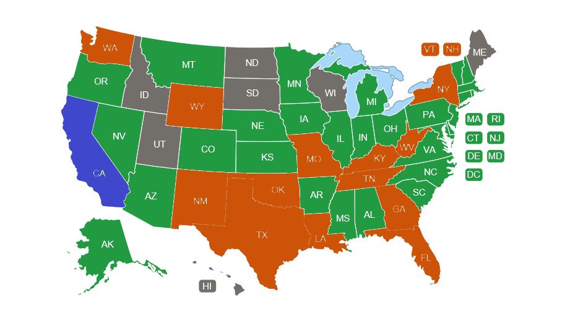
United States ABLE Programs Map
Accepts out of state residents
Accepts only in state residents
State does not have ABLE accounts
Notes:
42 ABLE States, plus the District of Columbia
26 States highlighted in green accept out of state resident account holder’s
17 States highlighted in orange only accept in state resident account holder’s
California highlighted in Blue accepts out of state resident account holders, and has a Medi-Cal claw protection for in state residents

Slide 7
ABLE Basics

Slide 8
Some ABLE Basics
Only one ABLE account
Beneficiary is always the account owner
Account can be opened by the beneficiary or an Authorized Legal Representative (parent, legal guardian/conservator, Power of Attorney)

Slide 9
Who is Eligible?
Must be onset before age 26 – AND –
Meets the eligibility criteria for disability benefits like SSI or SSDI - OR-
Self-certification: Has been diagnosed by a qualified physician with a physical or mental disability resulting in marked and severe functional limitations that is expected to last at least one year.
Condition is listed on SSA’s List of Compassionate Allowances or Blue Book Listings

Slide 10
Account Contributions
$529,000 total contribution cap for CalABLE (contribution only)
$100,000 total cap for recipients of SSI benefits (contribution + earnings)
$15,000 annual contribution cap (contribution only)
Before the ABLE Act
A person with a disability could not save more than $2,000 without impacting their SSI
Now
You can save up to $15,000 per year and up to $100,000 in total before SSI is impacted
CalABLE will automatically reject excess contributions

Slide 11
ABLE to Work
Permits working account owners to contribute above the $15,000 annual contribution limit, if they or their employer are not contributing to a retirement plan
Can contribute whichever is less:
Amount equal to annual gross salary – OR –
Federal Poverty Level ($12,760 in 2021)
For a potential $27,760 per year
Notes:
https://thefinancebuff.com/federal-poverty-levels-for-obamacare.html

Slide 12
How Do ABLE Accounts Work?

Slide 13
How Do ABLE Accounts Work?
Accounts are designed to protect assets, but they cannot shelter income
Function both like a savings or an investment account
Anyone can contribute
Funds are tax-exempt as long as they are spent on “Qualified Disability Expenses”

Slide 14
What is a Qualified Disability Expense (QDE)?
Any expense related to the designated beneficiary as a result of living a life with disabilities that helps maintain or improve your health, independence or quality of life
Categories are intentionally broad, and include education, housing*, transportation, health care expenses and more
Non-QDE: Not illegal, but if taken, expense is now subject to regular income taxes, plus a 10% tax penalty on account earnings – and benefits may be at risk (expense may now be considered a resource)

Slide 15
Housing Guidance
Reinforces the language and spirit of the Federal ABLE Act
HUD will exclude:
ABLE funds in determining family income
Third-party contributions
The entire value of an ABLE account from household assets
Distributions from an ABLE account are not considered income
Wage income received will be included as income
* Withdrawal and payment of housing expenses must occur in the same calendar month to avoid problems with program benefits

Slide 16
Protection from Medi-Cal Recovery and Creditors
AB 688 (Calderon) passed in 2017:
Exempts ABLE accounts from enforcement of money judgements
SB 218 (Dodd) passed in 2017:
Medi-Cal will not file a claim directly on the ABLE. The state may recover on assets that have transferred from an ABLE account to an estate
Account Protection only applies to California residents with a CalABLE account

Slide 17
What happens when an account owner passes away?
Any outstanding QDEs may be paid using ABLE funds
The account is then transferred into the deceased individual’s estate.
Medi-Cal will only attempt recovery if (ALL must apply):
The deceased was age 55 or older
The individual was a user of comprehensive Medicaid services (in home support, skilled nursing, etc.)
The individual’s estate is required to go into probate ($150,000 or more)
The individual is not survived by a spouse or children under 18 or a disabled child of any age

Slide 18
Investment Options

Slide 19
Saving and Investing
Investments managed by TIAA-CREF
Money can be deposited into an FDIC-insured portfolio or invested in any of three Target Risk Investment Options
Fees vary based on the savings / investment options selected
Funds may be transferred between portfolios two times annually

Slide 20
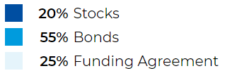
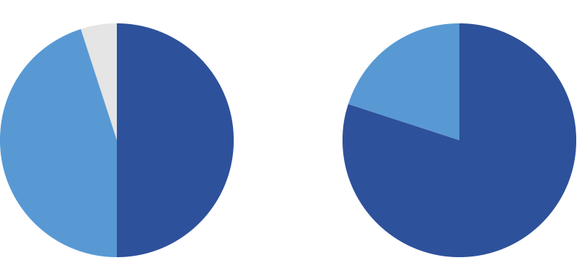
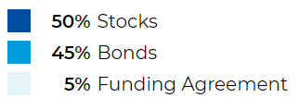
FDIC- Insured Portfolio
Conservative Portfolio
Moderate Portfolio
Aggressive Portfolio

Slide 21
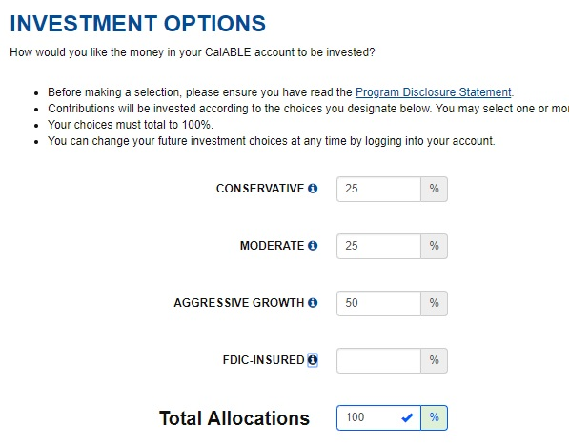

Slide 22
CalABLE Fees
Fee Type
Account Maintenance Fee (annual – assessed in monthly installments) | $37
Underlying Investment Fee (asset-based; varies per investment choice) | 0.00% - 0.09%
State Administrative Fee | 0.44%
Paper Statement Mail Delivery Fee (annually) | $10
Insufficient Funds (per occurrence) | $20
Check Issuance Fee (per check) | $5
Prepaid Debit Card (monthly) | $1.25*
* Additional fees may apply. Visit www.calablecard.com for a full listing of fees associated with the card

Slide 23
CalABLE Fees (cont’d)
$3,000 Assumed Assets
Investment Option | FDIC-Insured Portfolio | Investment Portfolios
Account Maintenance Fee | $37 | $37
Underlying Investment Fee 0.00% FDIC 0.09% Conservative 0.09% Moderate 0.08% Aggressive | $0 | $2.40 to $2.70
State Administrative Fee | $0 | $13.20
Total Annual Fees* | $37 | $52.60 to $52.90
*Paper statements will include an additional annual $10 fee

Slide 24
Opening an Account

Slide 25
CalABLE Features and Benefits
Free, easy online enrollment process
Contributions / deposits can be made by anyone via electronic fund transfers from a bank account, or by check
eGifting
Prepaid debit card

Slide 26
The CalABLE Visa® Prepaid Card
Load and reload your card directly from the CalABLE web portal
Use the card anywhere Visa debit cards are accepted, online or in-store
Statements provide purchase records
The CalABLE Visa Prepaid Card is issued by MetaBank®,N.A.,Member FDIC, pursuant to a license from Visa U.S.A. Inc.

Slide 27
What is Needed to Enroll?
Social Security Number and Government issued ID of the beneficiary (and ALR, if assigned)
$25 initial deposit
Routing and account number if you wish to link a bank account in order to transfer money to/from the CalABLE account
Notes:
Materials can be uploaded or mailed in.

Slide 28
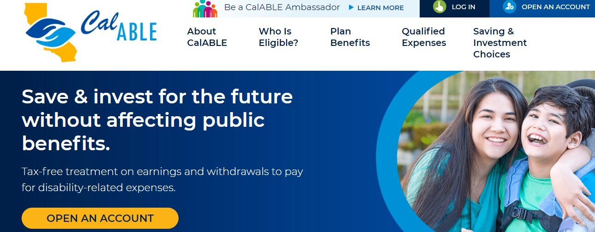
Ready to Open Your Account?
Get started at CalABLE.ca.gov

Slide 29
Resources and Contacts

Slide 30
Additional Resources
CalABLE Resources - treasurer.ca.gov/able/resources.asp
ABLE National Resource Center - ABLENRC.org
Disability Benefits 101 - DB101.org
A collaboration between NDI and CalABLE
nationaldisabilityinstitute.org/achievable-corner

Slide 31
CalABLE Staff
Dante Allen
Executive Director
Anne Osborne
Program Manager
Sandra Kent
Associate Governmental Program Analyst
CalABLE Act Board Office
CalABLE@treasurer.ca.gov
(916) 653-1753

Slide 32
Need Help with the Enrollment Process?
CalABLE Customer Call Center
Open 9:00 AM to 5:00 PM Pacific Time
Monday – Friday
833-Cal-ABLE (833-225-2253)
CalABLESupport@CalABLE.ca.gov

Slide 33
Connect With CalABLE
Find us on Facebook, Twitter, YouTube, and LinkedIn
Facebook: California ABLE Act Board
Twitter: @CalABLE_Board
YouTube: California ABLE Act Board
LinkedIn: California ABLE Act Board
All social media platforms are managed by the State of California.
Join our email distribution list – visit http://www.treasurer.ca.gov/able; under “Quick Links” in left side bar, click “Sign Up to Receive CalABLE Information”

Slide 34
Questions?

Slide 35
Disclaimer Statement
Consider the investment objectives, risks, charges and expenses before investing in the California 529A Qualified ABLE Program (CalABLE Program). Please call toll-free 833-CAL-ABLE for a Disclosure Statement containing this and other information. Read it carefully.
Before investing in any ABLE program, you should consider whether your home state provides its taxpayers with favorable state tax or other benefits that are only available through investment in the home state’s ABLE program. You also should consult your financial, tax, or other adviser to learn more about how state- based benefits (or any limitations) would apply to your specific circumstances. You also may wish to directly contact your home state’s ABLE program, or any other ABLE program, to learn more about those plans’ features, benefits and limitations. State-based benefits should be one of many appropriately weighted factors to be considered when making an investment decision.
The CalABLE Program is offered by the State of California. TIAA-CREF Tuition Financing, Inc. (TFI), program manager. TIAA-CREF Individual & Institutional Services, LLC, Member FINRA, distributor and underwriter.
None of the State of California, its agencies, TFI or TCS nor any of their applicable affiliates insures accounts or guarantees the principal deposited therein or any investment returns on any account or investment option, and you may lose the principal amount invested. The FDIC Insured Portfolio is FDIC-insured up to $250,000, subject to certain restrictions. Interests in the CalABLE Program are not registered with or in any way approved by the Securities and Exchange Commission or by any state securities commission.
All social media platforms are managed by the State of California.
If funds aren't used for qualified expenses, the earnings portion of a non-qualified withdrawal is subject to federal income tax, possibly including the additional federal tax. Non-qualified withdrawals may also be subject to state and/or local income tax. For those beneficiaries subject to California income tax, the earnings portion of a non-qualified withdrawal is subject to California income tax and the additional California tax.
This CalABLE informational program was brought to you by the State of California’s CalABLE Board. Any statements or opinions contained within are those of the State of California. Your experience may differ based on a variety of factors, including your own state-of-residence, your needs-based benefits, tax and financial circumstances. 1514982

