Slide 1
Providers and the Pandemic: Maintaining Viability in Difficult Times
THE WORKFORCE INNOVATION TECHNICAL ASSISTANCE CENTER (WINTAC)
April 8, 2020

Slide 2
POLL
POLL

Slide 3
Housekeeping
You are muted throughout the webinar
Please use the chat feature to post questions
We will answer as we can, for those we can’t we will publish answers later
The webinar will be recorded and posted with Closed Caption available and a transcript of the recording
http://www.wintac.org/content/resources-distance-service-delivery
The link to the evaluation will be posted in the chat
CRC credits will be provided following this webinar by completing the post event evaluation process

Slide 4
Purpose of Today’s Call
Welcome
Discussion of strategies to help you in working with vendors to deliver services now and into the future
Texas
Indiana
Maryland
Pennsylvania
Overview of Wintac.org- Resources for Distance Service Delivery and provider specific resources
Notes:
Use chat to pose a question
Muting everyone to keep noise to a minimum but we will set aside time to have folks share
Send questions to RSA and or Us
Don’t forget to respond to the NOI - Asked RSA to extend comment period (due the 30th)
RSA shared they were planning on a webinar
Today we wanted to provide a quick update on WINTAC TA in light of COVID19, and share new resources/website tour of what is up, and how this all relates back to Pre-ETS

Slide 5
Texas Workforce Commission

Slide 6
Texas Workforce Commission
Communication Strategy-overall goal exceptions/adaptations
Issuing service authorizations/receiving provider invoices
General and Specific Exceptions to provider requirements
Teleservice options for neurodevelopmental and psychological service providers
Project Search
Link: Texas Workforce Commission-VR Provider Resources

Slide 7
Indiana Vocational Rehabilitation

Slide 8
Pre-ETS Structure
10 contractors providing pre-ETS.
Contractors work with other providers for greater coverage.
All 92 Indiana counties & 408 schools are covered.
Contractors are assigned specific counties and school systems.
Contractors work with school personnel on identifying students for pre-ETS.
Student information and documentation entered into the pre-ETS portal for approval by VR.
Student services also entered into the portal for review.
Notes:
Just want to make sure our structure is understood as this varies greatly by state.

Slide 9
Virtual Guidance
On March 16th, schools were starting to close and move to continuous learning (e-learning), though not all had.
Statewide stay at home order had not yet been put in place.
Email went out on March 16th to all providers providing some basic guidance:
Encouraged the use of online learning or simply over the phone, when needed.
Indicated that besides WBL, other pre-ETS activities could more easily be modified for a virtual environment.
Encouraged the use of Skype, Facetime, or other platforms with students.
Packets could be sent to students without online access for review later.
Urged providers to keep lines of communication open with parents and teachers.
Suggested WINTAC resources for use.

Slide 10
Provider Response
Most providers have great relationships with their school systems.
Schools have a lot of local control, so we didn’t want to be too directive in our response, while ensuring that students continued to receive quality pre-ETS activities.
Most providers reached out immediately to schools to ensure pre-ETS was part of the e-learning environment whenever possible.
Providers quickly reached out to parents to gain permission for virtual pre-ETS activities and explain the process.
Our Department of Education is on-board and encouraging that pre-ETS be included in “continuous learning”.

Slide 11
Provider Training & TA
Guidance and TA continues to be shared, including webinars from WINTAC, NTACT, and others.
Further training to be provided tomorrow from VR, DOE, and 4 of our providers.
DOE is working on general secondary transition guidance to school systems including virtual work and will include pre-ETS information (including virtual pre-ETS).
Indiana VR has 8 youth counselors statewide (hopefully 10 soon!) who assist providers, schools and area offices, and have provided additional resources & support in their local areas as well as oversight during this time.
Notes:
Once finalized, I can share the DOE resource guide.
More information on Thursday’s training is in an upcoming slide.

Slide 12
Oversight & Monitoring
Portal entries are reviewed on a regular basis by me and the Coordinator of Youth Services as well as our 8 youth counselors.
Recent reviews indicated some concerns with group billing activities.
Overall guidance was sent to all providers to the effect that “we want to do everything we can to assist you, while also ensuring that the work you are doing is meaningful to the students and in line with the required activities.”
Youth counselors reviewed recent entries and sent concerns to me for further follow up with specific providers.
Concerns included: increased time spent reviewing curricula or time spent setting up virtual work (administrative). A few agencies not yet on board virtually.
Portal reviews allow us to see what is happening in almost real time and course correct as needed.
Notes:
Guidance email: While it is acceptable to review curricula and ensure it’s accessible to students, please keep in mind that in order to be billable, these reviews should be based on the interests and needs of specific students or groups of students. While it is important to review curricula that could be applicable to any student, it is not billable unless you can tie it to an individual or a particular group based on their identified strengths, interests and needs.
Based on these reviews, we were able to provide further guidance as well as shout-outs to work done well and how quickly some agencies moved to virtual work.

Slide 13
DOE Guidance
Four pre-ETS providers along with DOE will provide training tomorrow on virtual pre-employment transition activities.
DOE guidance includes:
Before reaching out to students and families, make sure you reach out to the school you’re working in.
Be consistent with the communication methods the school is using to keep in touch with students and families.
Make sure families are in agreement to keep receiving pre-ETS services during this time.
Schedules are different right now; make sure you’re working with the schedules that teachers/schools are using to ensure there’s not a conflict students have to work through.
Don’t get overwhelmed! Although we always want to supplement but not supplant, if school systems are unable to do a lot of transition activities at present, you do not have to fill in all the gaps.
Notes:
The overall advice from DOE is to communicate, collaborate and keep it simple!

Slide 14
Keep it Simple
This is a new experience for EVERYONE and a lot of rapid changes have occurred, so keep things simple:
Remind students you’re available to them - relationships are important now more than ever.
If providing video conferencing or phone conversation sessions, keep them short.
Allow students to take the lead.
@EducateIN
@michelleojaIN
Notes:
A slide from DOE’s portion of the training.

Slide 15
Provider Training Highlights
Four of our pre-ETS providers along with DOE will provide training tomorrow on virtual pre-employment transition activities.
From an Easter Seals ARC slide:
Called parents and students who were already enrolled in Pre-ETS
Coordinators called students within their school
Students/Parents made their appointment times
Started a roster of information
Started mapping out students addresses
Created routes based off of clusters of participants. (Regional)
Notes:
This is from one of our providers. By mapping out and creating routes, they are delivering pre-ETS curricula to students along with lunches prepared by local restaurants. Of course, that’s not billable, but it’s a great way to help families and prep for pre-ETS at the same time.
Providers also worked on virtual release forms for permission to work with students virtually.

Slide 16
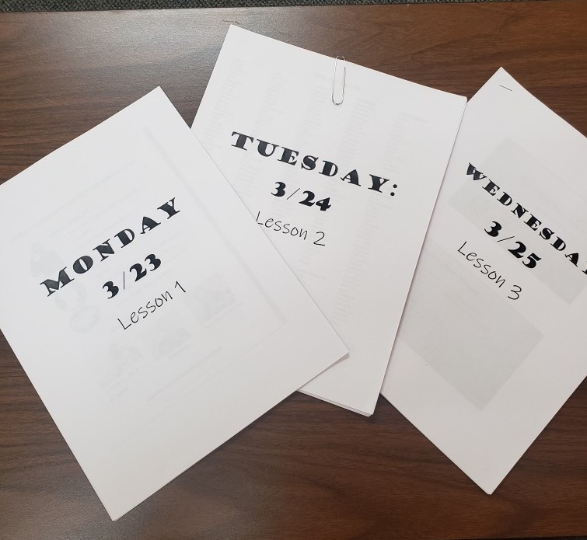
How is it implemented?
Provider Training Highlights
The coordinators will follow up with each student via phone. (via technology available to them)
Review/go through the learning packets.
30+ minute intervals
Notes:
A slide from ES/ARC.

Slide 17
Provider Training Highlights
From Opportunity Enterprises:
If you are able, gain access to the learning management system your students are using for E-learning.
For example, you can message students, create discussions, and add resources for students via Schoology.
When using your school’s learning management system, separate students into groups by grade.
You can add resources and facilitate discussions per grade level. You are also able to individually message students.
Notes:
For their part of the training, most of our providers gave examples of online learning platforms, OE also described how to access Google Meets and suggested setting up specific schedules with students each week.

Slide 18
Remote activity ideas:
Virtual college tours
Discuss vocational skills/programs
Virtual interviews with professionals
Career inventory quizzes
Create resumes, cover letters, list of references
Teach organizational skills
Teach/encourage self-advocacy skills
Complete FAFSA
Discuss VR/complete referrals with students
Create a "virtual classroom" using Google Meets. Invite students depending on interest and teach groups this way.
Teach students how to use job search tools online
Go through scenarios students may encounter in the workplace and discuss best actions to take in these scenarios
Practice mock interviews
Notes:
A sample slide from OE.

Slide 19
Provider Training Highlights
Bona Vista provided specific virtual examples for 4 of the required areas, along with this advice on communication:
Communication with students, families, teachers, and school administration is KEY to providing virtual services. Let them know you are providing Pre-ETS virtually!
Call and email parents to set up additional communications like Zoom or Facetime.
Email students – Since the students are E-Learning, they are using their school email address and will receive your communication.
Unsure of the student’s email address? TOR’s are a huge help and can send that information.
TORs can also let you know the E-Learning schedule
Check in weekly with TORs: when we provide services in the school, we speak with TORs daily – keep this communication going.
This will also help ensure positive relationships and a smooth start to the 2020-2021 school year.

Slide 20
Provider Training Highlights
Some examples of programming from Stone Belt:
Teacher Support through team and individual meetings
Parent Support – We’ve created a parent liaison for this virtual time
Zoom Room with Daily Themes – (M) Career Exp, (T) Exercise, (W) Group Mock Interview, (TH) Workplace Etiquette, (F) Game day
Continuing our Internship Program
Created a Peer : Peer program
Continuing our SA group and SA Speakers Series
Focus on Seniors that are diploma track
FB Daily Challenge
Notes:
SA = self advocates

Slide 21
POLL
POLL

Slide 22
Maryland Division of Rehabilitation

Slide 23
Maryland Division of Rehabilitation Services (DORS)
Approach to Provider Services (Pre-ETS) during the Pandemic
Guidance for CRPs for the provision of PreETS
Guidance for CRPs for DORS Employment Services
Guidance on the use of Teleconferencing to Provide Services
How Providers are working together
Service delivery virtually or via distance.
Adapted processes
Signatures
Reporting
Portal Demo

Slide 24
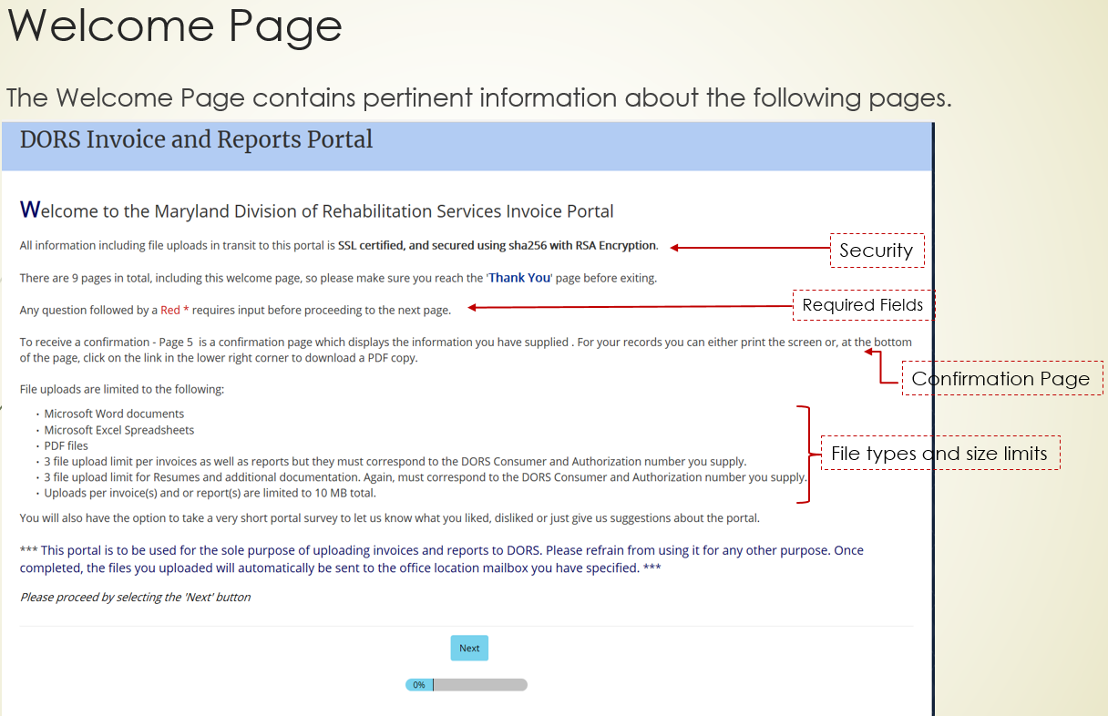
24

Slide 25
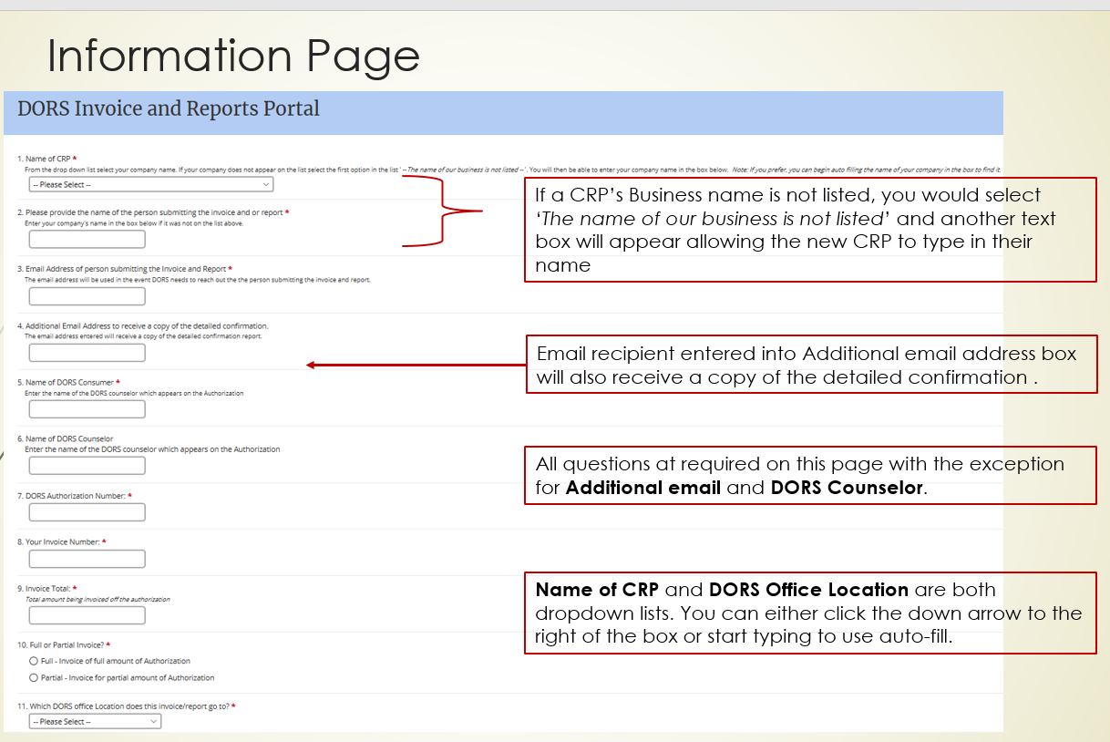
25

Slide 26
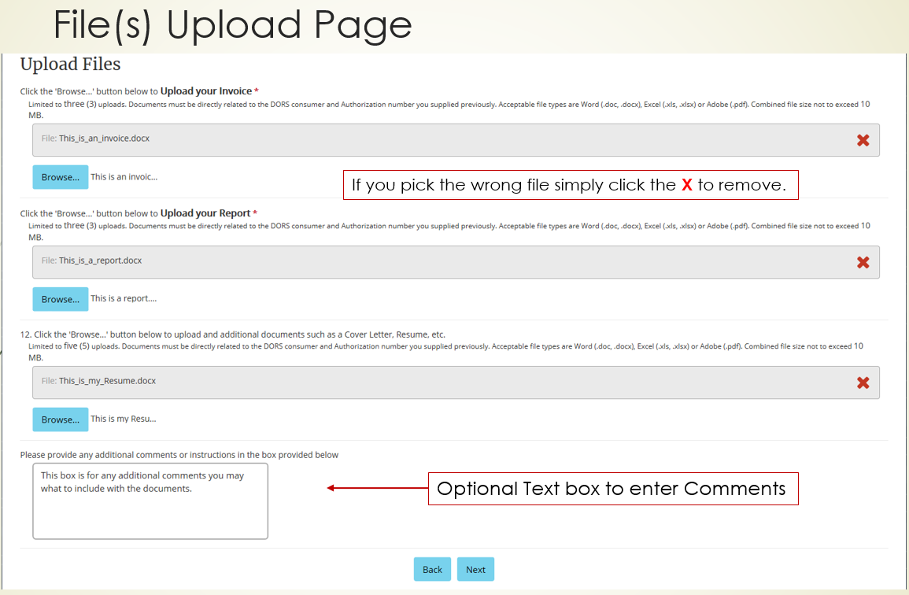
26

Slide 27
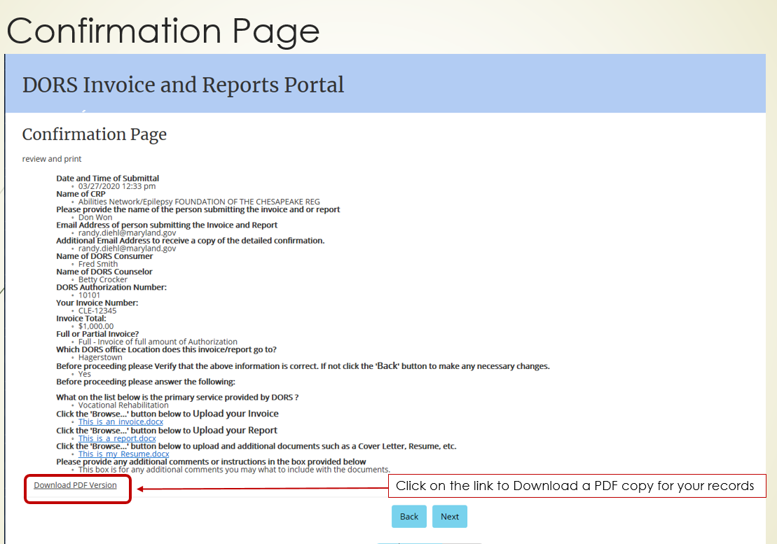
27

Slide 28
28

Slide 29
Pennsylvania Office of Vocational Rehabilitation

Slide 30
Pennsylvania Office of Vocational Rehabilitation (OVR)
Pre-ETS Guidance for Providers
2020 Project Search Guidance for Providers during COVID-19
SE Guidance for Community Providers
COVID-19 Mitigation Guidance

Slide 31
POLL
POLL

Slide 32
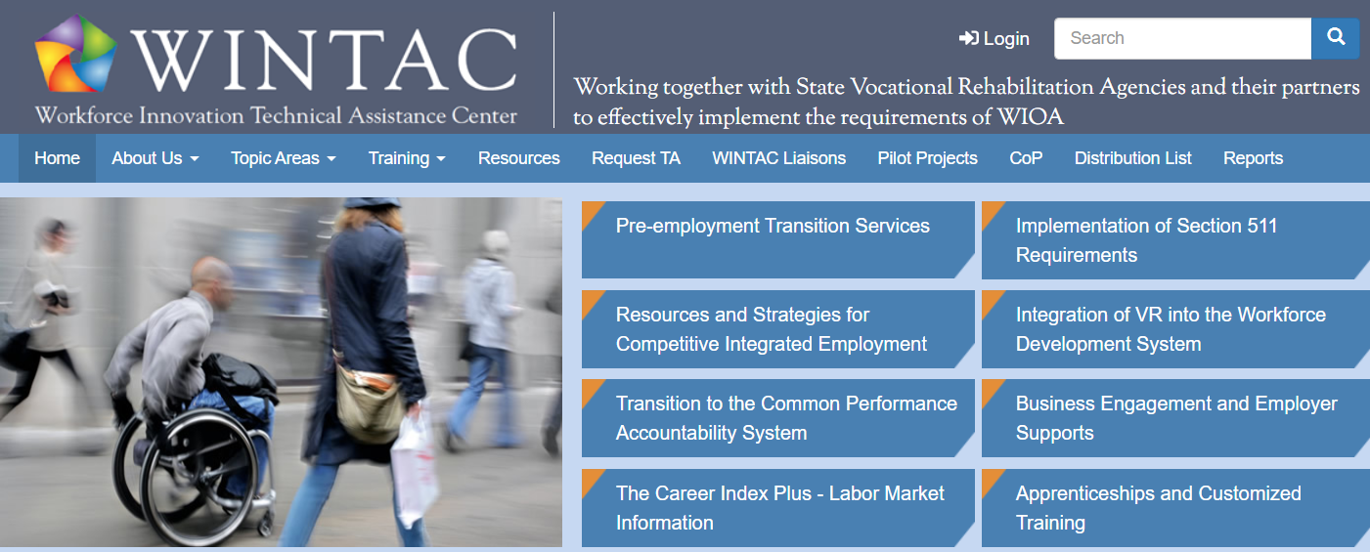
WINTAC TA – What’s New
http://www.wintac.org/
COVID-19 Resources and Resources on Distance Service Delivery
The WINTAC has created a list of resources to help VR programs that are operating by distance and providing services remotely during the COVID-19 crisis. We will be building on these resources daily, so please check back frequently. Click to access the COVID-19 Resources. Click to access the Resources on Distance Service Delivery.
Notes:
The WINTAC has received numerous requests from VR programs related to the continued operation of the VR program by distance and the provision of services to consumers remotely during the crisis. As a result, we requested that RSA allow us to expand the TA we provide in our topic areas to include strategies and resources for operating the VR program by distance and providing services to consumers remotely. RSA approved this request and we will begin this work immediately. Here are the first steps we are taking:
1. Creating two different resource pages on our website. The first will be dedicated to COVID-19 resources for the general public and for individuals with disabilities. The second will be resources and information specifically related to the operation of the VR program by distance and the provision of services to consumers remotely. Some initial categories we will be gathering information on include:
a. How VR agencies are responding-effective practices
b. Resources related to teleworking
c. Online training for VR staff
d. Remote delivery of services by Topic area:
i. Pre-employment transition services
ii. 511
iii. CIE
iv. Integration
v. CPMs
vi. Business engagement
vii. LMI-TCI+
viii. Apprenticeships
e. Leading and managing organizations by distance
f. Technology and programs that facilitate remote service delivery
g. FAQs
h. General resources
2. In addition to the website resources, which we will be adding to daily, our teams will be sharing information in Communities of Practice, calls and emails regarding what States are doing and how to respond to consumer needs.
3. We will be communicating regularly with RSA to get answers to questions submitted by VR programs and will publish the answers on the WINTAC website.
If you have any ideas of how else we might be of assistance, please share those and we will do our best to respond.

Slide 33
WINTAC TA – What’s New
Working and Providing Services by Distance Forums
WINTAC developed discussion forums on several topic areas to provide a ongoing communication during the COVID-19 crises. We encourage you to participate in the discussion forums to ask questions, share information and support one another.
You can log in and participate in the discussion forums.
If you have not registered to WINTAC site yet, click here to register.

Slide 34
Provider Resources
http://www.wintac.org/content/resources-distance-service-delivery
How VR Agencies are responding - Effective practices
Wisconsin Department of Workforce Development – COVID 19 Virus – Vendor Services
Texas Workforce Commission-VR Provider Resources - This link directs you to the TWC-VR provider resources website page and includes instructions for temporary exceptions to certain requirements in the VR Providers Manual, and archived notices to providers.
Nebraska Commission for the Blind-Services Provided
Maryland DORS Guidance on the use of Teleconferencing to Provide Services
Guidance for CRPs for DORS Employment Services
Guidance on the use of Teleconferencing to Provide Services
Telephone Services Authorized During State of Emergency for Supported Employment (SE) Services
Remote Delivery of Services by Topic area-Pre-ETS
Working With Providers of Pre-ETS During COVID-19
Notes:
Please note these resources will be updated daily, so the list of resources under each topic item will be constantly changing.

Slide 35
Tools Providers Can Use
http://www.wintac.org/content/resources-distance-service-delivery#pre-ets
Explore-Work
Pathways to the Future (West Virginia)
T-Folio - Careers Cluster Interest Survey
Objective.ed - Distance learning tools for vision-impaired students
TransitionTN Curriculum Database
Notes:
Pathways to the Future (West Virginia) This includes sample lesson plans and detailed curricula for students with disabilities that schools,VR, or other partners could use in delivering any of the five required Pre-ETS services. We advise that you thoroughly review these to see what activities you would approve your vendors using.
GCFLearnFree.org offers more than 200 topics, including more than 7,000 lessons, more than 1,000 videos, and more than 50 interactive links and games, completely free. We advise that you thoroughly review these to see what activities you would approve your vendors using.
T-Folio is a free online transition portfolio tool for high school-age youth with disabilities. The curriculum provides facilitators with lesson plans and tips to help youth build self-determination and job-readiness skills through a series of interactive exercises. T-Folio curriculum aligns with Individual Education Program (IEP) transition planning, DVR Pre-Employment Transition Service categories, and the CCTS Transition Services Flowchart.
TransitionTN has developed a searchable database of curriculum that includes options for providing the five required pre-employment transition services. You can search by Pre-ETS category, payment type (Free to subscription) and accessibility for hearing and vision impairments.

Slide 36
Recent or Upcoming Webinars
April 7: Employment Preparation and Work Based Learning Experiences in a Virtual World (recording available on NTACT/WINTAC Sites)
April 14: Strategies and Resources for Students with Complex Support Needs in Distance Learning Environments Register
April 21: Instagram, Snapchat, TikTok and Beyond – Using Social Media for Peer to Peer Engagement Register
Coming Soon:
Webinars on Virtual/Remote Strategies for each of the five required Pre-employment transition Services
VR/Education Guide

Slide 37
Texas Workforce Commission Contact Information
Cheryl Fuller, cheryl.fuller@twc.state.tx.us
Scott McCune, scott.mccune@twc.state.tx.us
Tammy Martin, tammy.martin@twc.state.tx.us
Laura York, laura.york@twc.state.tx.us
Claudia Peden, claudia.peden@twc.state.tx.us
Jennifer Hines, jennifer.hines@twc.state.tx.us
Melinda Paninski, melinda.paninski@twc.state.tx.us

Slide 38
Indiana VR Contact Information
Jonathan Kraeszig, M.R.C., C.R.C.
Vocational Rehabilitation Services
Director of Youth Services
O: (317) 232-1964
C: (317) 417-4847
Jonathan.Kraeszig@fssa.in.gov
Will Colteryahn, Coordinator of Youth Services
William.Colteryahn@fssa.in.gov
(317) 232-1966
General pre-ETS Mailbox: Fssa.pre-ets@fssa.in.gov

Slide 39
Maryland DORS Contact Information
Jill Pierce
Staff Specialist, Transition and Supported Employment
Division of Rehabilitation Services
Maryland State Department of Education
jill.pierce@maryland.gov
Toni Cobb-Cannon
Staff Specialist III, Community Rehabilitation Programs
Division of Rehabilitation Services
Maryland State Department of Education
latonya.cannon@maryland.gov
Randy Diehl
MIS Director
Division of Rehabilitation Services
2301 Argonne Drive
Baltimore, MD 21218
(p) 410.554.9419 (f) 410.554.9412
www.dors.maryland.gov

Slide 40
Pennsylvania OVR Contact Information
Shannon Austin, M.S., CRC, CWDP, GCDP, OWDS| Executive Director
PA Department of Labor and Industry | Office of Vocational Rehabilitation 1521 North Sixth Street | Harrisburg, PA 17102
Office (717) 783-3784 Cell (717) 579-0108
Email shaaustin@pa.gov
www.dli.state.pa.us

Slide 41
Questions?
Melissa P. Diehl M.A. Ed. CRC Project Director WINTAC Pre-Employment Transition Services The George Washington University Center for Rehabilitation Counseling Research and Education (CRCRE) (410) 430-9244 mpdiehl@gwu.edu
Brenda K. Simmons M.S. Sr. Research Associate WINTAC Pre-Employment Transition Services The George Washington University Center for Rehabilitation Counseling Research and Education (CRCRE) (816) 739-7648 bksimmons@gwu.edu
Christine Johnson M.A. Ed. CRC Sr. Research Associate WINTAC Pre-Employment Transition Services The George Washington University Center for Rehabilitation Counseling Research and Education (CRCRE) (301) 922-8294 cj1957@gwu.edu
DJ. Ralston M.S.
Sr. Research Associate WINTAC Pre-Employment Transition Services The George Washington University Center for Rehabilitation Counseling Research and Education (CRCRE) 740-398-5247
djralston@gwu.edu
Carol Pankow M.S. Sr. Research Associate WINTAC Pre-Employment Transition Services The George Washington University Center for Rehabilitation Counseling Research and Education (CRCRE) (952) 994-5205 cnpankow@gwu.edu
Notes:
DJ and MAureen are part time

Slide 42
Pre-employment Transition Services Thank You
WINTAC Pre-Employment Transition Services
WINTAC Pre-Employment Transition Services The George Washington University Center for Rehabilitation Counseling Research and Education (CRCRE)
http://www.wintac.org/topic-areas/pre-employment-transition-services

