Slide 1
Travis W. Cohen

Slide 2
Travis Cohen 26 Years Old
Has worked at Medtronic since 2014

Slide 3
Medtronic
My location makes heart valves
The valves are used to replace a person’s valve that is not working right
The valves help save people’s
lives
My Dad has a Medtronic heart
valve
Medical Device Company

Slide 4
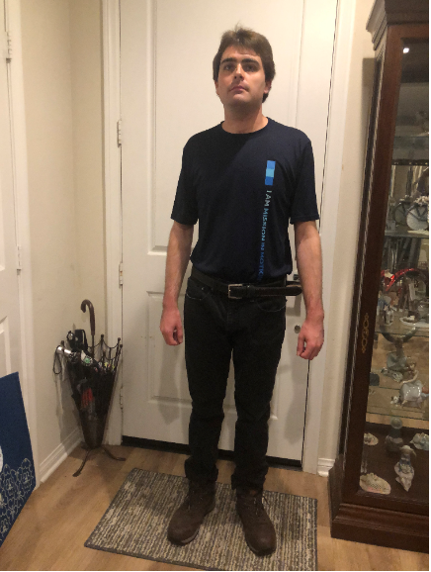
Preparing for Work
PREPARING FOR WORK
+ Shower and put on my UNIFORM
+ Black jeans, navy blue Medtronic shirt, tucked
in with belt, steel toed shoes
+ Make breakfast and pack lunch
+ Ride the ACCESS Bus, pick up times 6:00 A.M.
and 1:30 P.M.
+ Work hours are 7:00 A.M. to 1:30 P.M. (30
hours a week)

Slide 5
My Job
Work in the supply rooms and warehouse
Deliver supplies
Pull the Supplies I need
Stock the lockers for clean room employees
Place the correct size: gown, gloves, face masks, goggles, bouffants, booties

Slide 6
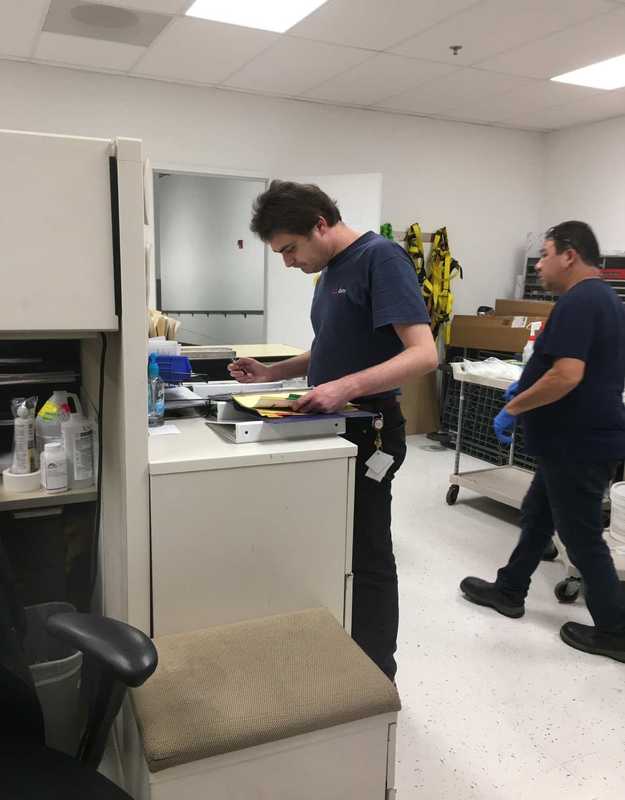
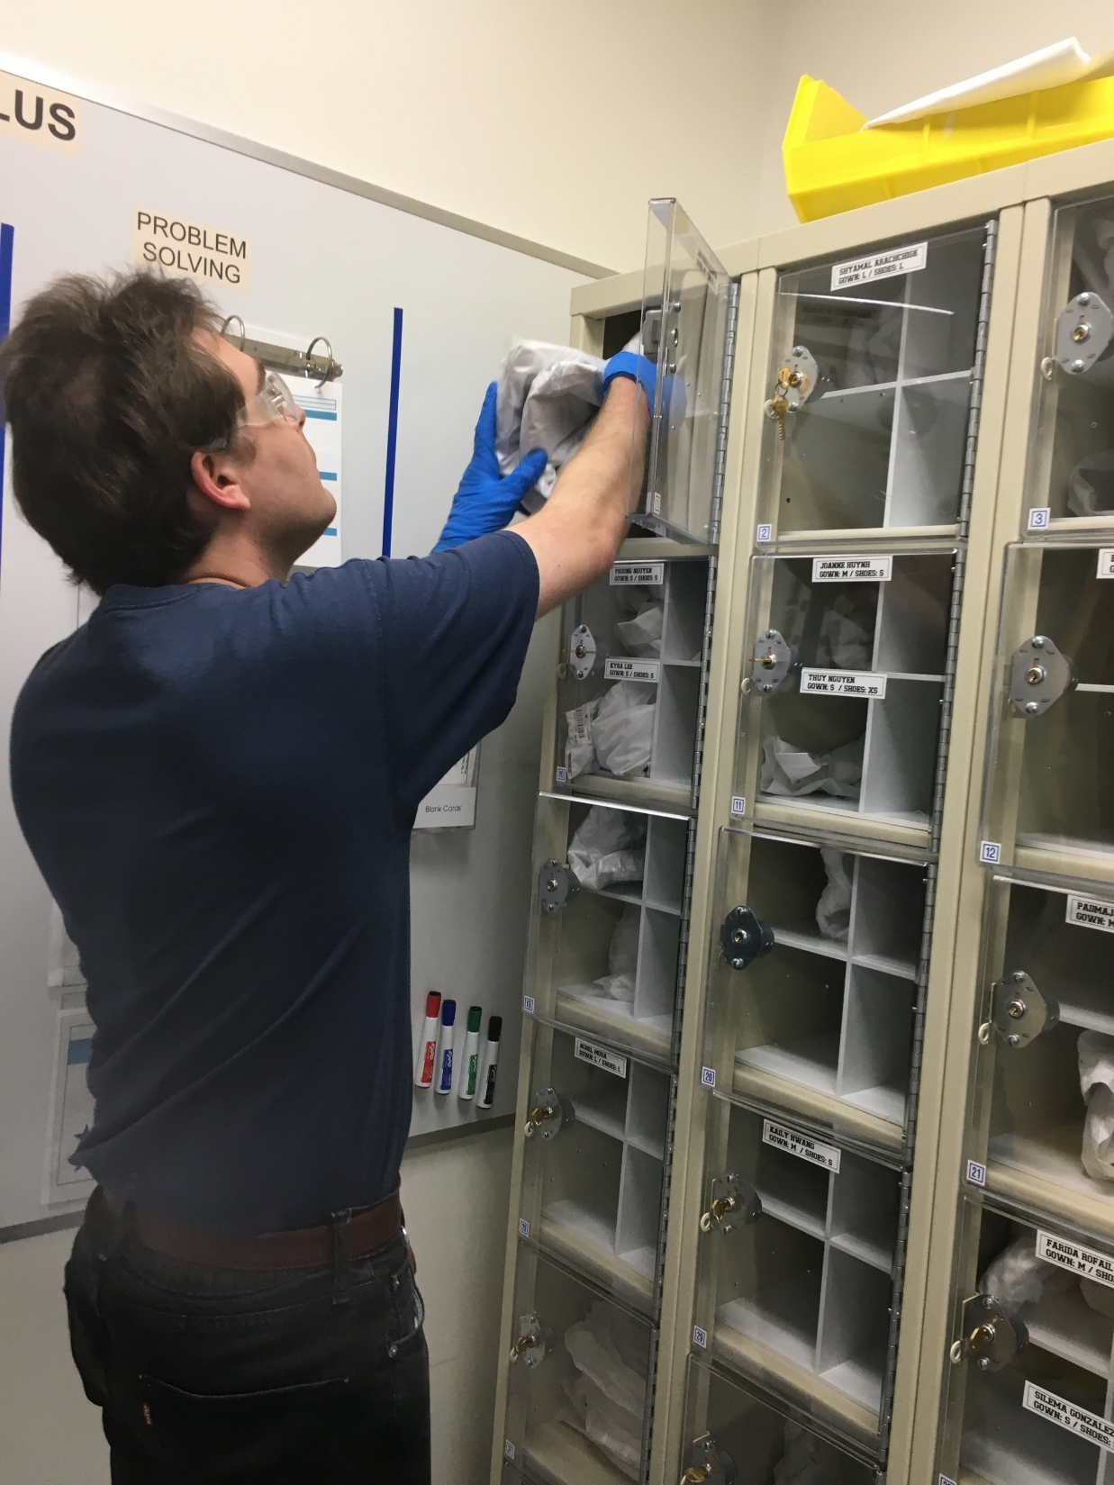
MEDTRONIC

Slide 7
My Job…continued
Empty bag of dirty gowns, replace with a new bag
Cut down my boxes, put into large carts
Take the carts to the trash escalator

Slide 8
Next Work Location
Go to the warehouse
Pick up and take the coolers to the harvesting rooms
The coolers have cow and pig heart valves
Pick up and deliver boxes and water bottles to the departments

Slide 9
Why I Like My Job
I like my job tasks
Helping people
Like my coworkers
(Photo of some coworkers)
Going to Edgar’s meetings
Company celebrations and luncheons
(Photo of Chinese New Year Dragon)

Slide 10
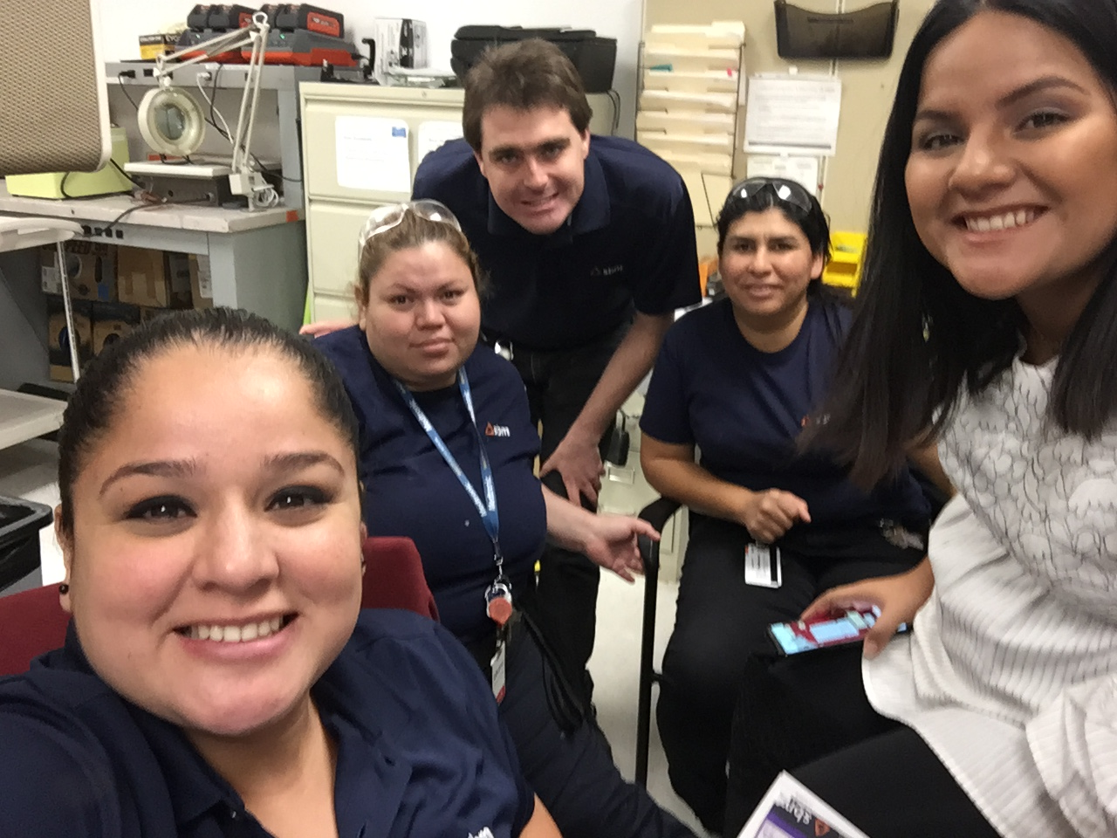
Medtronic
Co-Workers

Slide 11
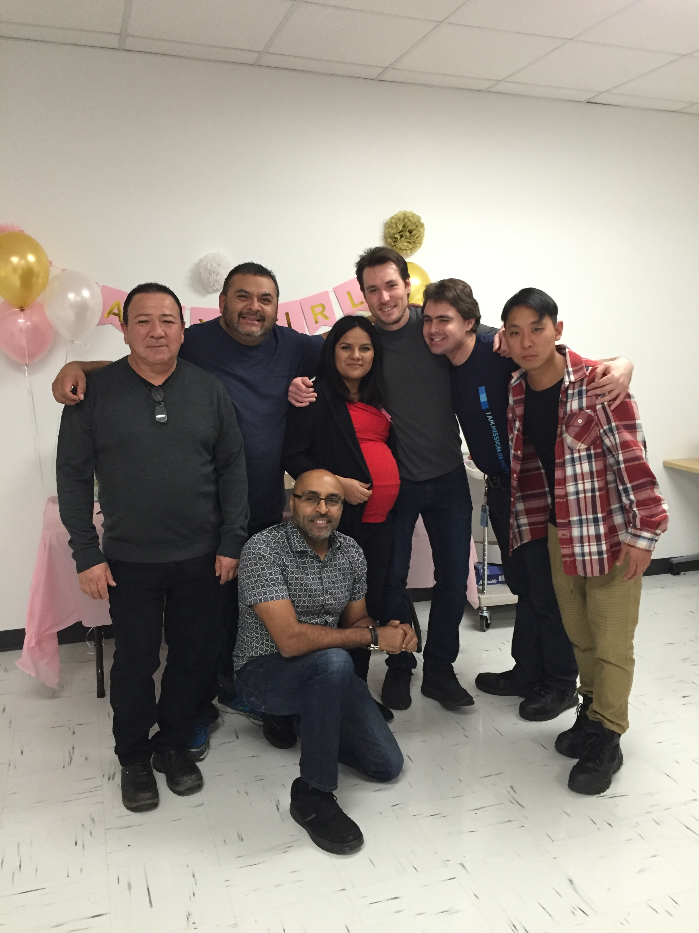
Medtronic
Co-Workers

Slide 12
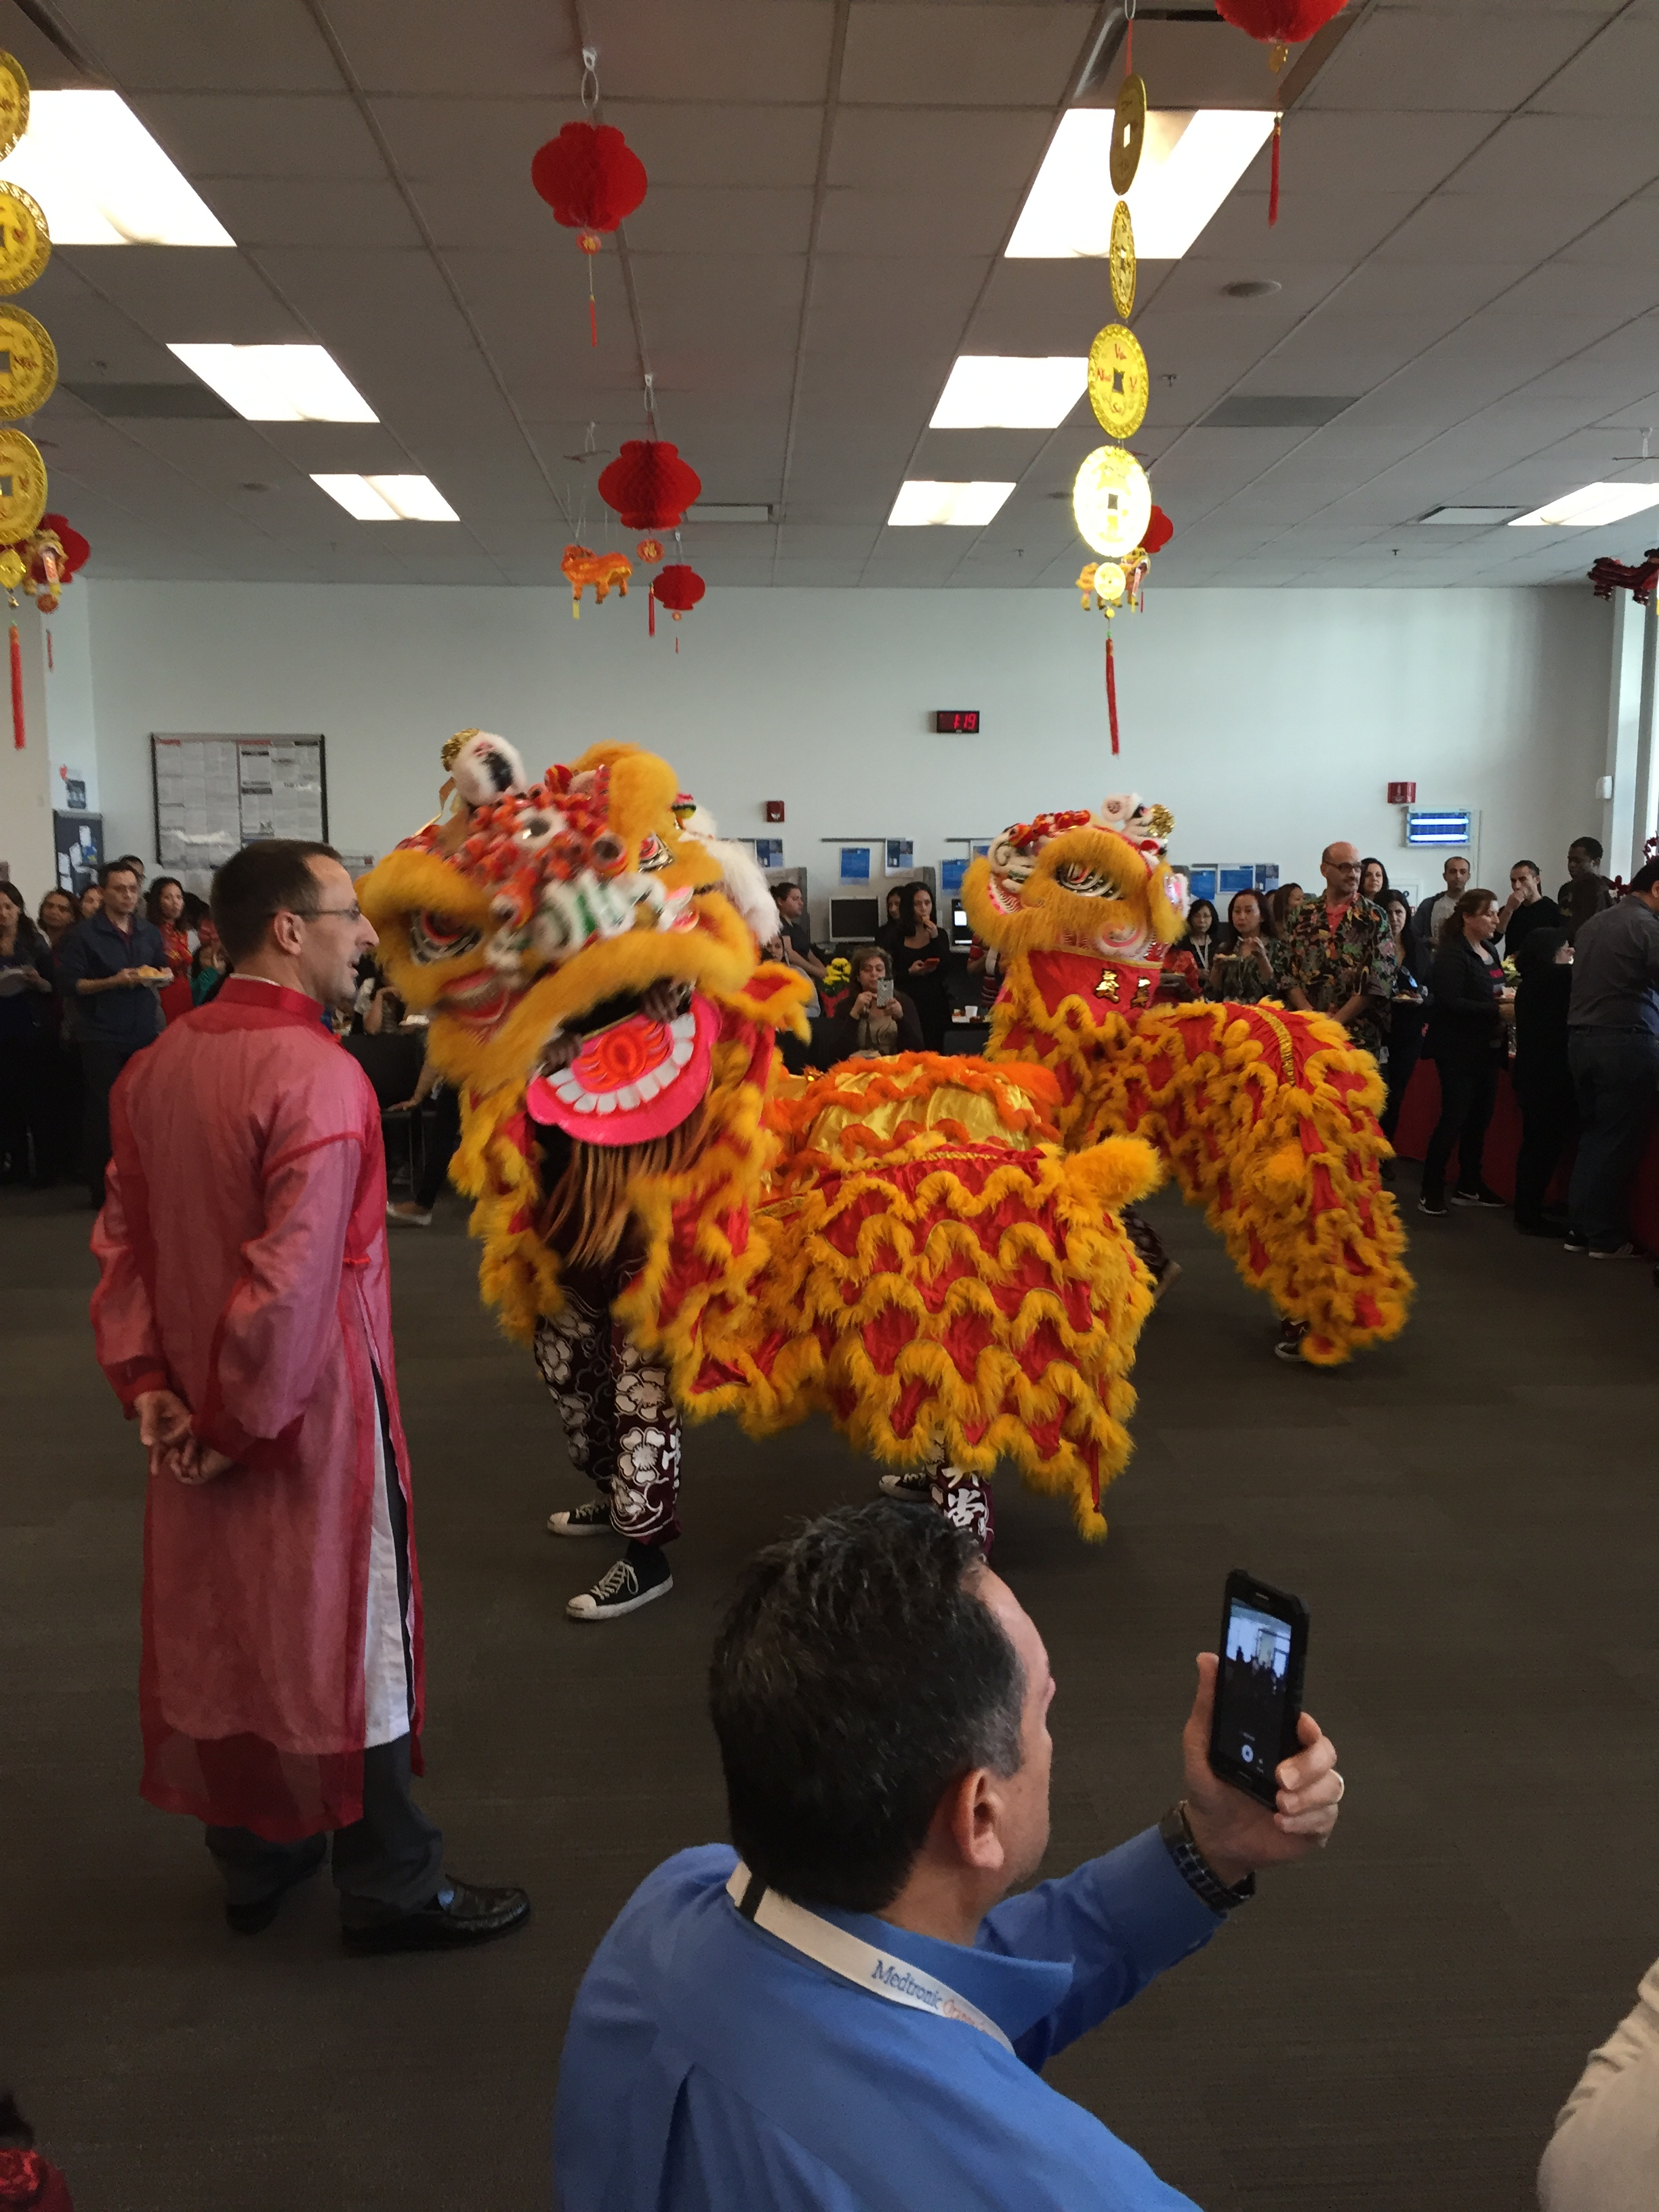
Chinese New Year!!

Slide 13
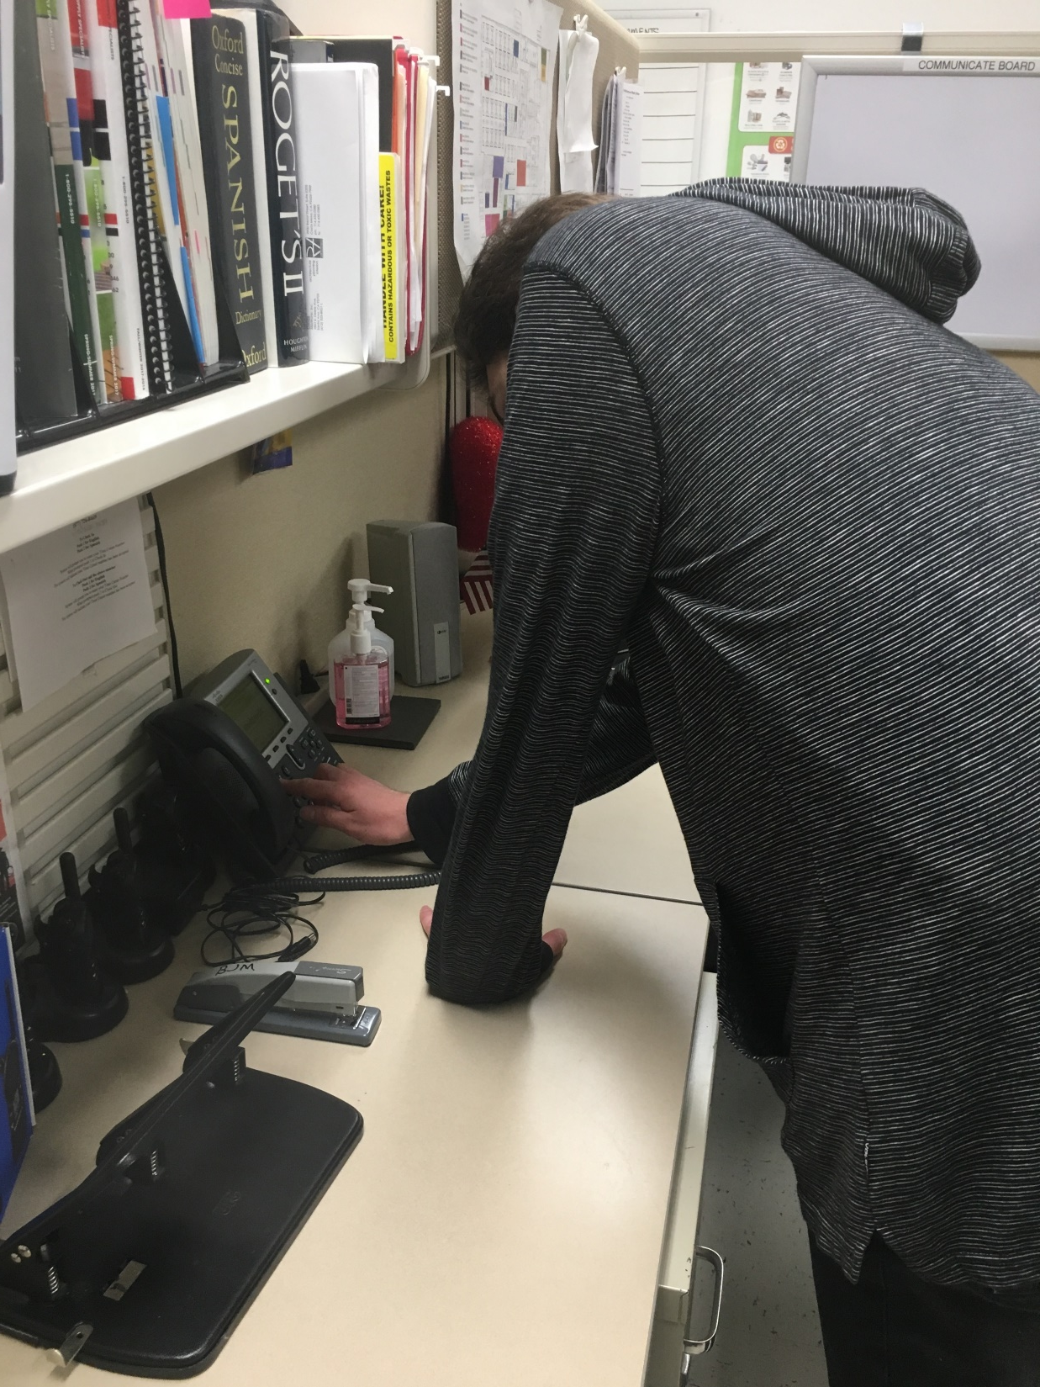
TRAVIS

Slide 14
My Pay-Check
I can buy:
+ DVDs
(Photo of DVD collection)
+ Fast Food Friday
+ Magazines, PEOPLE and US
+ Some groceries
+ New Bedroom Set
(Photo of Travis & cat, Envy)

Slide 15
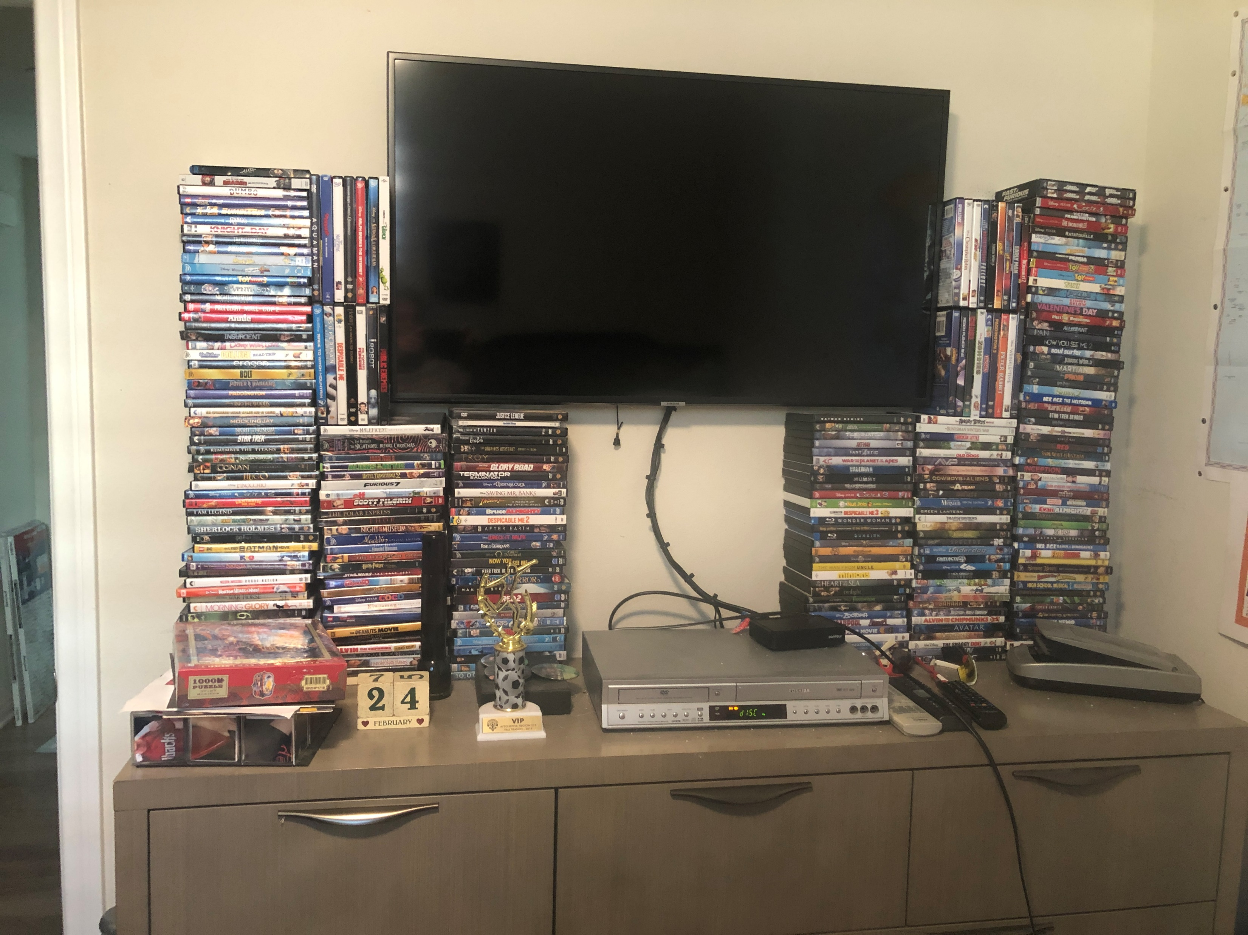

Slide 16
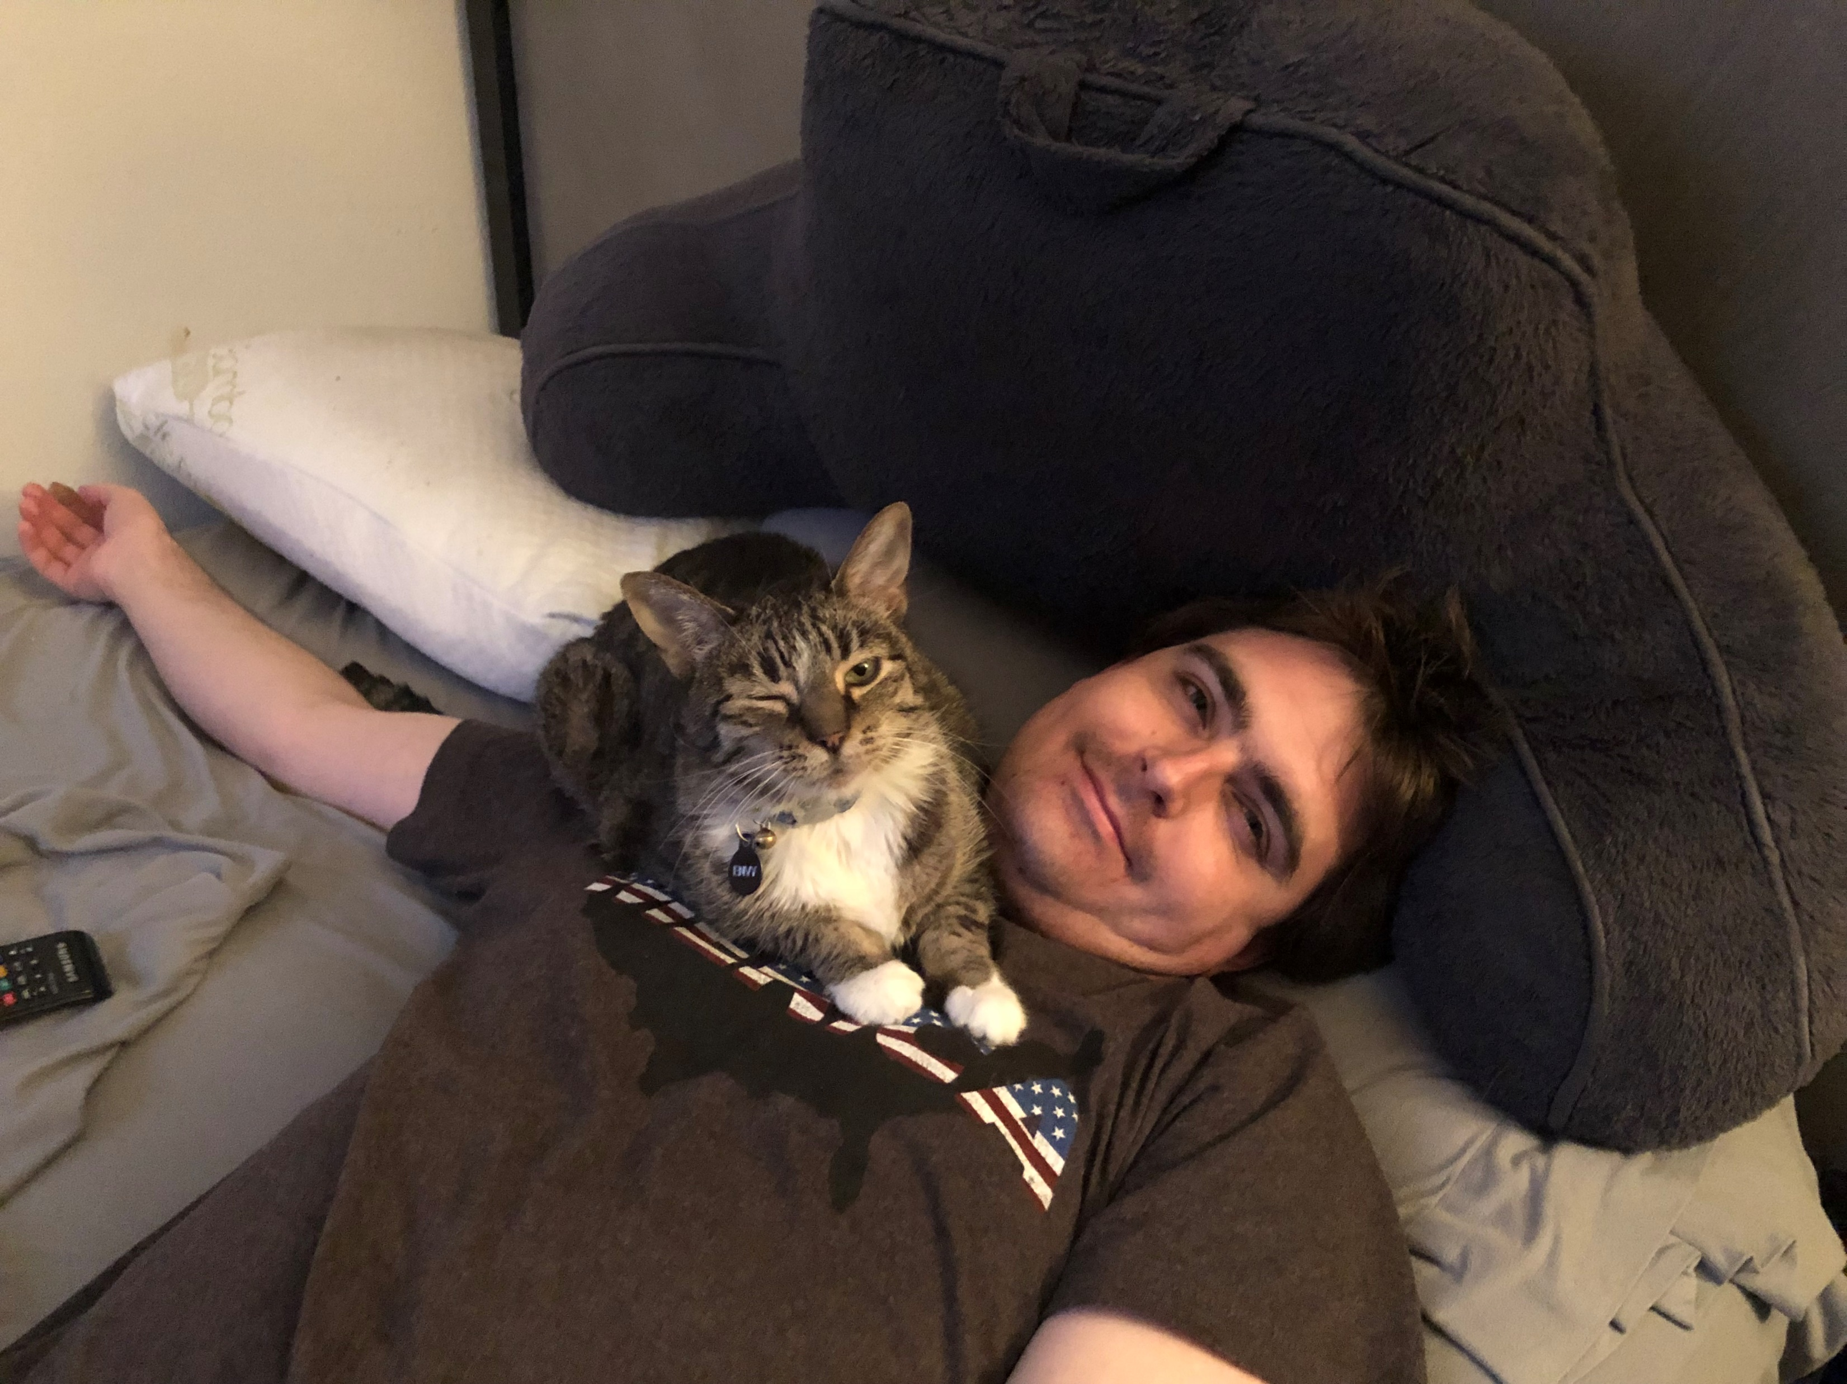

Slide 17
Cheryl Cohen
Mother
Single Parent
Conservator

Slide 18
Transitions Are Challenging
Represent change
Comfort Level
Known to the Unknown
Relationships End new ones Begin

Slide 19
Travis’s Transitions
RCOC Vendored Preschool Program, 2.5 yr.
OCDE Preschool, 3 yr
Private Preschool & K (5 yr.), retained
School District SDC Class Grade 1
Full Inclusion Grades 2&3
SDC Class 4-6 (Double Promoted)
Middle School SDC Class Grades 7&8
High School SDC class, full inclusion for some classes Grades 9-12
Adult Transition program
Employment

Slide 20
Where We Started
Diagnosed at 2.5 yrs. (30 months)
Initial Scores: 3-6 months
9-12 months
“Severely Autistic”
“Profound Developmental Delays”
“Mute, will never speak”

Slide 21
Lessons Learned
Educate Yourself
Be Involved
Build Relationships
Two-way communication
Follow through
Approach staff with a partnership perspective
Educate Staff about Your Child
Be open to honest feedback and guidance
Role of the parent in employment

