Slide 1
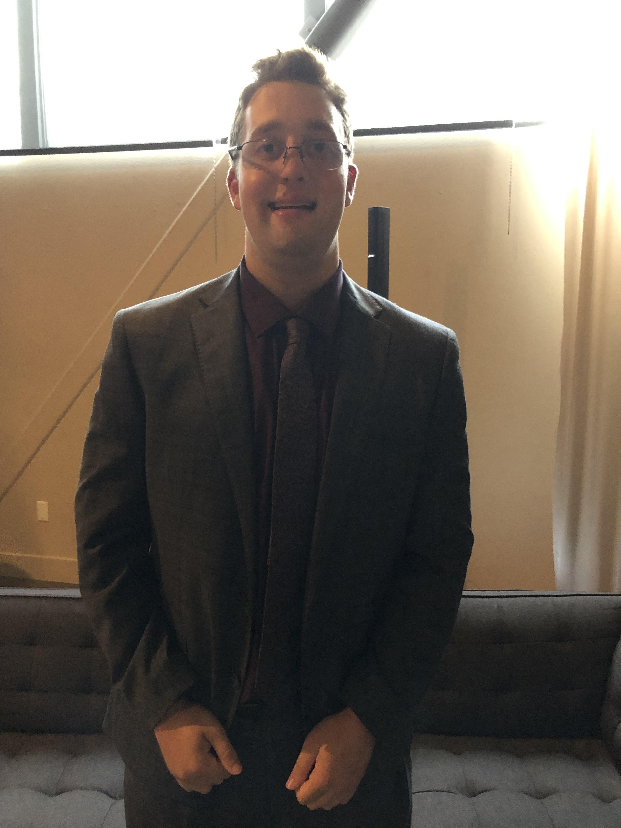
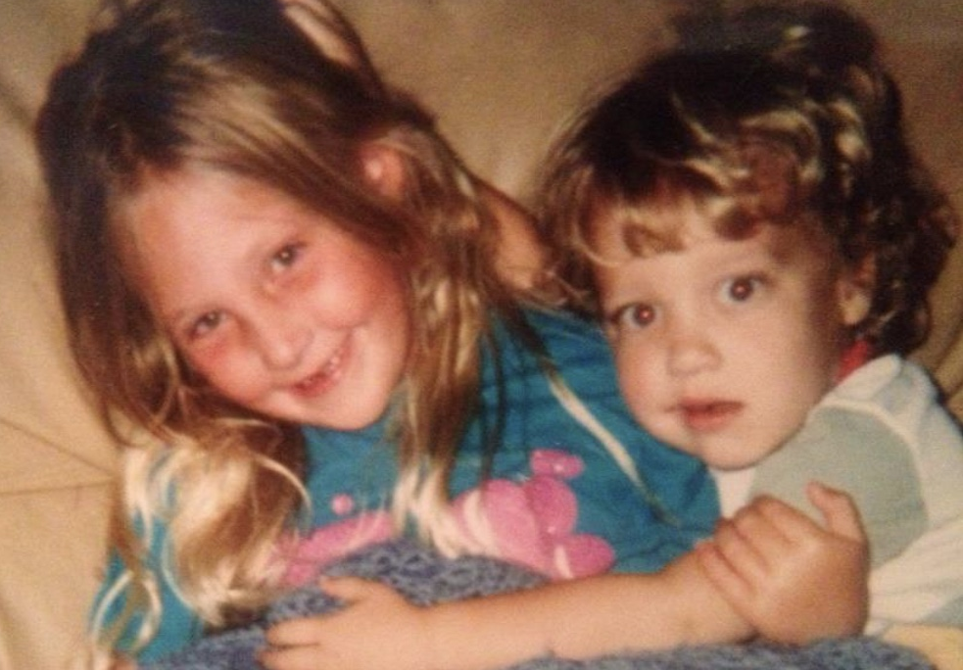
Taylor Cory

Slide 2
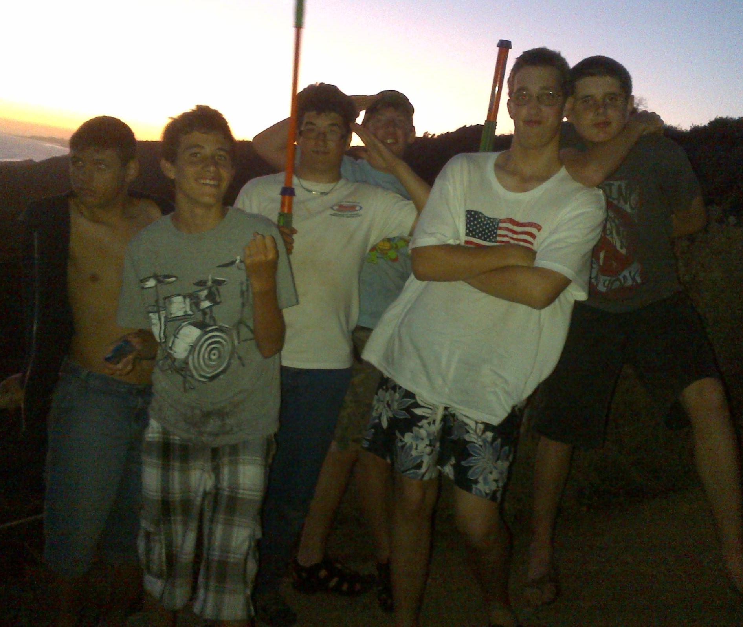
School
While at New Vista:
I Made Life Long Friends
Went to Dances
Participated in Boy Scouts
Went to public school through 2nd grade
Found New Vista in 6th grade

Slide 3
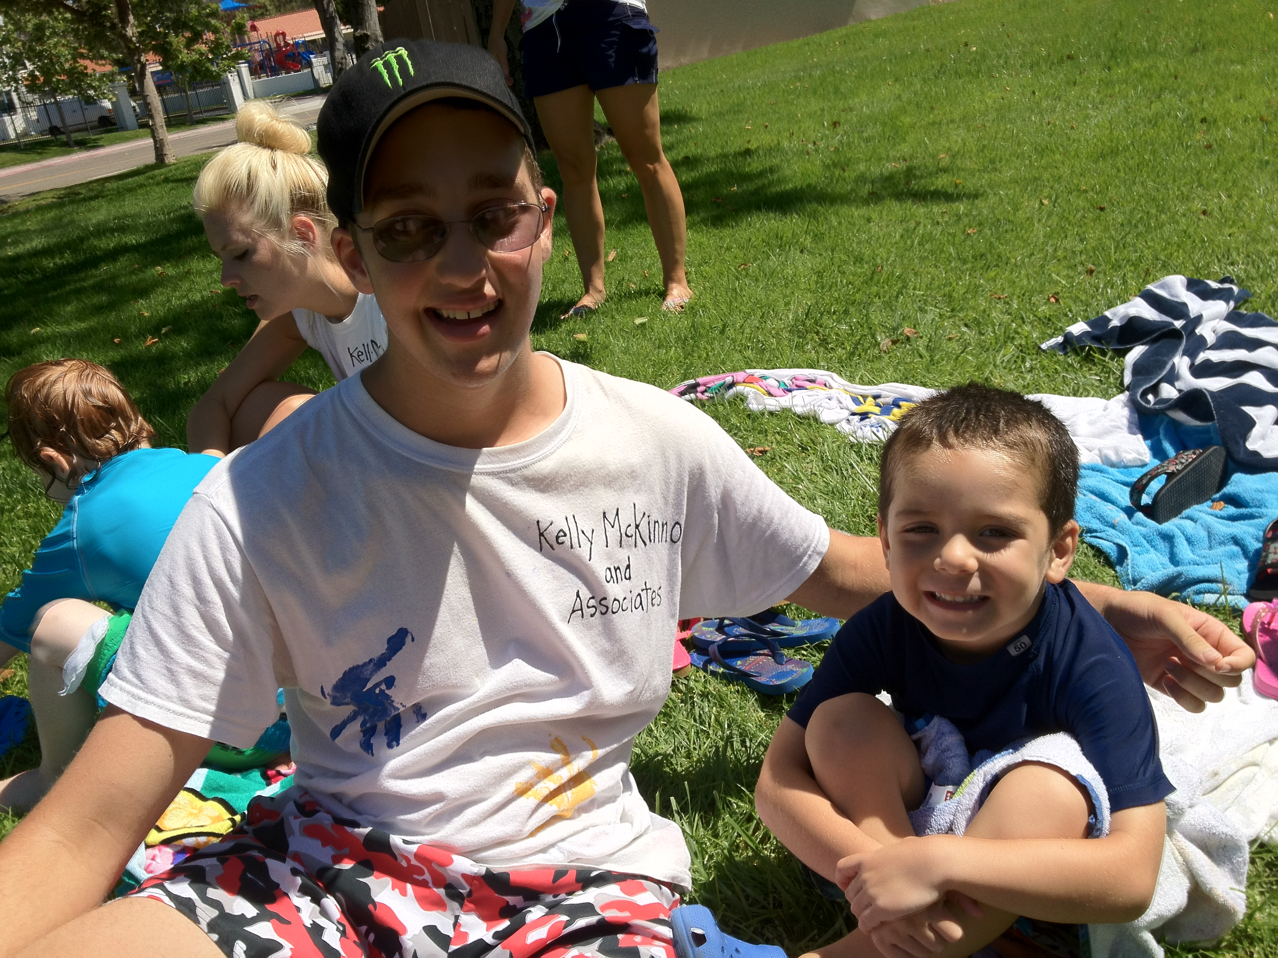
Activities
I have been involved in a lot of activities
Social Skills Classes
Martial Arts
Spirit League for 12 years

Slide 4
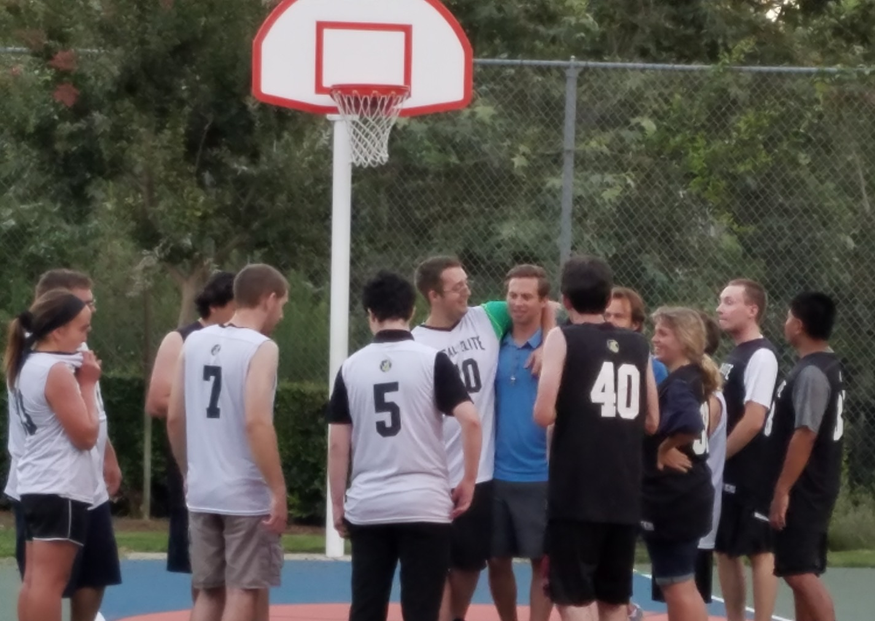
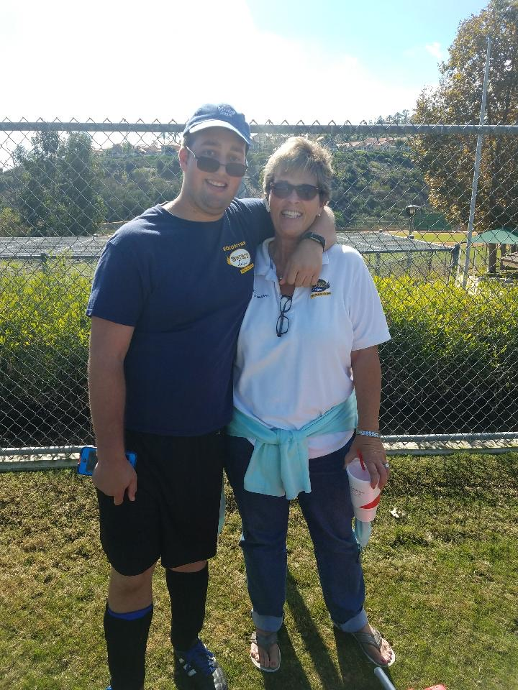
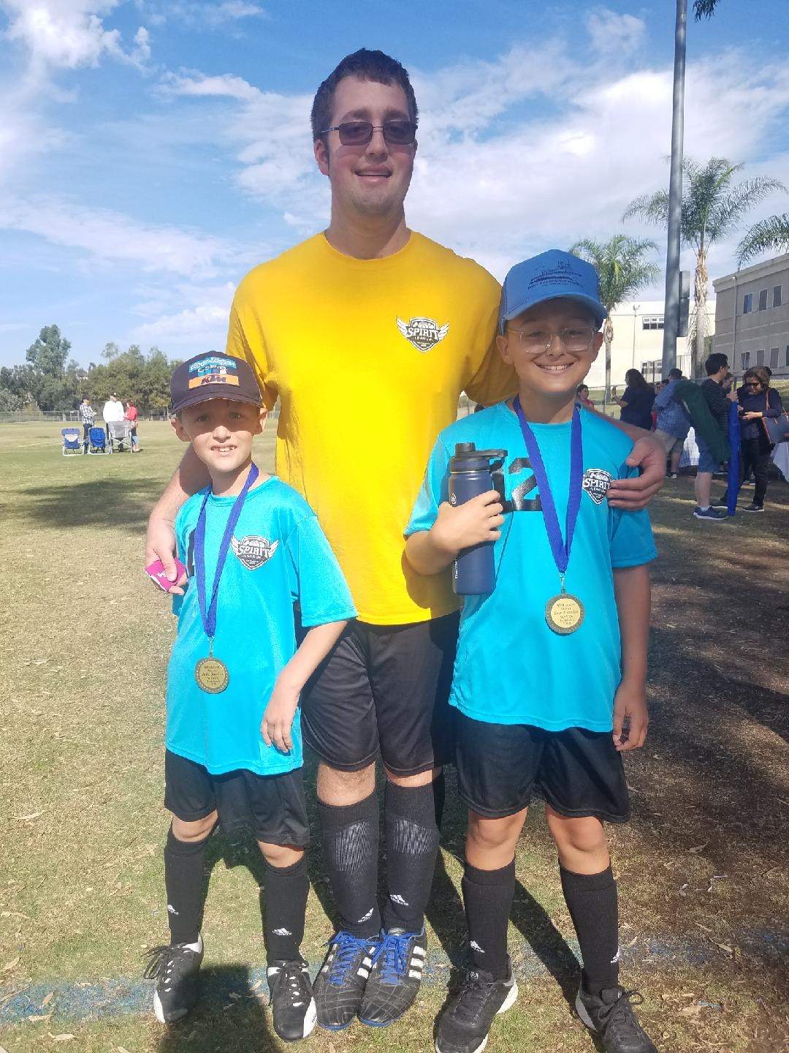
Spirit League
Spirit League for 12 years
Was a team mentor
Asst. Coach during Soccer
Participated Summer 2019 in adult program

Slide 5
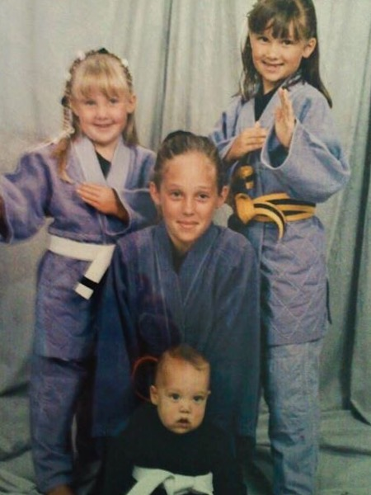
Martial Arts
I have been participating in Martial Arts with my dad since I was little
I now help him teach the younger classes (6-8 year olds)
It has given me a lot of self confidence

Slide 6
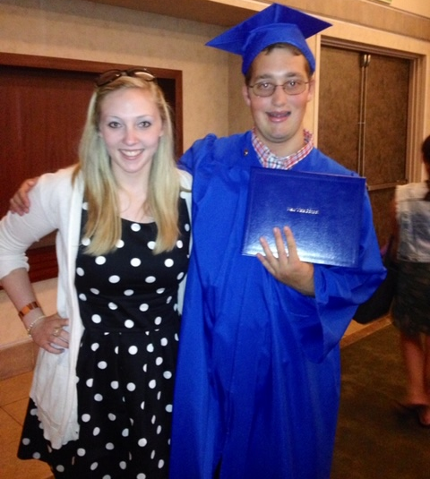
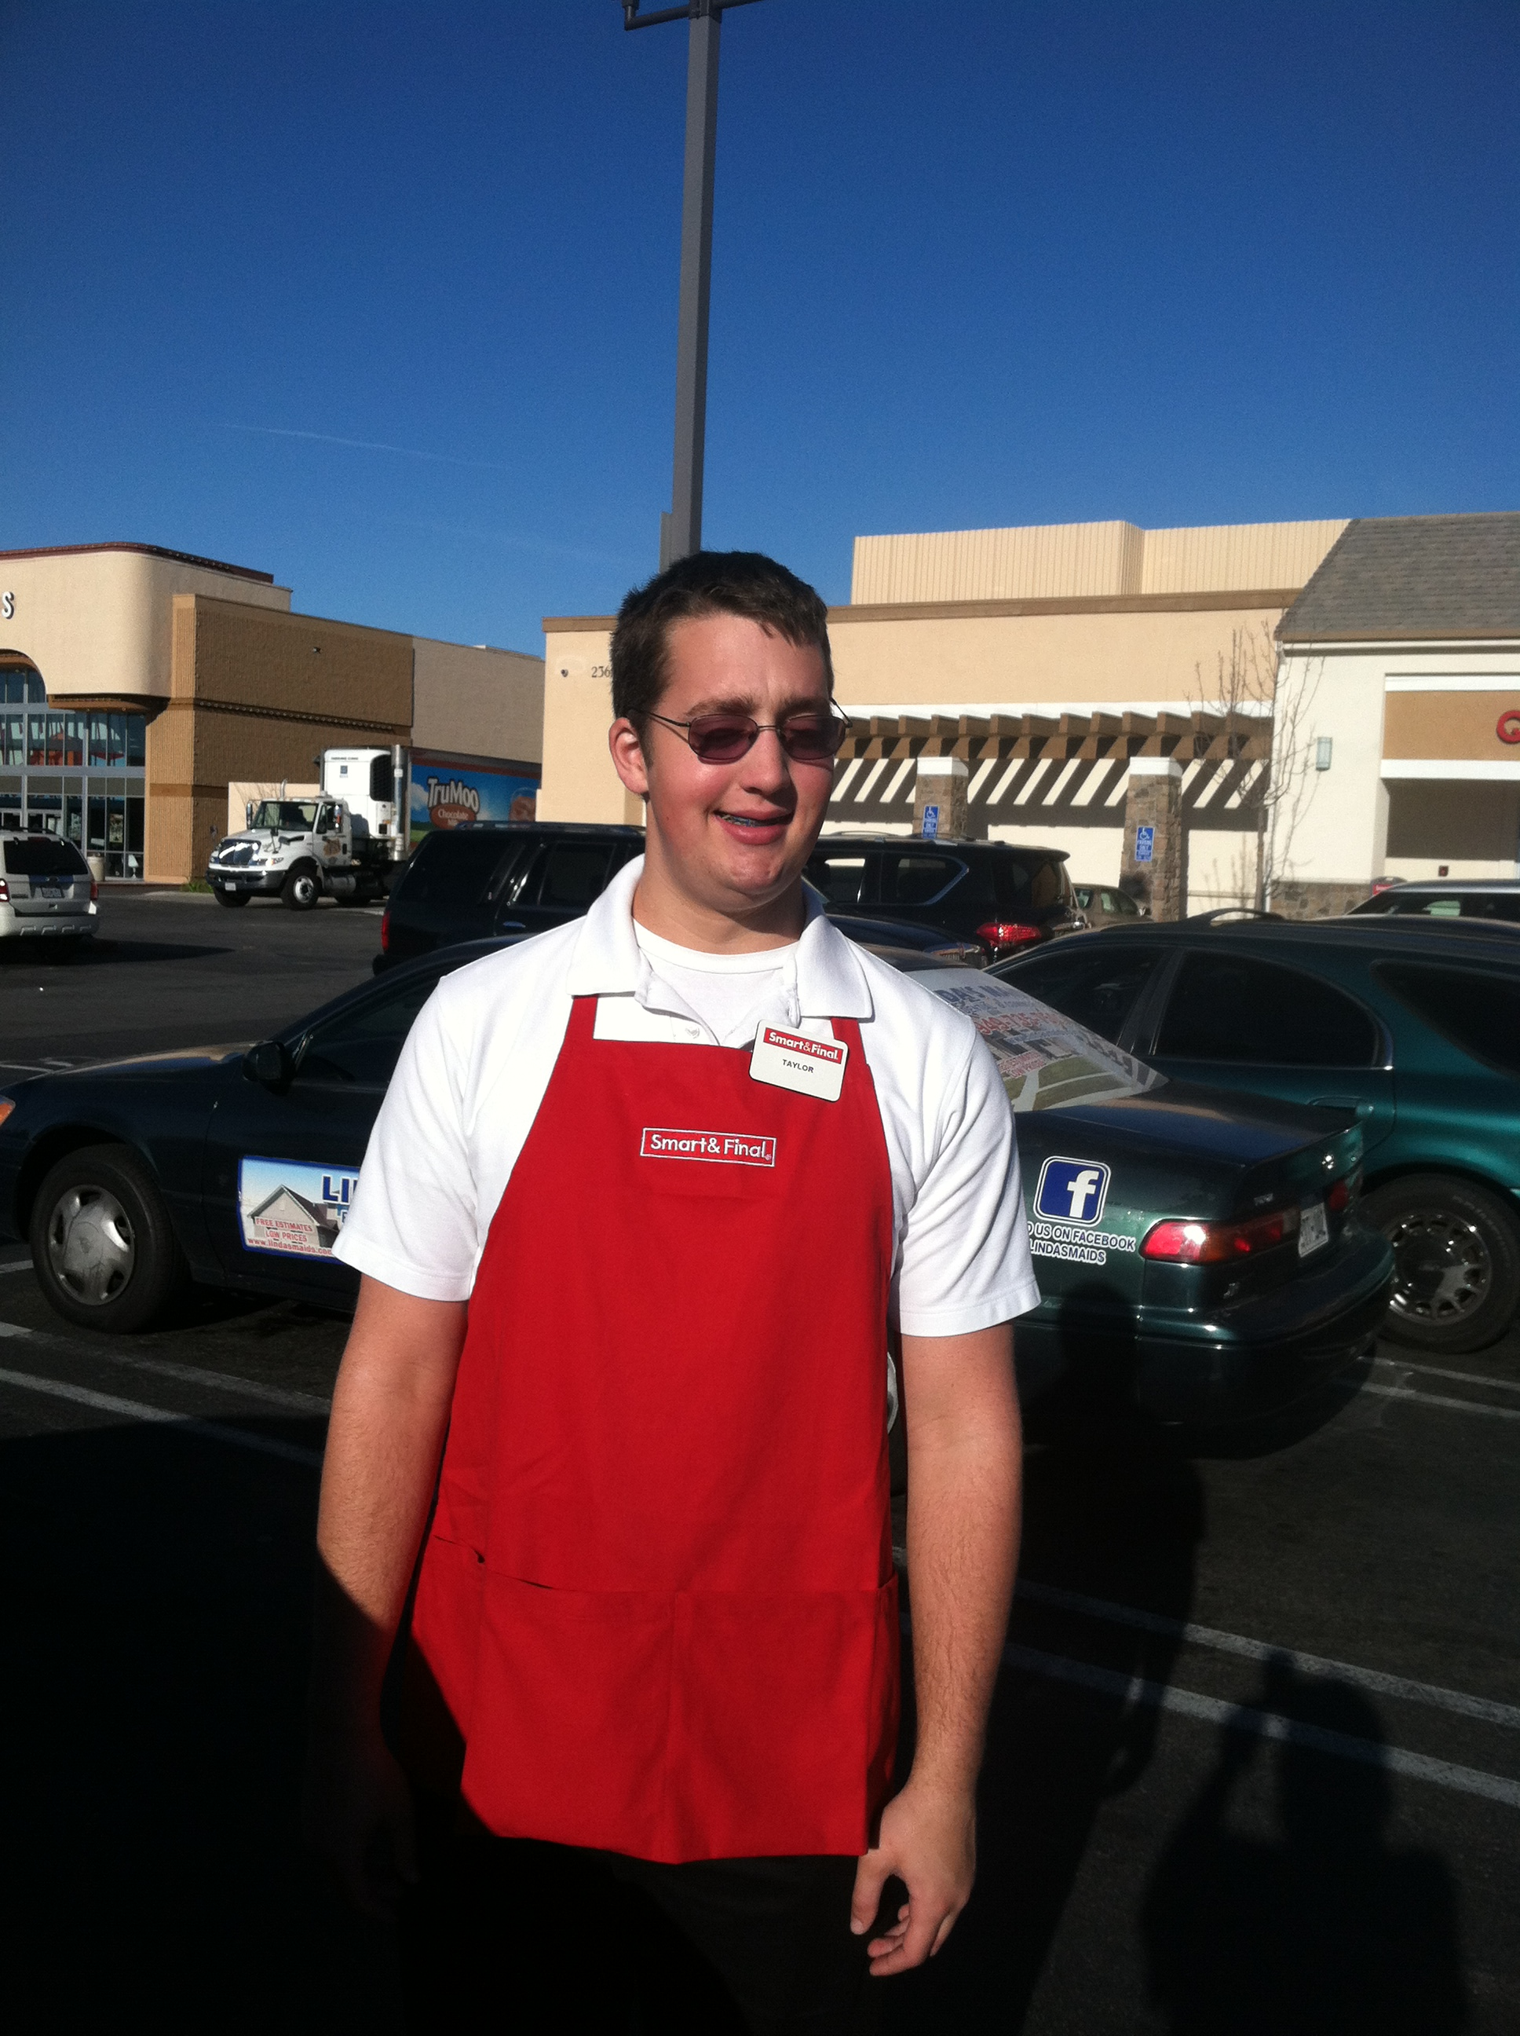
After I Graduated
I participated in a New Vistas transition program
I was hired at Smart and Final
Learned stocking
Courtesy Clerk
Changed Jobs
Camp Pendleton with Goodwill
Worked in the Mess Hall

Slide 7
Project Search
11 month program
Choc Hospital
Worked in 4 different departments
Favorite one was materials management
Currently:
Working at Pavilions
Courtesy Clerk
Goodwill works with me on Job Development Skills

Slide 8
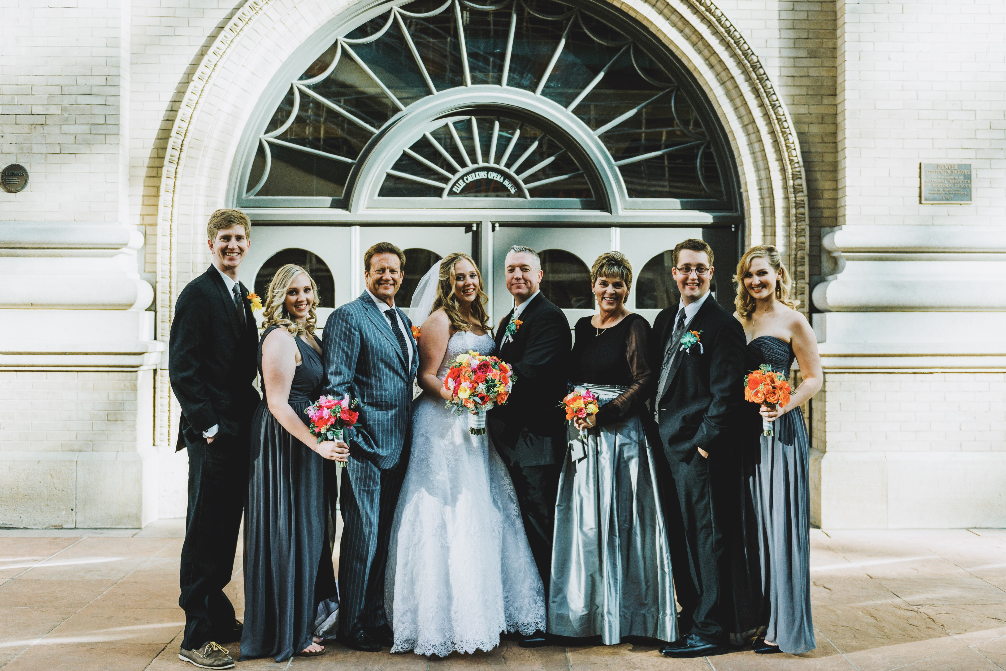
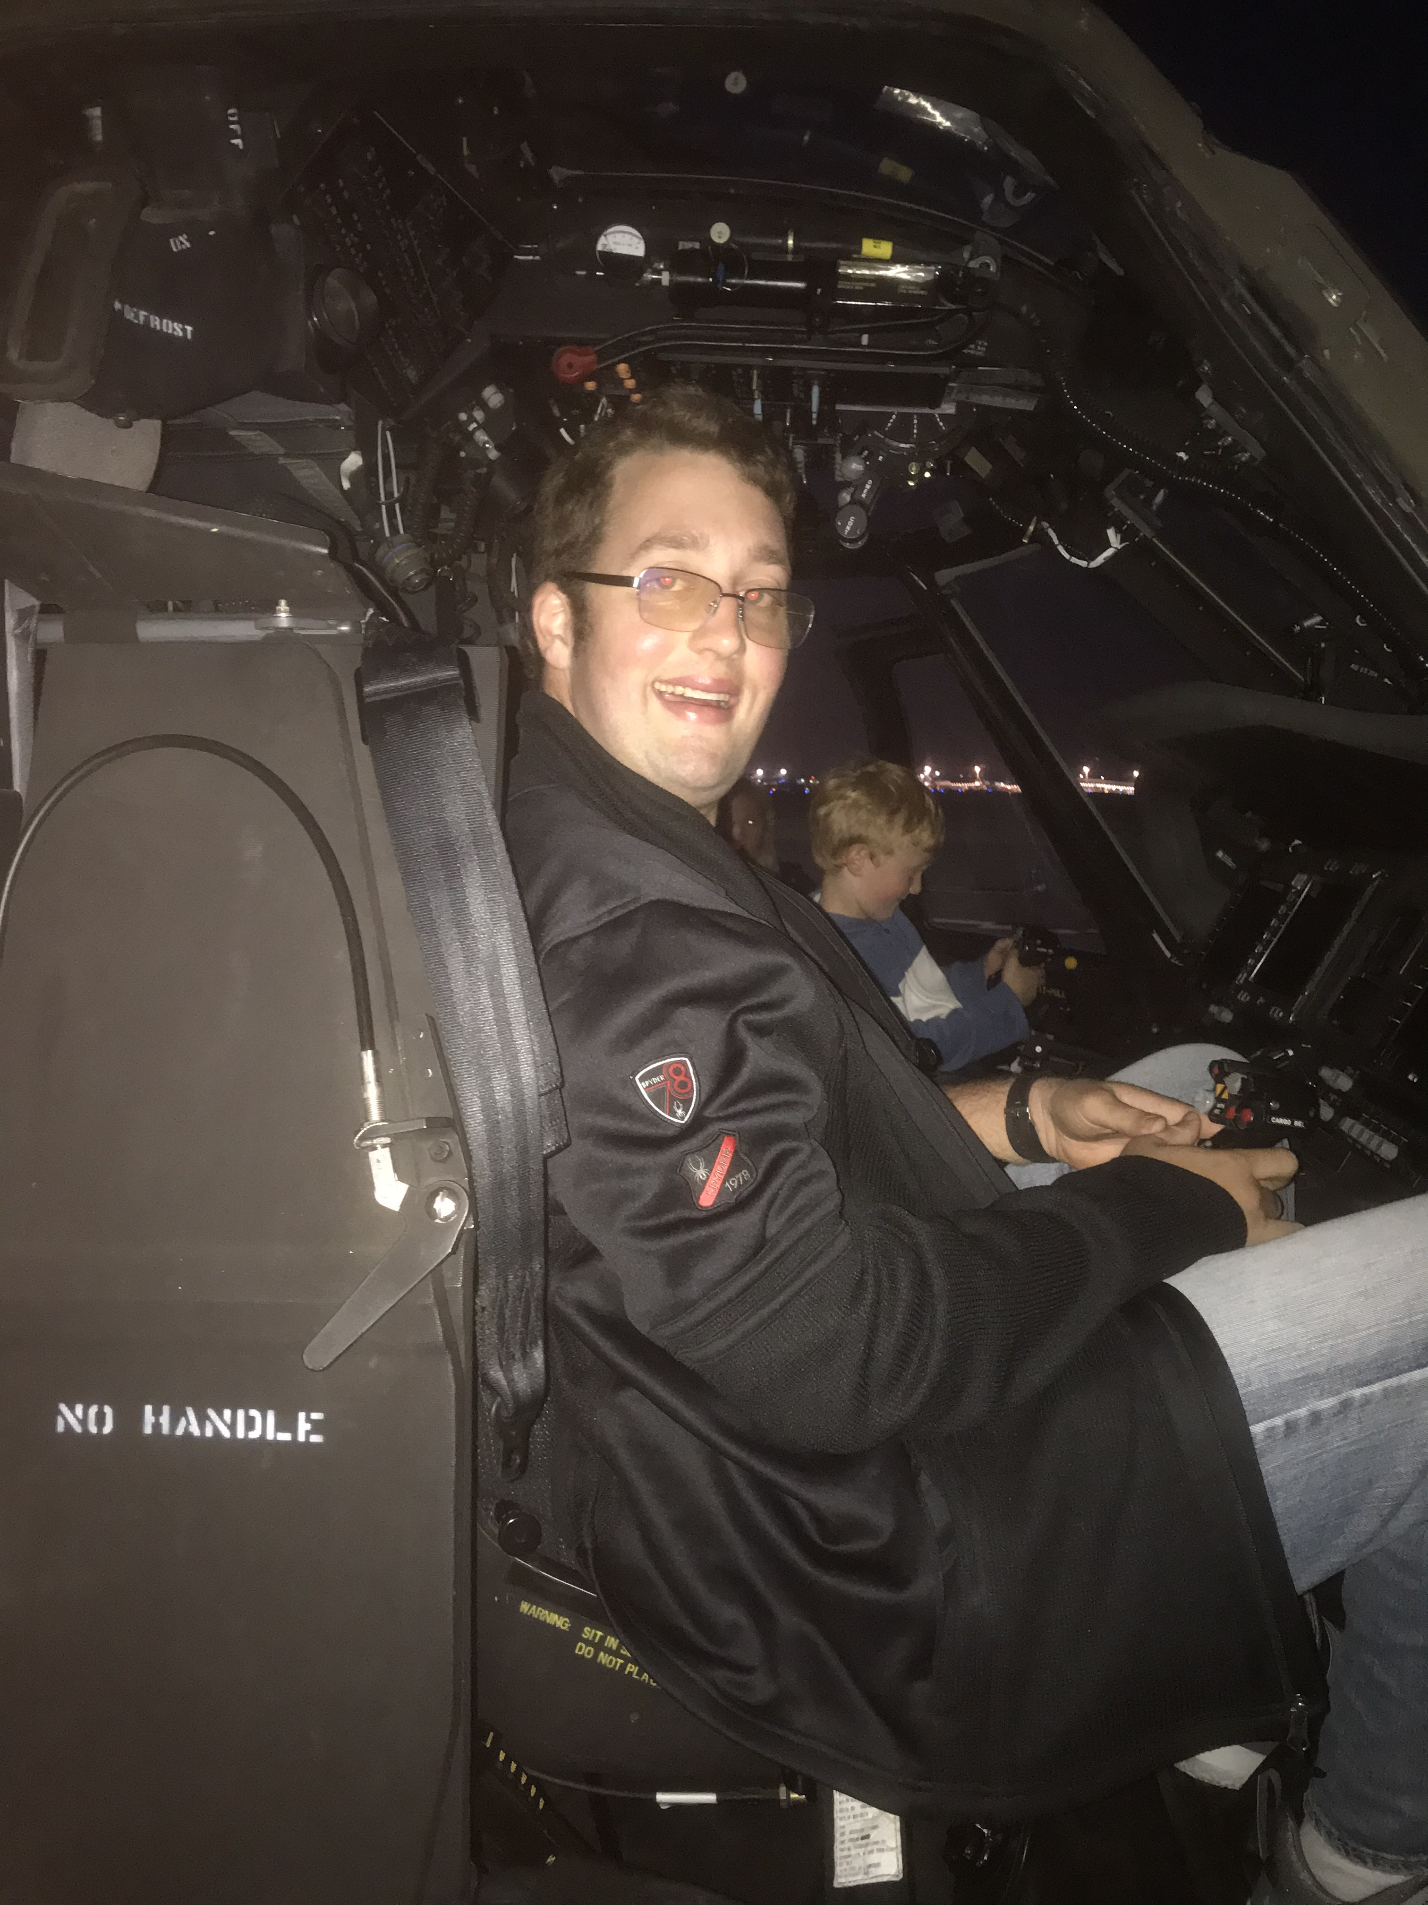
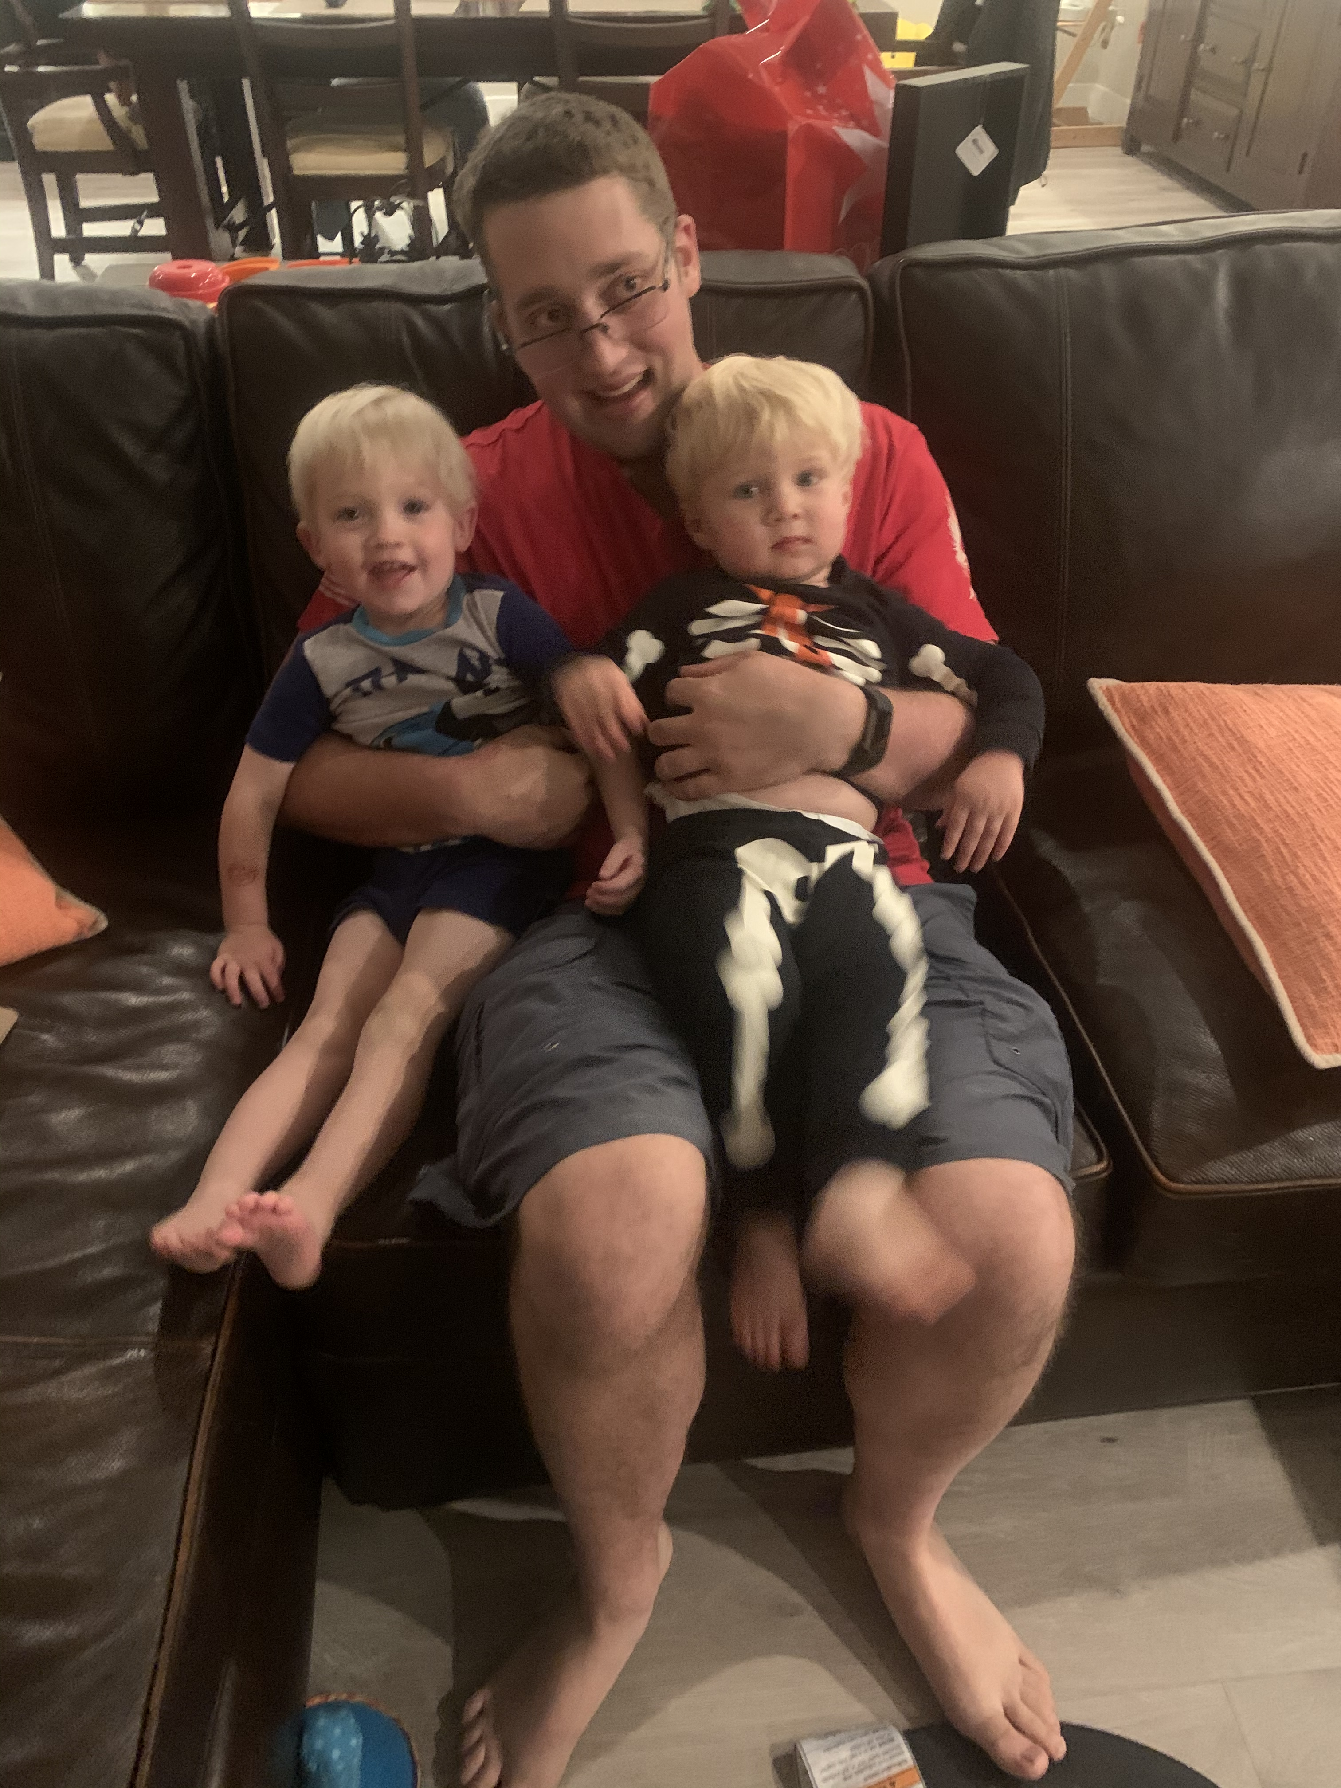
Future
Get a full time Job where I work 30-40 hours a week
I have started working with a Independent Skill Trainor
Hope to be more independent
Live on my own someday

