Slide 1
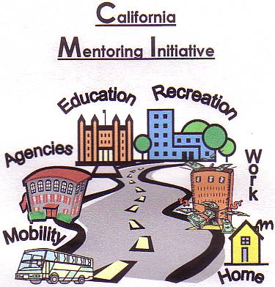
Effective Transition Planning...
Promoting Positive Life Outcomes!
Education, Employment & Independent Living
Regional Center of Orange County
May 30, 2019

Slide 2
Renee Melton Linda ONeal, M.A.
Current Positions
Current Positions
Irvine Unified School District , CA WorkAbility I Coordinator
Transition Partnership Program (TPP), Coordinator
Chapman University Thompson Policy Institute, Transition Initiative Leadership Team
Coastal Business Advisory Council Lead Facilitator
Orange County Local Partnership Agreement (OCLPA) Team
Regional Center of Orange County, Consultant
Chapman University Thompson Policy Institute, Transition Community Liaison
SDSU, Ca Career Innovations Principal Investigator
SDSU, CaPROMISE Region 4 Manager
SDSU, Program Specialist Workforce Innovation Technical Assistance Center
Orange County Local Partnership Agreement (OCLPA), Chairperson
OC Project Search Representative

Slide 3


Slide 4
Welcome
Transition Statistics
Competitive Integrated Employment
Transition Planning & Challenges
Parent/Family Engagement
Work-Based Learning & Employment
Travel Training
Education
Recreation
Agencies
Work
Mobility
Home
Transition Planning
AGENDA

Slide 5
Transition Planning

Slide 6
Transition Planning Mission
…………to empower all individuals with disabilities with the skills necessary to achieve their full potential in adult living, through support and collaboration with families, schools, and communities.

Slide 7
National Statistics
In 2016, the Social Security Administration (SSA) paid roughly $55 billion to 8.3 million people. (25% are under age 18)
In 2018, the maximum monthly (California) SSI payment is $931.72 per individual.) Fed Benefit rate =$771 + CA Supplement $160.72
Each year 86% of individuals who draw SSI payments have eligible disabilities.
57% of SSI Recipients have no other income
4.7% of SSI Recipients are working
… less than 1% of SSI Recipients ever become self-supporting through employment

Slide 8
Transition Challenges
Studies on individuals with disabilities indicate:
Lower high school graduation rates
Lower college entrance & graduation rates
Higher rates of poverty (29% live on household incomes of less than $15,000)
70%-89% unemployment (depends on the source & disability)
Under-employment
Less life satisfaction (socialization & optimism)

Slide 9
Family Buy-in & Support
Willingness to consider Work-Based Learning Competitive Integrated Employment (CIE)
Encourage as much independence in your student as early as possible.
Education is a collaborative process
Willing to learn about Benefits Planning & Management
Learn about the various community resources & services
Support work on the weekends, evenings & holidays

Slide 10
Work-Based Learning
(WBL)
NON-PAID WBL OPPORTUNITIES
Internships
Job Shadows
Community Based Learning
Volunteer Work
Work Experience
PAID EMPLOYMENT
Work Experience
Internships
On-the Job Training (OJT)
Jobs
Apprenticeships
Defined in Ed. Code (51760-51769.5) as an educational approach or instructional methodology that uses the workplace or real work to provide pupils with the knowledge and skills that will help them connect school experiences to real-life work activities and future career opportunities.
Work-based learning should be an integral part of a more comprehensive program that integrates academic courses and career technical education. There is an array of work-based learning experiences for career awareness, career exploration, career preparation and career training. Resources and information regarding work based learning can be found at: http://www.connectedcalifornia.org/curriculum/work_based_learning

Slide 11
Parent Support for Employment
Encourage student to consider a realistic and viable career ladder job
Consider labor market needs in local area
Research career options to help your student make good choices for him/herself
Consider transportation options to potential work sites
Know and understand the American’s with Disabilities Act (ADA)
Assist student in understanding required accommodation needs to support execution of the essential functions of the desired job
Request job coaching support through school & adult programs (Workability I, TPP, WIOA, etc.)

Slide 12
Competitive Integrated
Employment
CIE
Definition of Competitive Integrated Employment in WIOA:
The term "competitive integrated employment" means work that is performed on a full-time or part-time basis (including self-employment) –
Paid minimum wage or above, depending on the job

Slide 13
Definition of Competitive Integrated Employment in WIOA... continued:
With non-disabled peers
In an integrated Setting
If self-employed, yields an income that is comparable to the income received by other individuals
As appropriate, present opportunities for advancement that are similar to those for other employees who are not individuals with disabilities and who have similar positions.

Slide 14
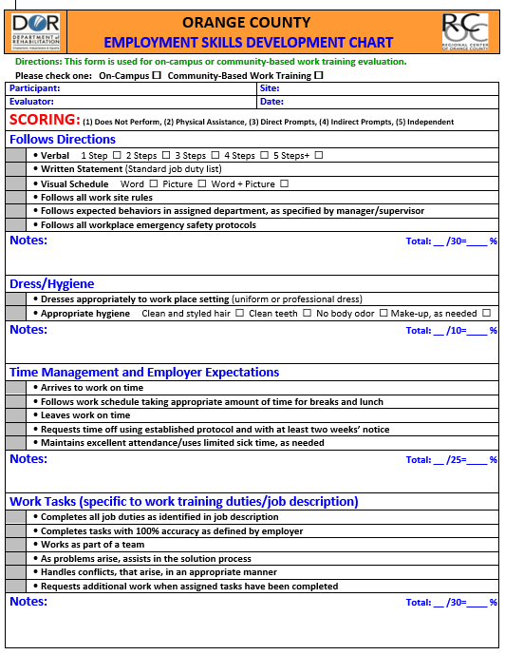

Slide 15
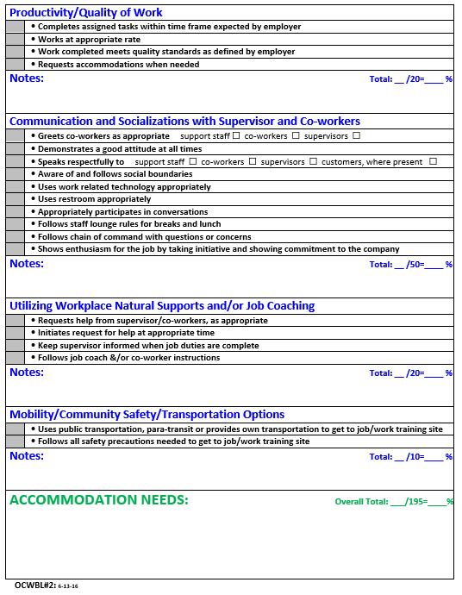

Slide 16

START EARLY
Preparation begins at a young age
  Dress/Hygiene
  Following Directions
  Time Management
  Work Tasks
  Communication and Socialization
  http://www.rcocdd.com/wp-content/uploads/2017/05/OCWBL1-OC-Pre-Employment-Skills-Development-Chart-7-18-16.pdf

Slide 17
Organizing Community-Based WBL Opportunities

Slide 18
Successful Work Experience & EMPLOYMENT $ (Direct Hire) Locations:
Food Service
Clothing & Retail
Education, Entertainment & other
McDonalds $
Pizza Hut $
Chili’s $
Red Robin $
Lampost Pizza $
Pieology $
Darna Restaurant $
Carl’s Jr. $
Del Taco $
Burger King $
Coffee Bean $
Denny’s $
Lucille’s $
Taco Bell $
CVS $
Marshalls $
Party City $
Office Max $
REI $
Macy’s $
Burlington Coat Factory $
Forever 21 $
Old Navy $
Staples $
Target $
Walgreens $
Kohls $
Conroy’s Flowers $
Irvine Valley College
IUSD, ECLC
Heritage Park Library
Pretend City $
Incredible Edible Garden
Families Forward
Aramark Sports Entertainment $
AMC Theaters $
Regal Cinema $
Discovery Science Center $
Irvine Chamber of Commerce $

Slide 19
Technology, Hardware, Grocery
Technology:
Best Buy $
Hardware, Specialized Trades:
Armstrong Garden Nursery
Grocery:
Walmart $
Office Depot $
Sprouts Market $
Sam’s Club $
Trader Joes$
H Mart
Smart & Final$
Ralphs $
Medtronic $
Big O Tires
Microsoft $
Game Stop $
Micro Center $
Leisure World Auto Repair $
Micro Center $
Notes:
This is a small Example of some of the successful corporate business partners we have developed. If you share these locations with others in your office, or other neighboring school districts, we then are all working together to place our participants into jobs in our communities.

Slide 20
Caregiving, Pets, Hospitality
Caregiving:
Silverado Senior Living
Pets:
Petco $
Hospitality:
La Quinta Hotels
Heritage Pointe
Atria Senior Living $
Woodbridge Manor
Boys and Girls Club $
Stonecreek Animal Hospital
City of Irvine Animal Shelter
Candlewood Suites
Radisson Hotels
Hyatt Hotels $
Ayres Hotels
Hoag Hospital
Doubletree Hotel $
Wyndham Hotel $
St. Michael Hospice
CHOC $
UCI Medical Center $
Pets Mart $
Passionate Pet $
Kaiser Irvine $
Kaiser Anaheim $
Notes:
This is a small Example of some of the successful corporate business partners we have developed. If you share these locations with others in your office, or other neighboring school districts, we then are all working together to place our participants into jobs in our communities.

Slide 21

© CCHMC 1/3/06

Slide 22
Nontraditional Jobs
Not the “Easiest Jobs”
but
“Complex and Systematic”
© CCHMC 1/3/06

Slide 23

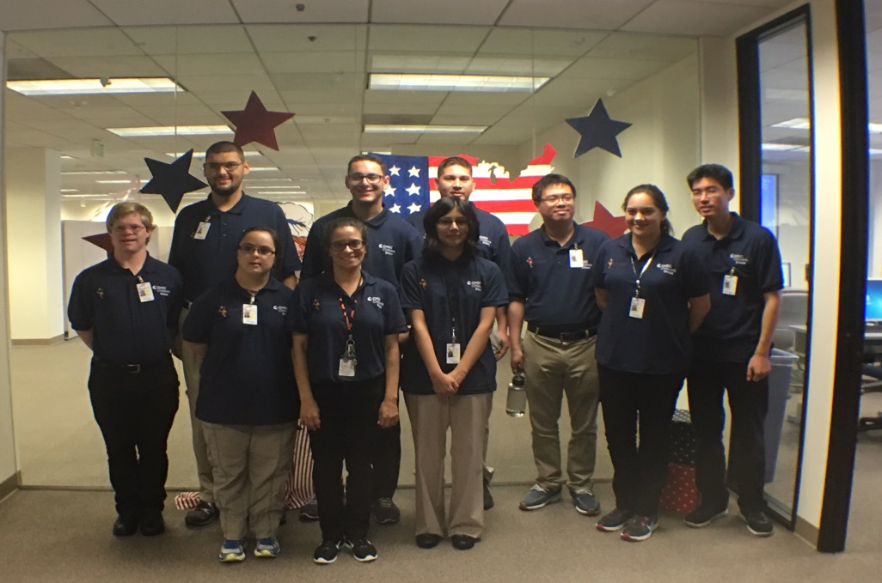

Person-Centered Planning and Interagency Collaboration builds hope, self-confidence and trust … ultimately yields quality outcomes in Adult life!
Gillman
Project Search
Children’s Hospital Orange County
C.I.E
Competitive Integrated Employment & Work-Based Learning
Young Adults with IDD
Family
CHOC Staff
Gillman Family Trust
Regional Center of Orange County
Integrated Resources Institute
Santiago Canyon College
UCI Technology in the Workplace Program
Department of Rehabilitation
Transportation Options

Slide 24
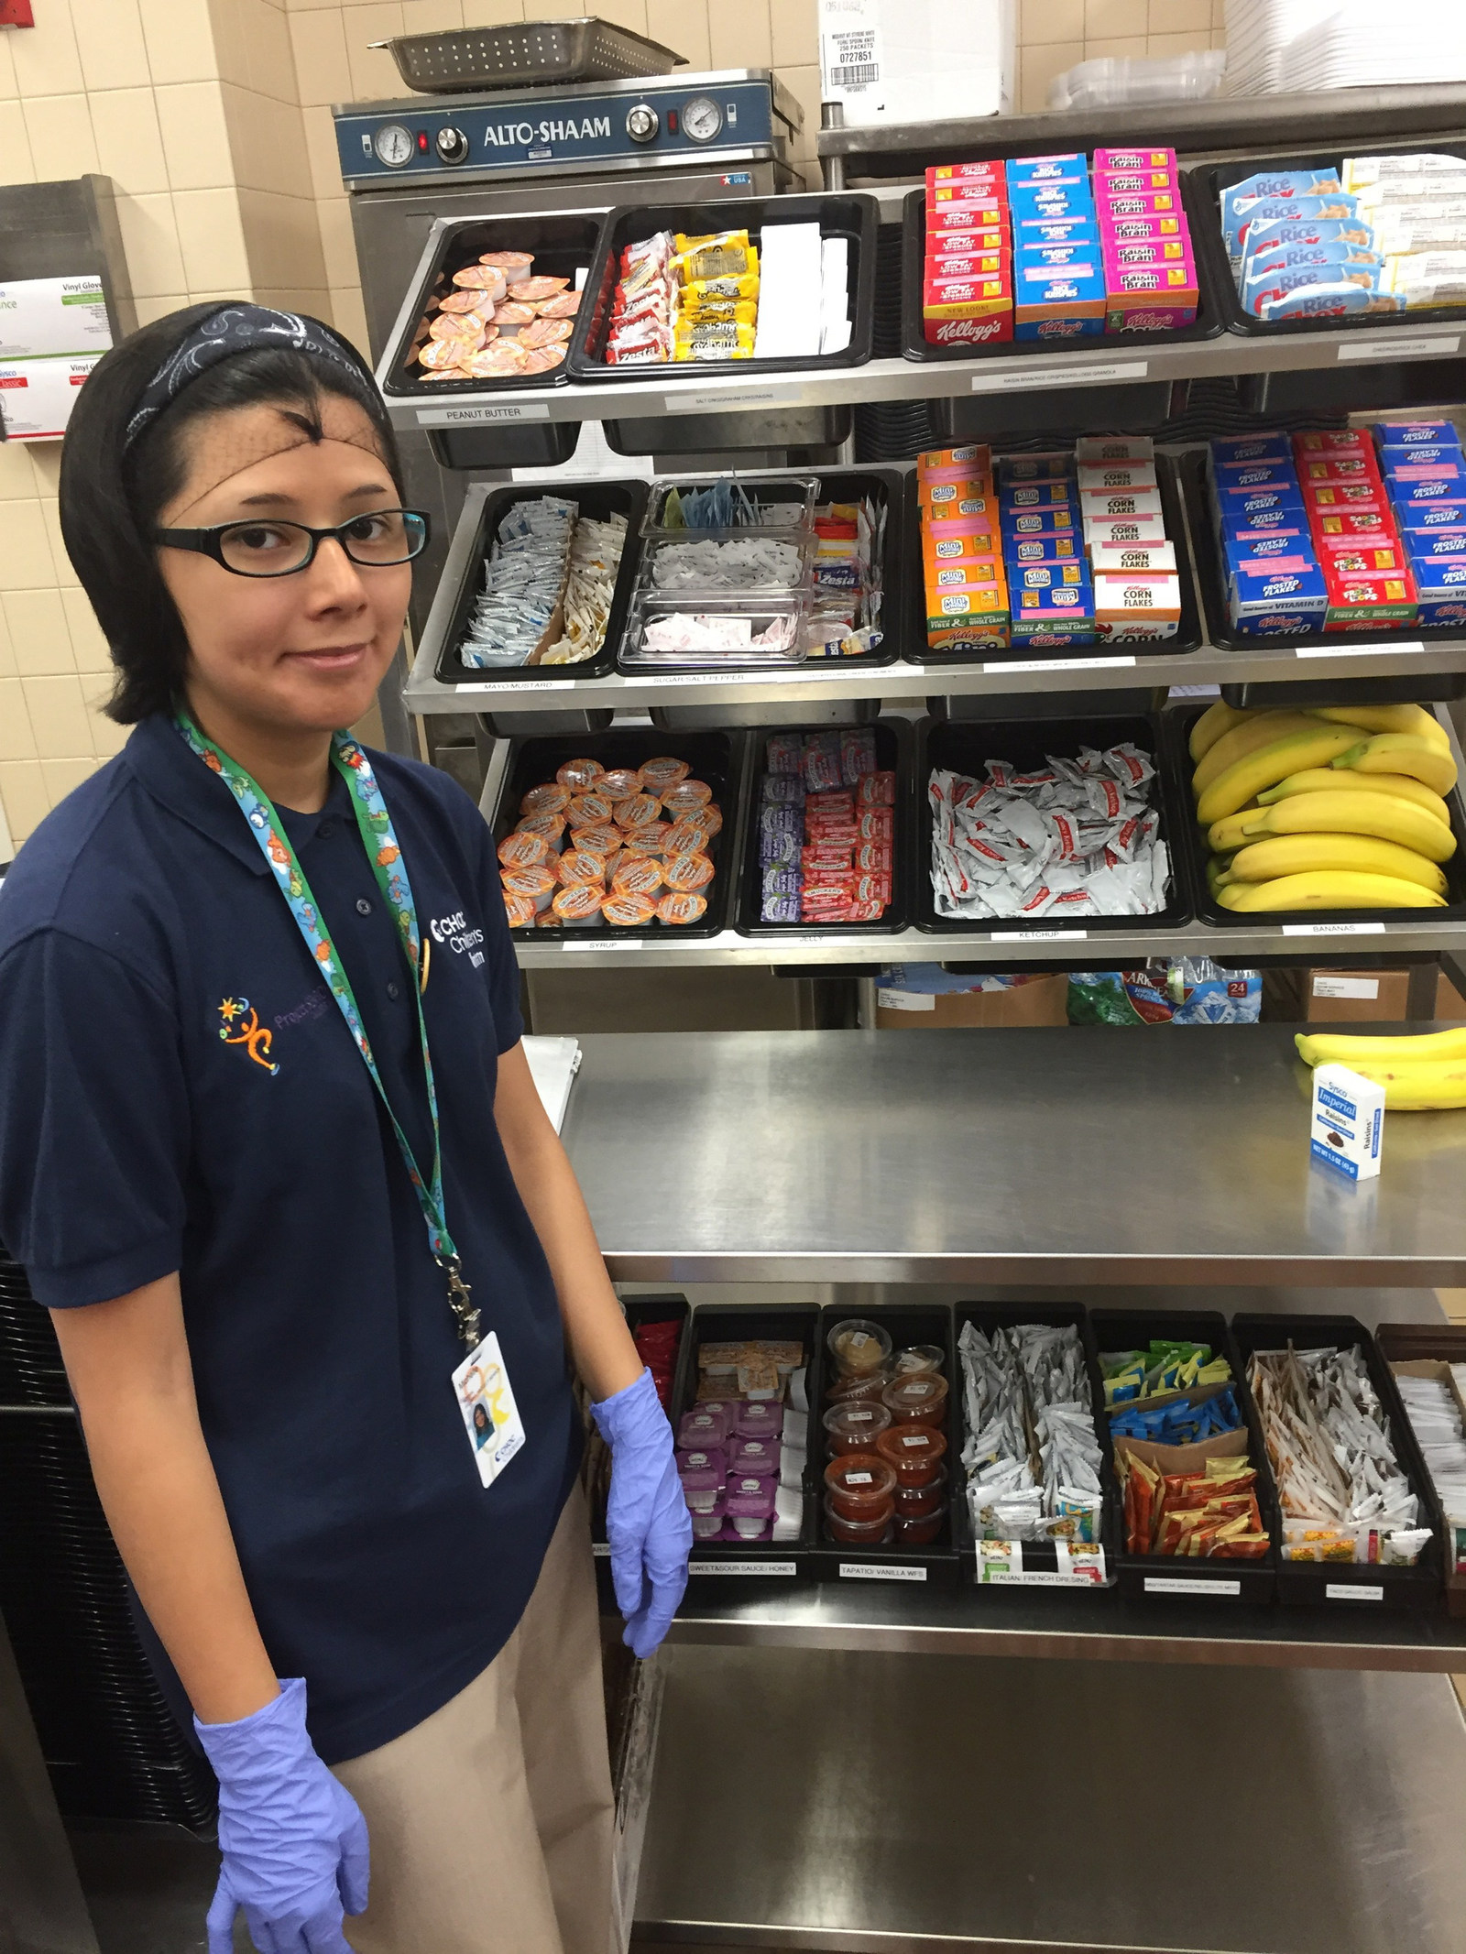
CHOC Hospital Employee
Michelle

Slide 25
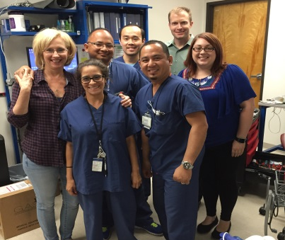
Happy Co-Workers!

Slide 26

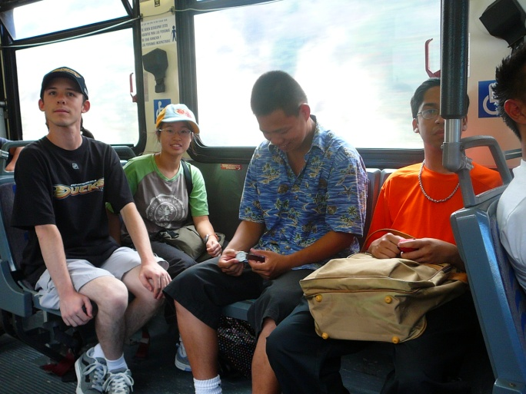
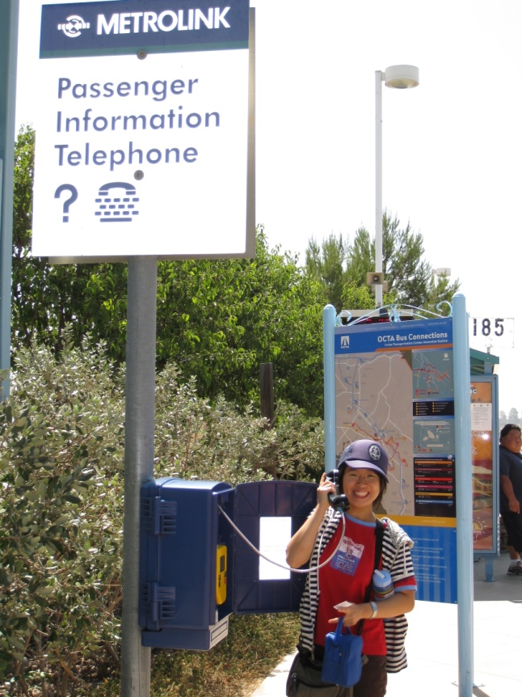
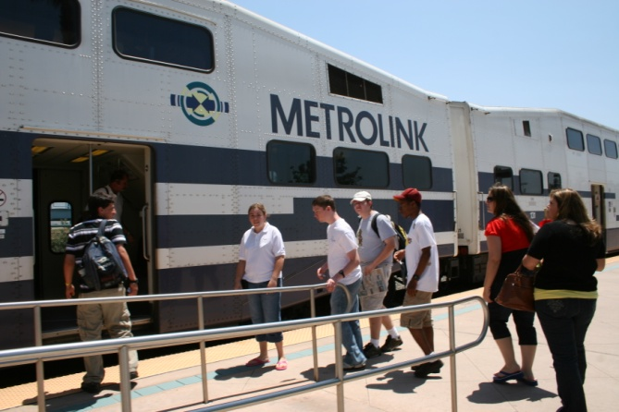
Travel Training

Slide 27
Accessibility
Transportation is one of the most significant barriers to persons with disabilities seeking employment.
The challenge is how to access the services and get a person matched with the correct resource taking into account their specialized needs.

Slide 28
Service Options
Public Transportation (OCTA)
  Reduced Fares
  Online Trip Planners
  Rider’s Alerts
Para Transit (OCTA ACCESS)
  Federally Mandated – operates under ADA guidelines
  Curb to Curb, Door to Door, Subscription
  One-to-One Training and Assessment

Slide 29
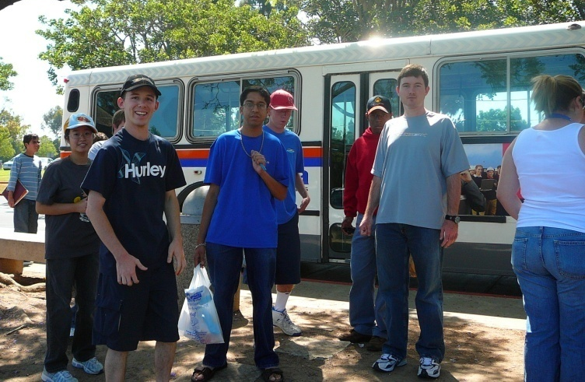
Benefits
Assists persons with disabilities in developing skills needed to independently travel in their community safely
Time spent on travel training
is based on individual need

Slide 30
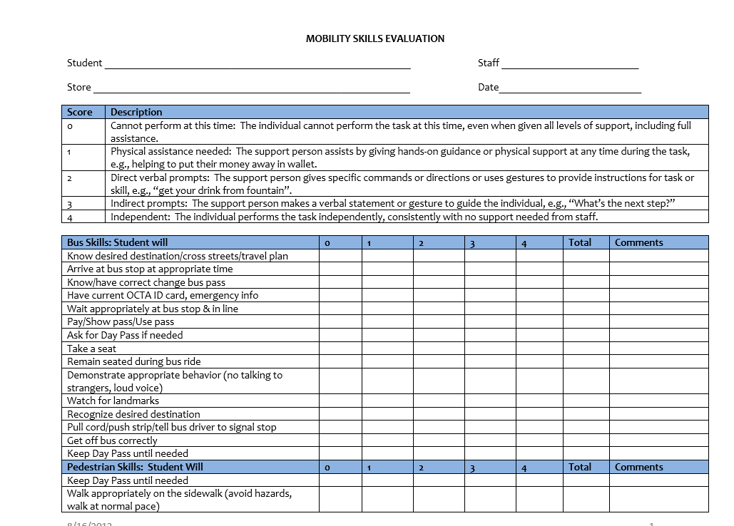

Slide 31
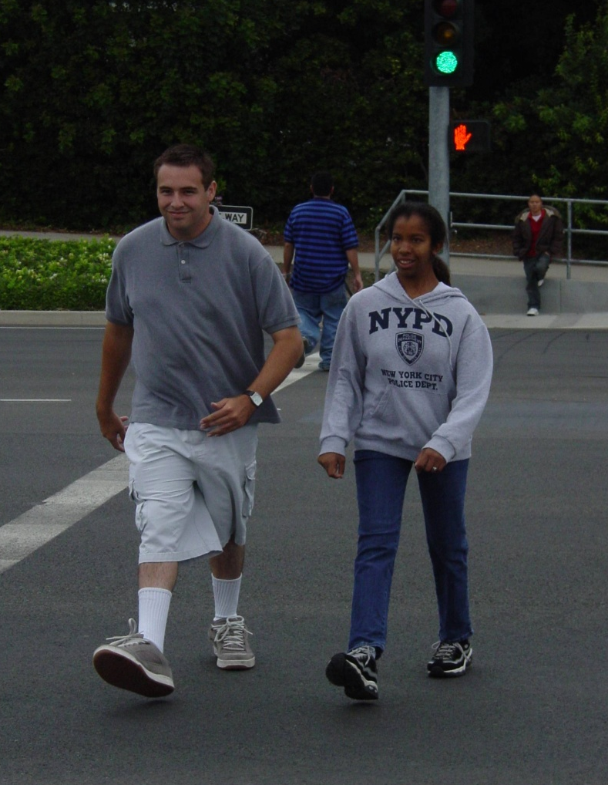
Street Crossing
Street Crossing
  Recognizing street signals
  Crossing distance
  Looking both ways
  The “big picture”
    Traffic conditions
    Road construction
    Other pedestrians
  Crossing clockwise vs.
  counterclockwise
  How you know when a student
  is ready to cross independently

Slide 32
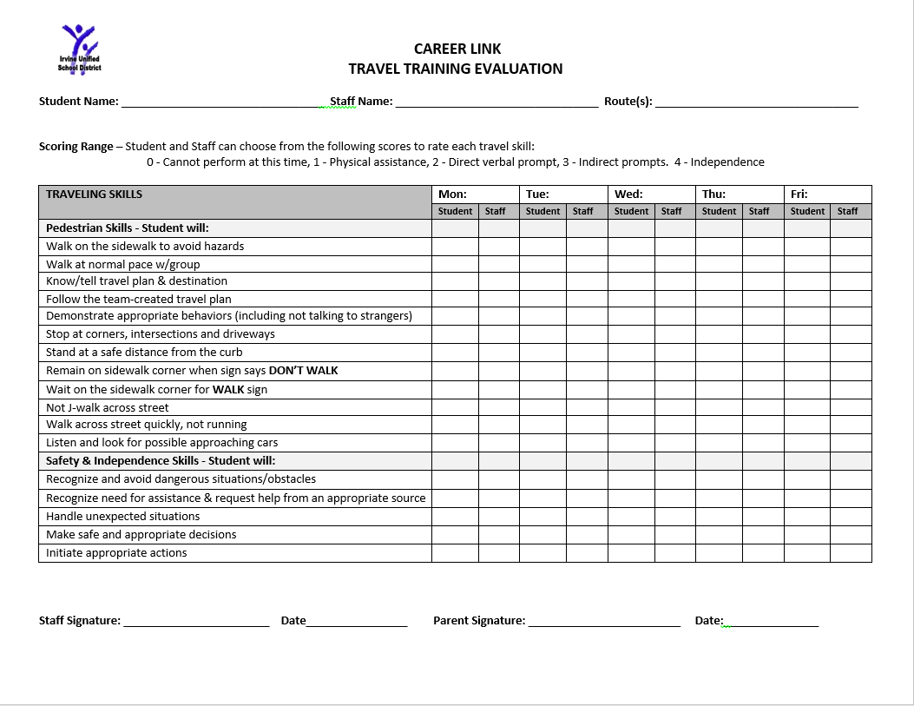

Slide 33
QUESTIONS
Transition Planning

Slide 34



Thanks for the Opportunity
to Meet with You Today!
Renee Melton ReneeMelton@iusd.org
Linda ONeal, M.A. linda_oneal@cox.net

