Slide 1
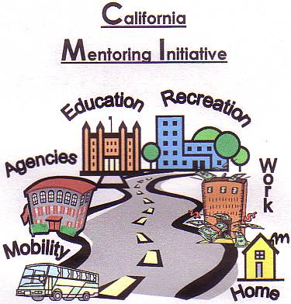
Effective Transition Planning...
Promoting Positive Life Outcomes!
Education, Employment & Independent Living
Regional Center of Orange County
May 30, 2019

Slide 2
Kurt Kosbab Linda ONeal, M.A.
Current Positions
Current Positions
Huntington Beach Union High School District, Lead Vocational Specialist
Orange County Adult Transition Task Force, Chairperson
Chapman University Thompson Policy Institute, Transition Initiative Leadership Team
California WorkAbility I Coordinator
Coastal Business Advisory Council Member
Orange County Local Partnership Agreement (OCLPA), Chairperson
Regional Center of Orange County, Consultant
Chapman University Thompson Policy Institute, Transition Community Liaison
SDSU, Ca Career Innovations Principal Investigator
SDSU, Program Specialist, Workforce Innovation Technical Assistance Center
Orange County Local Partnership Agreement (OCLPA), Chairperson
OC Project SEARCH Consultant
CA Project SEARCH Coordinator

Slide 3


Slide 4
Welcome
Transition Planning Overview
Top Ten Reasons to Involve Parents in Transition Planning
Transition from High School to College
Self Advocacy: 15 Tips for Parents & Family Members
Self Advocacy: 15 Tips for Self-Advocates
Education
Recreation
Agencies
Work
Mobility
Home
Transition Planning
AGENDA

Slide 5
Transition Planning

Slide 6
Transition Planning Mission
…………to empower all individuals with disabilities with the skills necessary to achieve their full potential in adult living, through support and collaboration with families, schools, and communities.

Slide 7
Post-School Options
California Adult Education
Community Colleges
  AA/AS Degrees/Transfer Degrees
  Industry Certifications
  University Degree Programs
  On-line Programs
  Apprenticeships
  Trade Schools
  Project SEARCH
Competitive Integrated Employment
Employment First Programs
Community Classes of Interest
Independent Living Classes/ Programming
Recreation Opportunities
Health & Fitness Activities
Interest Area Activities

Slide 8
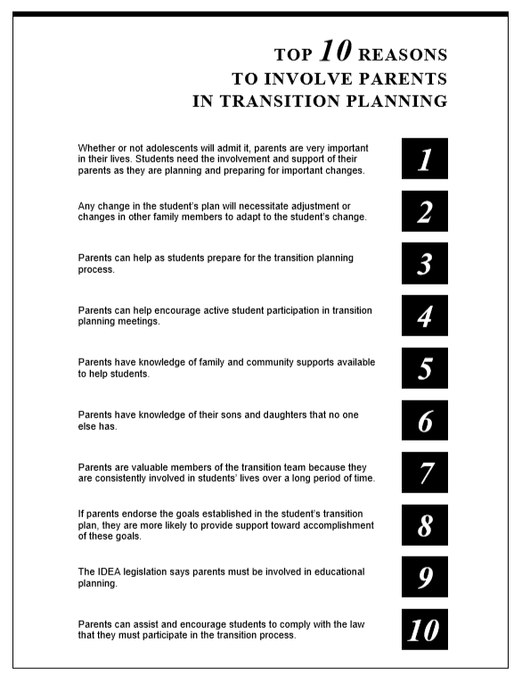
Ten
REASONS

Slide 9
Transition from High School to College Guide
This guide is meant to provide some basic information about the differences in the K-12 and College Special Education Resources & Services Available to students.

Slide 10
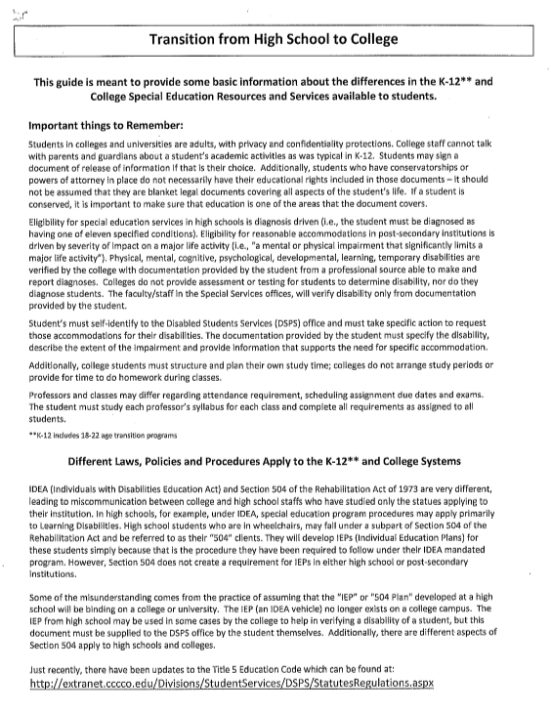
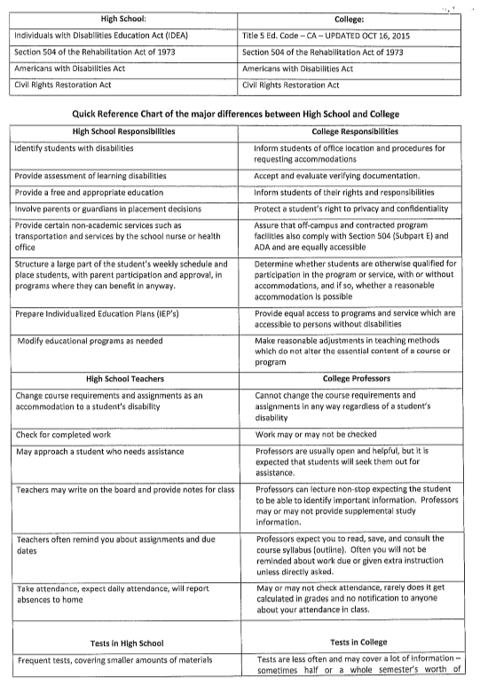

Slide 11
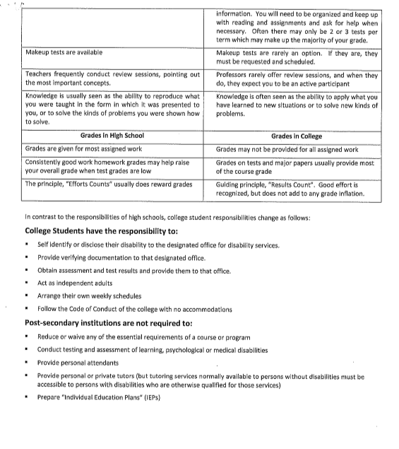

Slide 12
15 Tips for Parents & Family Member Advocates
Your goal is to best prepare your child or family member for adulthood and to ensure they have the services and supports to reach their goals. For many families this means communicating with agencies and systems that offer services to people with disabilities. It can also mean attending meetings and advocating on behalf of your loved one. This fact sheet includes tips to help you prepare for meetings, develop the best plan for your child or family member, and resolve conflicts that may arise in the process.

Slide 13
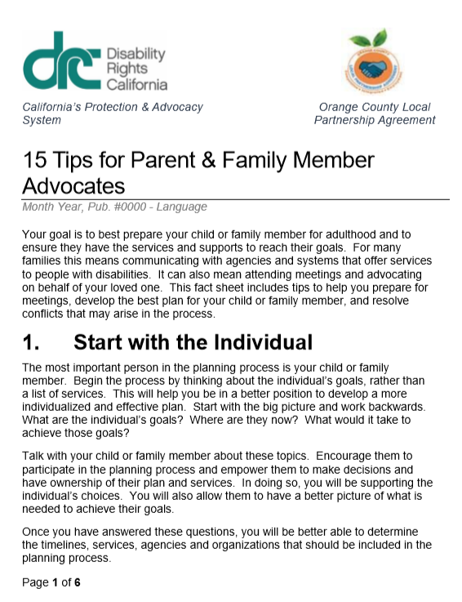
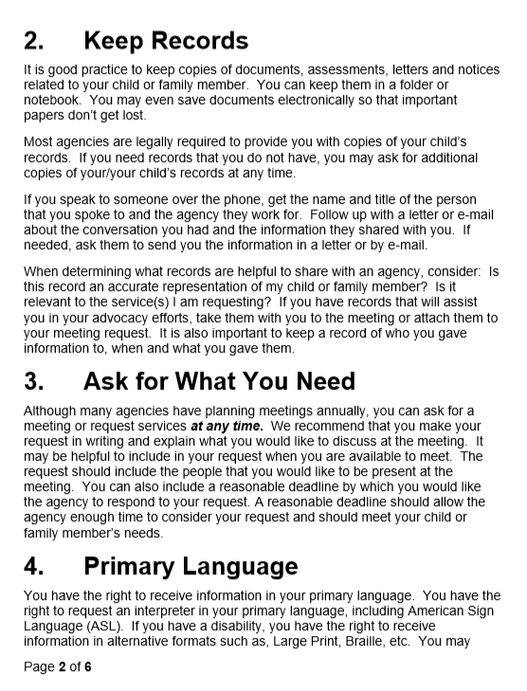

Slide 14
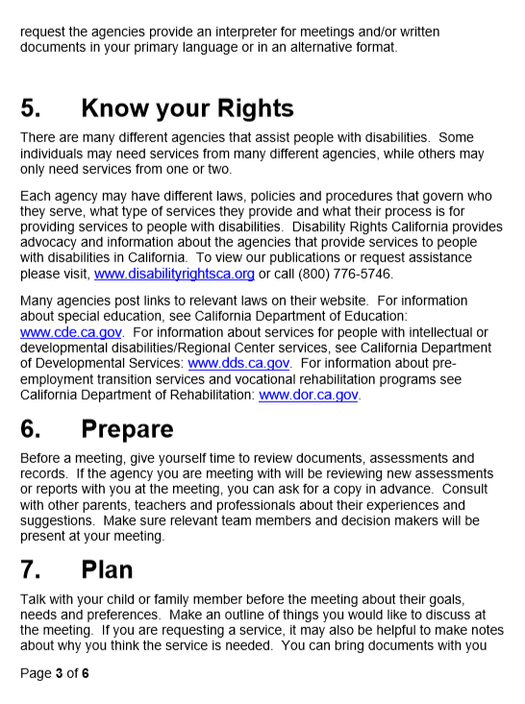
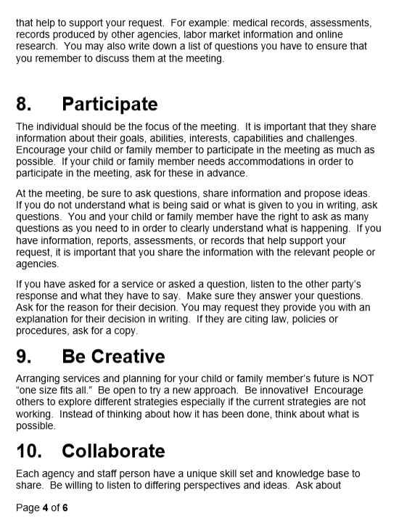

Slide 15
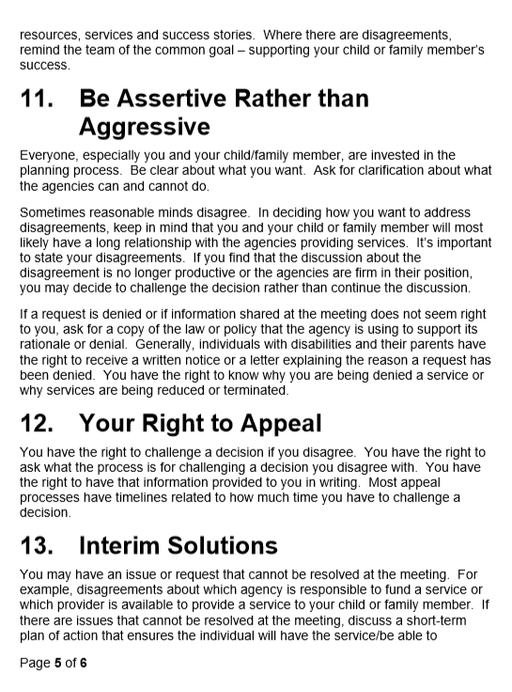
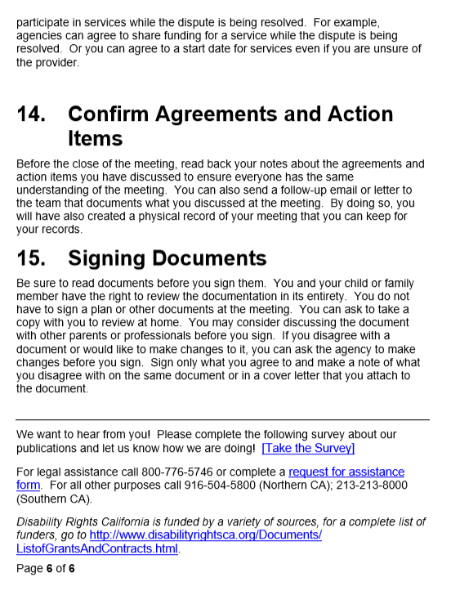

Slide 16
15 Tips for Self- Advocates
You may need services and supports to reach your goals. This means you may be communicating with agencies and systems that offer services to people with disabilities. It can also mean attending meetings and advocating for yourself. Self-advocacy can begin at any age.
This fact sheet includes tips to help you prepare for meetings, develop a service plan, and resolve conflicts that may arise in the process.

Slide 17
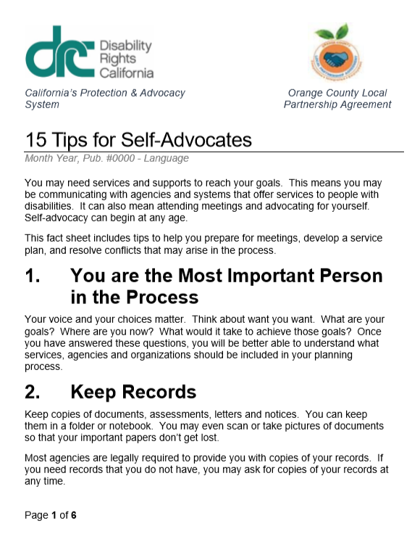
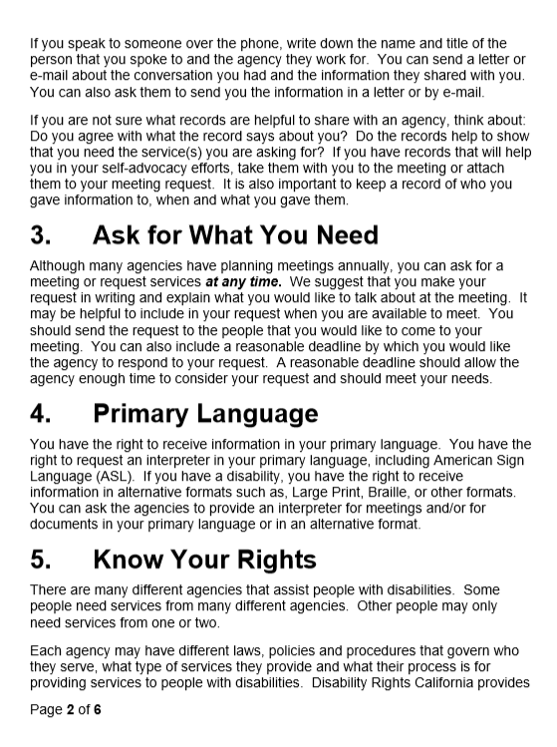

Slide 18
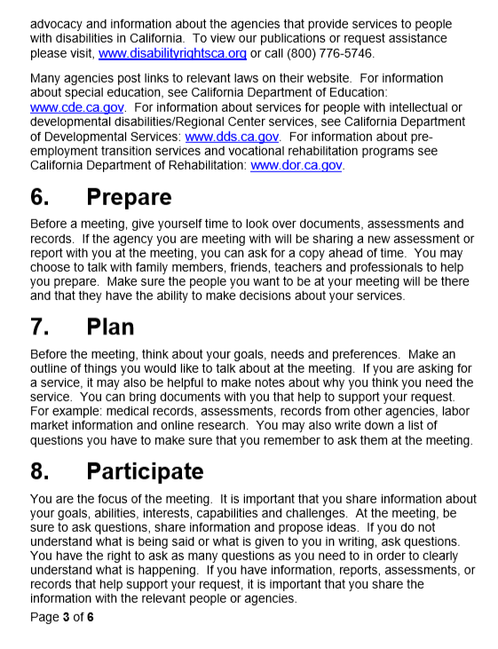
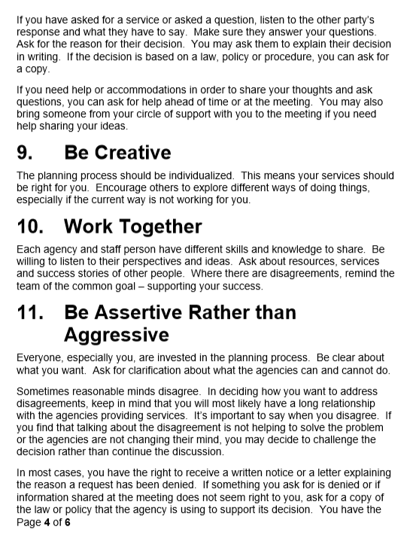

Slide 19
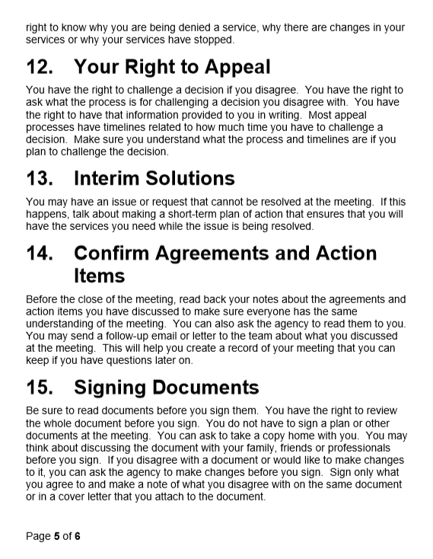
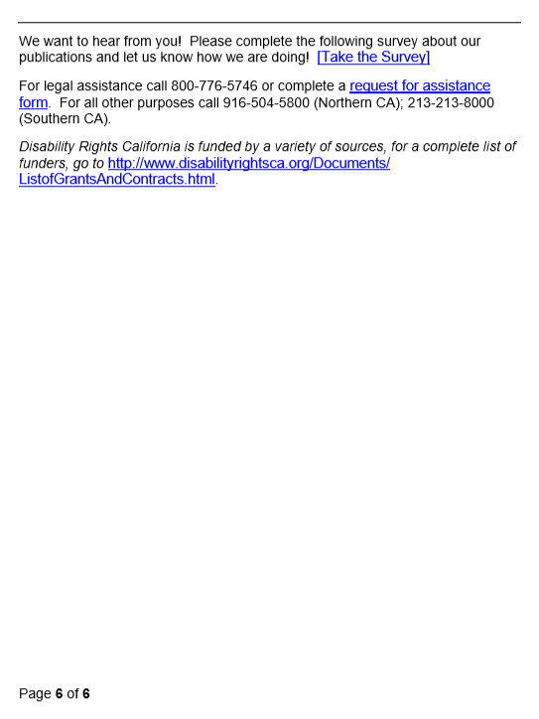

Slide 20

© CCHMC 1/3/06

Slide 21
Nontraditional Jobs
Not the “Easiest Jobs”
but
“Complex and Systematic”
© CCHMC 1/3/06

Slide 22

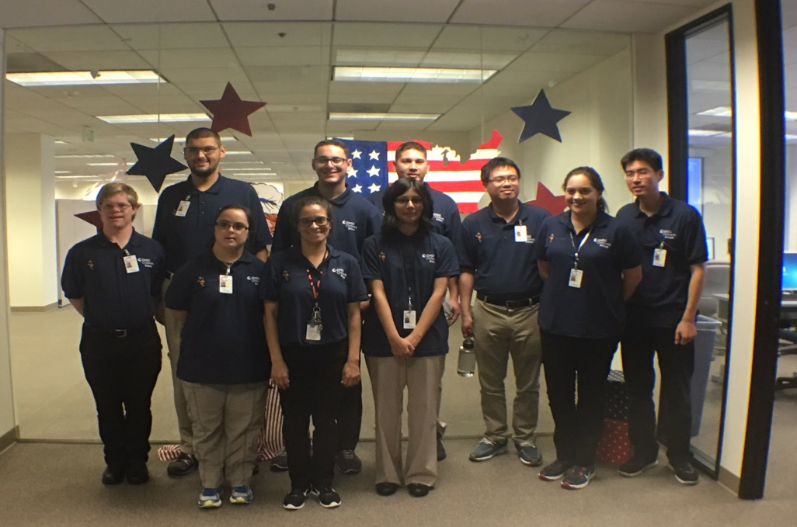

Person-Centered Planning and Interagency Collaboration builds hope, self-confidence and trust … ultimately yields quality outcomes in Adult life!
Gillman
Project Search
Children’s Hospital Orange County
C.I.E
Competitive Integrated Employment & Work-Based Learning
Young Adults with IDD
Family
CHOC Staff
Gillman Family Trust
Regional Center of Orange County
Integrated Resources Institute
Santiago Canyon College
UCI Technology in the Workplace Program
Department of Rehabilitation
Transportation Options

Slide 23
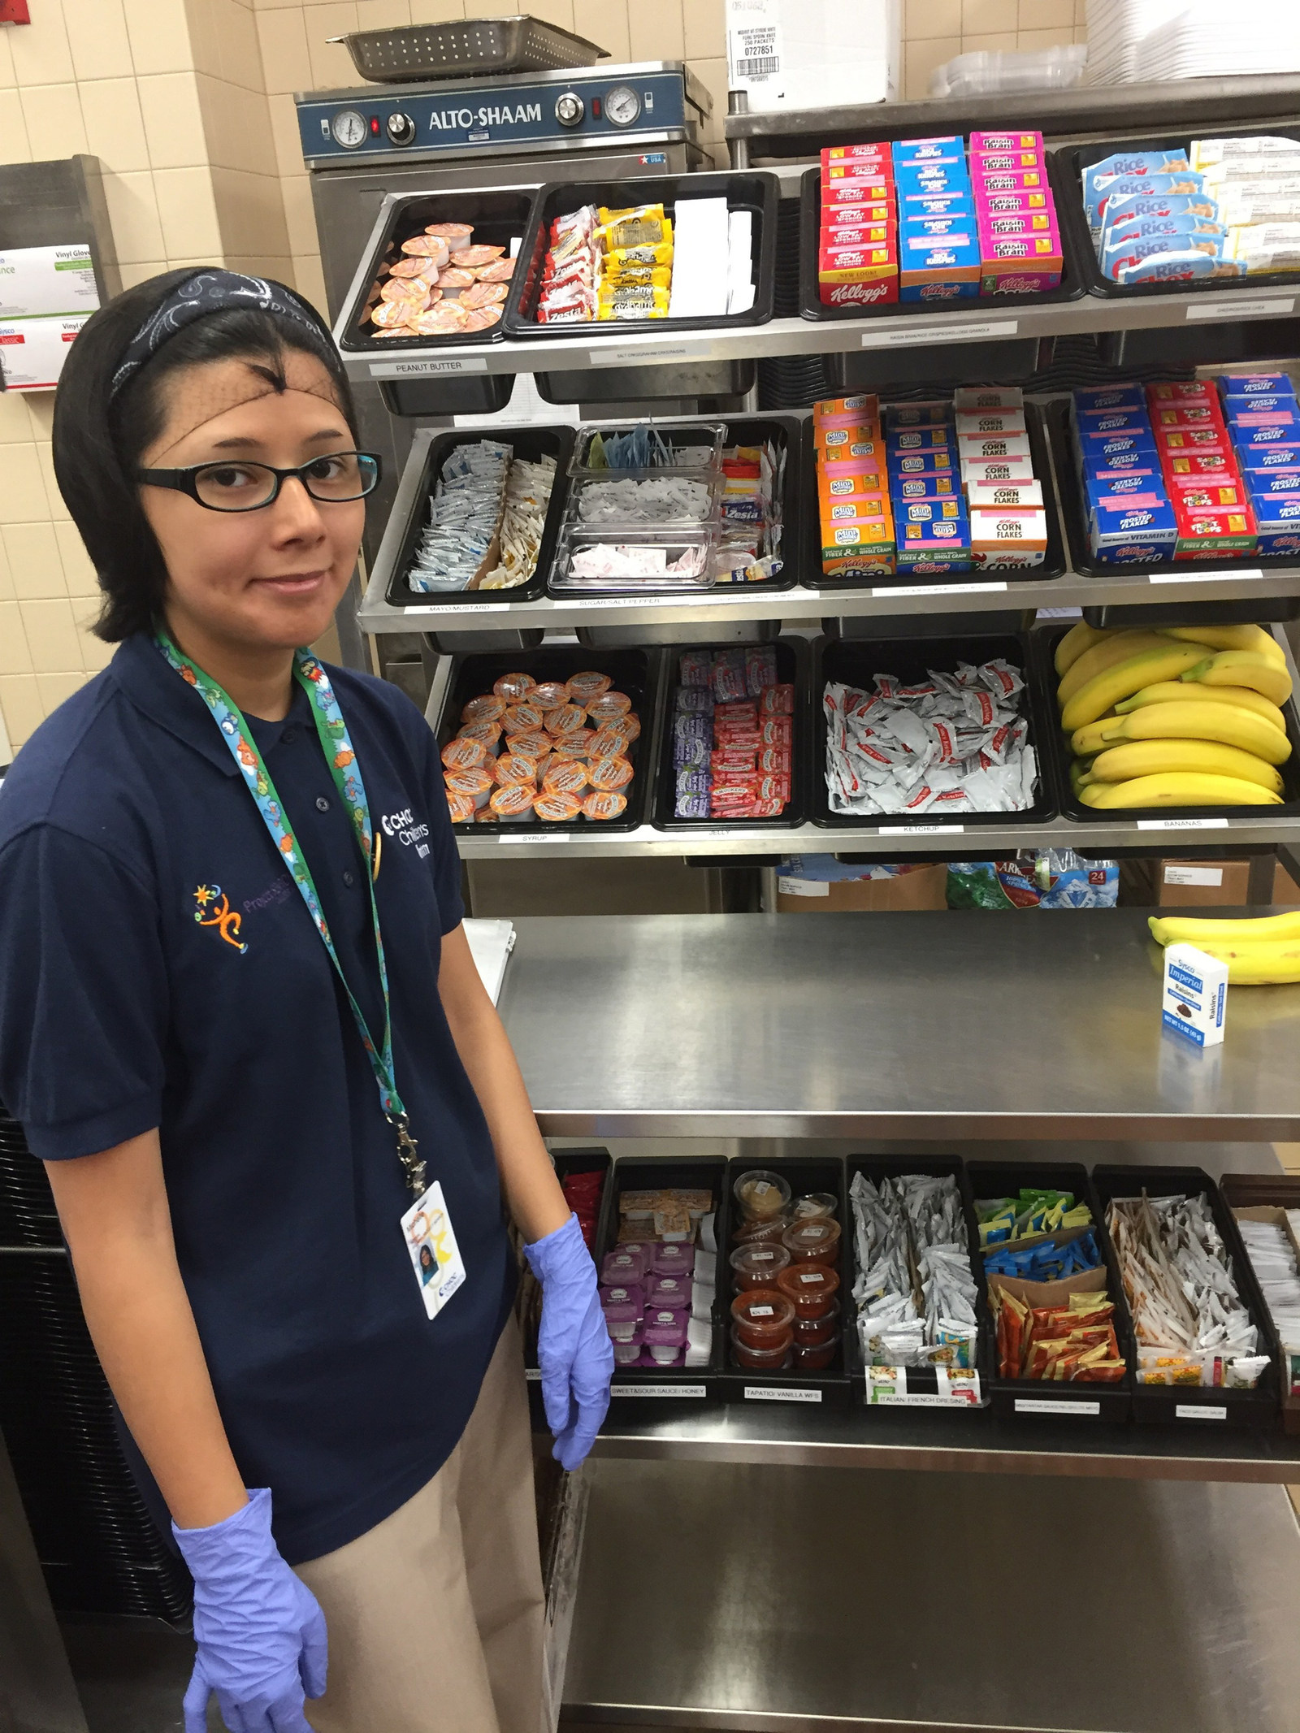
CHOC Hospital Employee
Michelle

Slide 24
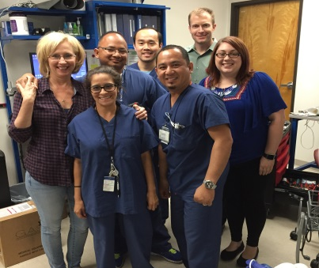
Happy Co-Workers!

Slide 25
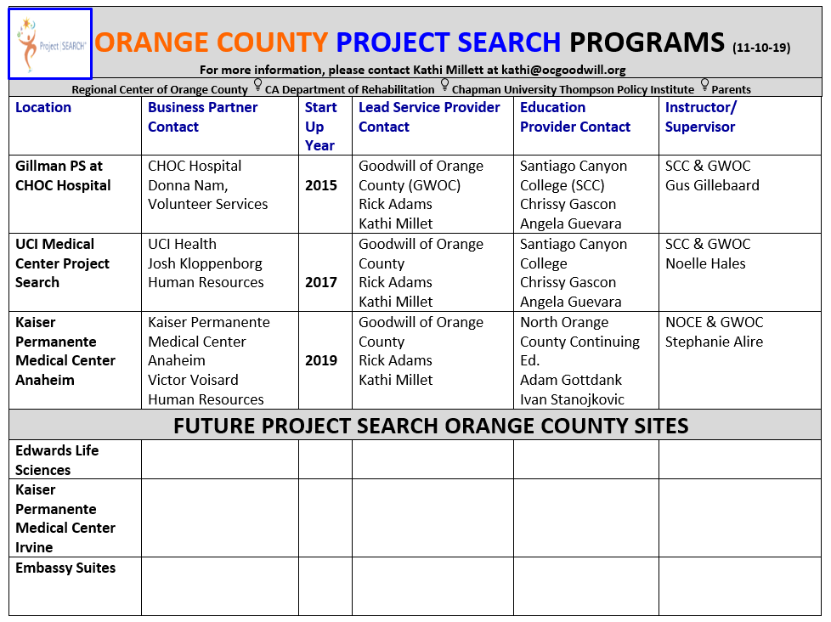

Slide 26
QUESTIONS
Transition Planning

Slide 27




Thanks for the Opportunity
to Meet with You Today!
Kurt Kosbab kkosbab@hbuhsd.edu
Linda ONeal, M.A. linda_oneal@cox.net

