Slide 1
Instagram, TikTok & Beyond: Social Media for Peer2Peer Engagement
Tuesday, April 21, 2020

Slide 2
Presenters
Erin Weierbach– Parent Education & Advocacy Leadership (PEAL) Center
Ali Hrasok - Lehigh Carbon Community College
David Quilleon - Best Buddies International
Samantha Cook - Best Buddies International
Alphonso Murphy - Best Buddies International
Michael Stoehr – NTACT

Slide 3
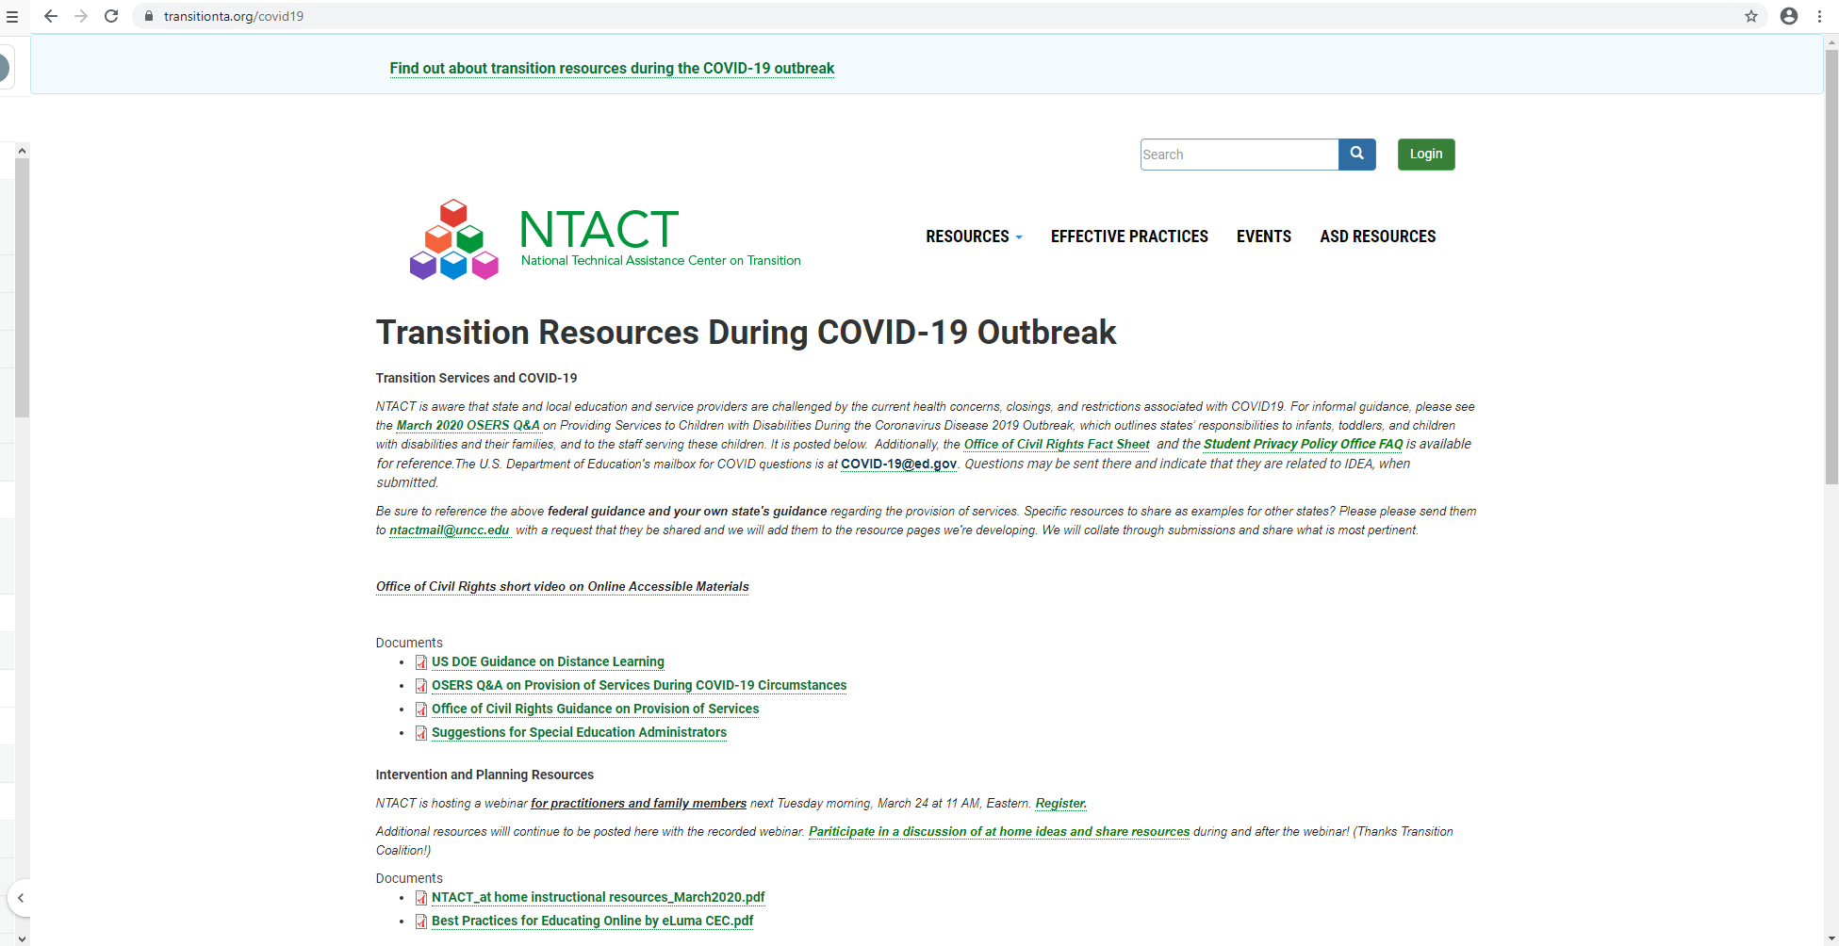
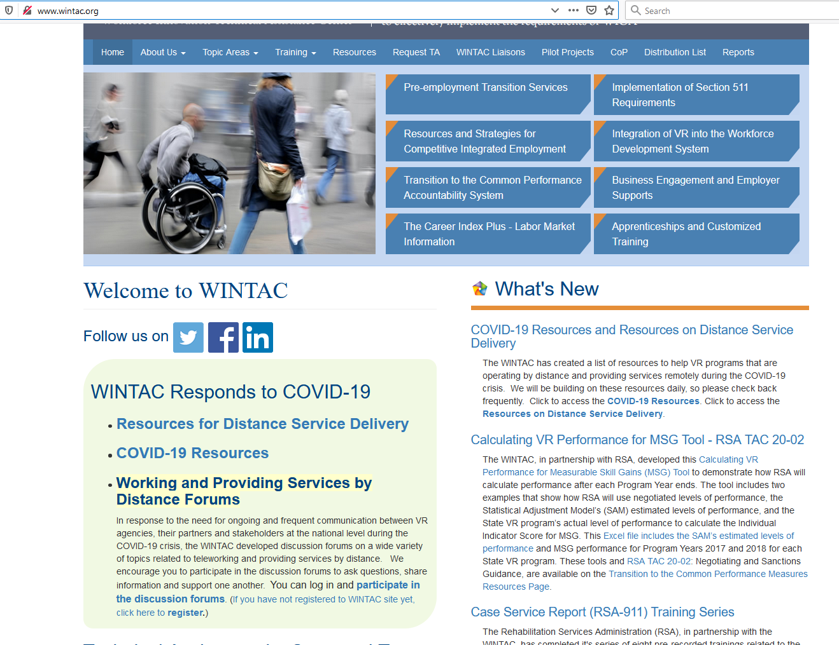
https://www.transitionta.org/covid19 http://www.wintac.org

Slide 4
These Continue to Be Challenging Times
Be mindful of self-care including:
Make time for yourself
Prioritize healthy choices
Be realistic
Set boundaries
Reconnect with things you enjoy
Articles that help put things into perspective:
Working at Home During COVID-10:How it's Different
Why You Should Ignore All That Cornoavirus-Inspired Productivity Pressure

Slide 5
Outline of Today’s Webinar
Welcome and Introductions
Realities of the Impact of COVID-19 on Youth & Young Adults – Erin Weierbach
Virtual Social Experiences: Peer to Peer Engagement – Ali Hrasok
Youth/Young Adult Engagement Resources – Michael Stoehr
Program Spotlight: Best Buddies International – David Quilleon, Samantha Cook, Alphonso Murphy
Continuing Today’s Discussion and Follow Up

Slide 6
Realities of the Impact of COVID-19 on Youth & Young Adults Erin Weierbach eweierbach@pealcenter.org
Reminders: The PowerPoint and all resources are available at: https://www.transitionta.org/events-details
Use Zoom Q & A Feature for Content Questions and to Share Any Resource Suggestions
Use Zoom Chat Feature for Technology Difficulty

Slide 7
Youth empowerment coordinator advocate self-advocate volunteer
Erin Weierbach

Slide 8
You are NOT alone!
Notes:
Read objectives aloud for participants

Slide 9
What are young people saying?
“Adults are taking over my personal space and time!”
Notes:
Read objectives aloud for participants

Slide 10
What can we do?
Respect their privacy
Provide just enough support
Allow time to socialize independently
Discuss various ways to participate
Notes:
Read objectives aloud for participants

Slide 11
What are young people saying?
“I’m not used to seeing my teacher in my kitchen!”
Notes:
Read objectives aloud for participants

Slide 12
What can we do?
Separate spaces for school work and friends
Set up stations
Schedule designated times for school and friends (Free time is free time!)
Notes:
Read objectives aloud for participants

Slide 13
What are young people saying?
“I went from having certain “screen time” to being on my computer all the time.”
Notes:
Read objectives aloud for participants

Slide 14
What can we do?
Give them a break! (and while you’re at it, take one yourself!)
Adjust lighting, atmosphere, screen distance
Stretch, change position, get moving
Stay away from screens during down time
Notes:
Read objectives aloud for participants

Slide 15
What are young people saying?
“When will this all be over?
It’s hard to focus on anything else.”
Notes:
Read objectives aloud for participants

Slide 16
What can we do?
Talk about it
Use social stories, schedules and calendars
Focus on concrete things and what you can control
Do not make false promises
Find things to look forward to
Allow control and decision-making whenever possible
Notes:
Read objectives aloud for participants

Slide 17
Most importantly…
Remember to breathe!
Notes:
Read objectives aloud for participants

Slide 18
Virtual Social Experiences: Peer to Peer Engagement Ali Hrasok ahrasok@lccc.edu
Reminders: The PowerPoint and all resources are available at: https://www.transitionta.org/events-details
Use Zoom Q & A Feature for Content Questions and to Share Any Resource Suggestions
Use Zoom Chat Feature for Technology Difficulty

Slide 19
A Virtual Social Experience
Ali Hrasok, MA
SEED Program Redesign Coordinator
Career/Academic Coach

Slide 20
A bit about SEED
Inclusive Higher Ed Program at LCCC
Partnership with LVCIL
Receive person-centered planning and coaching
Our population
21 students
Some matriculating, some career track
Cross-disability
Ages ranging from 18-34

Slide 21
Recognize each component as a social contact
Add additional coaching meetings or check ins
Transition Resource Staff tutoring to virtual format
Confirm regular meetings with their Learning Specialist
Offer comparable social interactions
Maintain schedules as much as possible

Slide 22
What being social looks like for us now
Peer Facilitator was maintained
Individual meetings
App-based platform for communication
SEED Social Hour with Jackbox games

Slide 23
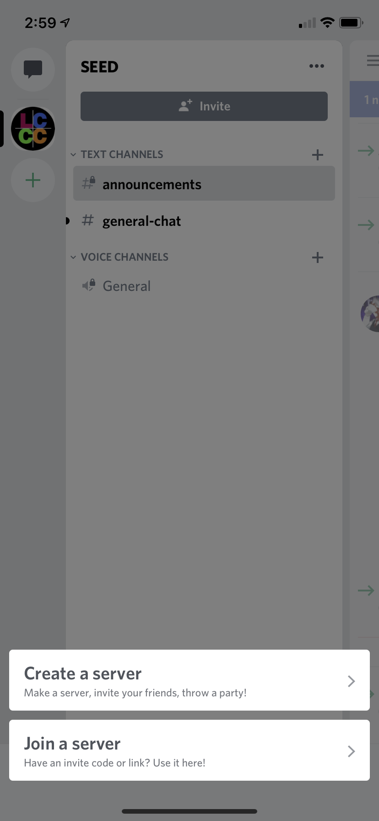
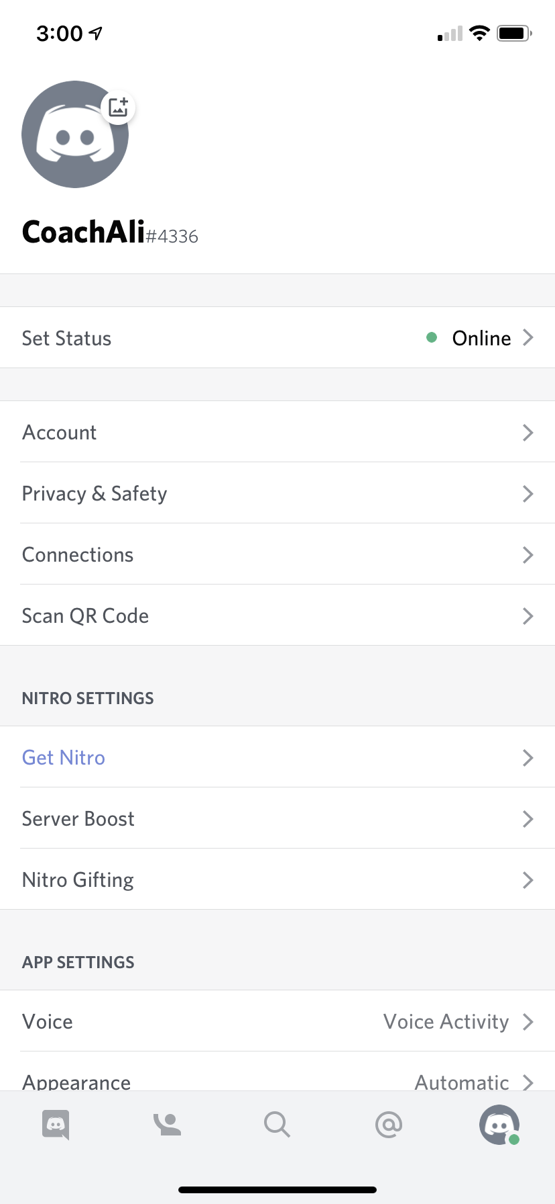

Slide 24
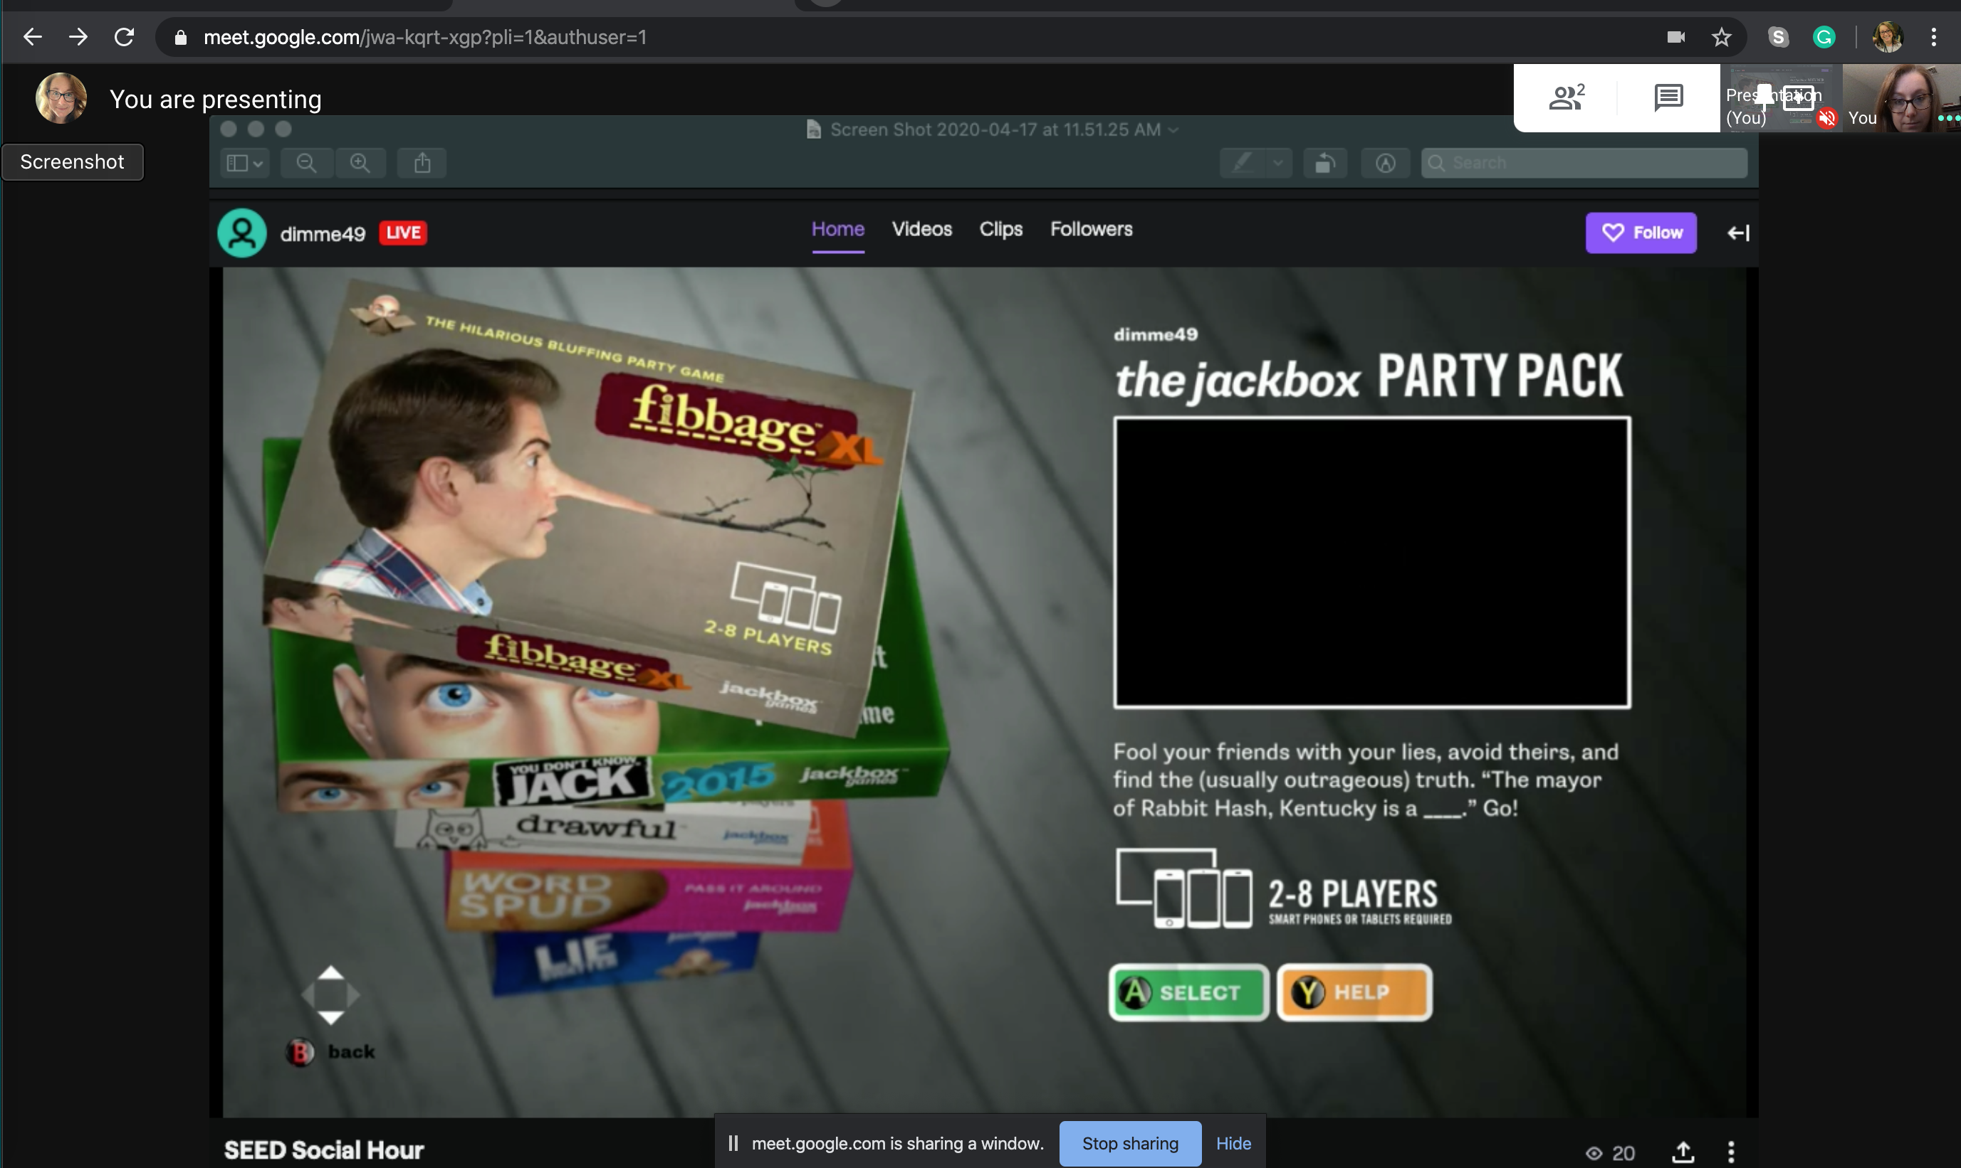
Open Twitch app in gaming console
Name your stream
Select to start your broadcast
Enter Jackbox app on gaming console
Open a browser on your computer
Log into your Twitch account
Invite people to virtual meeting and share your screen

Slide 25
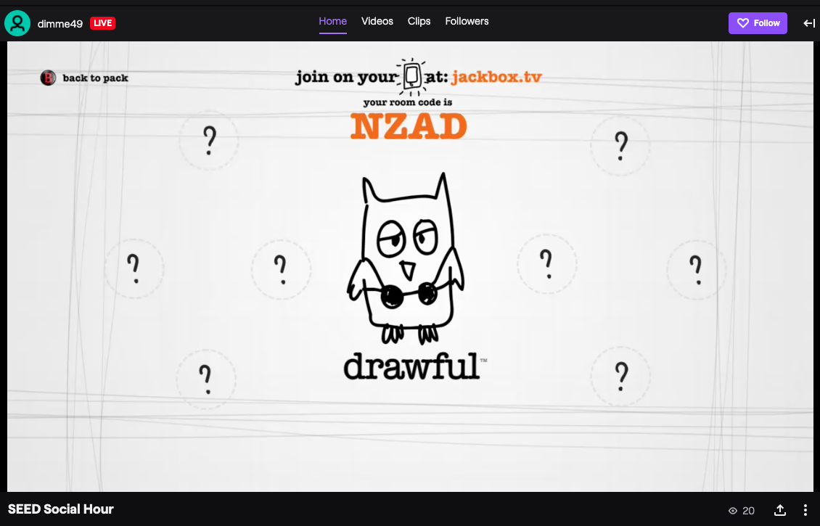
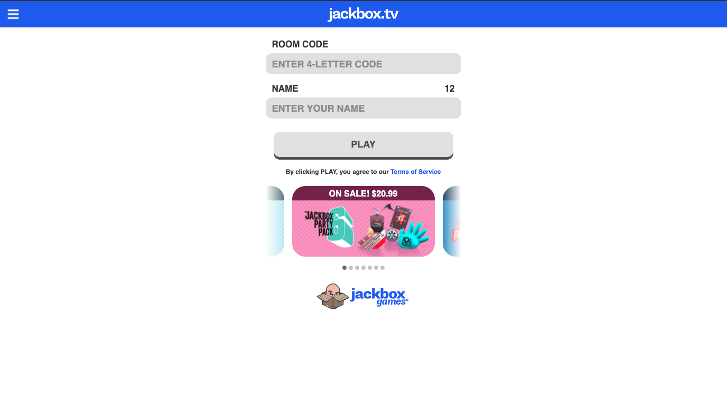
Select the game to play on Jackbox
Change settings as desired
Wait for all participants to join, then start the game!
Join jackbox.tv on your computer or smartphone
Enter 4-letter room code and name
Select “Play” and wait for the game to start!

Slide 26
The Process of Change
1) Forget the idea “I can’t do ____ online!”
2) What are the goals of what you usually do?
3) How can we accomplish those goals virtually?
4) What do our youth enjoy?

Slide 27
Suspending Doubts and Fears
Our youth have grown up in a more digital age than any of us
Having to socially distance ourselves is scary
Technology has gotten
vastly better
Being online is
different
However
Sometimes not being productive is okay
It feels like it happening at lightning speed
We can re-create formats to accomplish our goals

Slide 28
What are your social goals?
For us:
Engage in age-appropriate social experiences
Access college experiences
Grow their interpersonal skills
Take a break and enjoy themselves
What is it that you look to accomplish typically?

Slide 29
What other ways accomplish these goals?
Group vs individual
Large vs small
Activity:
Music, Discussion, TV/Movie, Video Games, Challenges, etc
Platforms:
Facebook, Zoom, Google Meets, Instagram, Streaming, etc
Computer-Based vs Non-Computer-Based (activity and report)
Time of Day
Level of Support
Needed
Level of Support
Available

Slide 30
Stick to Best Practices
Person Centered Planning
Universal Design for Learning
Offer different options
Be flexible in what participation looks like

Slide 31
Youth/Young Adult Engagement Resources Michael Stoehr mstoehr@uncc.edu
Reminders: The PowerPoint and all resources are available at: https://www.transitionta.org/events-details
Use Zoom Q & A Feature for Content Questions and to Share Any Resource Suggestions
Use Zoom Chat Feature for Technology Difficulty

Slide 32
Teen & Young Adult Resources
Managing Social Distancing So It Doesn't Suck – (Participant Handout)
Ideas to Act for the Common Good - Youth Service America
The People's Supper - A Story-Sharing and Listening Guidebook
Supporting Teenagers & Young Adults During the Coronavirus - Child Mind Inst.
Checklist - Building Developmental Relationships During COVID-19 for Teens

Slide 33
Teen & Young Adult Resources
UNICEF - Risk Communication & Community Engagement: Tips on Engaging Youth
While the COVID-19 response will need to address priorities and needs of adolescents and youth, they should not only be considered as affected populations but also as highly effective partners in the COVID-19 efforts. They can meaningfully engage to be educators and change agents among their peers and in their communities. This brief provides practical tips regarding engaging adolescents and youth as part of the COVID-19 preparedness and response.
Additional National and State/local Webinars, Events, and Resources
Youth Move National (scroll to “latest news” section)
MAEC - A Conversation with Students - How COVID-19 is Affecting Their Ed. Experience
Self-Advocates United as One - Events

Slide 34
Program Spotlight: Best Buddies International David Quilleon - Davidquilleon@bestbuddies.org Samantha Cook - cooksamanthan@gmail.com Alphonso Murphy - alphonsocmurphy@yahoo.com
Reminders: The PowerPoint and all resources are available at: https://www.transitionta.org/events-details
Use Zoom Q & A Feature for Content Questions and to Share Any Resource Suggestions
Use Zoom Chat Feature for Technology Difficulty

Slide 35
DAVID QUILLEON
ALPHONSO MURPHY
SAMANTHA COOK
Senior Vice President, Global Mission, State Development & Operations
Vice Chair, Best Buddies Young Leaders Council (YLC)
Board Member, Best Buddies International

Slide 36
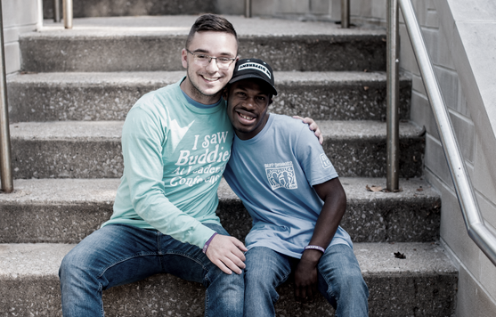
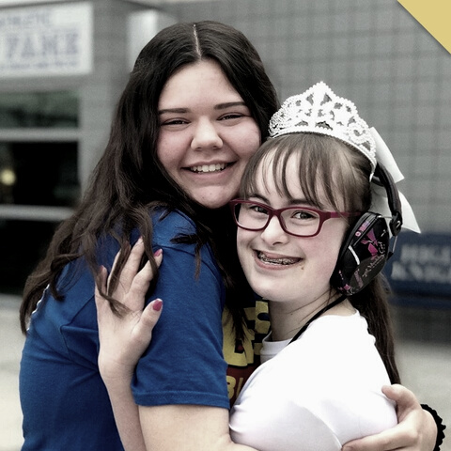
Best Buddies is a global non-profit dedicated to inclusion for people with intellectual and developmental disabilities
Our Mission:
Friendships. Jobs. Leadership. Inclusive Living.

Slide 37
Peer to Peer Connections
MAINTAIN CONNECTIONS
UTILIZE NEW & EXISTING TOOLS
Strategies for ensuring connections continue during social distancing.
Accessibility to communication tools and technology.

Slide 38
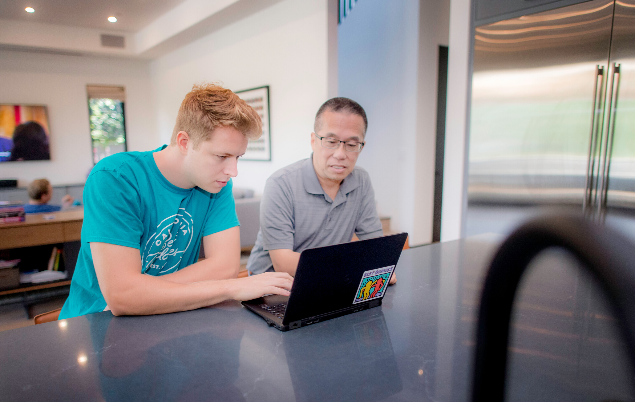
E-BUDDIES
Promotes online social
inclusion for people with
intellectual and
developmental disabilities through the exchange of
e-mails.

Slide 39
INTERESTS
Participants are matched based on
similar interests, which are collected and evaluated during the sign-up process.
AGE
Matches are made specifically to
partner people who are close in age.
LOCATION
Individuals are matched with a person who does not live in their geographical location.

Slide 40
Virtual Program Engagement
ONLINE
MESSAGING
FRIENDSHIPS
Through Zoom, Google Hangouts, & Social Media
Text messaging and video sharing
Peer to Peer locally and nationwide

Slide 41
Best Buddies
Young Leaders Council
A DIVERSE OUP OF YOUNG LEADERS WHO ARE BRIDGING THE GAP BETWEEN THE STUDENT PERSPECTIVE AND STAFF EXPERIENCE THROUGH TARGETED OUTREACH, LEADERSHIP DEVELOPMENT
AND COLLABORATION.

Slide 42
CHECK IN
Find ways to check-in with your friends and family - even if it’s only for five minutes.
PRIORITIZE FRIENDS
Make a point to communicate
frequently with those in your life. Remind them they are important.
GET CREATIVE
Recognize that this social distancing may call for creative measures - look for new ways to stay connected.

Slide 43
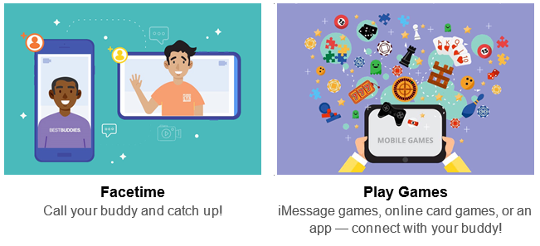
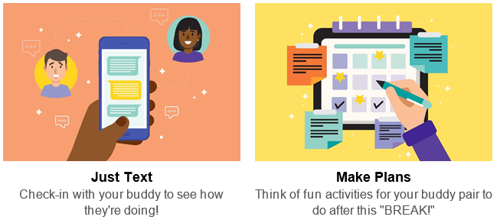

Slide 44
Virtual Connections & Learning Opportunities

Slide 45
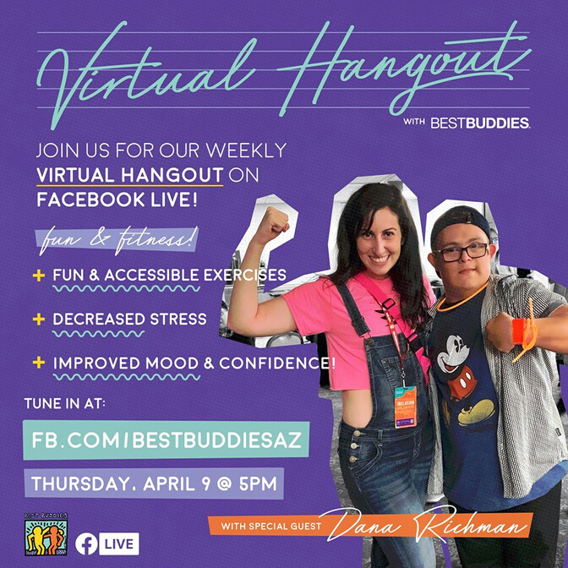
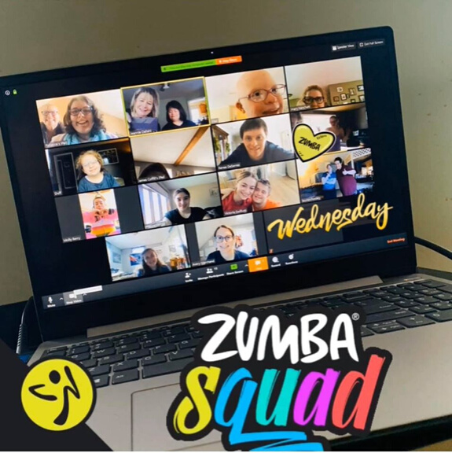
Activities with Friends
Chapter Events

Slide 46
Networking with Peers
Online Trainings

Slide 47
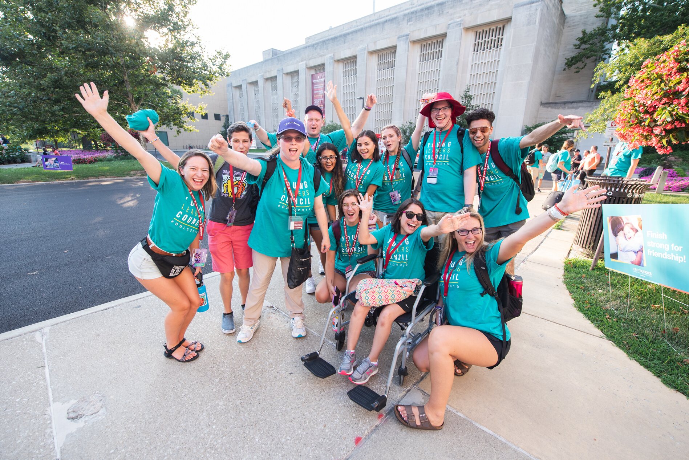
INCLUSION LIVES HERE
How can we take the lessons we learn about communication and engagement during this time and remember when social distancing has passed?

Slide 48
Continue Today’s Discussion and Follow Up

Slide 49
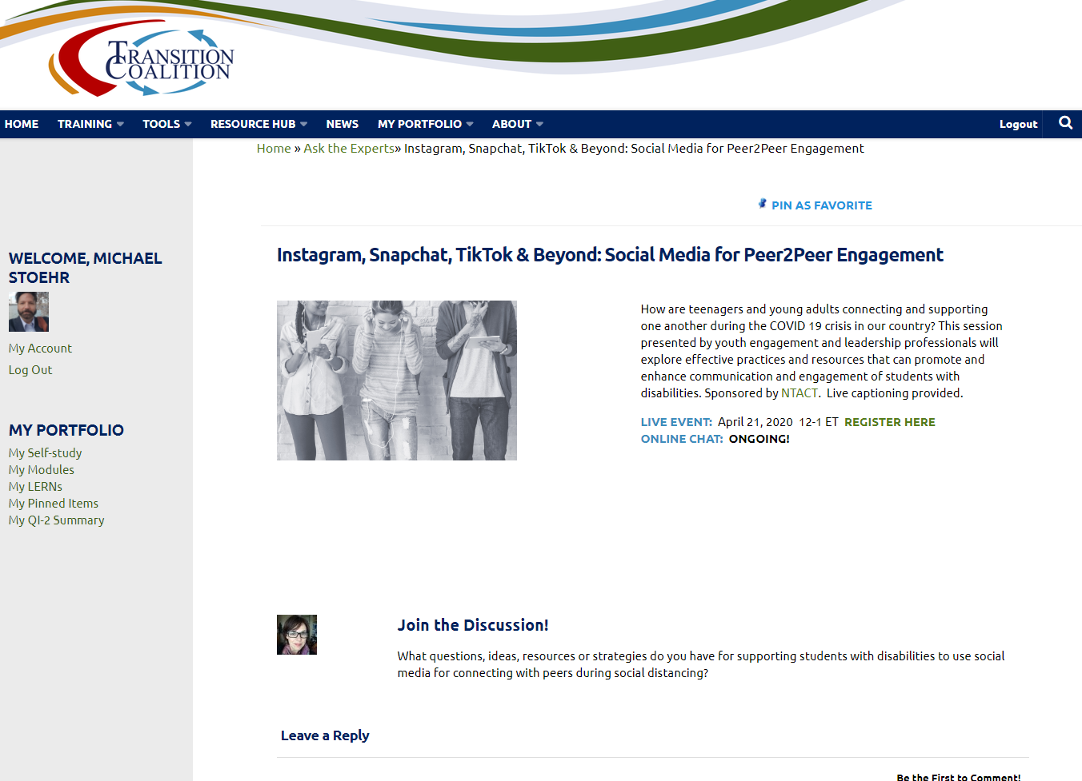
Online Discussion and Share Resources

Slide 50
POWERPOINT, RECORDINGS, and CREDITS
This webinar is being recorded.
The PowerPoint can be found at www.transitionTA.org – under “Events”
The recording of today’s webinar will be available at www.transitionTA.org by Monday, April 27, 2020
A captioned recording will be available at www.transitionTA.org by Friday, May 1, 2020
CRC credits will be provided through WINTAC following this webinar by completing the post-event evaluation process. All participants will receive a "Certificate of Attendance" from NTACT following the webinar.

Slide 51
Upcoming Events
WINTAC Webinar – Pre-ETS – Thirsty Thursday Think Tank: Creative ways states are delivering Pre-ETS in a pandemic
Register to Join our Zoom Meeting: https://zoom.us/meeting/register/tJEtduqsrTIoH9HXO2uP2XZU-68Bz3yjXQtH
DATE: Thursday, April 23, 2020
TIME: 2 p.m. (ET)
The purpose of this virtual discussion is to highlight and share the creative ways State VR agencies are responding to the COVID 19 Crisis and collaborating with their partners to deliver pre-employment transition services.
NTACT Webinar: Community of Practice for Indicator 14
Register for the meeting in advance
DATE: Friday, May 1, 2020
TIME: 2 p.m. (ET)
The purpose of this webinar is for state’s to share adjustments and strategies related to Ind. 14 in light of COVID 19
.

Slide 52
YOUR FEEDBACK
Take 5 minutes to tell us what you think…..
Watch for a follow-up email tomorrow
With this link to Survey
https://bit.ly/InstagramSnapchatTikTokandBeyond

Slide 53
53

Slide 54
Websites:
www.transitionta.org
www.wintac.org
Contact us:
ntactmail@uncc.edu
http://www.wintac.org/request-ta

Slide 55
Find us on:
#transitionta
Sign up for our listserv
www.transitionta.org
ntactmail@uncc.edu

