Slide 1
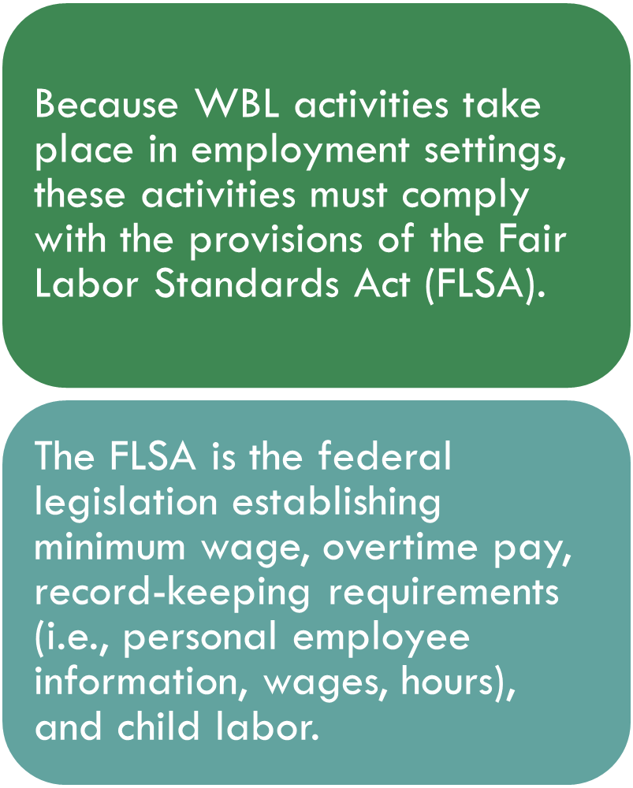
REQUIREMENTS OF THE FLSA RELATED TO WORK-BASED LEARNING http://ascip.org/wp-content/uploads/2014/05/ASCIP-Work-Based-Learning-Guidelines-August-2015.pdf

Slide 2
THE FLSA AND WBL CAREER EXPLORATION, CAREER ASSESSMENT, AND WORK-RELATED TRAINING COMPONENTS
Youth with disabilities who engage in nonpaid career exploration, career assessment, and work-related training activities are not considered employees of the businesses in which they receive these services only if they can demonstrate compliance with all the following guidelines:

Slide 3
FLSA & WBL GUIDELINES
Participants will be youth with physical and/or mental disabilities for whom competitive employment at or above the minimum wage level is not immediately obtainable and who, because of their disability, will need intensive ongoing support to perform in a work setting.

Slide 4
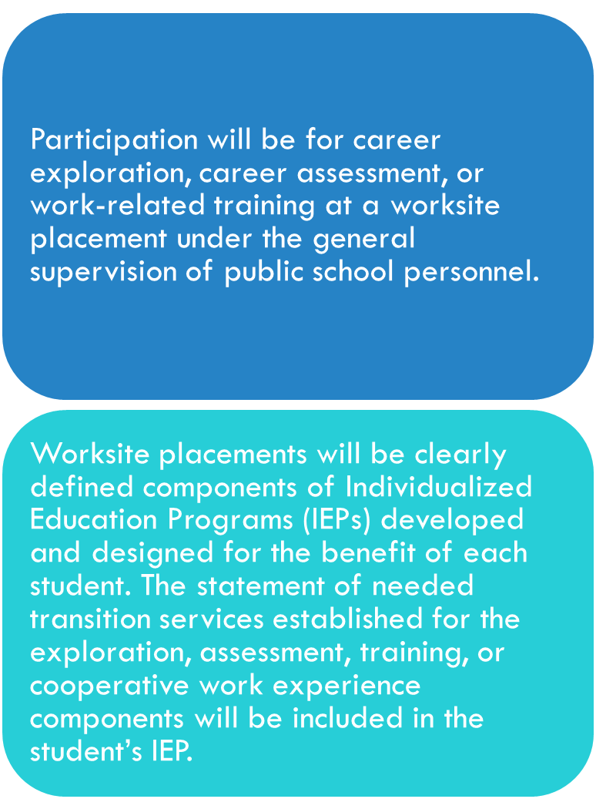
FLSA & WBL GUIDELINES – CONT.

Slide 5
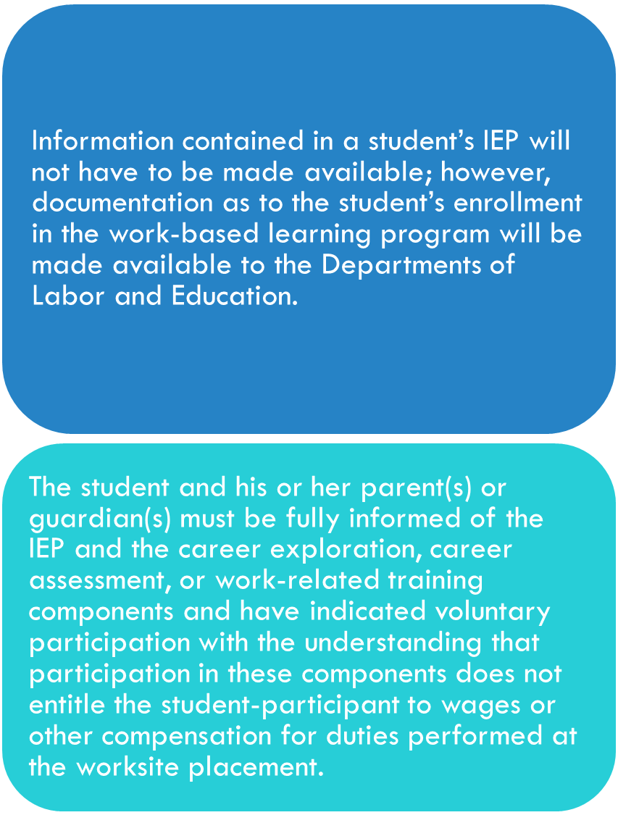
FLSA & WBL GUIDELINES – CONT.

Slide 6
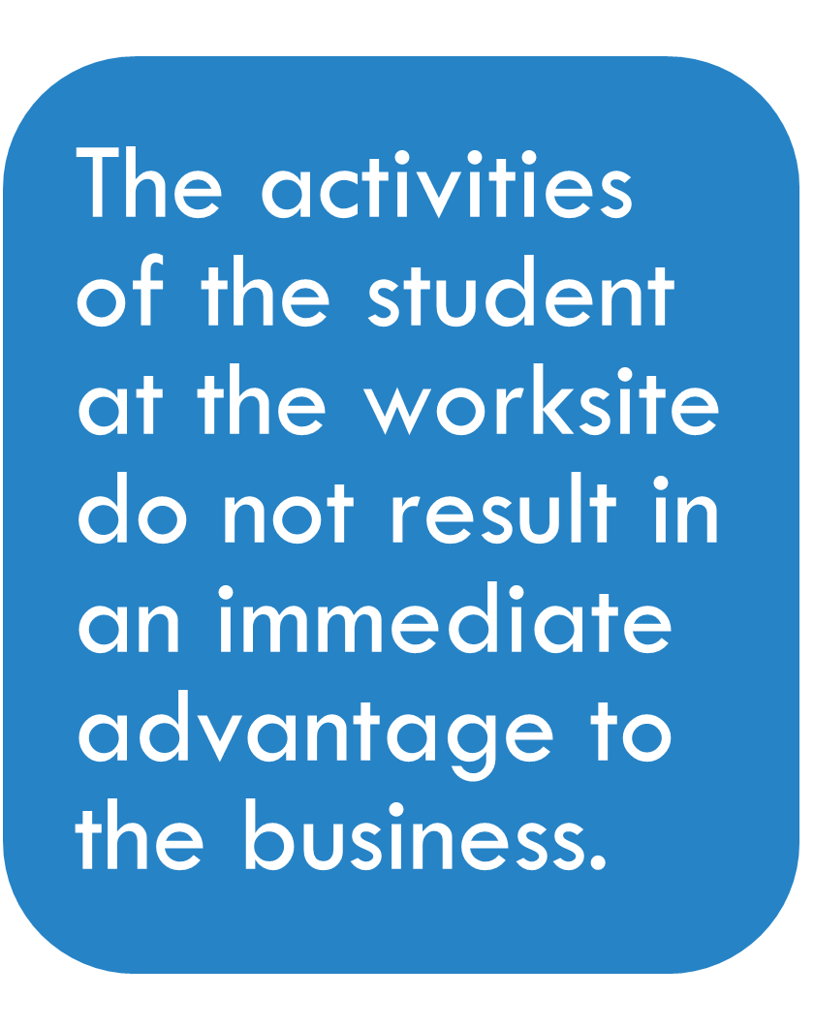
FLSA & WBL GUIDELINES – CONT.

Slide 7
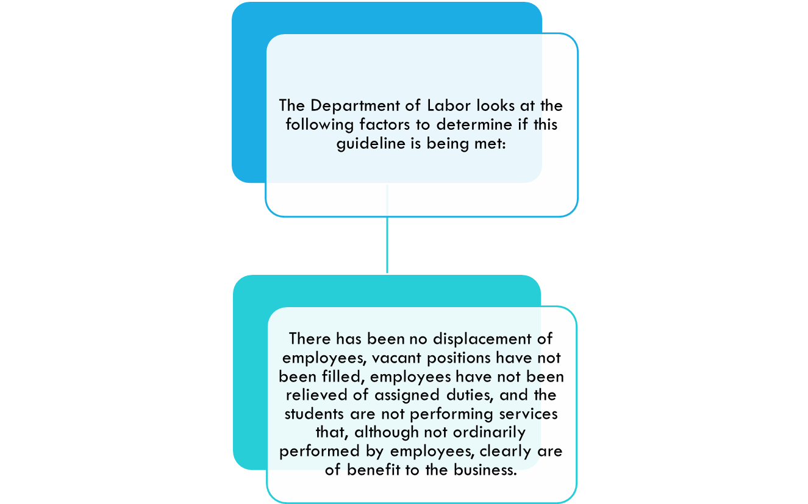
FLSA & WBL Seven Factors

Slide 8
FLSA GUIDELINES - CONTINUED
The students are under continued and direct supervision by either representatives of the school or by employees of the business.
The student receives ongoing instruction and close supervision at the worksite during the entire experience, resulting in any tasks the student performs being offset by the burden to the employer of providing ongoing training and supervision.

Slide 9
FLSA GUIDELINES - CONTINUED
Such placements are made according to the requirements of the student’s IEP and not to meet the labor needs of the business.
The periods of time spent by the students at any one site or in any clearly distinguishable job classification are specifically limited by the IEP.

Slide 10
FLSA GUIDELINES - CONTINUED
While the existence of an employment relationship will not be determined exclusively based on number of hours, as a rule, each component will not exceed the following limitation during any one school year:
Career exploration–5 hours per job experienced
Career assessment–90 hours per job experienced
Work-Related training–120 hours per job experienced

Slide 11
FLSA GUIDELINES - CONTINUED
Students are not automatically entitled to employment at the business at the conclusion of their IEP. However, once a student has become an employee, the student cannot be considered a trainee at that worksite placement unless in a clearly different occupation.

Slide 12
AND, FINALLY…
Schools and participating businesses are responsible for ensuring that all seven of these guidelines are met. If any of these guidelines are not met, an employment relationship exists, and participating businesses can be held responsible for full compliance with the FLSA.

Slide 13
WHAT DOCUMENTATION IS REQUIRED?
It is important that WBL programs document that all participants, including the student, the parent(s) or guardian(s), the employer, and instructional staff, understand that:
If at any point the WBL activity is no longer a learning experience the activity is not a non employment relationship.
Students are not entitled to wages for the time spent in the learning experience.
Students are not automatically entitled to employment at the worksite.

Slide 14
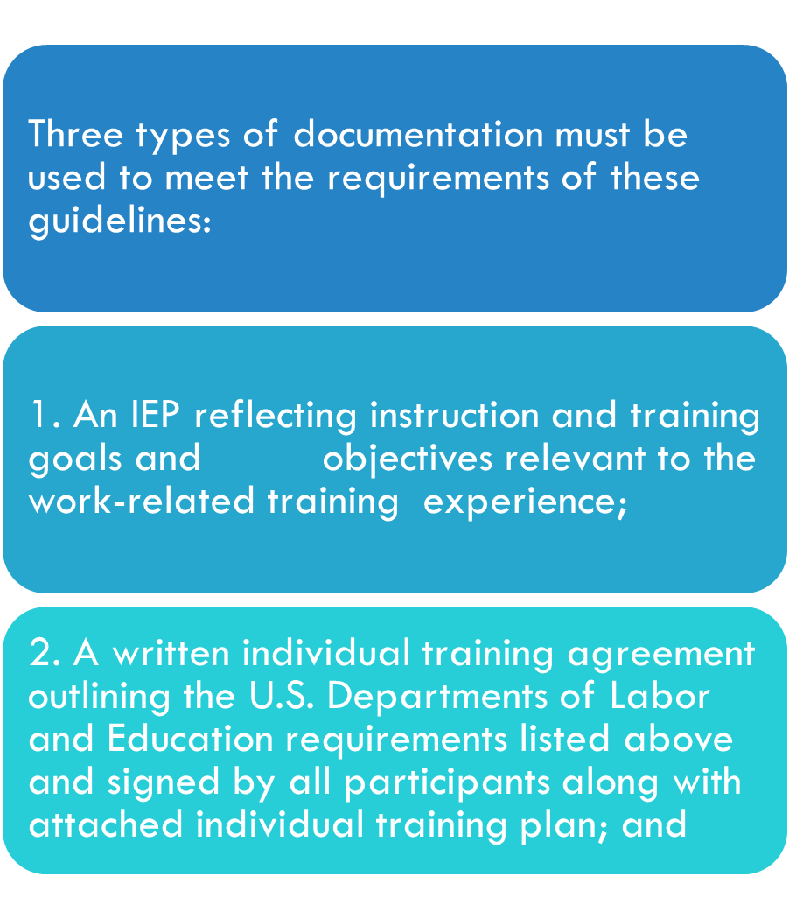
WHAT DOCUMENTATION IS REQUIRED?

Slide 15
WHAT DOCUMENTATION IS REQUIRED?
3. Records of student experience (i.e., log of hours spent in WBL activities, progress reports, observation reports, safety training, and performance evaluations).

Slide 16
LIABILITY COVERAGE FOR WBL STUDENTS
Work-based learning is considered part of the student’s individualized education program. In nonpaid, nonemployment relationships, the worksite is perceived as an extension of the school.
If the student’s participation in workplace activity can be considered instructional and part of a nonemployment relationship, then the school may be responsible for liability coverage. Generally, the same insurance and liability policies that apply to other off-site school experiences should apply.

